Slide 1
Status of the Responsible Parenthood and Reproductive
Health Law Implementation
Jose Gerard Belimac, MD, MPH
Director III
Disease Prevention and Control Bureau
Notes:
Good day, everyone. Today, I will be presenting the status of the Responsible Parenthood and Reproductive Health (RPRH) Law implementation for the year 2023. The presentation will highlight key accomplishments, challenges, and governance priorities as we move forward.

Slide 2
Outline
Introduction to RA 10354
Key Result Area Status
Challenges and Policy Recommendations
    Governance
    Service Delivery
    Financing
Notes:
The Outline for this presentation are as follows:
Introduction to RA 10354: Responsible Parenthood and Reproductive Health Law of 2012
Key Result Area Status
Challenges and Policy Recommendations in terms of
Governance
Service Delivery
Financing

Slide 3
RA 10354: Responsible Parenthood and Reproductive Health Law of 2012
focuses on promoting and ensuring UNIVERSAL ACCESS to reproductive health (RH) services, information, and education, while also recognizes the individual’s
right to reproductive health
right to choose and make decisions for the family
right to RH education and information
through the following measures:
universal access to affordable and quality RH care and services
provision of RH care for all individuals regardless of civil status
preferential access to the poor
Notes:
The RPRH Law or RA 10354 is on its 10th year of implementation since 2014 following a TRO which delayed its implementation in 2012. The Law guarantees universal access to reproductive health services, information and education anchored on three rights: the right to reproductive health; the right to choose and make decisions for the family and the right to Reproductive Health education and information. It ensures that quality RH care and services are accessible and affordable to all regardless of civil status prioritizing access to the poor.

Slide 4





KEY RESULT AREAS/
FOCUS OF THE RPRH IMPLEMENTATION
Maternal, Neonatal, Child Health, and Nutrition
Family Planning
Adolescent Sexual and Reproductive Health
Sexually Transmitted Infections (STI) and HIV/AIDS
Violence Against Women and Children
Notes:
We focus on 5 Key Result Areas as we continue to pursue our commitment to the Sustainable Development Goal 3: Ensure healthy lives and promote well-being for all ages through the 2016-2030 Global Strategy for Women’s, Children’s and Adolescent’s Health for Sustainable Development.
The 5 KRAs of RPRH are (1) Maternal, Neonatal, Child Health, and Nutrition, (2) Family Planning, (3) Adolescent Sexual and Reproductive Health, (4) Sexually Transmitted Infections (STIs) and HIV/ AIDS, and (5) Violence Against Women and Children.

Slide 5

KEY RESULT AREA STATUS

Slide 6
KRA 1: Maternal, Newborn, Child Health and Nutrition
Maternal Care | 2022 Accomplishment | 2023 Accomplishment | 2030 National Targets
Facility-based Delivery | 91.69% | 92.96% | 95%
Skilled Birth Attendant | 92.95% | 93.97% | 95%
Antenatal Care | 80.7% | 76.88% | 95%
Postnatal Care | 88.69% | 90.58% | 95%
Source: FHSIS 2023
Notes:
KRA 1 highlights Maternal, Newborn, Child Health and Nutrition Programs or MNCHN.
For Maternal Care there are 4 key indicators that are being monitored which are Facility based delivery, Skilled Birth Attendant, Antenatal Care, and Post-Natal Care.
The national targets is set at 95% (by 2030) for all of these indicators.
In 2023, we observe an increase in the maternal health indicators on Facility based delivery, Skilled Birth Attendant and Postnatal Care except in Antenatal Care which reported a decrease from 80.7% to 76%.
We note the Improvement on Facility based delivery, Skilled Birth Attendant and Postnatal Care from 2022 data > We have reached at least the 90% performance.
Following the trend, we need to work harder to meet the target for the three indicators before reaching the year 2030.

Slide 7
KRA 1: Maternal, Newborn, Child Health and Nutrition
Newborn and Child Health | 2022 Accomplishment | 2023 Accomplishment | 2030 National Targets
Newborn Screening | 90% | 94.6% | 95%
Breastfeeding Initiation | 81.98% | 84.85% | 95%
Fully Immunized Children (FIC) | 59.92% | 62.34% | 95%
Vitamin A supplementation (6-11 months) | 51.06% | 128.77% | 95%
Vitamin A supplementation (12-59 months) | 43.94% | 67.49% | 95%
Source: NIH-NSRC; FHSIS 2023
Notes:
For the Newborn, Child Health and Nutrition programs, there are five key indicators that are being monitored namely:
Newborn Screening, Breastfeeding practice; Fully Immunized Children, Vitamin A Supplementation for age group 6-11 months and age group 12-59 months children.
We observe an overall increase in the performance indicators as reflected in the 2022 and 2023 data.
The Newborn Screening performance of 94.6% in 2023 has already met the set national target of 95% (by year 2030).
However, the report on the Fully Immunized Children, and Vitamin A supplementation for age group 12-59 months old remains to be a challenge.
The figure for Vitamin A Supplementation for the 6-11 months old needs to be validated given the very significant increase of more than 100% for the year 2023.

Slide 8
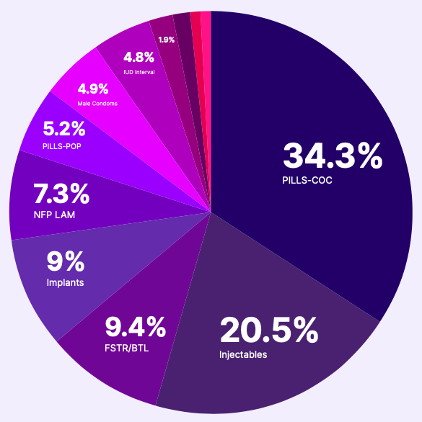
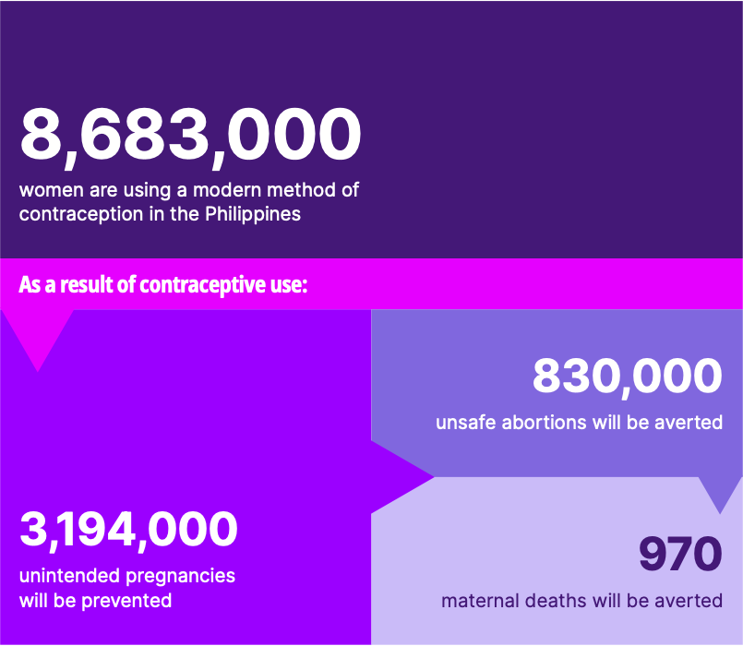
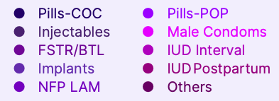
KRA 2: Family Planning
 | 2022 Accomplishment | 2023 Accomplishment | 2030 National Targets
Demand Satisfied | 58.10% | 67% | 75%
 | 2022 | 2023 | 2030 National Targets
Demand Satisfied | 58.10% | 67% | 75%
Top 3 Modern Contraceptives | Pills - 34.99% Injectables - 20.33% FSTR/BLT - 9.79% | Pills - 34.3% DMPA - 20.5% FSTR/ BTL - 9.4% Implants - 9%
Source: FHSIS 2023
Notes:
For KRA 2: Family Planning
In 2023, there were 8,683,000 women aged 15-49 years who were reported to have their need for family planning satisfied by any modern method, corresponding to 67.01% of the total demand for FP.
As a result of the Family Planning coverage, it is estimated that 3 million unintended pregnancies, 830,000 unsafe abortions and 970 maternal deaths were averted as shown in the right Figure.
Combined oral contraceptives or COCs remain to be the most commonly used modern family planning method, accounting for 34.3% of the total current users. This was followed by injectables with 1,794,406 users (20.5%) of total current users and BTL or female sterilization (9.4%) of the total modern FP users.
By choosing to use modern Family Planning methods, women are less likely to experience unintended pregnancies, unsafe abortions and, ultimately, maternal deaths from complications during delivery or from unsafe abortions.

Slide 9
KRA 3: Adolescent Sexual and Reproductive Health
 | 2021 Accomplishment | 2022 Accomplishment
Adolescent Birth Rate 15-19 | 26.45% | 29.02%
Modern FP Users |  | 10-14: 2,762 (0.13%) 15-19: 119,639 (5.47%)
 | 2021 Accomplishment | 2022 Accomplishment
Adolescent Birth Rate | 26.4 | 29
Number of adolescent births Under 15 | 2,320 | 3,135
Modern FP Users for 2022
10-14 years: 2,762 (0.13%) 15-19 years: 119,639 (5.47%)
Source: PSA
Notes:
For KRA 3: Adolescent Sexual and Reproductive Health
Adolescent Birth Rate among adolescent aged 15-19 years, increased from 26.4 in 2021 to 29 in 2022. Similarly, there is also increase among under 15 adolescents from 2,320 to 3,135
According to the 2022 National Demographic Health Survey (NDHS), the total Adolescent Birth Rate among adolescent aged 10-19 years was reported at 14.5% which satisfies the national target of 15 ABR per 1000 livebirths. However, while the proportion of adolescents aged 15-19 years who have ever experienced childbearing has declined, the number of live births among young adolescents (10-14 years old) was observed to be increasing.
In the same period it was being reported that 2,762 or 0.13% of adolescents aged 10-14 were using a modern method of contraception, while there were 119,639 or 5.47% of adolescents aged 15-19 were using a modern method of contraception.

Slide 10
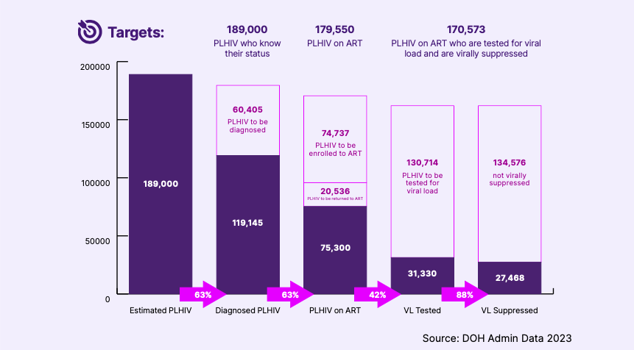
KRA 4: Sexually Transmitted Infections and HIV/AIDS
Source: DOH Admin Data 2023
Notes:
KRA 4: Sexually Transmitted Infections and HIV/AIDS
Between 2010 and 2022, the annual new HIV infections were at 418 percent. In 2023, the estimated total number of People Living with HIV (PLHIV) is at 189,000 with 26,700 annual new infections and 1,700 AIDS-related deaths. The number of estimated PLHIV is projected to increase by more than twofold or 401,700 by 2030.
The HIV and AIDS Surveillance of the Philippines reported that, as of December 2023, of the estimated 189,000 PLHIV, there were 119,145 (63%) diagnosed or laboratory-confirmed cases and currently alive or not reported to have died. Among those diagnosed, 75,300 PLHIV were on life-saving Antiretroviral Therapy (ART).
Among those undergoing treatment, 31,330 (42%) have been tested for their viral load (VL) in the past 12 months. Among those tested for Viral Load, 27,468 (88%) were virally suppressed, noting, however, that only 36% are known to be virally suppressed among PLHIV on ART.
These translate to 63% testing coverage, 63% treatment coverage, and 36% viral suppression.

Slide 11
KRA 5: Violence Against Women and Children
VAWC Case Management in WCPUs | 2022 Accomplishment | 2023 Accomplishment | 2030 National Targets
Number of VAWC cases managed in WCPUs | Women: 4,382 Children: 10,635 | Women: 4,834 Children: 13,776 | 100% managed cases
Most Reported Type of Abuse
0-17yo | Sexual abuse > Physical abuse > Neglect
Women | Physical abuse > Sexual abuse > Psychological/Emotional abuse
Source: WCPMIS 2023
Notes:
A total of 13,776 cases of violence against children and 4,834 cases of violence against women were reported by the 68 WCPU nationwide through the Women and Child Protection Information System (WCPMIS). The increase in the number of reported cases, both for women and children, can be attributed to several factors such as the increasing number of reporting WCPUs that receive referrals from multiple points of entry, improved help- and health-seeking behavior of victim-survivors, and the effective promotion and awareness campaigns by different agencies involved in women and children protection.
Notes: Data on most type of abuse
0-17yo : sexual abuse > physical abuse > neglect
Women: physical abuse > sexual abuse > psychological/ emotional abuse

Slide 12
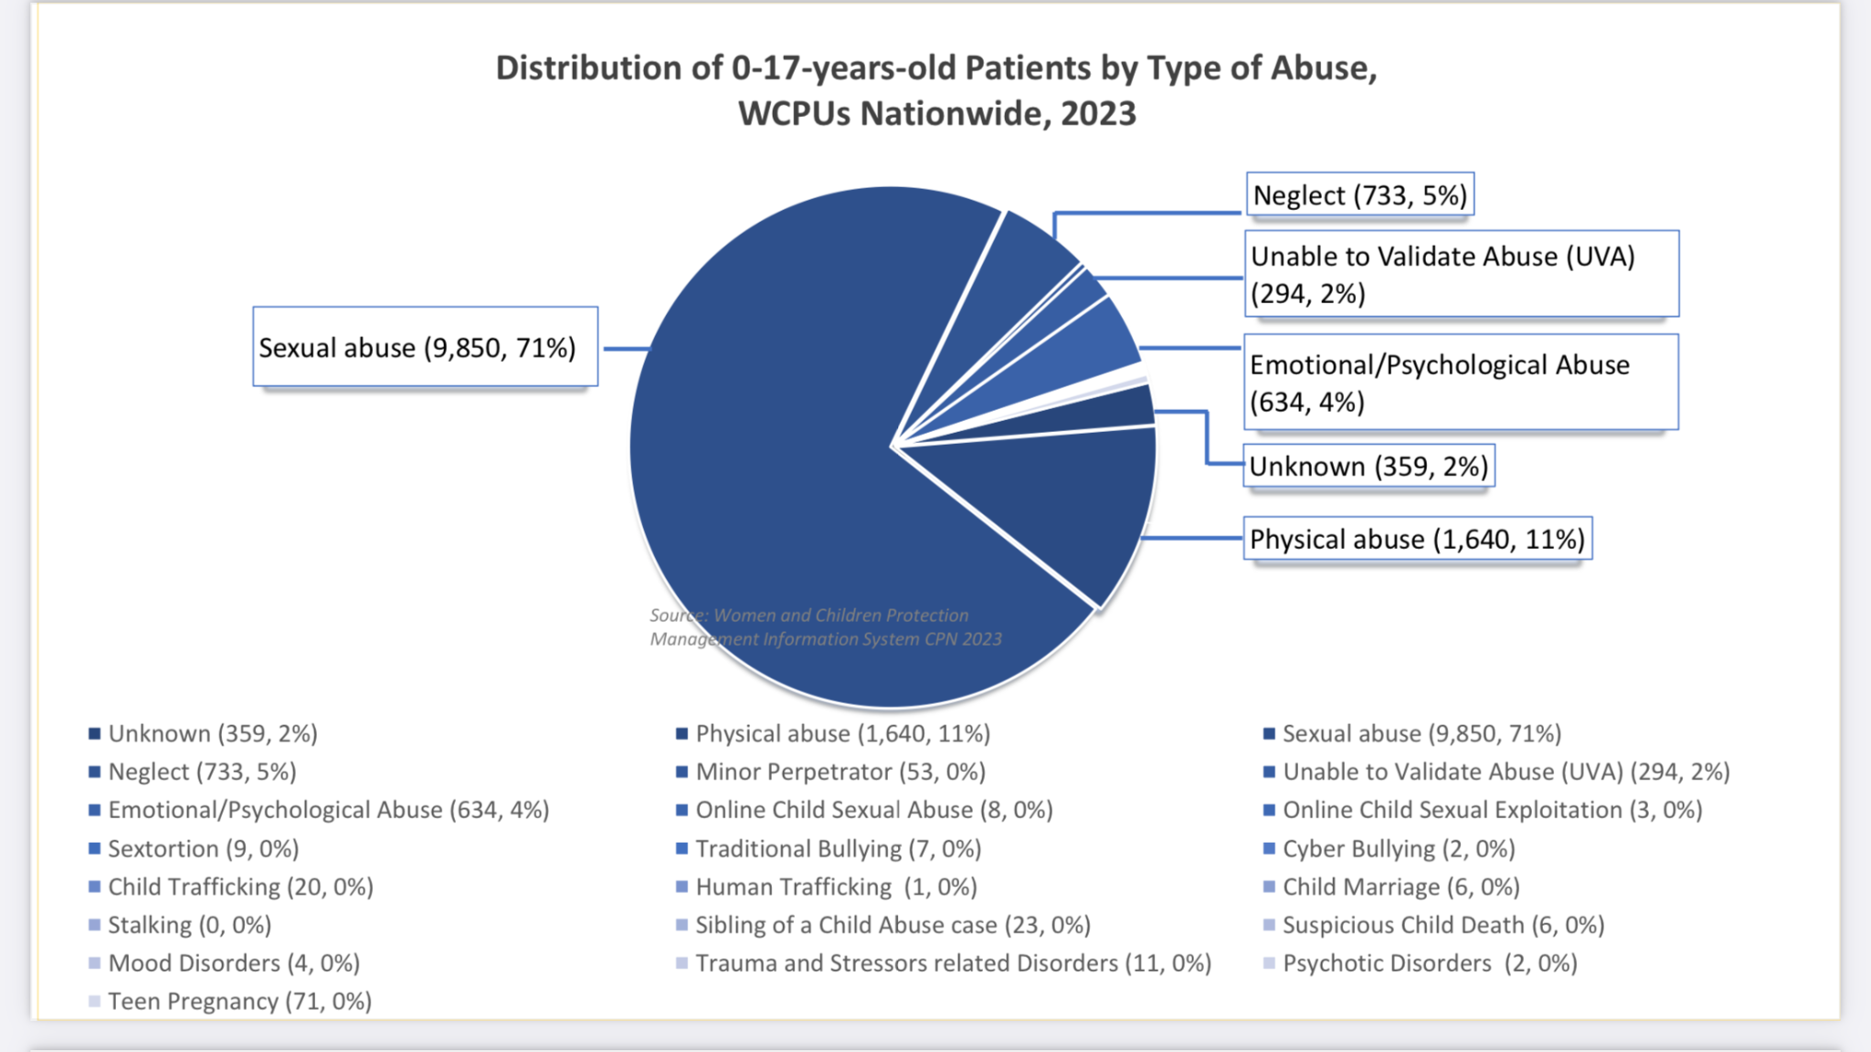

Slide 13
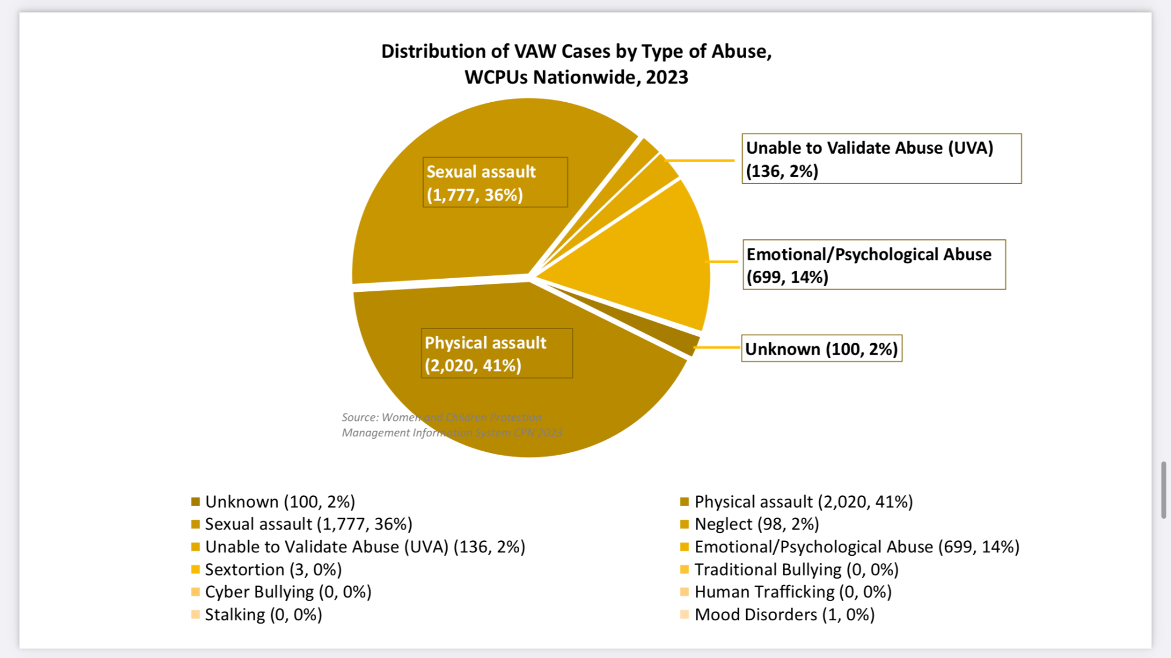

Slide 14
RPRH Challenges and Recommendations

Slide 15
GOVERNANCE
Challenges | Policy Actions/Recommendations
Organization of Governance bodies | Revival and Designation of NIT and role clarification
Institutionalization of RPRH Unit | DOH and DBM to discuss and review the Creation of the RPRH Unit with staffing Complement Regular Funding support for the operations to carry out the functions of the RPRH Unit for program implementation and service delivery in all levels
Development of a Unified Strategic Plan | Development Maternal, Newborn, Child Health Strategic Plan in accelerating efforts in achieving the 2030 Sustainable Development Goals consistent with the current strategies of DOH Finalization of the Multisectoral Framework
Convergence Budgeting of NGAs | Initiate discussions on convergence budgeting and Explore strategic procurement reforms
Notes:
The National Implementation Team (NIT) is the national structure created under a DOH administrative order to provide oversight in the implementation of RPRH programs and services. The results of the RPRH evaluation from the Philippine Institute of Development Studies (PIDS, 2021) have pointed to some very critical governance issues that need to be addressed by the NIT.
Among the major areas of concern were:
a) organizational changes in NIT;
b) institutionalization of RPRH Focal Units with full time focal person and support staff (at the Central level), designated RH focal person at the CHD level and RPRH Focal Person for each NGA for expanded Quantity and Quality of the RPRH Workforce for greater involvement and participation;
c) Development of a Unified Strategic Plan;
d) Convergence Budgeting of the NGAs;
Recommendations:
Revival and Designation of the structured NIT Leadership and Membership with role clarification;
DOH and DBM to discuss and review the Creation of the RPRH unit and staffing Complement;
Regular Funding support for the operations to carry out the functions of the RPRH Unit for program implementation and service delivery in all levels;
Development of Maternal, Newborn, Child Health Strategic Plan in accelerating efforts in achieving the 2030 Sustainable Development Goals
Finalization of the Multi Sectoral Framework;
Initiate discussions on convergence budgeting and Exploring strategic procurement reforms to ensure funding support for the multi-sectoral framework priorities

Slide 16
SERVICE DELIVERY
Challenges | Policy Actions/ Recommendations
Gaps in the availability of service providers and funding inadequacies | Creation of adequate plantilla positions with sufficient funding to support the necessary HRH requirements in providing RPRH services at the local level
Operational bottlenecks in the logistics management system, particularly in the procurement and distribution of RH commodities | Review of the existing procurement law to fasttrack and improve logistics management system for RPRH essential commodities and supplies
Notes:
Service delivery gaps remain to be a challenge in terms of health human resource requirements and funding support. Measures to create and ensure the availability of competent RH service providers with adequate funding support should be instituted most especially at the local levels.
Ensuring the availability of adequate RH supplies and commodities is a critical element in the healthcare delivery system. Improving the logistics management supply chain to include the procurement process needs to be expedited.

Slide 17
FINANCING
Challenges | Policy Actions/ Recommendations
Integration of the SRH package into the Comprehensive Outpatient Benefit Package of PhilHealth | DOH collaboration with PhilHealth on the status of SRH Integration with COBP Incentivize the establishment and maintenance of AFHF
Difference in the sharing of PhilHealth reimbursements among health providers across LGUs, resulting in demotivation and lack of interest to become PhilHealth-accredited providers | Closing the gap of Philhealth reimbursements by establishing clear policies and guidelines across all LGUs regarding PhilHealth reimbursement sharing for professional fees of service providers and fees to support facility operations
Notes:
While the DOH has conducted a study on the possible integration of SRH package into the Comprehensive Outpatient Benefit Package of Philhealth, putting this into fruition has yet to be realized. Collaboration with PhilHealth has to be pursued further to ensure that SRH will be included in the COBP of Philhealth & ensuring health facilities to be Adolescent Friendly.
Another challenging area is the current difference in the sharing of PhilHealth reimbursements among health providers across LGUs which results to demotivation and lack of interest of health providers to be PhilHealth accredited. There is a need to close the gap of Philhealth reimbursements by establishing clear policies and guidelines across all LGUs regarding PhilHealth reimbursement sharing of professional fees and fees to support facility operations.

Slide 18
Maraming Salamat po!

Slide 19
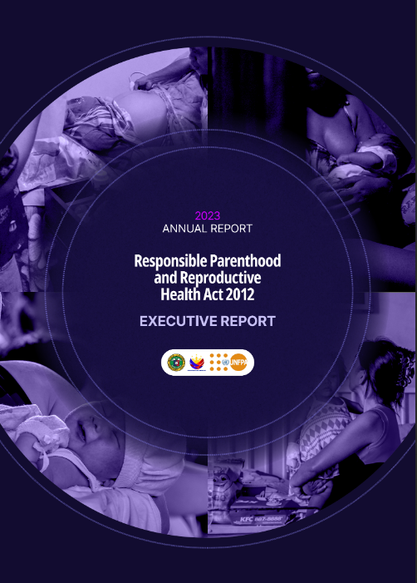


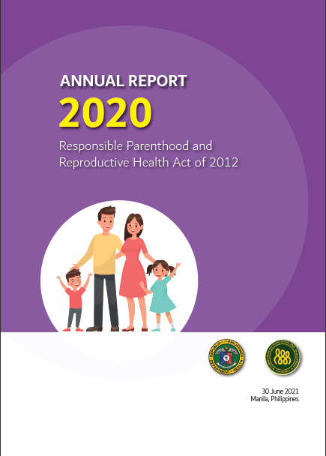




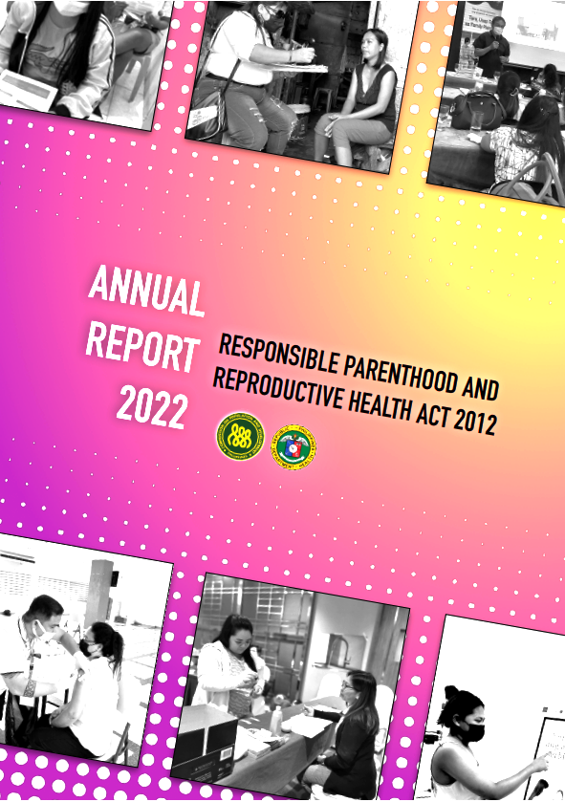
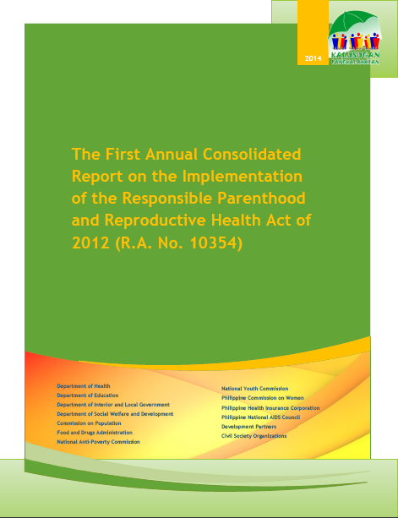

Slide 20
Priorities for 2024

Slide 21
KRA 1: Maternal, Newborn, Child Health and Nutrition
Priorities | Status
Maternal, Newborn, Child Health Strategic Plan in accelerating efforts in achieving the 2030 Sustainable Development Goals
Continuous Capacity Building for the health workers

Slide 22
KRA 2: Family Planning
Priorities | Status
Doc Mara, HELP
FP2030 Consensus Meetings

Slide 23
KRA 3: Adolescent Sexual and Reproductive Health
Priorities | Status
Certification of Adolescent-Friendly Health Facilities (AFHF) with adequate, competent, and AJA-trained health service providers | New Department Circular for the enhanced AFHF certification guidelines in 2025; On-going supportive supervision of ASET TOT in the regional CHDs (with DepEd and CPD)
Pro-active participation in the Technical Working Group of EO 141 that outlines the Comprehensive Action Plan (CAP) in reducing adolescent pregnancy | Expansion of membership for more collaborations, Development of the 2024-2028 CAP
Integration of ASRH in Maternal Health / Safe Motherhood Program | Onboarding and alignment processes
Initiatives on Ending Child Pregnancies | On-going consultation

Slide 24
KRA 4: Sexually Transmitted Infections and HIV/AIDS
Priorities | Status

Slide 25
KRA 5: Violence against Women and Children
Priorities | Status
Updating/revision of AO 2013-0011: National Policy on the Establishment of WCPU in government hospitals Uploading of 4Rs Training at DOH Academy e-learning hub Development of Training guidelines for WCPU Orientation & Training on updated (Online & Offline) WCPMIS; finalization of manual Development of Financing scheme for victims-survivors of GBV/VAWC Conduct of GBV Quality Assurance – Assessment of Post-GBV Response in healthcare facilities Readiness assessment & M & E tool for the establishment & functionality of WCPU Development of OHG-Guidelines Implementation Tool for GBV WCP Training for Primary Care Providers Appraisal of “Juana Be Wais” playbook (to be coordinated with HPB)

Slide 26
GOVERNANCE
RPRH Unit/Focal Persons
Challenges | Policy Actions/ Recommendations
Institutionalization of RPRH Unit with full time focal person and support staff (Central level) designated RH focal person (CHD level) | DOH and DBM to discuss and review the Creation of the RPRH unit and staffing Complement Issuance of Department Order (DOH); Regular Funding support for the operations to carry out the functions of the RPRH Unit for program implementation and service delivery in all levels
RPRH Focal Person for each NGA

Slide 27


Official Slides Template*
Resources Page**
The next set of slides contain ICONS, DIAGRAMS and SUPPLEMENTAL GRAPHICS which can be added to your presentation.
ENSURE THE DELETION OF THIS PAGE BEFORE STARTING YOUR PRESENTATION
*implemented as of July 2022
**Assets should ONLY be used in OFFICIAL DOH PRESENTATIONS.

Slide 28
Medical Icons*
The following Icons are crafted as editable shapes.
This means that you can:
Resize them without losing quality.
Change line color, width and style.
ENSURE THE DELETION OF THIS PAGE BEFORE STARTING YOUR PRESENTATION
*Graphic Assets should ONLY be used in OFFICIAL DOH PRESENTATIONS

Slide 29
Non-Medical Icons*
The following Icons are crafted as editable shapes.
This means that you can:
Resize them without losing quality.
Change line color, width and style.
ENSURE THE DELETION OF THIS PAGE BEFORE STARTING YOUR PRESENTATION
*Graphic Assets should ONLY be used in OFFICIAL DOH PRESENTATIONS

Slide 30
Non-Medical Icons*
The following Icons are crafted as editable shapes.
This means that you can:
Resize them without losing quality.
Change line color, width and style.
ENSURE THE DELETION OF THIS PAGE BEFORE STARTING YOUR PRESENTATION
*Graphic Assets should ONLY be used in OFFICIAL DOH PRESENTATIONS

Slide 31
Human Body*
*Graphic Assets should ONLY be used in OFFICIAL DOH PRESENTATIONS
ENSURE THE DELETION OF THIS PAGE BEFORE STARTING YOUR PRESENTATION
The following graphics are crafted as editable shapes.
This means that you can:
Resize them without losing quality.
Change line color, width and style.
Please take note that these human body images have 2 layers that are grouped together (color fill and outline)

Slide 32
Infographic Charts and Diagrams
To use:
Copy-paste your desired graphic in a page.
Enlarge and add corresponding text details / data
ENSURE THE DELETION OF THIS PAGE BEFORE STARTING YOUR PRESENTATION

