Slide 1
Emerging Governance Issues at the Sub-National Level
National Family Planning Program

Slide 2
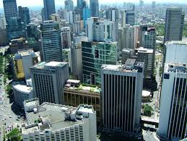
Background
To respond and adapt to the evolving demographic situation, there is a need to create a dialogue among stakeholders to discuss emerging trends and operational issues related to the family planning program at the sub-national level
Notes:
The RPFPC generally aims to provide a platform for in-depth discussions on population and development issues and policy-related concerns. Specifically, it aims to:
to convene regional stakeholders to collectively appreciate, understand, and identify the emerging population and family planning issues and their implications in the region particularly within the context of regional development;
to learn from existing good practices on population and family planning at the regional and local levels;
to identify gaps in terms of interventions and gather recommendations and areas for collaboration to address these gaps; and
to generate a commitment to the implementation and promotion of the PPD-POA 2023-2028 and other relevant national goals and strategic direction.

Slide 3
The Philippine Population and Development Plan of Action (PPD-POA)
2023-2028

Slide 4
Coordinate, collaborate and establish institutional partnerships with concerned government agencies
1
2
Monitor and assess the implementation of the PPD-POA
Approving and Adopting the PPD-POA 2023-2028, and Directing the Implementation Thereof
Memorandum Circular No. 40, series of 2023
4
3
Undertake POPDEV research, establish databases and enable institutions
Build public and institutional awareness on the impact of population dynamics on socio-economic development

Slide 5
Coordinate, collaborate and establish institutional partnerships with concerned government agencies
In accordance with their respective mandates, all concerned agencies and instrumentalities of the National Government, including government-owned or -controlled corporations are hereby directed, and all LGUs are hereby encouraged, to undertake efforts in support of the implementation of the PPD-POA 2023-2028, and the plans and programs specified therein.
1
2
Monitor and assess the implementation of the PPD-POA
Memorandum Circular No. 40, series of 2023
4
3
Undertake POPDEV research, establish databases and enable institutions
Build public and institutional awareness on the impact of population dynamics on socio-economic development

Slide 6
1
Coordinate, collaborate and establish institutional partnerships with concerned government agencies
2
Monitor and assess the implementation of the PPD-POA
Roles of CPD under MC 40
3
Undertake POPDEV research, establish databases and enable institutions
4
Build public and institutional awareness on the impact of population dynamics on socio-economic development

Slide 7
PPD-POA Goal
To optimize demographic opportunity and address persistent population issues to accelerate sustainable and inclusive socioeconomic development

Slide 8
Provide a platform for in-depth interagency and multisectoral discourse on population and development emerging trends and implications
Generate commitments and collaboration for the PPD-POA 2023-2028
Learn good practices and innovative solutions
OBJECTIVES

Slide 9
RCFP Framework
Sexual and Reproductive Health and Rights fulfilled and protected
Demand
Supply
Emerging fertility and family planning preferences and behaviors
Provision needed information through SBCC strategies
Availability of RPFP and RH services
Quality of services (i.e., capacity of service providers)
Delivery systems and mechanisms
ACCESSIBILITY
Equality and equity
Universality or coverage
Responsiveness
Referral mechanism
Emerging factors affecting demand
GOVERNANCE MECHANISMS

Slide 10
RCFP Framework
Fulfillment and protection of sexual and reproductive health and rights
ENABLING POLICY
MANAGEMENT SYSTEM
KNOWLEDGE & LEARNING
STRUCTURE
LEADERSHIP
COMPETENCY
RESOURCES (TECHNOLOGY, FINANCIAL AND PHYSICAL)
GOVERNANCE MECHANISMS

Slide 11
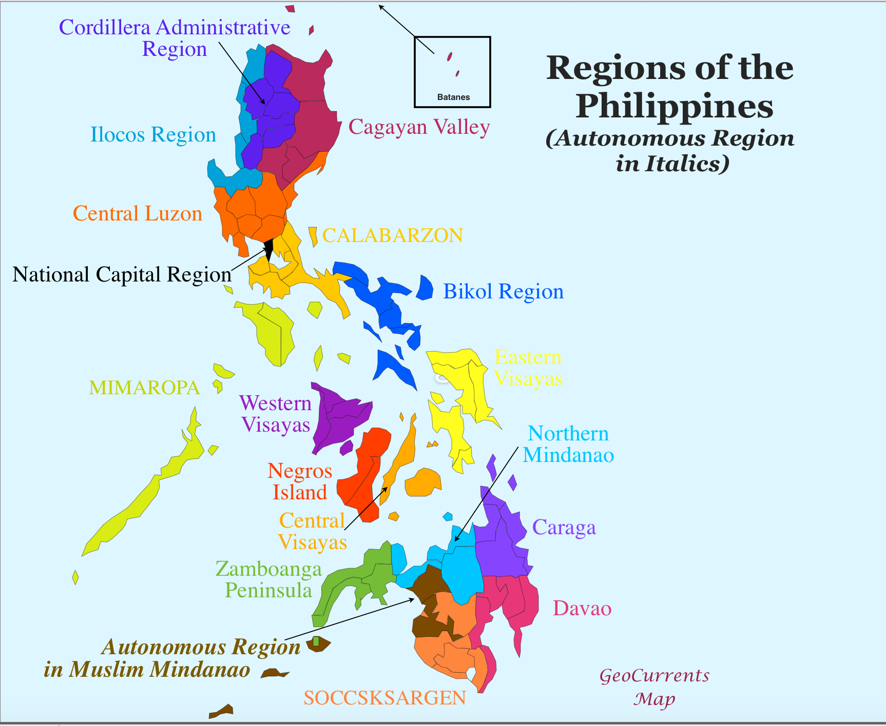
Schedules of the RCFPs
CAR | June 27-28 | Baguio City
R-II | June 20-21 | Tuguegrao City
R-I | June 6-7 | San Fernando City, LU
Calabarzon | May 21 | Calamba, Laguna
R-III | May 29-30 | Subic, Zambales
NCR | June 25-26 | Manila
R-V | June 5-6 | Legaspi City
Mimaropa | May 29-31 | Puerto Princesa
R-VIII | June 13-14 | Tacloban City
R-VI | May 28-29 | Iloilo City
R-X | June 13-14 | Cagayan de Oro City
R-VII | June 20 | Cebu City
R-IX R-XI R-XII | June 19-20 | Davao City
Caraga | May 15-17 | Butuan City
Bangsamoro Autonomous Region in Muslim Mindanao

Slide 12
Background
Key inputs from the RCFPs
Notes:
The RPFPC generally aims to provide a platform for in-depth discussions on population and development issues and policy-related concerns. Specifically, it aims to:
to convene regional stakeholders to collectively appreciate, understand, and identify the emerging population and family planning issues and their implications in the region particularly within the context of regional development;
to learn from existing good practices on population and family planning at the regional and local levels;
to identify gaps in terms of interventions and gather recommendations and areas for collaboration to address these gaps; and
to generate a commitment to the implementation and promotion of the PPD-POA 2023-2028 and other relevant national goals and strategic direction.

Slide 13
Background
Insights on Governance for Family Planning, POPDEV, and Reproductive Health
Notes:
The RPFPC generally aims to provide a platform for in-depth discussions on population and development issues and policy-related concerns. Specifically, it aims to:
to convene regional stakeholders to collectively appreciate, understand, and identify the emerging population and family planning issues and their implications in the region particularly within the context of regional development;
to learn from existing good practices on population and family planning at the regional and local levels;
to identify gaps in terms of interventions and gather recommendations and areas for collaboration to address these gaps; and
to generate a commitment to the implementation and promotion of the PPD-POA 2023-2028 and other relevant national goals and strategic direction.

Slide 14
SRHR Outcomes
Unplanned pregnancies especially among women who are socioeconomically poor and marginalized
Prevalence of gender-based violence
Low level of modern contraceptive use particularly among the poor
Increasing incidence of maternal deaths
Increasing incidence of child and adolescent pregnancies
Low level of participation of men in RH-FP

Slide 15
Emerging Behaviors and Preference on SRH
Changing fertility preferences of Filipino women and couples (i.e.g, delayed marriage and pregnancy)
Social media and online platforms are becoming the primary source of information
No unified framework for unified and synchronized national and local promotional campaign for SRH and family planning
LGUs has inadequate capacity and investment for the development and implementation of SBCC strategies
Not all LGUs have community-based workers for SBCC services

Slide 16
SRHR Behaviors
Untrained teachers on CSE
Inaccessible RPFP and RH information among indigenous people and other marginalized population
Inadequate counseling on family planning services

Slide 17
Governance Issues
Mandates/Enabling Policy
Section 17 of Local Government Code – population development and family planning services as part of welfare services
Magna Carta of Women (RA 9710)
RPRH Law (RA 10354) – including its IRR, relevant executive orders, and DOH/DILG administrative issuances
EO 138 (Full Devolution Policy)
CPD Devolution Transition Plan

Slide 18
Governance Issues
Mandates/Enabling Policy
Regional resolutions and circulars enjoining LGUs to support the implementation of RPFP initiatives
Local ordinances and policies – E.g., RH and GAD Codes, AHD ordinances, POPDEV policies

Slide 19
Governance Issues
Mandates/Enabling Policy
Emerging Issues
Varying level of local implementation of mandates and key RPFP and RH strategies as determined by
Local thrusts and priorities
Available resources
Institutional capacities
Leadership (awareness and appreciation of existing mandates, cultural factors, etc.)

Slide 20
Governance Issues
Structure
Varying models of implementing structures
FP delivery are done mostly by local health offices and some local population offices (i.e., also in-charged of generating demand for FP services through community-based volunteers and workers
Inadequacy of human resource as well as competency for the delivery of quality FP services
Many LGUs have community-based volunteers for FP but needs retooling and job aids for promotion and public advocacy

Slide 21
Governance Issues
Competency
Recurring clamor for training and capacity building for service providers and on SBCC (demand generation)
Significant gap in the availability and accessibility (deployment) of trained service providers on long-acting and permanent methods
Significant gap in the capacity of teachers and service providers on CSE
Challenges in using technology especially among community-based volunteers

Slide 22
Governance Issues
Management System
PLANS AND BUDGETS
Planning for comprehensive, sustainable and evidence-based local RPFP program is being pursued by CPD as a localization strategy
Intersectoral planning for RPFP remains wanting
In many LGUs, FP services comprises the initiative for FP (not in a long-term plan)
Many LGUs have inadequate investments in SBCC

Slide 23
Governance Issues
Management System
COORDINATIVE MECHANISMS
Many LGUs have created their local implementation teams for RPRH law (but needs to improve its regularity and efficiency in addressing emerging local issues)
Regional coordinative structures have supported the LGUs in the implementation of RPFP strategies

Slide 24
Governance Issues
Management System
SERVICE DELIVERY
Low utilization of available PhilHealth benefits for family planning
Inadequacy of supplies and commodities in some LGUs including the challenges in storing the commodities
Inadequate services for long-acting and permanent methods

Slide 25
Governance Issues
Management System
All LGUs with community-based population volunteers have maintained basic household profile including status on FP use
Continuing challenges in gathering, processing and utilizing database on RPFP and POPDEV (including the inadequacy of competencies in data analysis)
National surveys cannot be adequately used for local analysis
Available researches are at the national and regional levels (mostly done for academic purpose) and need to be consistently conducted (partnership with academe)

Slide 26
Governance Issues
Leadership
The full devolution policy has increased ownership and innovations on RPFP among LGUs, but these initiatives need to be broadened, sustained and mainstreamed
Significant gaps in terms of investment and institution of comprehensive strategies for RPFP as manifestation of leadership commitment and support

Slide 27
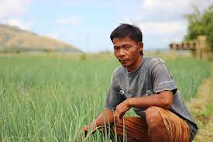
Background
RECOMMENDATIONS
Notes:
The RPFPC generally aims to provide a platform for in-depth discussions on population and development issues and policy-related concerns. Specifically, it aims to:
to convene regional stakeholders to collectively appreciate, understand, and identify the emerging population and family planning issues and their implications in the region particularly within the context of regional development;
to learn from existing good practices on population and family planning at the regional and local levels;
to identify gaps in terms of interventions and gather recommendations and areas for collaboration to address these gaps; and
to generate a commitment to the implementation and promotion of the PPD-POA 2023-2028 and other relevant national goals and strategic direction.

Slide 28
Recommendations
Strengthen national and regional coordinative and collaborative mechanisms to address the multidimensional components of family planning and reproductive health (e.g., NIT/RIT)
Improve vertical (national and local) and horizontal (among various stakeholders) collaboration
Intensify institutional capacity development to enable LGUs to plan, allot resources, implement, monitor, and assess their local POPDEV and FP programs (along the pillars of capacity development) pursuant to full the devolution policy

Slide 29
Recommendations
Address gaps in the competencies and availability of modern FP services particularly for permanent and long-acting methods
Establish a functional and useful data and information system for RPFP and SRH
Expand institutional partnership for RPFP including CSOs, private institutions, and the academe
Improve policy environment for the program by pursuing the following policy agenda:
Prevention of adolescent pregnancy
Mandatory establishment of local population offices

Slide 30
Recommendations
Improve data and information management for RPFP and RH especially at the local level for more evidence-based decision-making at all levels
Continuously create knowledge on RPFP through research at all levels
Continue to build leadership for RPFP at the national and local level (especially in view of the upcoming election)

