Slide 1
Population, Health, Environment, & Development
Activities at USAID
8 Nov 2024
Notes:
Tere Intro …

Slide 2
PHED 101
Population, health, environment, and development (PHED) programming/activities intentionally link FP/RH programming with environmental conservation interventions, and often with interventions in other health and development sectors as well.
PHED activities are often used to reach remote communities where access to FP/RH and other basic health services is limited.
PHED activities have been adopted in a wide range of geographies, including South and Southeast Asia, sub-Saharan Africa, and Latin America.
USAID supports PHED as an approach to simultaneously increase access to quality FP/RH services, conserve resources and improve livelihoods in resource dependent rural communities.

Slide 3
USAID’s Population & Environment Directive
“Soft” earmark from Congress in how USAID gets money for FP/RH:
“... not less than $XX XX should be made available for family planning/reproductive health, including in areas where population growth threatens biodiversity or endangered species.”
Notes:
We interpret this directive broadly to encompass activities that have an intentional linkage between provision of FP/RH services and biodiversity, including activities that center in/around protected areas or otherwise link to improving ecosystem conditions. This can include work on climate change adaptation depending on the context.
PRH promotes voluntary FP/RH services and respect for human rights throughout all of our programming. This commitment is integral to our work and is non-negotiable.

Slide 4
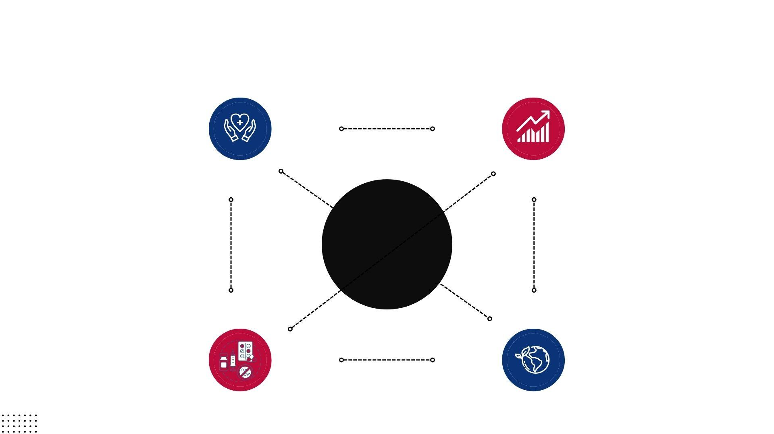
What Relationships Exist Between FP/RH, Health, Environment, & Development?
Health
Development
Maternal & child health, emerging infectious diseases, (One Health), health systems strengthening, etc.
Alternative livelihoods, physical infrastructure provision/improvement, policy reform, etc.
Directionality & Context Matters!
FP/RH
Environment
Contraceptive provision, gender-based violence, child, early, & forced marriage, menstrual health & hygiene, etc.
Sustainable forest/fisheries management, tree planting, conservation education, ecosystems wellbeing & resilience, etc.
Notes:
Can add Water and sanitation
alternative/diversified livelihood enterprises

Slide 5
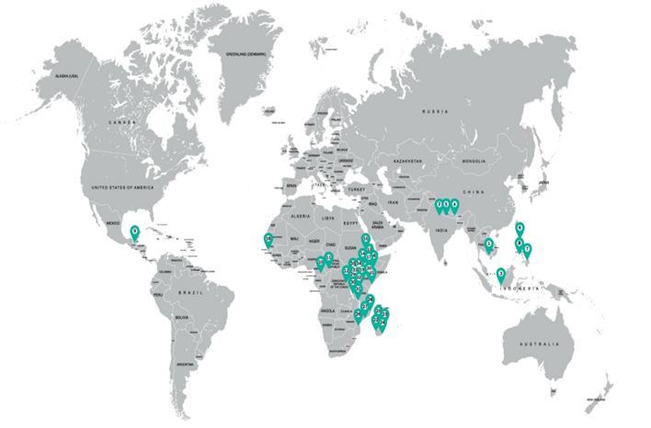
Evidence of PHED Programming
Integrated approach yields a larger impact on human and ecosystem health and food security compared to the single-sector approaches
D’Agnes L, D’Agnes H, Schwartz JB, Amarillo ML, Castro J. (2010) Integrated management of coastal resources and human health yields added value: a comparative study in Palawan (Philippines). Environmental Conservation 37 (4)
PHE projects can have a profound impact on family planning use, reproductive health, and other health and environmental practices and behaviors.
The Evidence Project , 2015, PRB, Population Council

Slide 6
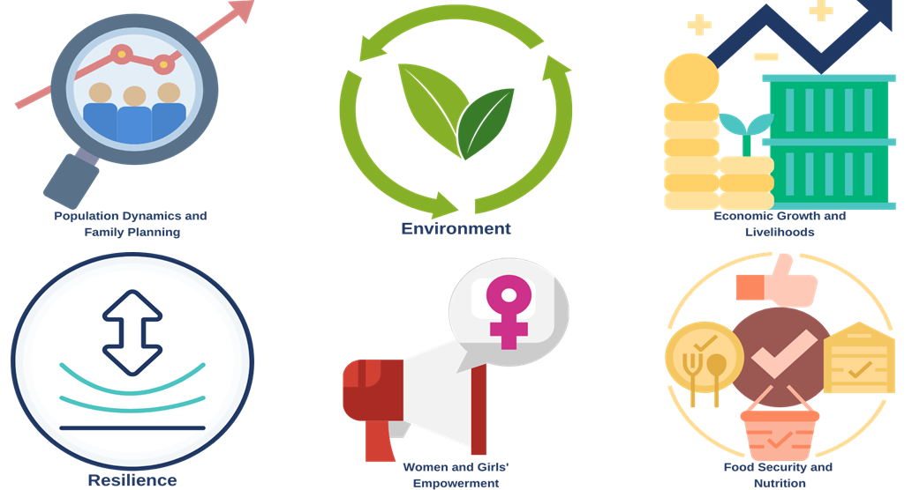
Benefits of Integrated PHED Programming

Slide 7
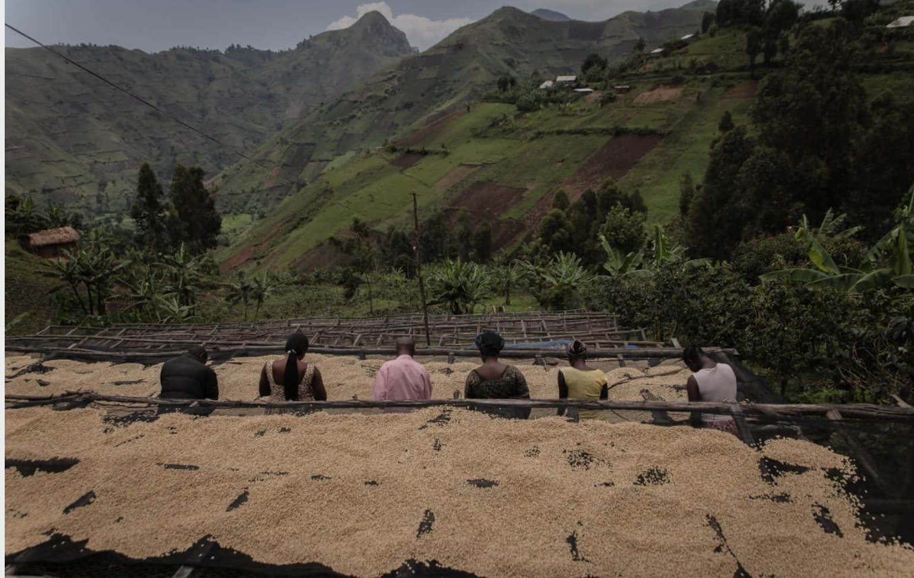
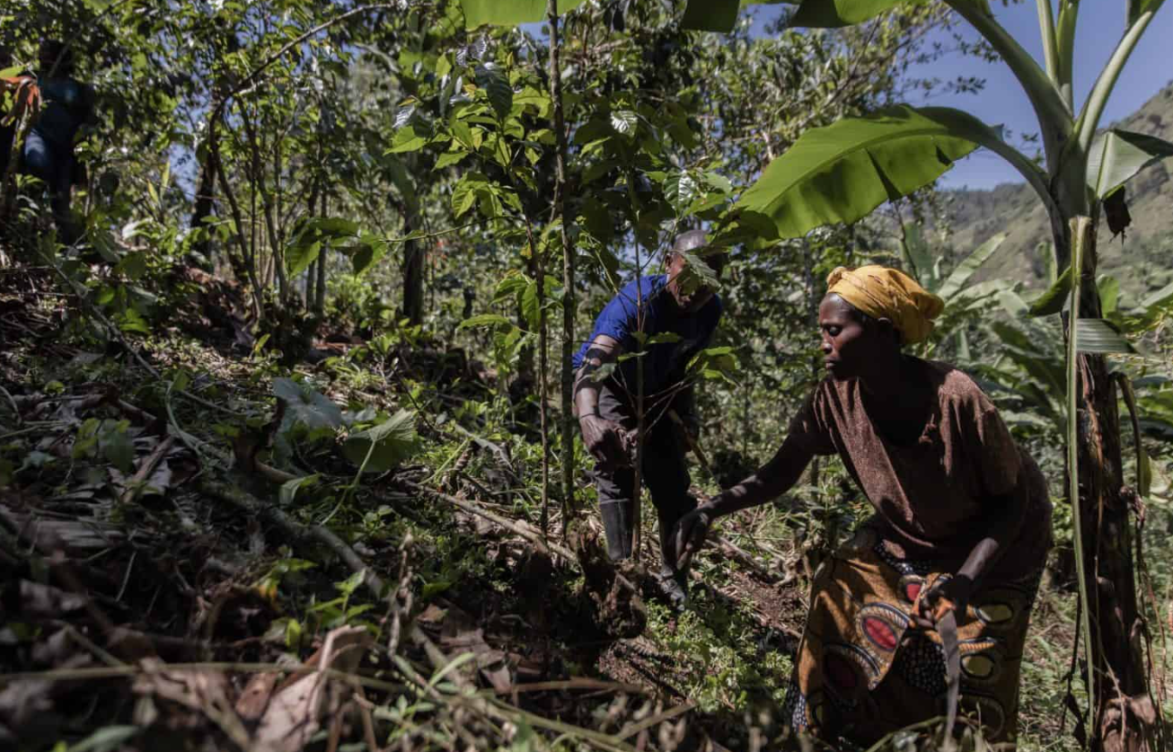
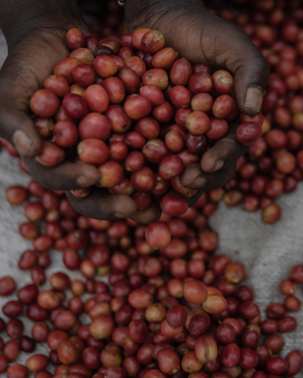
PHED Example 1: HEARTH Gorilla Coffee Alliance
Photo Credit:Nespresso
2021-Present, South Kivu (Kahuzi-Biega National Park, DRC)
Notes:
Private sector partnership with leading coffee producers, to do regenerative agriculture and sustainable coffee production alongside wildlife (gorilla) conservation and management activities, improving community health services (including FP/RH), and improve gender relations and norms. Goal is to reduce forest encroachment and deforestation, increase household incomes, improve access to clean water, and improve health and nutrition status.

Slide 8
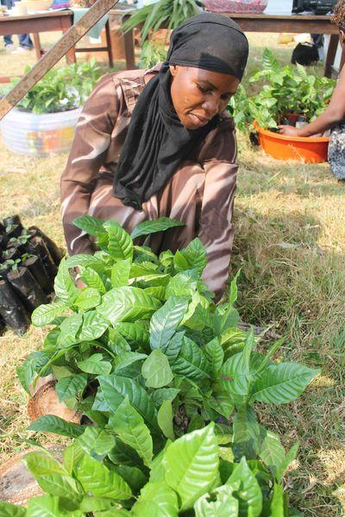
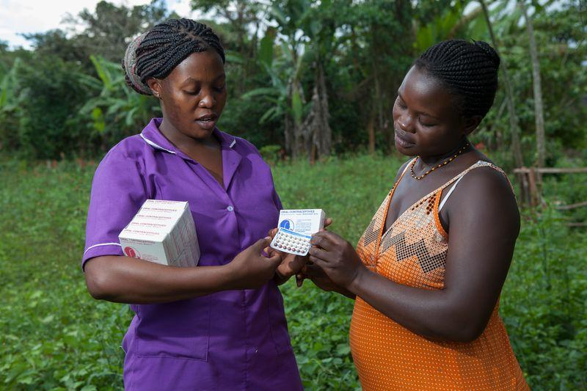
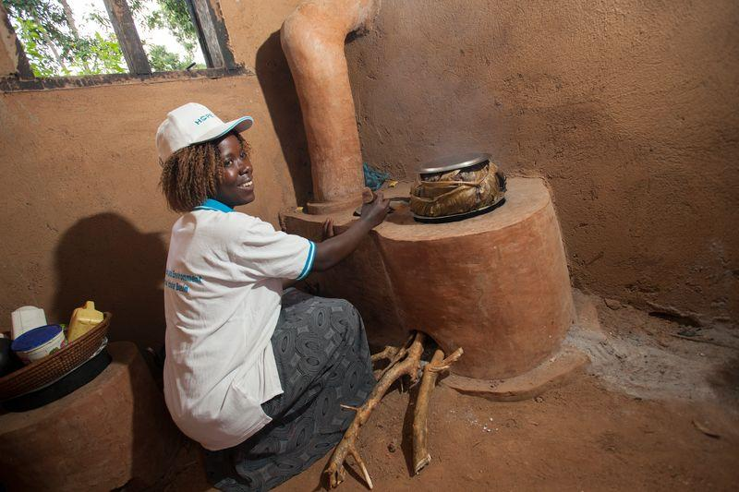
PHED Example 2: HoPE-LVB
Photo Credit: Jake Lyell
2011-2019; Lake Victoria Basin (Uganda & Kenya)
Notes:
HoPE-LVB combined various health interventions, including FP/RH and EMOC improvements with tree nursery development, engagement to improve enforcement and efficacy of fisheries management, sustainable cookstoves, and model households

Slide 9
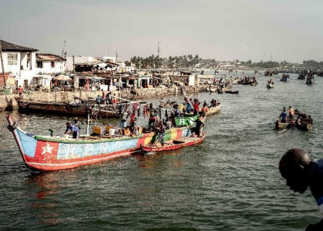
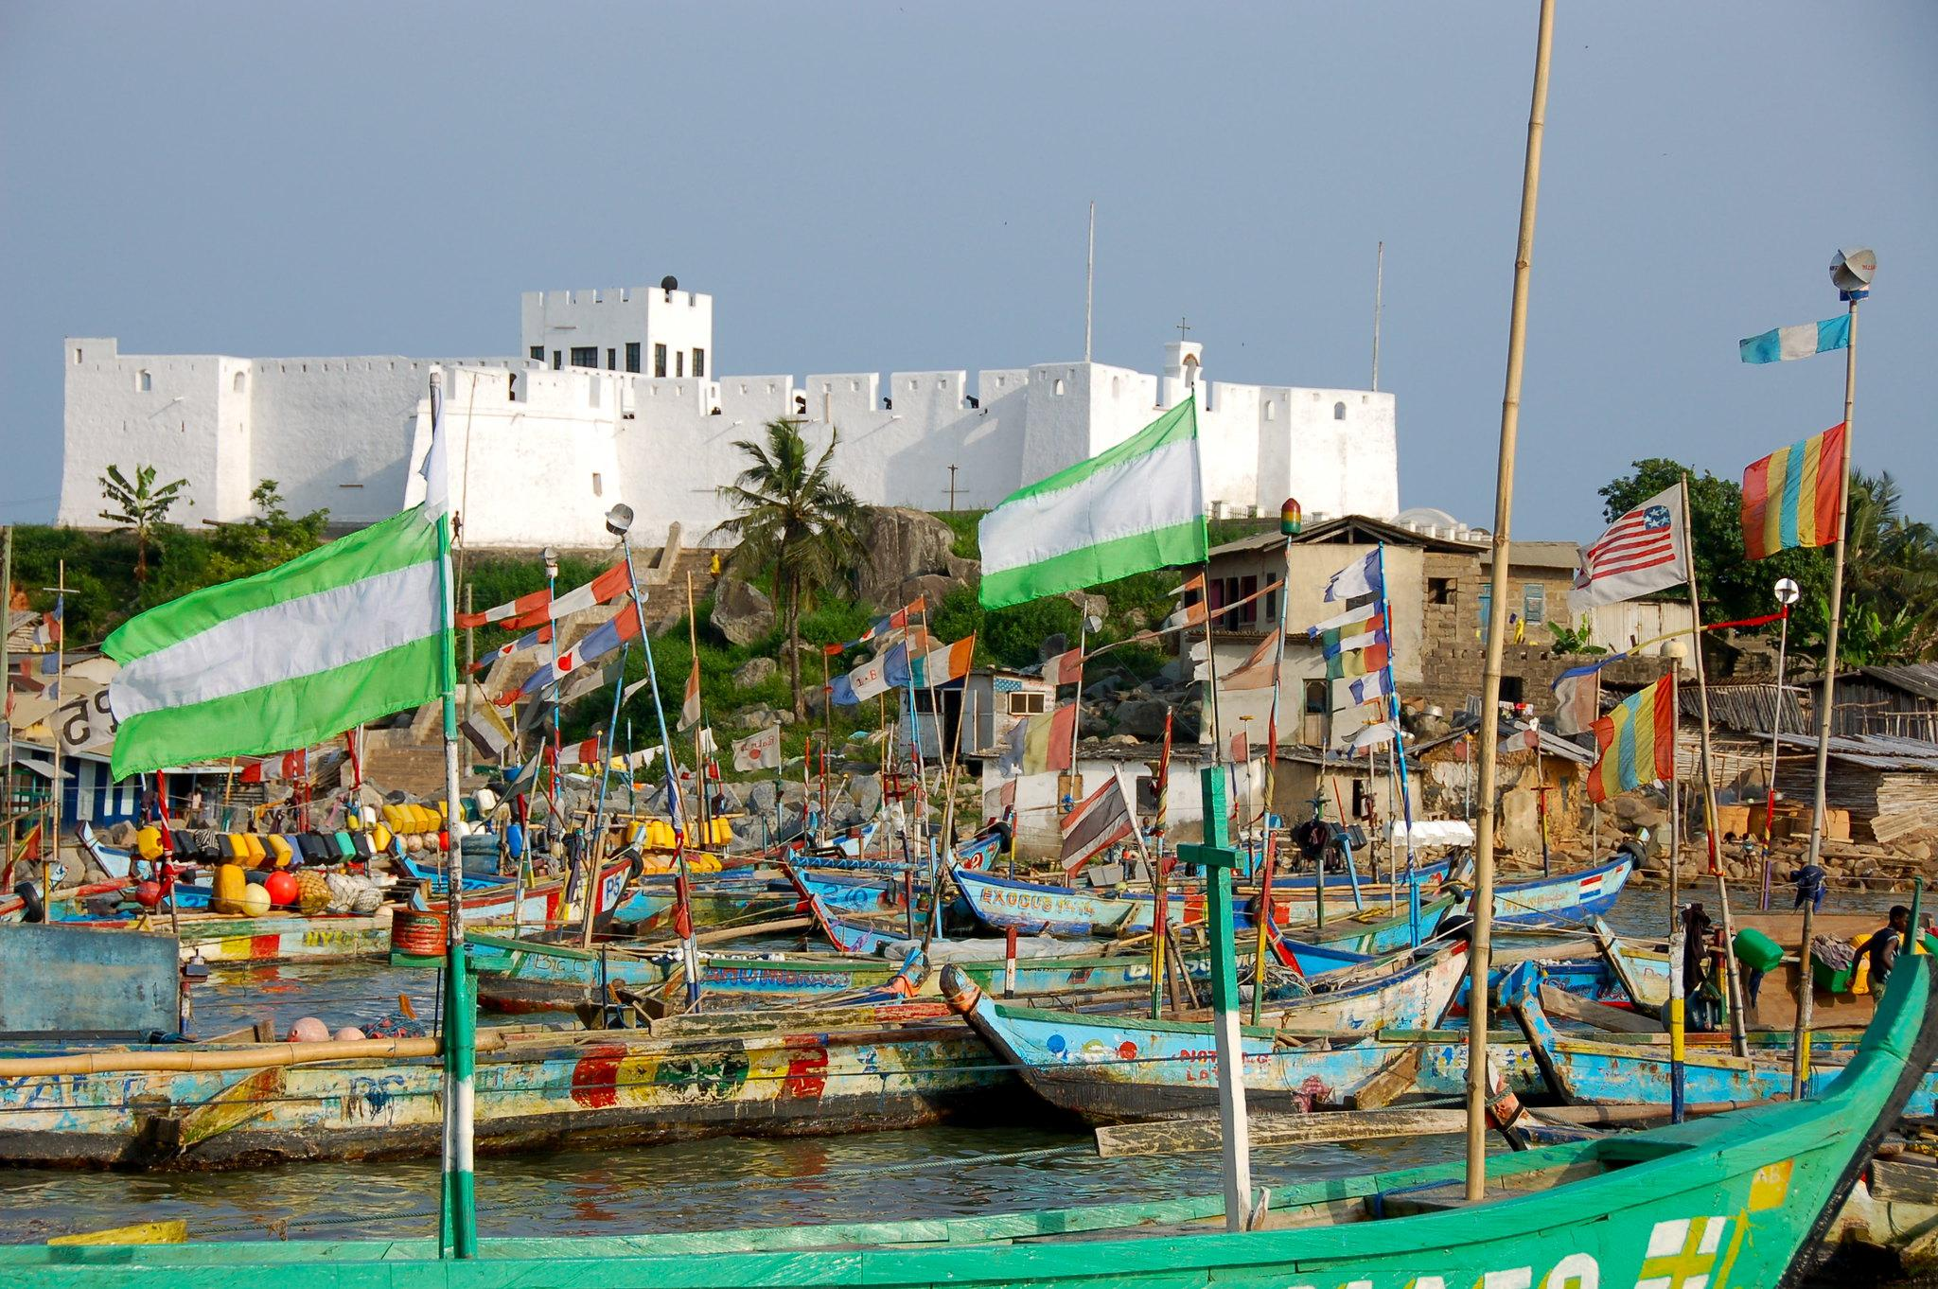
PHED Example 3: Ghana Fisheries Recovery & Family Planning Social Marketing and Private Sector Engagement Activities
Photo Credit: Lieven Engelen, Glenn G. Page, SustainaMetrix
2021-2026: Coastal Ghana
Notes:
Ghana Fisheries Recovery Activity, a USAID-sponsored program to improve fisheries management in coastal Ghana, has partnered with the Mission’s Family Planning Social Marketing and Private Sector Engagement Activity in order to expand access to underserved fishing communities where adolescent pregnancies are common.

Slide 10
PHED Example 4: BALANCED Project
2008-2013: East Africa and Asia – those with USAID biodiversity funding and USAID FP priority
status
Notes:
The Building Actors & Leaders For Advancing Community Excellence in Development ( BALANCED ) Project promoted wider adoption and use of effective PHE approaches globally. It was implemented in 8 countries with 21 organizations in various contexts: Landscape in Ethiopia, ecosystems conservation and sustainable development in Uganda, livelihood in Zambia, conservation in PNG, marine and coastal conservation and food security in the Philippines

Slide 11
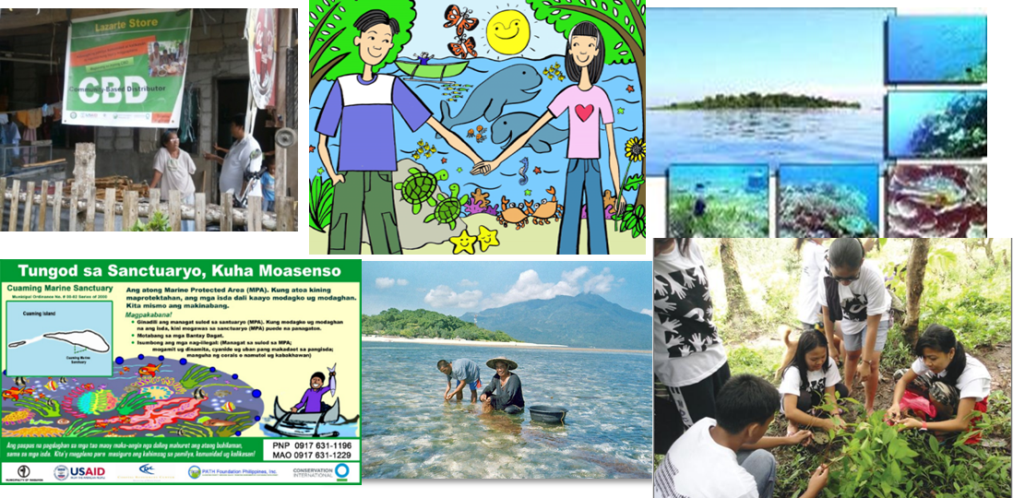
PHED Example 4a: BALANCED Philippines Project
2010-2013: Verde Island Passage and Danajon Bank key marine biodiversity areas
Notes:
The BALANCED Philippines was supported by the USAID Mission in two key marine biodversity areas to: 1) improve access to family planning services ,2) increase community awareness and acceptance of family planning and conservation as a means to improve health, food security and natural resources, and 3) increase LGU policy maker commitment to FP services and integrated PHE approaches.
The key community based interventions were: Peer education (couples, women , fishers, youth); Marine Protected area management, Livelihood, policy advocacy, community based distribution outlets for FP commodities
At the end of the project, PFPI strengthened and/or established community based distribution systems in 570 barangays of 28 municipalities. 690 adults and 110 youth were trained and/or re-trained to serve as Peer Educators for FP/RH and PHE practices. The peer educators delivered over 60K Inter-Personal Communication and Counseling (IPC/C) sessions to their peers in the target communities . Increased FP uptake

Slide 12
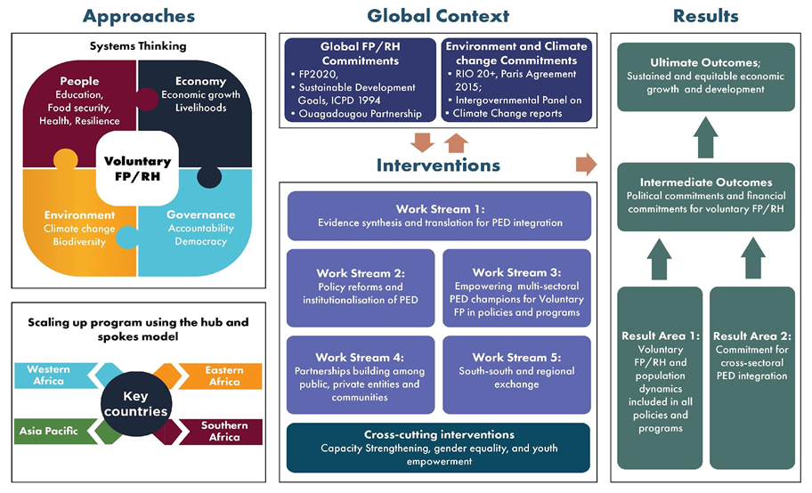
PHED Example 5: BUILD Project
2021-2024: East, South, West Africa and Asia Pacific
Notes:
The Building capacity for Integrated FP/RH and Pop, Envi and Development Action Project (BUILD) from 2021-2024 was a Policy Advocacy Project that aims to achieve strong political commitment, sustained financial resources and accountability for voluntary FP/RH.
It was implemented in select low to middle income countries in East, South, West Africa and Asia Pacific. The project developed tools/ materials for advocacy , papers on the linkages and build a cohort of youth leaders and advocates
In the Philippines and the region, we established a PHED National advisory committee, forged a tripartite MOU with DENR and CPD to jointly ensure that PHED is included in the National Climate Action Plans, in the roll out of the Phil Devveloment plan of action

Slide 13
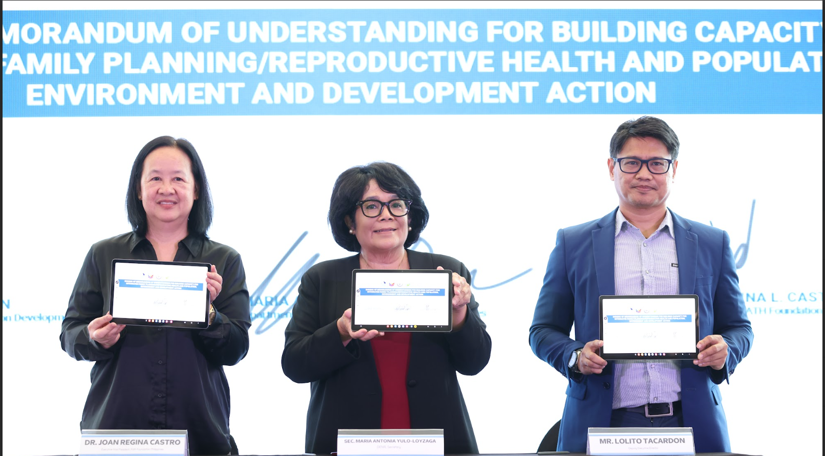
Making PHED Programming work
Policy and Decision Makers
Align PHED programming in addressing critical issues like climate change, poverty alleviation, agricultural security, biodiversity conservation, etc.
Intentionally integrate FP/RH package in the design, implementation and monitoring and consider technology, cultural , institutional and policy context/ factors
Plan for uncertainty and design to promote learning and adaptive management
Notes:
With more than two decades of PHE Programming , some points learned that worked across the various projects.
With policy and decision makers :
Align PHED programming with the vision and strategies to address critical issues especially at the local level
Integrating FP/RH into natural resource management is not merely adding a SRHR package but design, implement and monitor integrated programs that provides multisectoral services to remote areas and includes livelihood opportunities as part of equity-focused programs
At the onset of the PHED program ensure policy reforms and systems to increase access to finances, information and technology and plan to Expand , replicate, adapt and sustain and effective PHE model in program or policy to create a larger impact but also plan for uncertainties . Use PHE programming to promote learning and adaptive management

Slide 14
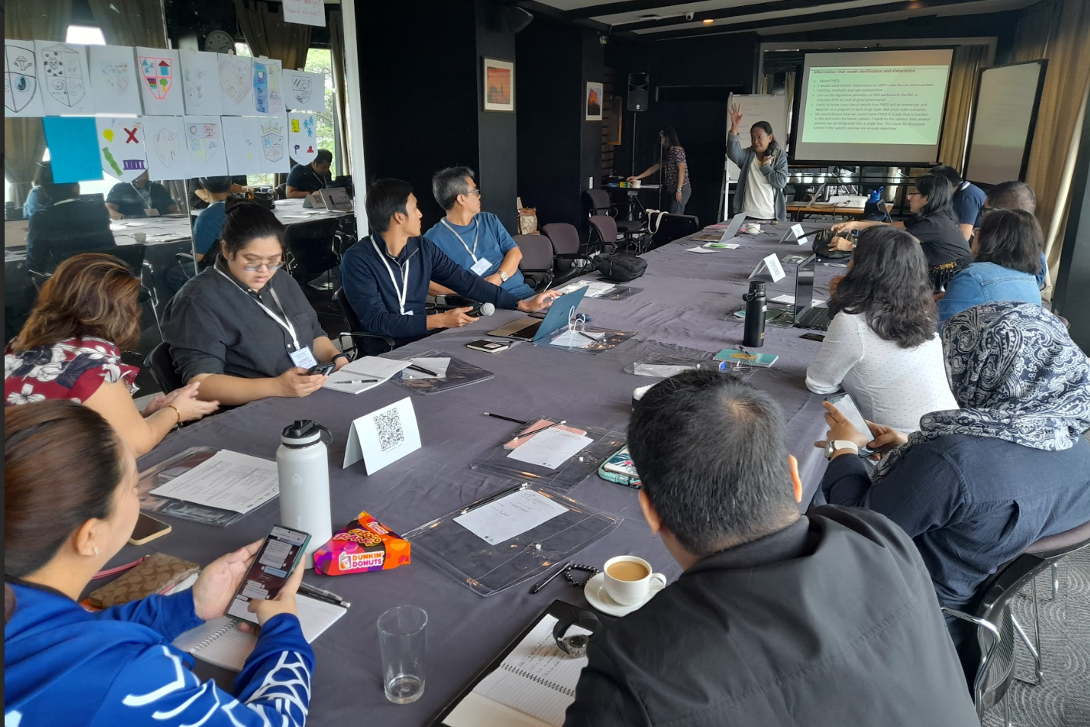
Making PHED Programming work
PHED Community of Practice
Harness commitment of existing and new PHED Champions, it is key to sustaining PHED and keeping it alive
Expand PHED constituency to include media, legislators, etc.
Establish PHED network to connect organizations, institutions and individuals and form a common identity, advocacy and direction drawn by combined strengths, shared experience and vision
Notes:
Building a constituency of PHED Practitioners is a backbone of PHED programming
The Philippines initiated the PHE network in 2004 which was replicated in various part of Africa which sustained PHED. The Philippines remains to have a sustaining PHE network that will hold its 10th PHE conference in 2025.
This regular activity continue to harness the commitment of existing PHE champions and building new PHED Champions, is key to sustaining PHED and keeping it alive
Expand PHED constituency to include media, legislators, etc and even from national to a regional community. PHED networking provides opportunities for exchange and close the gap between sectors, issues and geographies
And where network is not yet established , to establish PHED network to connect organizations, institutions and individuals and form a common identity, advocacy and direction drawn by combined strengths, shared experience and vision

Slide 15
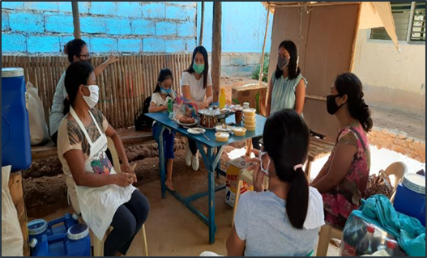
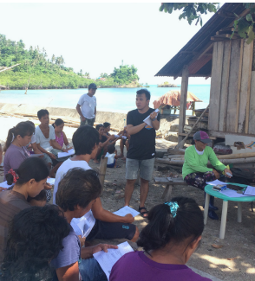
Making PHED Programming work
Community
Listen , engage, and empower the community to promote ownership and sustain PHED actions
Tailor interventions considering their priorities, aspirations and their integrated way of life
Recognize and celebrate community contributions with incentives, reciprocal agreements, etc.
Notes:
With the community where PHED is a way of life , PHED programming can ensure a more effective systems thinking and planning that reflects the concerns of the community by
Listening , engaging, and empowering the community to promote ownership and sustain PHED actions
Support community strategies that contributes to community pride and increased commitment to the protection of natural resources
Tailoring interventions considering their priorities, aspirations and their integrated way of life
Recognizing and celebrating community contributions with incentives.
We learned that Reciprocal agreements can be a win-win. Integrated PHED approach lends sustainability to natural resource management interventions. On the other hand, natural resource management provides a comprehensible context for communities to recognize the necessity of planning their families to achieve food security and improve family welfare

Slide 16
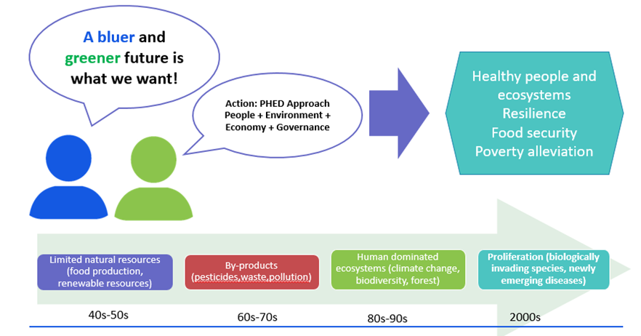
What we need to improve on
Continue to raise understanding on the PHED linkages and the benefits of integrating FP/RH in environment and sustainable development. Correct existing misconceptions on FP/RH
Build new champions and harness the voice of PHED advocates to ensure technical expertise, and secure financial resources
Document results to inform scale up, and adaptive management
Notes:
Despite significant progress in PHED programming, some items that we can still improve on:
Continue to raise understanding on the PHED linkages and the benefits of integrating FP/RH in environment and sustainable development. Correct existing misconceptions on FP/RH
Build new champions and harness the voice of PHED advocates to ensure technical expertise, and secure financial resources
Document results to inform scale up, and adaptive management
The slide shows the waves of concern experienced by various generations since 1940-50s, the limited natural resources affecting food production, renewable resources, in the 60s-70s – the issues on by-products (pesticides, waste and pollution), the 802-902- concern on human denominated ecosystems thus cliamet change, biodiversity loss were experienced, and 2000 issues on biologically invading species, newly emerging diseases).
We all want a healthy population and environment and a holistic , we are learning more and more that the PHED where the intersectional way of analyzing, planning, designing and implementing programs with provision of FP/RH services in tandem with conservation ensures equity and for every individual to reach their aspiration of a health resilience well being

Slide 17
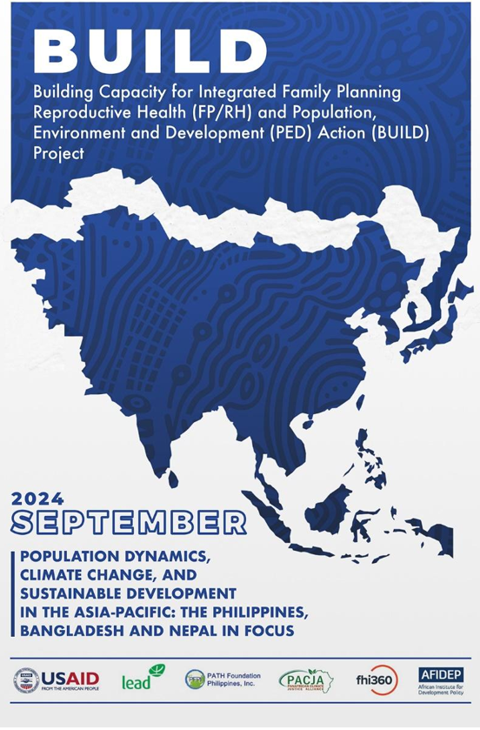
Key Takeaways
Provision of FP/RH and natural resource management actions ensures long term sustainability of conservation gains
PHED is a platform to attaining social, economic and environmental equity
Invest in youth PHED leadership for a lifetime of returns
Build evidence and disseminate results . Document experiences and results. Provide a platform for PHED champions to tell their stories
Notes:
Key take aways
Evidence have shown that Provision of FP/RH and natural resource management actions ensures long term sustainability of conservation gains
Operationally, PHED is a platform to attaining social, economic and environmental equity
Jose Rizal is correct when he said the youth is the future …..Invest in youth PHED leadership for a lifetime of returns
Build evidence and disseminate results . Document experiences and results. Provide a platform for PHED champions to tell their stories

Slide 18
Thank you

