Slide 1
FP2030: A Global Family Planning Partnership
FP2030 Strategy, Priorities, & Actions
Satellite Session 3: Global Basket
National Family Planning Conference 2024
Manila, Philippines
Dr Jameel Zamir, Regional Lead – Country Engagement, FP2030 Asia – Pacific Regional Hub

Slide 2
The Changing Landscape
Demographic patterns are shifting globally, with birth rates falling in most countries.
Declining fertility rates raise concerns about shrinking and aging populations, seen as threats to national welfare, healthcare, and the economy.
These changes have sparked debates on reproductive rights, impacting women's freedom and autonomy as they face pressure to reproduce for perceived national interests.
It is crucial to ensure universal access to person-centered, rights-based family planning and to create policies and programmes that empower individuals to achieve their desired fertility goals.

Slide 3
TFR in Asia & Pacific Region: 2000-24
Notes:
Only UNPD

Slide 4
TFR, mCPR, and Unmet Need for Contraception Asia & Pacific Region, 2023-24
Source: Track 20 / UNPD

Slide 11
Country Commitment Overview
Hub covers 50 countries in Asia and the Pacific Function: The Hub works in partnership with countries in South Asia, East Asia, Southeast Asia, Central Asia and Pacific Countries | Commitment Making Countries (8) | India, Bangladesh, Pakistan, Nepal, Indonesia, Philippines, Lao PDR and Kyrgyz Republic
 | Currently Drafting / Finalizing / Discussing a commitment (9) | Thailand, Cambodia, Timor-Leste Vietnam, Malaysia Uzbekistan and Kazakhstan Fiji and Solomon Islands
Notes:
FP2030
FP2030 stands as the sole global partnership dedicated exclusively to voluntary and rights-based family planning. Our unique concentration enables us to unite a diverse array of partners placing family planning at the intersection of global health, development, and gender equality.

Slide 12
Country Engagement Approach
FP2030 Commitment
Partner Alignment
Actionable Plan
Accountability Framework
Measuring and Reporting Results
Foundational to consequent country engagement strategies
To socialize the commitment to all partners in charge of implementation, financing and results reporting
FP2030 leads and ensures all countries that make a commitment have an actionable plan – could be a CIP, FP Action plan including use of the FP Goals model.
The framework exists, and is institutionalized at a country level including working with civil society and other partners
Progress and results are captured at a country level including self-reporting.
Notes:
SD

Slide 13
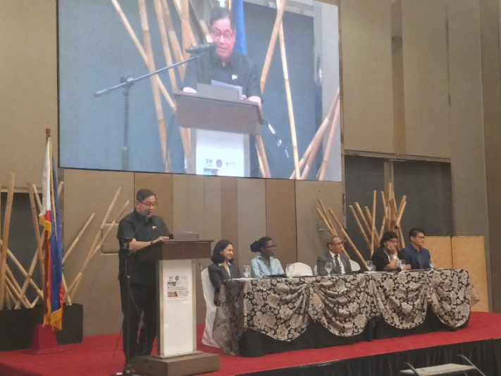
Key Regional Activities 2024
FP2030-UNFPA Research Initiative: Regional White Paper on addressing rights-based family planning in the demographic context
FP2030 Asia-Pacific Focal Points Workshop, Manila, Philippines
South-to-South Learning Workshop, 2nd to 4th December Kathmandu (Adolescent Pregnancy)
National Workshop on High Impact Practices (HIPs) in Family Planning
DMPA-SC / SI Community of Practice (COP) in collaboration with Injectables Access Collaborative
Notes:
Around 52% of the world's population, or 4.2 billion people, resides in this region.
These barriers include reproductive coercion by partners or family members, child marriage, patriarchal gender norms, and the underrepresentation of women in decision-making roles.

Slide 14
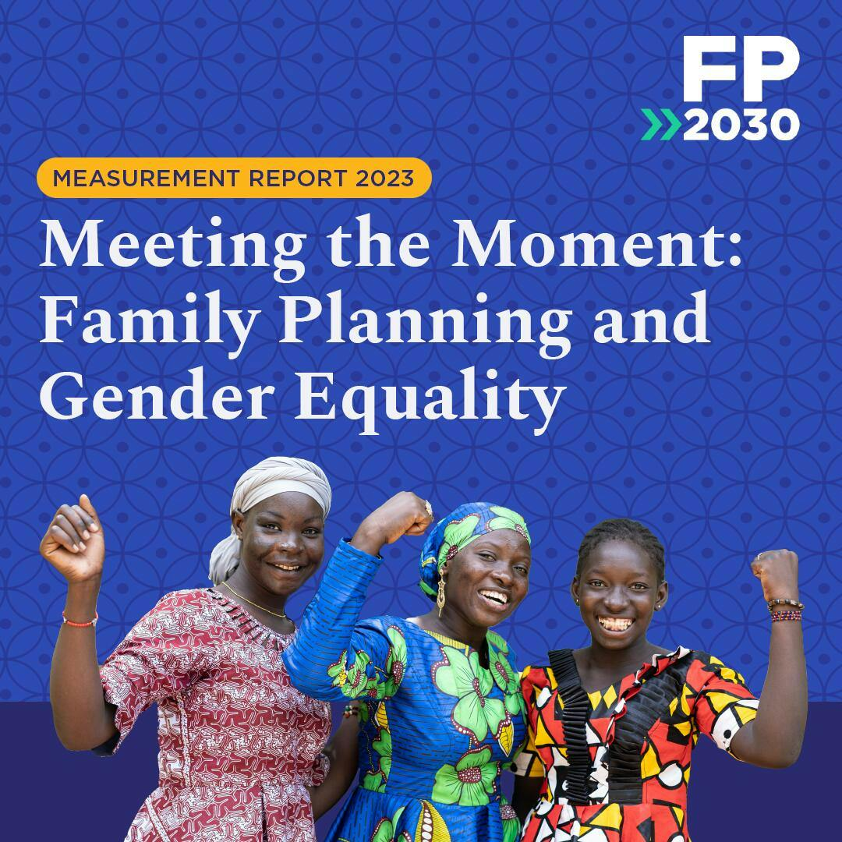
Lao PDR FP2030 Commitment Launch

Slide 15
Thank you!

