Slide 1
The Pagadian City Workplace Model: Closing the Gap on FP Access in the Workplace
National Family Planning Conference
November 20-21, 2024
Ms. Agnes Godoy-Nazareno
Presenter

Slide 2
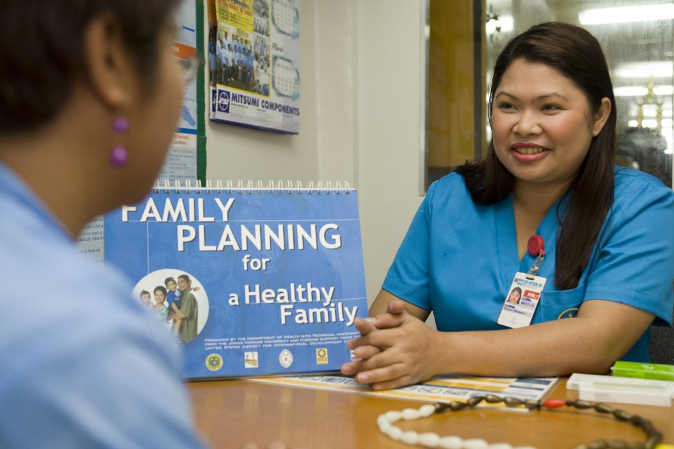
Background
LEGAL FRAMEWORK
Article 134 on family planning services; incentives for family panning of Presidential Decree 442 (Labor Code of the Philippines) and its Implementing Rules and Regulations
Department Order No. 56-03- Rationalizing the Implementation of the FWP in the Establishments; Checklist of Priority Activities Related to FWP Implementation
E.O. No. 12 - Attaining “Zero Unmet Need for Modern FP Planning” encouraged the Department of Labor and employment (DOLE) in implementing FP in the Workplace program
Notes:
Engaging the private sector for family planning in the Philippines has been a challenge for decades despite the mandate under Article 134 of the Labor Code of the Philippines which states that companies with 200 or more shall provide free family planning services to the employees including their spouses.
This was even reinforced with the issuance of the Department Order 56-03 of the Department of Labor and Employment to establish a Family Welfare Program which requires family planning as a mandated activity.
Moreover, EO 12 known as Attaining “Zero Unmet Need for Modern FP Planning” encourages DOLE to support the Department of Health in attaining the goal through its Family Planning in Workplace program.

Slide 3
Background
FP in the workplace programs were not sustained
fast turnover of company nurses
lack of capacity to provide FP services
high cost of setting-up a family planning clinic
Notes:
But despite these mandates, most companies are not able to set-up a family planning program in the workplace or are not able to sustain the program and Gaisano Capital is among them. The difficulty in the implementation was due to the following top three reasons:
A) There is a fast turnover of company nurses as most of them are hired through an agency.
B) There is a lack of capacity to perform the services because company clinic staff are not trained to provide Family Planning
services. Note that a health service provider has to undergo Family Planning Competency-Based Training (FPCBT)
before he/she can provide the services. And
C) many companies including Gaisano Capital struggle due to clinic set-up cost including procurement of FP
commodities.

Slide 4
Program Intervention: Collaboration with Stakeholders
Collaborating Partners
Notes:
Given the challenges in the implementation of the FP in the WP program, USAID’s ReachHealth Project collaborated with the Department of Labor and Employment, the Department of Health and the Commission on Population and Development in implementing the Family Planning Workplace Program: Matching Model. The three agencies agreed as they find the model very practical and sustainable. The model was tested with Gaisano Capital in Pagadian City. The Gaisano Capital was paired with Mom’s Birthing Home & Family Planning Clinic. Mom’s birthing Home was chosen because it is PhilHealth accredited and I am also tagged with PhilHealth as Family Planning service provider. Being tagged is important because I get paid through PhilHealth reimbursements from the FP services I provided.

Slide 5
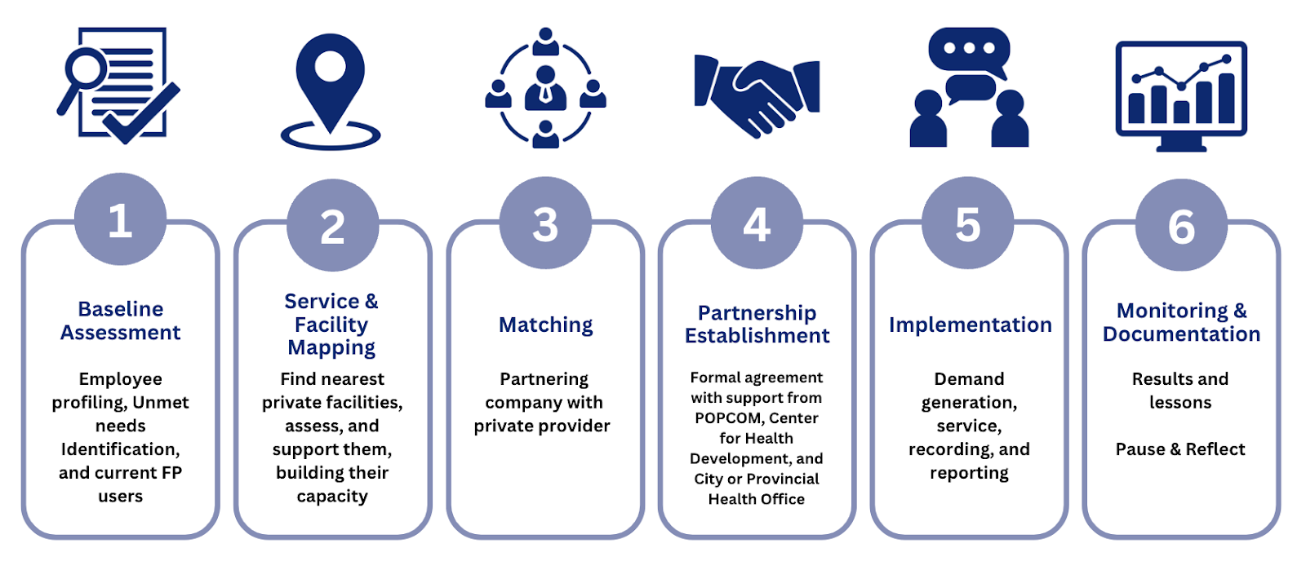
Methodology
The Matching Process
Notes:
Let me share the Matching Process that we went through. It started with 1) rapid FP profiling to identify the family planning unmet needs of the employees. The results were used for action planning. 2) Next is Service and Facility mapping to locate a facility that is strategically located near the company. Facility assessment was also conducted. In this case, Mom’s Birthing Home and Family Planning Clinic was the nearest private facility to Gaisano Capital. 3) Partnership meetings was facilitated between Mom’s BH and Gaisano Capital; our commitment was generated after the partnership meetings. 4) After our commitment was generated, we defined our respective roles and responsibilities and signed the MOU to formalize our partnership. 5) Implementation started immediately after the agreement was signed. Demand generation activities were conducted with service provision; Mentoring and coaching on FP recording & reporting was provided; 6) Monitoring was conducted USAID’s ReachHealth Project to document results and lessons learned. The journey was captured and some lessons learned were noted to enhance the process.

Slide 6
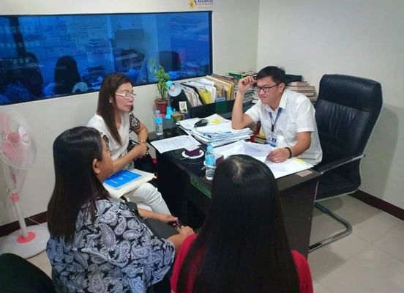
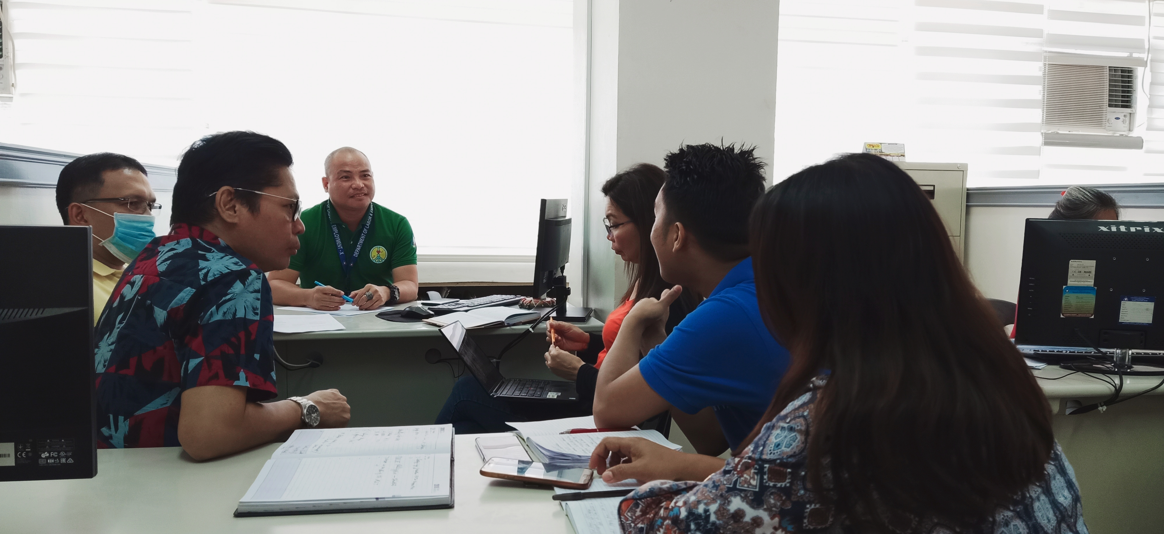
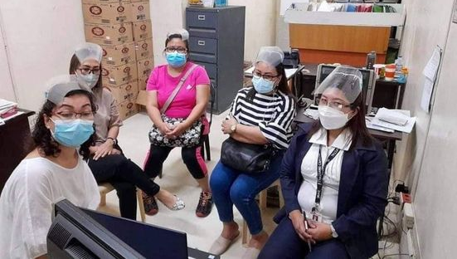
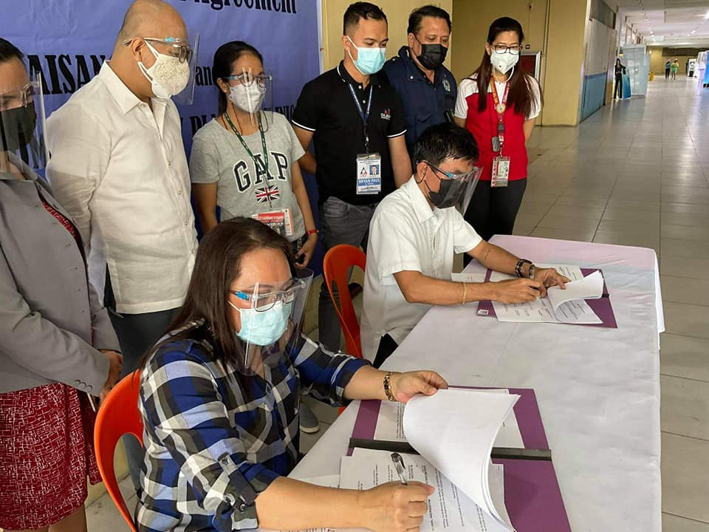
Methodology
Consultation Meetings
Partnership Meeting
Partnership Agreement
Notes:
This is to show you the process as discussed in the previous slide. Consultation meetings were conducted with the collaborating partners such as the Department of Labor and Employment, the Commission on Population and Development, the Department of Health and the local health offices. Partnership meetings between the Mom’s Birthing Home and Gaisano Capital were facilitated by ReachHealth and together with the Provincial Health Office and Provincial Population Office of Zamboanga del Sur to discuss roles and responsibilities. The memorandum of understanding was drafted after agreeing with the roles and responsibilities. Then we sealed our partnership by signing the MOU which was witnessed by DOLE, CPD, DOH, CHO-Pagadian to make family planning services available and PHO-Zamboanga del Sur. The signing of the MOU on September 30, 2021, signaled the start of the family planning service provision for the employees of Gaisano Capital.

Slide 7
Baseline Results
65% wanted to have another child in the next 4 to 6 years
56% are not using any modern FP Method
3 % are using long-acting method
High unmet need for family planning
35% or 1 out of 3 said they don’t know where to go for FP services;
Notes:
Let me show you the results of the FP profiling conducted with Gaisano Capital employees. The results showed that majority or 65% of the employees wanted to have another child in the next 4 to 6 years. But only 3% are using long-acting method while more than half or 56% are not using any modern FP method. Reasons range from myths and misconceptions to don’t know where to get family planning services. Hence, a high unmet need for Family Planning.

Slide 8
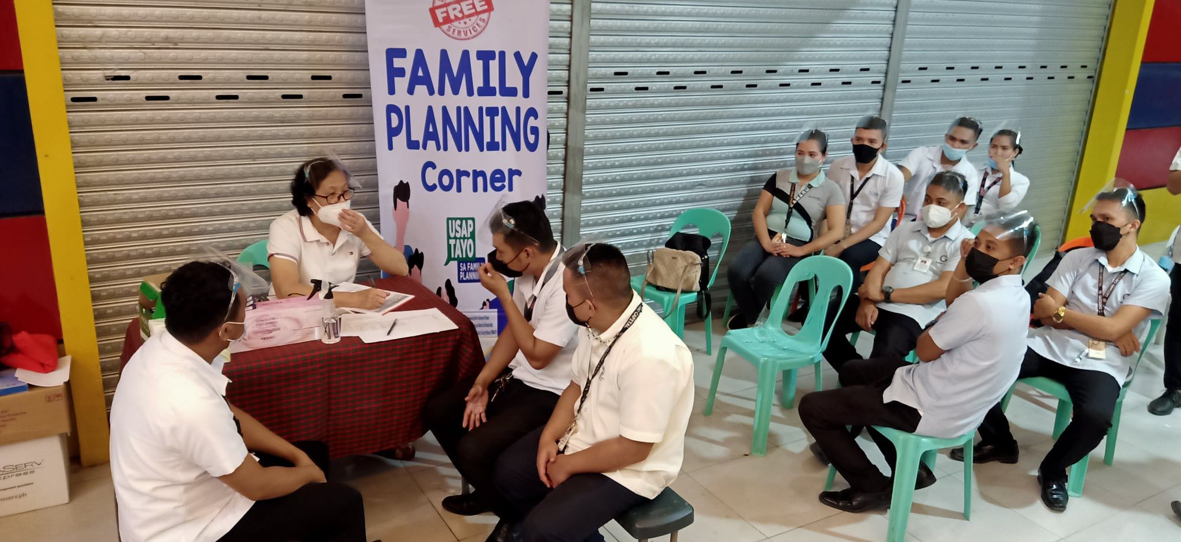
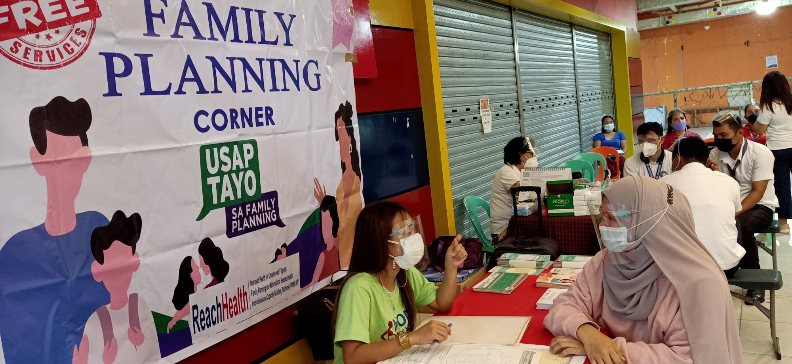
Outcome
October to December 2021)
New Acceptor -34
Current Users - 85
January to March 2024
New Acceptors - 186 or 547%
Current Users – 283 or 332%
City Health Office allocated FP supplies
Company support to the program-
- health break for the employees
Department of Labor and Employment’s adoption of the Matching Model
Companies from other regions in Mindanao are now replicating
Notes:
Given the high unmet need for family planning, the service provider, Mom’s birthing home and the Gaisano Mall Capital tapped the Provincial Health Office, Provincial Population Office and the City Health Office for demand generation activities. Enhanced Usapan sessions were conducted. Misconceptions were addressed and services were immediately provided. For the first quarter of the implementation (October to December 2021) about 34 new acceptors and 85 current users were recorded. And during first quarter of 2024 an increase of 547% or 186 total new acceptors was noted. I have also recorded a total of 283 current users or 332% increase. With the increasing demand for FP services, the City Health Office committed to allocate FP commodities and supplies for the employees. Gaisano Capital also provided support by 1) ensuring a space for the FP service provision as agreed; 2) allowing the employees to be excused from work for a maximum of 1 hour to avail of FP services. Satisfied with the results, DOLE adopted the Matching Model and started to conduct rollout activities. Replication has been started in other regions as well.

Slide 9
Challenges
Trained and accredited private family planning service providers are very few in Pagadian City, hence, difficult for other companies to look for partner service providers.
Mom’s Birthing Home is also experiencing turnover of trained staff.
Sometimes services schedule in the workplace are not followed when facility is understaffed.
Record keeping and Data Management. Gaisano Capital employees’ records are sometimes mixed with regular FP clients.
Notes:
-The challenge though in the implementation is the availability of FP trained and PhilHealth accredited private service providers. Mom’s Birthing Home cannot be in many places since we also experience staff turnover and the distance of some companies from the clinic is not feasible.
There are times when scheduled services in the workplace are not followed especially when the facility is understaffed.
One of the effects of staff turnover is poor record keeping. Service providers are focused on service provision and sometimes missed to properly record the services. And some records of Gaisano employees are mixed with regular Family Planning clients. Hence effort in recording becomes double.

Slide 10
Program Implications/Lessons Learned
It is important to have at least two to three trained staff to avoid disruption of services if one discontinues her engagement with the facility. This will also ensure continuity of recording and submission of FP accomplishments to the City Health Office.
The availability of free quality family planning services in the workplace has addressed the employees’ family planning unmet needs.
The strong collaboration and support made the implementation of the Matching Model more efficient.
Indeed, Family Planning program in the workplace is possible without setting-up a clinic or hiring trained service providers.
A follow-up study on the program’s benefits for employees and companies is recommended including further collaboration with private providers for potential partnerships with companies.

Slide 11
in partnership with
THANK YOU!
agnes7572@yahoo.com
Notes:
This initiative is made possible through USAID’s ReachHealth Project and RTI International’s strong collaboration with the Philippines’ Department of Labor and Employment, Department of Health Commission on Population, Gaisano Capital Mall of Pagadian City and Mom’s Birthing Home & Family Planning Clinic.
Thank you for this opportunity to share with you our innovative intervention in engaging the private sector for family planning in the Philippines!

