Slide 1
Family Planning Commodity Security in the Local Government Units through Maximizing the Devolution Transition Plans
Lady Jedfeliz C. Molleno, MD, MPM
Regional Manager
USAID’s ReachHealth Project

Slide 2
PRESENTATION OUTLINE
Background
The Local Government Code of 1991
Supreme Court Ruling in the Mandanas-Garcia Case for “just share” of LGUs to all national taxes
EO 138 as Measure to Mitigate Impact of the Ruling
Methodologies/Approaches
Planning process
Key Considerations
What were the Results and Key Findings
Conclusions

Slide 3
INTRODUCTION/BACKGROUND
Local Government Code of 1991 established the groundwork for the transfer of power from the national government to the hands of the LGUs.
> include health facilities, functions, and personnel
> to enhance provision of services and improve
efficiency in resource allocation
Mandanas-Garcia Ruling states that the “just share” of LGUs include ALL national taxes including custom duties and others.
Executive Order 138 provides guidance on the “Full Devolution of Certain Functions of Executive Branch to the Local Government Units”.
Devolution Transition Plans should be developed by the LGUs to provide the delivery of devolved services.
Notes:
Local Government Code of 1991 established the groundwork for the transfer of power from the national government to the hands of the LGUs.
These powers and resources include health facilities, functions, and personnel.
This is to enhance provision of services as well as improve efficiency in resource allocation.
Mandanas-Garcia Ruling states that the “just share” of LGUs include ALL national taxes including custom duties and others.
Executive Order 138 provides guidance on the “Full Devolution of Certain Functions of Executive Branch to the Local Government Units”.
Devolution Transition Plans should be developed by the LGUs to provide the delivery of devolved services.

Slide 4
METHODOLOGIES/APPROACHES
Need for evidence-based and realistic devolution transition plans to better prepare the LGUs for their important roles and responsibilities.
Supported areas:
- Zamboanga del Norte
- Zamboanga del Sur
- Agusan del Norte
- South Cotabato
- Gen. Santos City
- Davao City

Slide 5
METHODOLOGIES/APPROACHES
Set Clear Objectives and Scope
Situational Analysis: Assessing Local Needs and Current Capacities
Define Goals and Expected Outcomes
Stakeholder Engagement and Advocacy for LGU Buy-In
Evidence-Based Planning and Costing Exercises
Develop and Present the Devolution Transition Plan
Finalize the FP Budget and Secure Approval
Implement, Monitor and Ensure Long-Term Sustainability
Feedback Loop

Slide 6
METHODOLOGIES/APPROACHES
Set Clear Objectives and Scope

Slide 7
METHODOLOGIES/APPROACHES
Set Clear Objectives and Scope
Understand Current Family Planning Landscape and LGU Context
Evidence Collection
Stakeholder Mapping
Identify Gaps
Situational Analysis: Assessing Local Needs and Current Capacities

Slide 8
METHODOLOGIES/APPROACHES
Set Clear Objectives and Scope
A fully costed DTP
An approved, locally-aligned FP budget with sustainable funding models integrated into the LGU’s annual budget cycle
Improved local government engagement and advocacy support for FP
Situational Analysis: Assessing Local Needs and Current Capacities
Define Goals and Expected Outcomes

Slide 9
METHODOLOGIES/APPROACHES
Set Clear Objectives and Scope
Building Understanding and Appreciation for the DTP
Workshops and Orientations
Explain the Benefits of Devolution
Evidence and Data
Address Concern
Advocacy for an Approved FP Budget
Highlight Financial Efficiency and Long-Term Benefits
Local Advocacy Leaders
Budget Advocacy Materials
Demonstrating Alignment with Local Priorities
Situational Analysis: Assessing Local Needs and Current Capacities
Define Goals and Expected Outcomes
Stakeholder Engagement and Advocacy for LGU Buy-In

Slide 10
METHODOLOGIES/APPROACHES
Set Clear Objectives and Scope
Involve LGUs in the Planning Process
Costing Exercises
Participatory Costing
Breakdown by Locality
Total Budget Proposal
Costing Transparency
Situational Analysis: Assessing Local Needs and Current Capacities
Evidence-Based Planning and Costing Exercises
Define Goals and Expected Outcomes
Stakeholder Engagement and Advocacy for LGU Buy-In

Slide 11
KEY CONSIDERATIONS:
Income Class
Poverty Incidence
Local Capacity
Availability of Services and Commodities in the Local Market
Possible Fund Sources

Slide 12
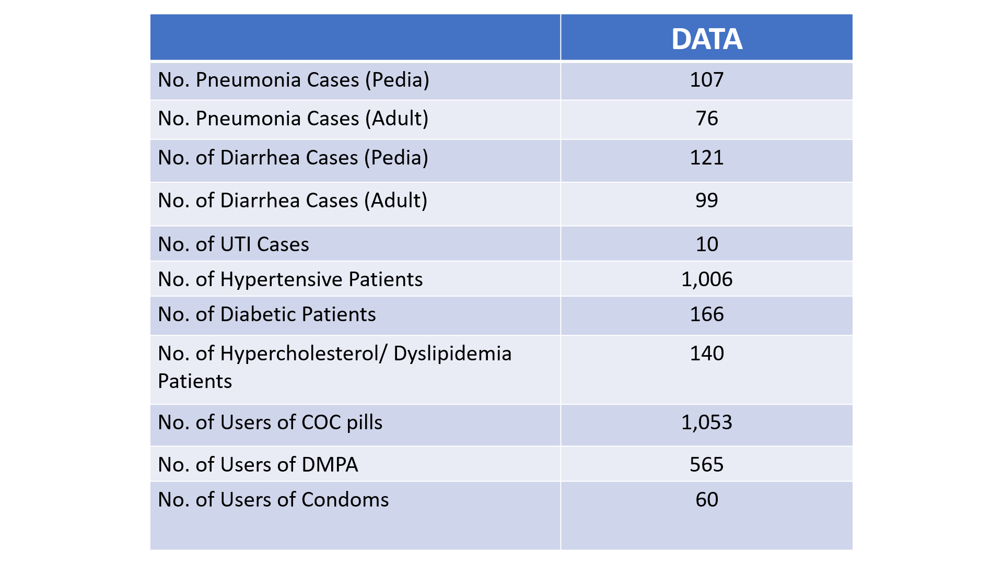
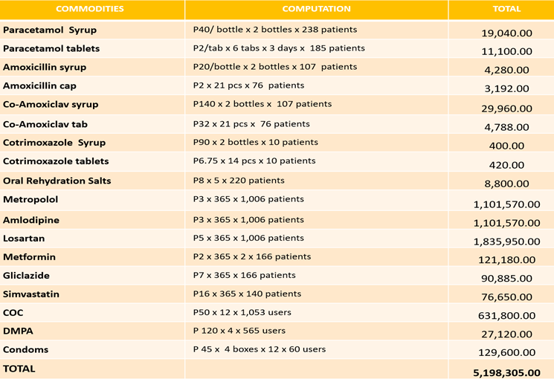
SAMPLE COMPUTATION – PUBLIC HEALTH COMMODITIES
INCOME CLASS: 4th Class Municipality POVERTY INCIDENCE: 61.91 TOTAL POPULATION: 24,616
COVERED BY PHILHEALTH KONSULTA

Slide 13
SAMPLE COMPUTATION – FP COMMODITIES
Family Planning Commodity Needs | COST
COC (Php50 x 12 x 1,053 users) | Php631,800.00
DMPA (Php120 x 4 x 565 users) | Php27,120.00
Condoms (Php45 x 4 boxes x 12 x 60 users) | Php129,600.00
Total Budget for FP Commodities | Php788,520.00

Slide 14
METHODOLOGIES/APPROACHES
Set Clear Objectives and Scope
Develop and Present the Devolution Transition Plan
Key Features of the DTP
Emphasize LGU Role and Leadership
Presentation to LGU Decision-Makers
Situational Analysis: Assessing Local Needs and Current Capacities
Evidence-Based Planning and Costing Exercises
Define Goals and Expected Outcomes
Stakeholder Engagement and Advocacy for LGU Buy-In

Slide 15
METHODOLOGIES/APPROACHES
Set Clear Objectives and Scope
Develop and Present the Devolution Transition Plan
Finalize the FP Budget and Secure Approval
Situational Analysis: Assessing Local Needs and Current Capacities
Evidence-Based Planning and Costing Exercises
Define Goals and Expected Outcomes
Stakeholder Engagement and Advocacy for LGU Buy-In

Slide 16
METHODOLOGIES/APPROACHES
Set Clear Objectives and Scope
Situational Analysis: Assessing Local Needs and Current Capacities
Define Goals and Expected Outcomes
Stakeholder Engagement and Advocacy for LGU Buy-In
Evidence-Based Planning and Costing Exercises
Develop and Present the Devolution Transition Plan
Finalize the FP Budget and Secure Approval
Implement, Monitor and Ensure Long-Term Sustainability

Slide 17
METHODOLOGIES/APPROACHES
Set Clear Objectives and Scope
Situational Analysis: Assessing Local Needs and Current Capacities
Define Goals and Expected Outcomes
Stakeholder Engagement and Advocacy for LGU Buy-In
Evidence-Based Planning and Costing Exercises
Develop and Present the Devolution Transition Plan
Finalize the FP Budget and Secure Approval
Implement, Monitor and Ensure Long-Term Sustainability
Feedback Loop

Slide 18
Key Considerations Throughout the Process
METHODOLOGIES/APPROACHES
Ownership and Capacity Building
Political Will
Local Context and Sensitivity
Collaboration and Partnerships
Sustainability of Funding

Slide 19
WHAT WERE THE RESULTS?
A Fully Costed DTP indicating FP budget generated from the portion of the National Tax Allocation
Generated, allocated and approved, locally-aligned FP budget with identified additional fund sources such as PhilHealth payments
- Zamboanga del Sur (27/27)
- Zamboanga del Norte (27/27)
- South Cotabato (2/11)
- Agusan del Norte (5/11)
- General Santos City
- Davao City
Improved local government engagement and advocacy support for FP
Allocation Policies and Integration to Local Development Plan and Budget

Slide 20
CONCLUSIONS
The successful development of the DTPs coupled with the approval of FP budget marks a significant milestone in decentralizing FP services and ensuring their sustainability at the local level.
The process has:
Engaged and empowered LGUs by equipping them with the knowledge, tools and resources to take full ownership of FP services,
Fostered collaboration between national health agencies, local officials and key stakeholders ensuring a shared vision for improving reproductive health outcomes,
Integrated evidence-based planning and thorough costing exercises to ensure that the FP budget is realistic, feasible and aligned with local needs and priorities, and,
Secured the long-term commitment of local officials, through targeted advocacy. To allocated and protect the necessary resources for FP services within the LGU’s budget

Slide 21
DISCUSSION
Questions and Comments

Slide 22
Thank you!

