Slide 1
Advancing Male Involvement:
No Scalpel Vasectomy Program of Davao City
Dr. Tomas Miguel Ababon
Officer in Charge - City Health Office
Davao City

Slide 2
Advancing Male Involvement: No Scalpel Vasectomy Program of Davao City

Slide 3
PRESENTATION OUTLINE
Introduction
Methodologies and Approaches
Ways Forward
Results
Data from NSV Program
Conclusion

Slide 4
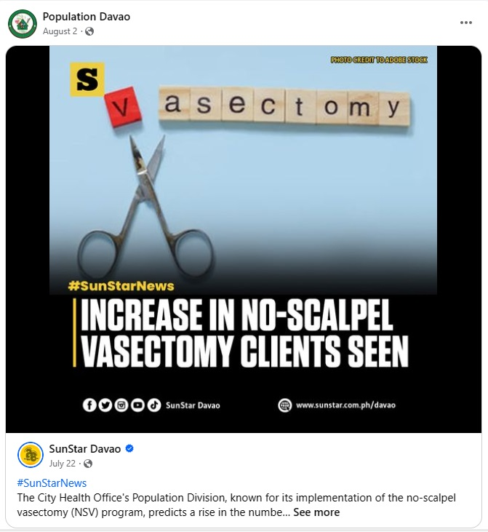
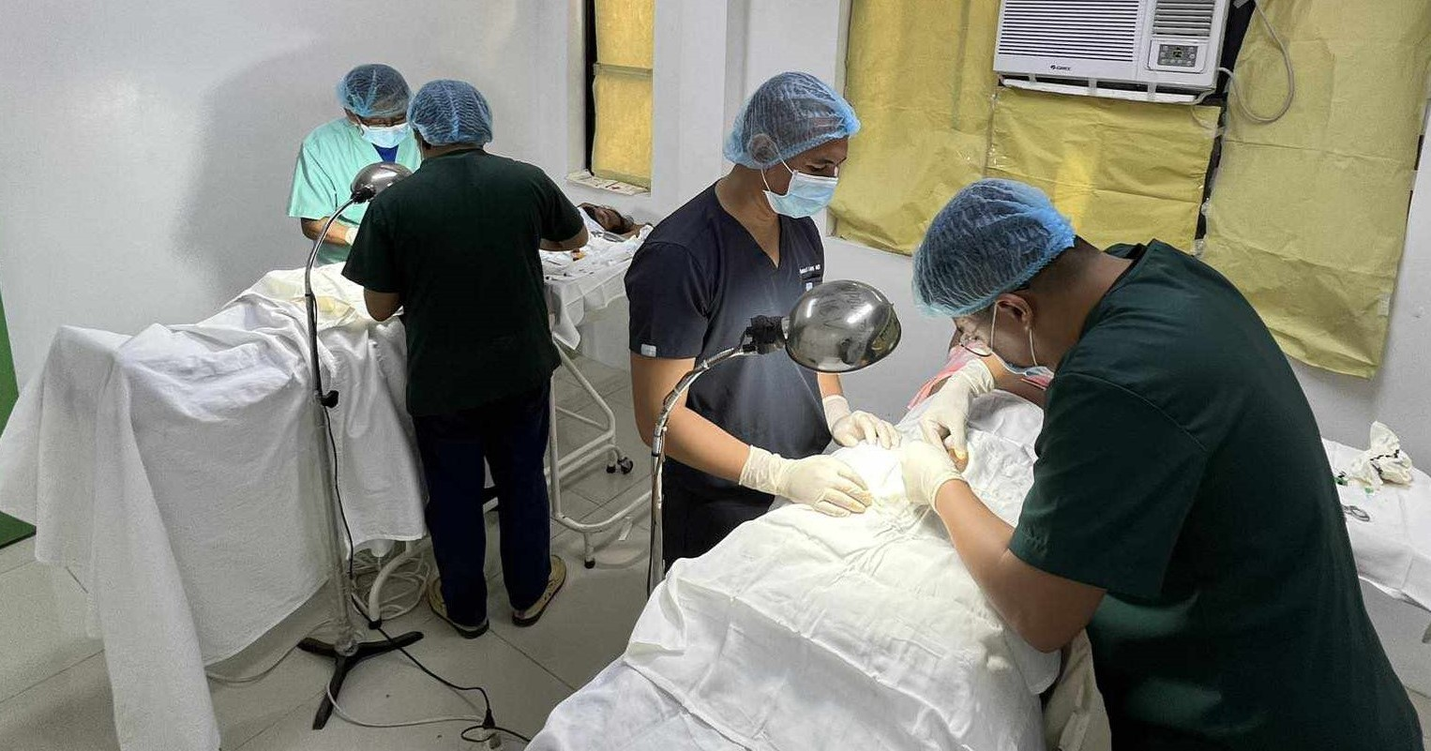
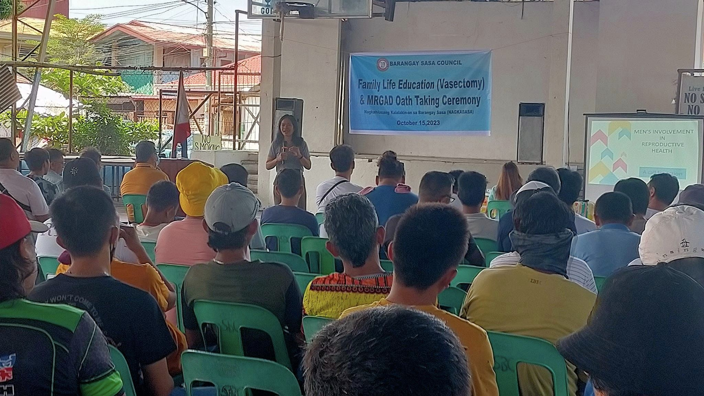
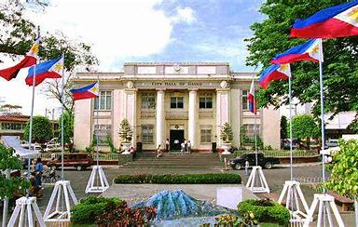
INTRODUCTION
2024
2008
Notes:
For a long time, family planning initiatives have disproportionately focused on women, particularly in the Philippines. Recognizing the need for a more balanced approach, the City Health Office (CHO) of Davao City has taken significant strides to involve men actively in family planning decisions and position them as key stakeholders in the well-being of their families.
In 2008, a group of doctors at the CHO conceived the idea of an official program where men get more actively involved in decision-making for family planning. This was through the No Scalpel Vasectomy (NSV). Initially performed as an office procedure, the NSV program has evolved and now operates independently at the Davao City Vasectomy Center through the unwavering support from the local government unit. The local leaders have actively supported and promoted the importance of family planning in the city.
The City Population Division has played a crucial role in dispelling misconceptions surrounding family planning including the NSV procedure. Regular information drives and FP in MEN campaigns and lectures at the barangay level have engaged men directly, correcting misinformation on FP and encouraging them to be active participants in prenatal and FP counseling visits with their partners. Over the years, the campaign for increased male involvement has yielded positive results. More men embraced the idea of family planning and have voluntarily opted for NSV, aligning with their desired family size.
The CHO’s commitment to this cause is further demonstrated by its strong and strategic partnerships with private organizations such as DKT, C-MEN International and USAID’s ReachHealth, providing training, logistical support, and technical guidance. Recently, USAID’s ReachHealth Project has been instrumental in donating a MadaJet Anesthesia Device Kit promoting painless NSV procedure and supporting the NSV Center’s accreditation as DOH-accredited training institution for NSV.
The success of the NSV program speaks volumes. Davao City has positioned itself as a trailblazer in increasing men’s involvement in family planning in Davao City, attracting clients not only from the city but also from other areas of Mindanao, Visayas and Luzon and even other countries. In 2023, 107 NSV clients were served in a year, a remarkable increase compared to that in 2019, which only had 26 clients. This underscores a significant growth and impact achieved by the NSV program.
Davao City’s NSV program models for fostering positive change in family planning dynamics, not just locally but on broader scale. The dedication of the CHO and its partners has not only transformed the lives of families within the city but has also set a remarkable precedent for future initiatives in the realm of reproductive health.

Slide 5
METHODOLOGIES and APPROACHES
Client Advocacy
Targeted Demand Generation
Partnership and Networking
Skills Training
LGU Support
Intensified Information Dissemination
Free Access

Slide 6
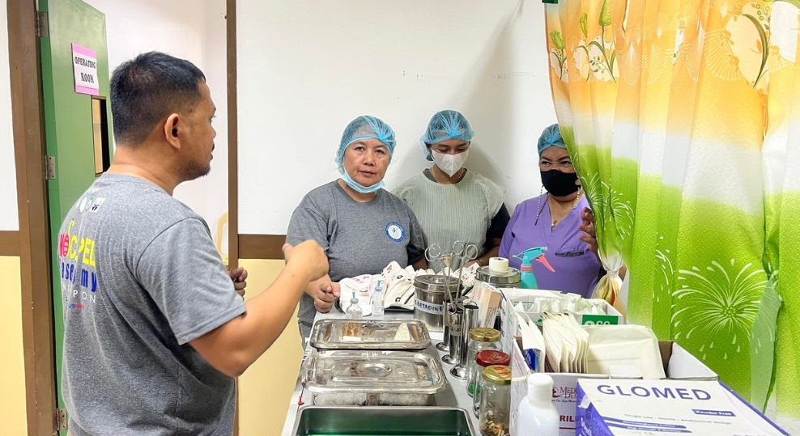
RESULTS
In the last 6 years (2018-2023), results showed a 713% rise in NSV clients highlighting the program’s effectiveness.

Slide 7
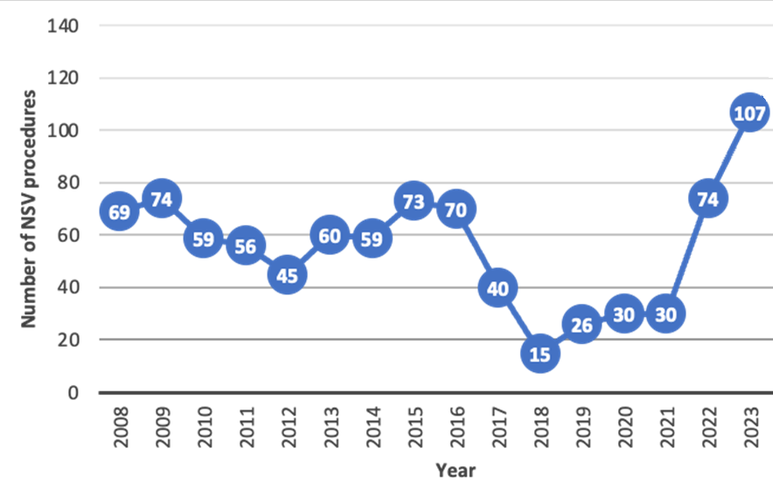
RESULTS
Data since NSV Program started

Slide 8
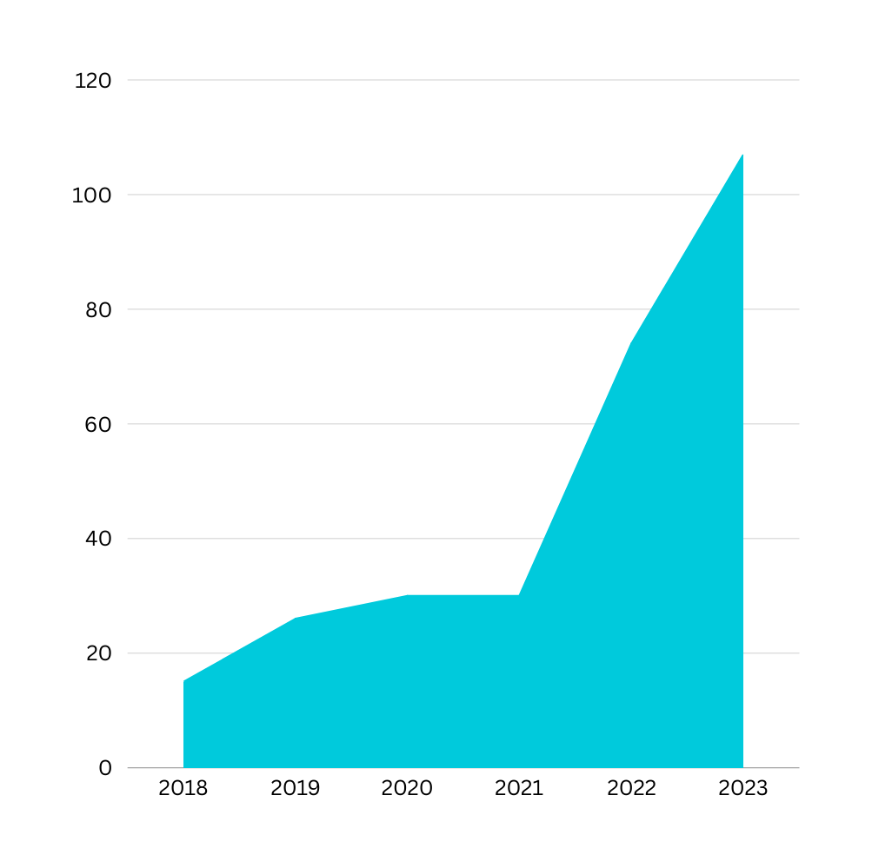
6-Year Data Analysis
2018 had the lowest acceptors for NSV. The number gained traction and increased to 107, which is a 713% increase when compared to 2023 data.

Slide 9
CONCLUSIONS/FINDINGS
Address Gender Disparity
Dispelling Cultural
Misinformation
Sustained Local Partnerships
Clients Engagement
Community Health Impact
Skills Training
DAVAO CITY NSV PROGRAM APPROACH

Slide 10
WAYS FORWARD
Utilization of PhilHealth Konsulta for NSV Program
Strengthened Partnership and LGU Support
CHO NSV Center to become a Training Institution for NSV Providers
Expansion program for Men’s Clinic

Slide 11
DISCUSSION
Questions and Comments

Slide 12
Thank you!

