Slide 1
TRANSFORMING HEALTHCARE SPACES:
Creating FUNCTIONAL
Adolescent Friendly Health Facilities
Angeli Conti-Lopez, MD, MPH, FPPS, DPSAMS
Rosario Marilyn Benabaye, MD

Slide 3
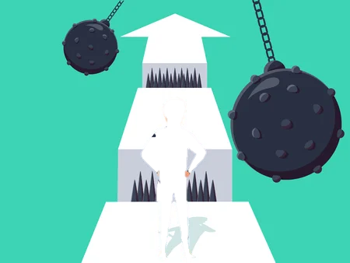
Notes:
Adolescents, despite being at the peak of their health, are underserved in healthcare. This phase of life is crucial as they develop skills, behaviors, and beliefs that shape their autonomy and decision-making, influencing their lifelong health. According to a formative research by ReachHealth Project in 2019, adolescents want to prevent pregnancy but lack direct access to reproductive health services. This emphasizes the need for an enabling environment to access essential preventive healthcare services, including sexual and reproductive health guidance during adolescence.

Slide 4
One of the key insights:
TEEN STRUGGLE IS REAL
it is a challenge to access contraceptives unless they have already been pregnant

Slide 5
Need for an enabling environment to access essential preventive healthcare services, including sexual and reproductive health guidance during adolescence

Slide 6
Adolescent-Friendly Health Facilities
Certification
Functionality

Slide 7
Adolescent-Friendly Health Facilities
Level I
Adolescent sin the catchment area are aware about the services the health facility provides and finds the facility easy to reach and obtain services from it
Certification
Level II
Services are in line with the accepted package of health services and are provided on-site or referral linkages by well-trained staff
Policies are in place: services, privacy and confidentiality
Level III
Provides health services in ways that respect the rights of the adolescents and their privacy and confidentiality
Adolescents find the surroundings and procedures appealing and acceptable

Slide 8
Adolescent-Friendly Health Facilities
Are we addressing the health needs of the adolescents?
Are we reaching more adolescents?
Are the patients satisfied with the services?
Do the patients come back?
Are health seeking behaviors improved?
Is the general well-being of the adolescents in your community improving?
Functionality

Slide 9
Ensuring Functionality
Do the adolescents know that there are services for them? (Signage)
Is there a designated space that provides privacy and confidentiality?
Do we have SBC materials for teens and the community?
Do we appropriately have trained staff?

Slide 10
Ensuring Functionality
Do we follow recommended patient-provider interaction?
(algorithm, guideline)
Do we have regular demand generation activities among adolescents or adolescent influencers?
Do we have recording and reporting tools to assess how our program is doing?
Do we have functional referral mechanism?
Are our patients following up?

Slide 11
Ensuring Functionality
Do the adolescents know that there are services for them? (Signage)
Elements of Functionality (FACILITY ENHANCEMENT)
Installation of Welcome “Adolescent-Friendly” Signage with schedule

Slide 12
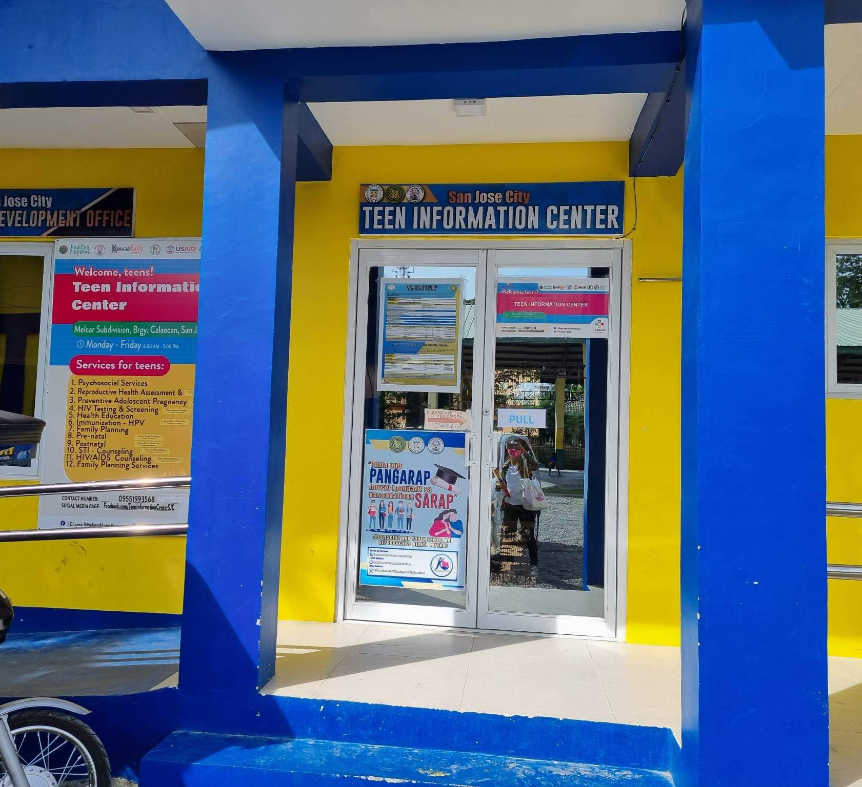

Slide 13
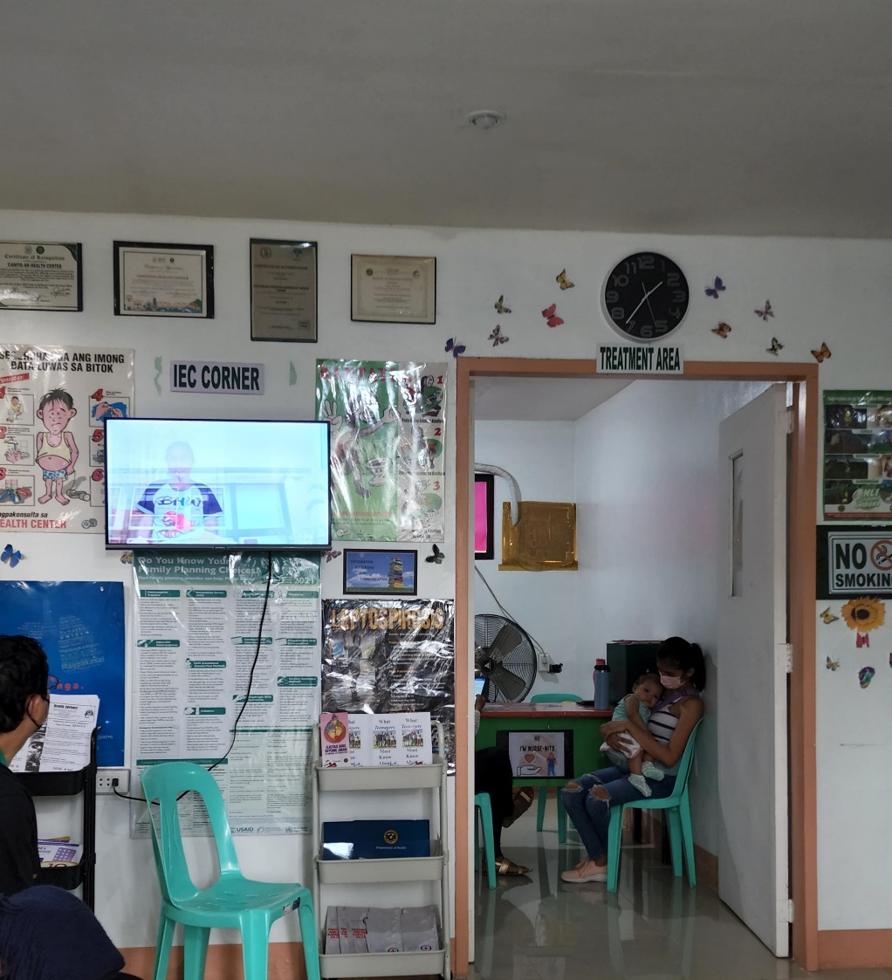
Ensuring Functionality
Is there a designated space that provides privacy and confidentiality?
Elements of Functionality (FACILITY ENHANCEMENT)
Designated room/space for adolescent clients with privacy and confidentiality

Slide 14
Ensuring Functionality
Do we have SBC materials for teens and the community?
Elements of Functionality (FACILITY ENHANCEMENT)
SBCC/ IEC materials available
POSTERS FOR TEENS

Slide 15
Ensuring Functionality
Do we have trained staff?
Elements of Functionality (SYSTEMS OF OPERATIONS ENHANCEMENT)
HSP trained and is able to refer Rapid HEEADSSS Orientation Adolescent Job Aid Training Adolescent Health Education and Practical training for Healthcare Providers (ADEPT) Foundational Course

Slide 16
Ensuring Functionality
Do we follow recommended patient-provider interaction?
(algorithm, guideline)
Elements of Functionality (SYSTEMS OF OPERATIONS ENHANCEMENT)
Policies, Protocol and guideline for Patient-Provider Interaction

Slide 17
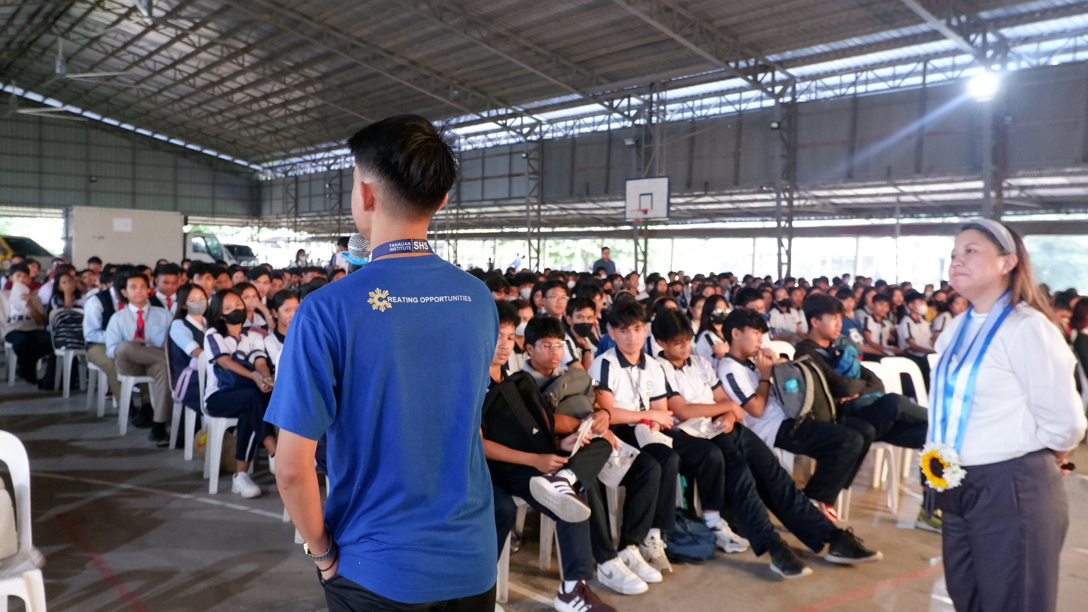
Ensuring Functionality
Do we have regular demand generation activities among adolescents or adolescent influencers?
Elements of Functionality (SYSTEMS OF OPERATIONS ENHANCEMENT)
Regular Demand Generation Activities

Slide 18
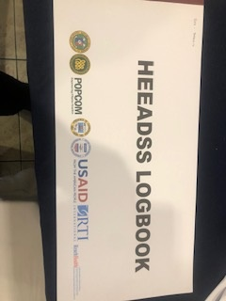
Ensuring Functionality
Do we have recording and reporting tools to assess how our program is doing?
Elements of Functionality (SYSTEMS OF OPERATIONS ENHANCEMENT)
Established information system on service utilization; registration logbook, recording reporting
Notes:
AYRH registration logbook
AYRH recording and reporting system
TCL/M1 for adolescents consistent with FHSIS with age/sex/ service disaggregation

Slide 19
Ensuring Functionality
Do we have functional referral mechanism?
Are our patients following up?
Elements of Functionality (SYSTEMS OF OPERATIONS ENHANCEMENT)
Referral System
Notes:
AYRH registration logbook
AYRH recording and reporting system
TCL/M1 for adolescents consistent with FHSIS with age/sex/ service disaggregation

Slide 20
TITLE
Transforming Healthcare Spaces:
Functional Adolescent- Friendly Health Facilities
ADD TEXT
Guide for CHDs and PHOs in supporting health facilities to be certified and functional AFHFs

Slide 22
TITLE
Transforming Healthcare Spaces:
Functional Adolescent- Friendly Health Facilities
ADD TEXT
Guide for CHDs and PHOs in supporting health facilities to be certified and functional AFHFs

Slide 23
ARH KEY PERFORMANCE INDICATORS
INDICATOR | 2021 | 2022 | 2023 | 2024
Number of functional Adolescent-Friendly Health Service Delivery Points | 64 (29) | 138 | 281 | 383
No. of adolescents availed FP-MCH-SRH services in AFHFs | 294, 667 (65,683) | 327,395 | 617,108 | 633,939

Slide 24
T
AFHF
848
Average utilization
Functional AFHF 1,313
Notes:
Based on the project’s experience, the average service utilization from 317 RHUs that are functional AFHF was 1,313, while 755 RHUs that were not functional had an average service utilization of 848.

Slide 26
MARAMING SALAMAT!

