Slide 2
QUEZON CITY HEALTH DEPARTMENT
Notes:
Introduction
Good [morning/afternoon], everyone. Today, I’ll be discussing the Family Planning Good Practices implemented by the Quezon City Health Department (QCHD). Our aim is to share our journey in improving postpartum family planning (FP) services and ensuring that all residents of Quezon City have access to effective and accessible birth spacing methods.

Slide 3
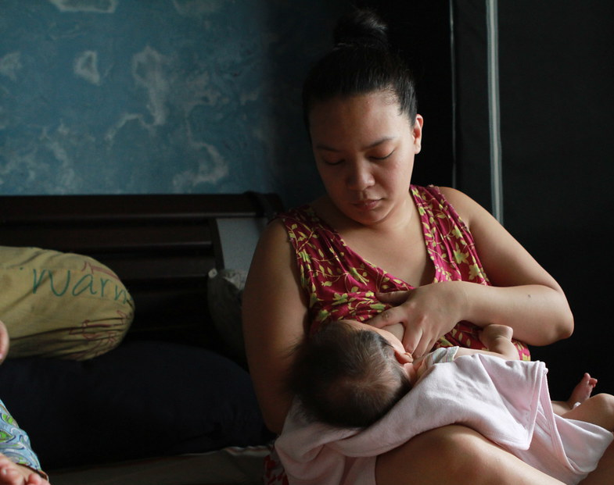
Myth:
“Breastfeeding mothers automatically use LAM.”
Notes:
Challenges identified include:
Postpartum women delaying FP consultations until menstruation resumes.
A lack of comprehensive postpartum FP counseling.
High risk of unplanned pregnancies within the first year postpartum.

Slide 4
Challenge:
Missed opportunity for FP counseling
Notes:
Challenges identified include:
Postpartum women delaying FP consultations until menstruation resumes.
A lack of comprehensive postpartum FP counseling.
High risk of unplanned pregnancies within the first year postpartum.

Slide 5
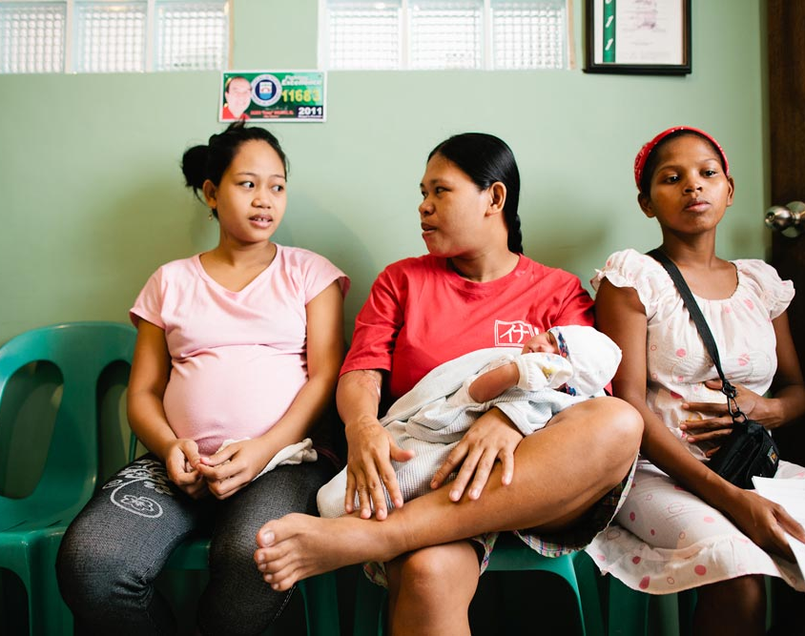
What we do…
Intensified FP counseling during pre-natal visits up to post-partum care.
Notes:
Challenges identified include:
Postpartum women delaying FP consultations until menstruation resumes.
A lack of comprehensive postpartum FP counseling.
High risk of unplanned pregnancies within the first year postpartum.

Slide 6
Women who within 6 months to a year post-partum
Waiting for menstruation to resume
Sexually active before FP advice
Notes:
Challenges identified include:
Postpartum women delaying FP consultations until menstruation resumes.
A lack of comprehensive postpartum FP counseling.
High risk of unplanned pregnancies within the first year postpartum.

Slide 7
Project Objectives
Ensuring that post partum women have a modern FP method other than LAM
Increase the uptake of effective family planning methods among postpartum women.
Ensure mothers are well-informed about the limitations of LAM and are offered alternative family planning methods at one and a half months postpartum.

Slide 8
Project Objectives
Ensuring that post partum women have a modern FP method other than LAM
Increase the uptake of effective family planning methods among postpartum women.
Ensure mothers are well-informed about the limitations of LAM and are offered alternative family planning methods at one and a half months postpartum.

Slide 9
Project Objectives
Ensuring that post partum women have a modern FP method other than LAM
Increase the uptake of effective family planning methods among postpartum women.
Ensure mothers are well-informed about the limitations of LAM and are offered alternative family planning methods at one and a half months postpartum.

Slide 10
Step 3
Determine report receiver
Health center to District
District to City
Step 4
Implementation of tool
Staff orientation
Step 2
Design tracking tool
Implement
Revise tool as needed
Step 5
Evaluate efficiency
Provide recommendation
Step 1
Data Analysis
Determine the problem
Identify gaps and issues
Key Implementation Steps

Slide 11
Step 4
Implementation of tool
Staff orientation
Step 5
Evaluate efficiency
Provide recommendation
Step 3
Determine report receiver
Health center to District
District to City
Step 1
Data Analysis
Determine the problem
Identify gaps and issues
Step 2
Design tracking tool
Implement
Revise tool as needed
Key Implementation Steps

Slide 12
Step 5
Evaluate efficiency
Provide recommendation
Step 1
Data Analysis
Determine the problem
Identify gaps and issues
Step 4
Implementation of tool
Staff orientation
Step 2
Design tracking tool
Implement
Revise tool as needed
Step 3
Determine report receiver
Health center to District
District to City
Key Implementation Steps

Slide 13
Step 1
Data Analysis
Determine the problem
Identify gaps and issues
Step 2
Design tracking tool
Implement
Revise tool as needed
Step 5
Evaluate efficiency
Provide recommendation
Step 3
Determine report receiver
Health center to District
District to City
Step 4
Implementation of tool
Staff orientation
Key Implementation Steps

Slide 14
Step 2
Design tracking tool
Implement
Revise tool as needed
Step 3
Determine report receiver
Health center to District
District to City
Step 1
Data Analysis
Determine the problem
Identify gaps and issues
Step 4
Implementation of tool
Staff orientation
Step 5
Evaluate efficiency
Provide recommendation
Key Implementation Steps

Slide 15
Tracking Form for Post Partum Women
DISTRICT / CITY
HEALTH CENTER | PP SEEN |  |  |  |  |  |  |  |  | FP SEEN
 | DMPA | PILLS | IUD/ PP IUD | CON | PSI | SDM | BTL | LAM | OTHERS | DMPA | PILLS | IUD/ PP IUD | CON | PSI | SDM | BTL | LAM | OTHERS
HC 1
HC 2
HC 3
HC 4
HC 5
HC 6
DISTRICT

Slide 16
Results of the Tracking Tool
Among the post partum women seen, the data below will show the number of those been shifted to other modern family planning method.
YEAR | PP SEEN |  |  |  |  |  |  |  |  | FP SEEN
 |  | DMPA | PILLS | IUD | CONDOM | IMPLANT | BTL | LAM | OTHERS | DMPA | PILLS | IUD | CONDOM | IMPLANT | BTL | LAM | OTHERS
2022 | 40,179 | 1,454 | 2,058 | 895 | 455 | 975 | 638 | 33,361 | 343 | 5,063 | 8,168 | 1,210 | 3,646 | 2,083 | 840 | 9,956 | 9,213
2023 | 59227 | 3141 | 4518 | 2300 | 1378 | 2573 | 1385 | 43448 | 484 | 6288 | 10562 | 2817 | 4733 | 3718 | 1655 | 12952 | 16502
2024 | 21,258 | 1,243 | 1,674 | 970 | 574 | 1,141 | 569 | 14,784 | 303 | 1,709 | 2,470 | 1,051 | 1,116 | 1,412 | 609 | 9,845 | 3,046
2023
PP SEEN: FP other than LAM 15,295 (26 % ) vs. LAM 43448 ( 73 % )
2023
FP SEEN: other than LAM 29773 (50 % ) vs. LAM 12952 (22% )
2024
PP SEEN: FP other than LAM 6171(29 % ) vs. LAM 14,784 ( 70% )
2024
FP SEEN: other than LAM 8367 (39 % ) vs. LAM 9845 ( 46% )
2022
PP SEEN: FP other than LAM 6,475 (16 % ) vs. LAM 33, 361 ( 83% )
2022
FP SEEN: other than LAM 21,010 (52 % ) vs. LAM 9956 ( 25% )
Notes:
Results and Impact
Our tracking and intervention efforts have yielded significant improvements:
In 2022, only 13.68% of postpartum women adopted FP methods other than LAM.
By the end of 2023, this increased to 43.98%.
Data for 2024 shows continued improvement, reaching 31.79% in the early months.
These results demonstrate a substantial shift towards more effective FP options, contributing to healthier families.

Slide 17
16%
Data show that in 2022, the total number of acceptors other than LAM in the PP seen report was 5,500, which is equivalent to 16% of the total postpartum cases reported.
52%
39%
Notes:
Challenges identified include:
Postpartum women delaying FP consultations until menstruation resumes.
A lack of comprehensive postpartum FP counseling.
High risk of unplanned pregnancies within the first year postpartum.

Slide 18
52%
On the other hand, there was a significant increase in acceptors other than LAM by 52% (21,010) in the FP seen report by the end of the year.
16%
39%
Notes:
Challenges identified include:
Postpartum women delaying FP consultations until menstruation resumes.
A lack of comprehensive postpartum FP counseling.
High risk of unplanned pregnancies within the first year postpartum.

Slide 19
Impact to mCPR
The table below shows the gradual percentage increase in the prevalence:
YEAR | TARGET | ACC | CPR
2022 | 884,626 | 277803 | 31.40
2023 | 883,752 | 300907 | 34.05
2024 | 894,216 | 321346 | 38.39
39%
In 2023, the increase was from 26% in the PP seen report to 50% in the FP seen report, and in 2024, from 29% to 39%.
16%
52%
Notes:
Challenges identified include:
Postpartum women delaying FP consultations until menstruation resumes.
A lack of comprehensive postpartum FP counseling.
High risk of unplanned pregnancies within the first year postpartum.

Slide 20
Impact to mCPR
The table below shows the gradual percentage increase in the prevalence:
YEAR | TARGET | ACC | CPR
2022 | 884,626 | 277803 | 31.40
2023 | 883,752 | 300907 | 34.05
2024 | 894,216 | 321346 | 38.39

Slide 21
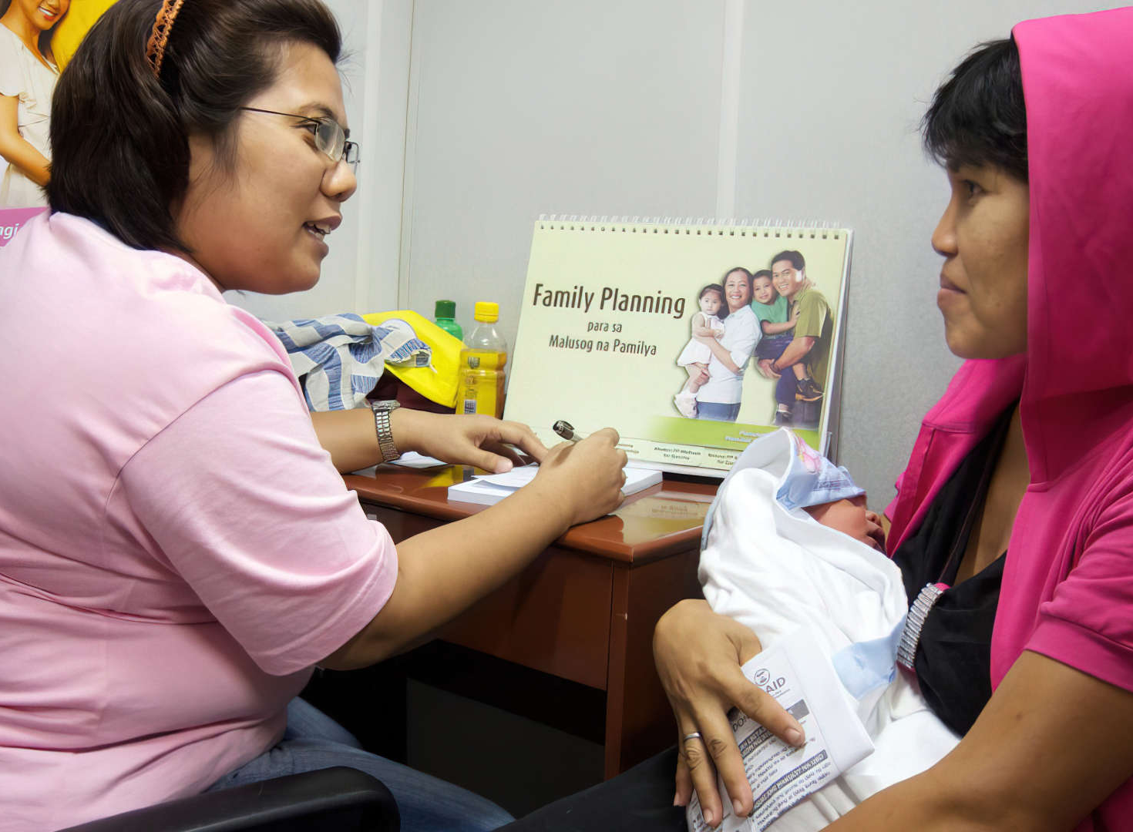
Lessons Learned
Training Health Worker
Continuous Follow-Up
Community Involvement
Early Counseling is Crucial
Ongoing training and support for health workers are vital to address the evolving needs of postpartum women effectively.
Regular follow-up is necessary to ensure postpartum women continue to use family planning methods and do not drop out of the program.
Engaging the community can significantly enhance the reach and effectiveness of family planning initiatives.
Providing counseling at one and a half months postpartum is essential for transitioning women from LAM to other family planning methods.
Notes:
Challenges identified include:
Postpartum women delaying FP consultations until menstruation resumes.
A lack of comprehensive postpartum FP counseling.
High risk of unplanned pregnancies within the first year postpartum.

Slide 22
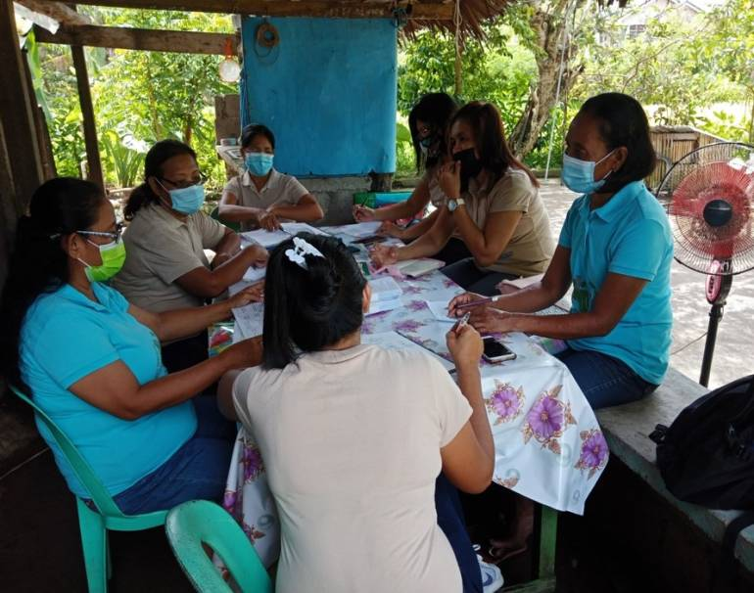
Lessons Learned
Training Health Worker
Continuous Follow-Up
Community Involvement
Early Counseling is Crucial
Ongoing training and support for health workers are vital to address the evolving needs of postpartum women effectively.
Regular follow-up is necessary to ensure postpartum women continue to use family planning methods and do not drop out of the program.
Engaging the community can significantly enhance the reach and effectiveness of family planning initiatives.
Providing counseling at one and a half months postpartum is essential for transitioning women from LAM to other family planning methods.
Notes:
Challenges identified include:
Postpartum women delaying FP consultations until menstruation resumes.
A lack of comprehensive postpartum FP counseling.
High risk of unplanned pregnancies within the first year postpartum.

Slide 23
Lessons Learned
Community Involvement
Early Counseling is Crucial
Training Health Worker
Continuous Follow-Up
Engaging the community can significantly enhance the reach and effectiveness of family planning initiatives.
Providing counseling at one and a half months postpartum is essential for transitioning women from LAM to other family planning methods.
Ongoing training and support for health workers are vital to address the evolving needs of postpartum women effectively.
Regular follow-up is necessary to ensure postpartum women continue to use family planning methods and do not drop out of the program.
Notes:
Challenges identified include:
Postpartum women delaying FP consultations until menstruation resumes.
A lack of comprehensive postpartum FP counseling.
High risk of unplanned pregnancies within the first year postpartum.

Slide 24
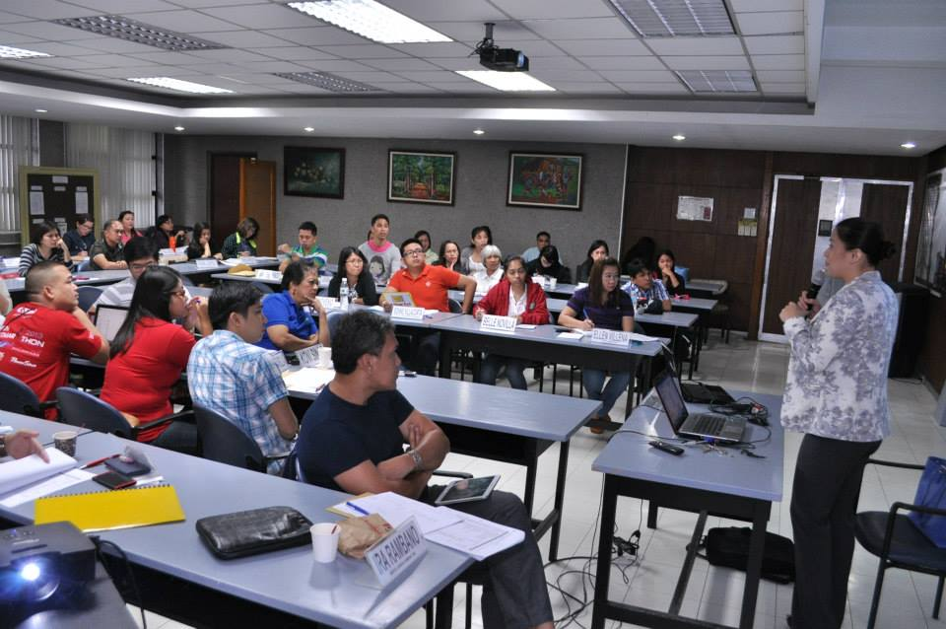
Lessons Learned
Training Health Worker
Community Involvement
Early Counseling is Crucial
Ongoing training and support for health workers are vital to address the evolving needs of postpartum women effectively.
Engaging the community can significantly enhance the reach and effectiveness of family planning initiatives.
Providing counseling at one and a half months postpartum is essential for transitioning women from LAM to other family planning methods.
Notes:
Challenges identified include:
Postpartum women delaying FP consultations until menstruation resumes.
A lack of comprehensive postpartum FP counseling.
High risk of unplanned pregnancies within the first year postpartum.

Slide 25
THANK YOU
Notes:
Conclusion
The QCHD is committed to empowering women through informed FP choices. With continuous efforts and community partnerships, we envision a Quezon City where responsible parenthood thrives, enhancing the quality of life for all residents.
Thank you.

