Slide 1
Contraception for the Patient with Congenital Heart Disease
Patricia Ann A. Factor, MD
Institute of Reproductive Health – National Institutes of Health
University of the Philippines - Manila
Notes:
Good afternoon, thank you for having the IRH participate in this conference. I am Patty and today I will discuss about contraception for the patient with congenital heart disease. This is supposed to focus on those MEC 4 for CHC, but it’s important to discuss also Cardiac Disease in Pregnancy and what options are best for them.

Slide 2
FAMILY PLANNING
Family planning (FP) is essential in educating and encouraging contraceptive use among women and couples
FP involves an individual or a couple making decisions on whether to have children, when to have children, how many children they want to have, and how they are spaced
World Health Organization. Family Planning: A Global Handbook for Providers. 2018.
Notes:
Family planning (FP) is essential in educating and encouraging contraceptive use among women and couples
FP involves an individual or a couple making decisions on whether to have children, when to have children, how many children they want to have, and how they are spaced.
All women of reproductive age should have access to sexual and reproductive healthcare services

Slide 3
Reproduced/translated from Family Planning: A Global Handbook for Providers. Geneva. WHO; 2018.
Notes:
This is a WHO infographic on the effectivity of different family planning methods. Of note, the LARC and surgical sterilization are the most effective methods, while fertility based methods and barrier methods are significantly less effective.

Slide 4
Family Planning Counselling and Client Assessment
A process by which a health provider learns about
the health status
family planning needs of the client
Determines the client’s eligibility for using a contraceptive option
Notes:
The client assessment is a process by which a health provider learns about the health status and the family planning needs of the client.
It determines the client’s eligibility for using a contraceptive option and determines whether a client needs further examinations or referrals.
thorough history taking and careful physical examination are important aspects of client assessment.
It is important that the health provider has the necessary knowledge and skills to be able to adequately assess the health needs and health status of clients seeking to start family planning methods².

Slide 5
Medical Eligibility Criteria
Category | Description | With clinical judgment
1 | No restriction for use | Use the method under any circumstances
2 | Benefits generally outweigh risks | Generally use the method
3 | Risks usually outweigh benefits | Use of method not usually recommended, unless other methods are not available/acceptable
4 | Unacceptable health risk | Method not to be used
Notes:
The WHO MEC serves as a tool that's accessible for evaluating clients to determine their suitability for using a particular contraceptive method. This evaluation relies on criteria derived from evidence-based information
Essentially, it helps family planning service providers ascertain whether a client with a pre-existing medical condition can utilize contraceptive methods without compromising safety or effectiveness.

Slide 6
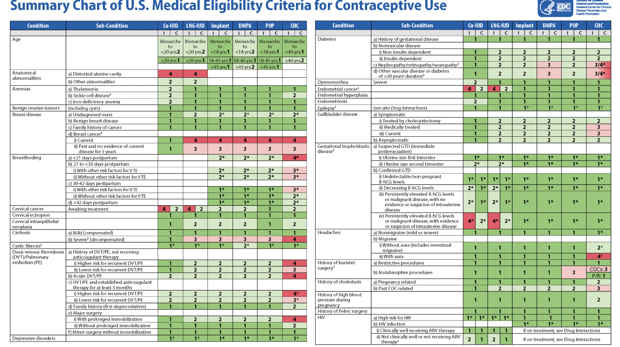
Notes:
This is a summary of the MEC, so they included several medical conditions and in the table we can find the classification of different contraceptive methods.

Slide 7
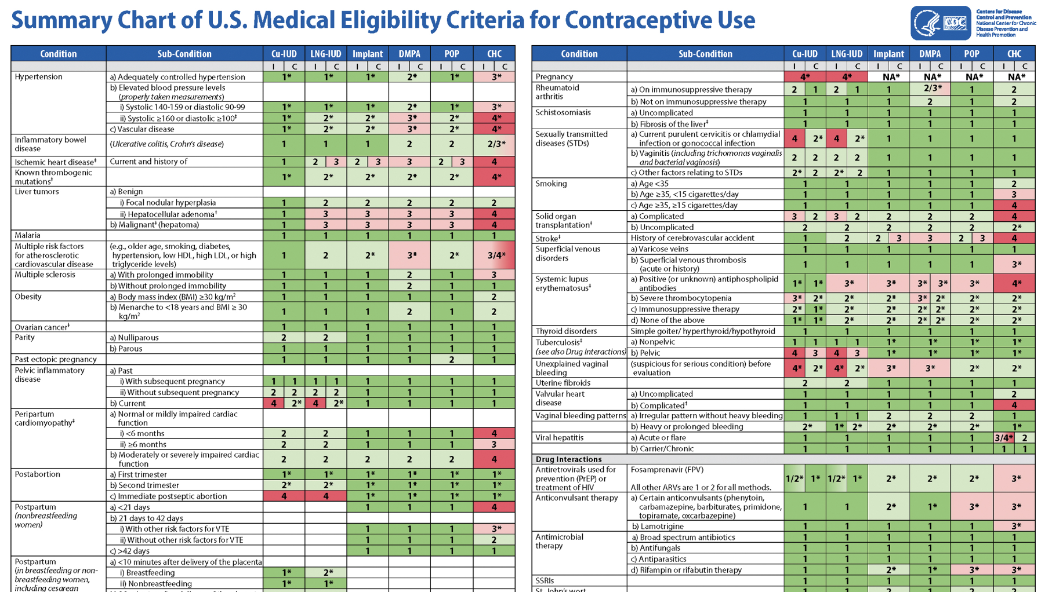

Slide 8
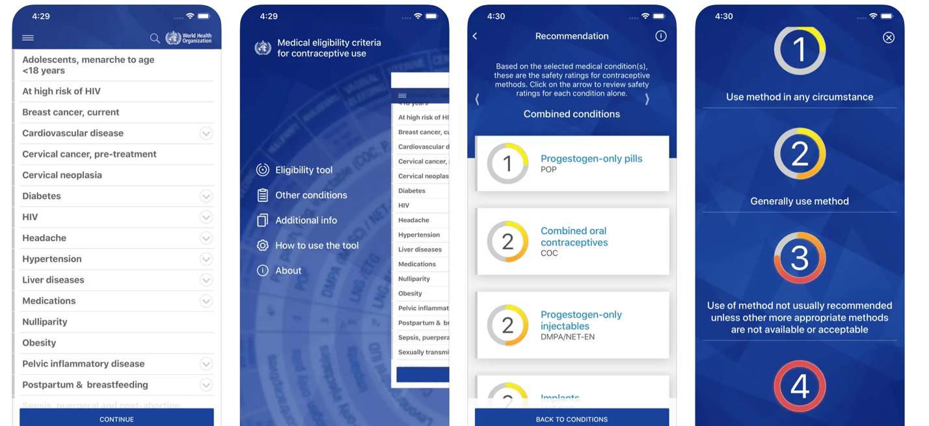
Notes:
There is also an available app available for both IOS and android that allows us to access the MEC by simply inputing patient characteristics and even including client preferences.

Slide 9
Contraceptive use among women with chronic medical conditions
Women with chronic medical conditions are at higher risk of adverse pregnancy outcomes, which may be minimized through optimal preconception care and appropriate contraceptive use.
In Malaysia, about two-third of women with chronic medical conditions who needed contraceptive did not use them despite the higher risk of pregnancy related complications.
Manaf, R. A., Ismail, I. Z., & Latiff, L. A. (2012). Contraceptive use among women with chronic medical conditions and factors associated with its non-use in Malaysia. Global journal of health science, 4(5), 91–99. https://doi.org/10.5539/gjhs.v4n5p91
Notes:
Women with chronic medical conditions are at higher risk of adverse pregnancy outcomes, which may be minimized through optimal preconception care and appropriate contraceptive use.
Family planning takes into account achieving good disease control prior to pregnancy, and using the most effective method of contraception particularly for those with severe disease-related damage, high levels of disease activity, or use of teratogenic medications. We also provide patients with guidance regarding effective and safe methods for the given clinical situation, while taking into account their specific values and preferences. Any risk associated with a contraceptive method must be weighed against the risk of unintended pregnancy for that particular patient.
In Malaysia, about two-third of women with chronic medical conditions who needed contraceptive did not use them despite the higher risk of pregnancy related complications. 2 cited reasons: they were not advised or even if they were advised, they did not feel that using contraceptives would be safe.
I tried to look for a study in the Philippines, but I was not able to see one. Maybe our residents here would like to conduct a study on this?

Slide 10
Contraceptive use among women with chronic medical conditions
Women with medical conditions are highly influenced by a complex family planning specialist with their contraceptive options; and when receiving such counseling, will often choose highly effective methods.
Health care providers vary widely in their knowledge, perceived competence, and comfort in providing contraceptive counseling.
Mody, S. K., Cansino, C., Rible, R., Farala, J. P., Steinauer, J., Harken, T., & University of California Family Planning Collaborative (2020). Contraceptive use among women with medical conditions: Factors that influence method choice. Seminars in perinatology, 44(5), 151310. https://doi.org/10.1016/j.semperi.2020.151310
Akers, A. Y., Gold, M. A., Borrero, S., Santucci, A., & Schwarz, E. B. (2010). Providers' perspectives on challenges to contraceptive counseling in primary care settings. Journal of women's health (2002), 19(6), 1163–1170. https://doi.org/10.1089/jwh.2009.1735
Notes:
Women with medical conditions are highly influenced by a complex family planning specialist in regard to their contraceptive options and when receiving such counseling, will often choose highly effective methods.
Health care providers vary widely in their knowledge, perceived competence, and comfort in providing contraceptive counseling.

Slide 11
WOMEN WITH CONGENITAL HEART DISEASE

Slide 12
Cardiac physiology in pregnancy
Two major hemodynamic changes: fall in systemic vascular resistance and increase in cardiac output
In patients whose cardiac output is limited by myocardial dysfunction or valvular lesions (eg, mitral stenosis), volume overload is poorly tolerated and may result in heart failure.
Cardiac output increases progressively from the first stage of labor, sometimes reaching an additional 50 percent by the late second stage.
Women with preexisting heart disease are at increased risk for thromboembolism during pregnancy.
Notes:
Progress in medical and surgical treatment has resulted in larger number of women with congenital heart disease surviving to child-bearing years and proceeding with pregnancy

Slide 13
Modified WHO Classification of Maternal Cardiovascular Risk
 | mWHO I | mWHO II | mWHO II-III | mWHO-III | mWHO IV
Diagnosis | Mild PS Small PDA Small VSD | ASD Repaired TOF Arrythmias | BAV Ao < 45mm | Cyanotic coronary heart disease Mechanical valve | Severe PV LVEF <30%
Risk | Not increased | Small | Intermediate | Significant | Extremely high
Maternal CV event rate | 2.5 to 5% | 5 to 10% | 10 to 19% | 20 to 27% | 40 to 100%
Regitz-Zagrosek V, Roos-Hesselink JW, Bauersachs J, et al. 2018 ESC Guidelines for the management of cardiovascular diseases during pregnancy. Eur Heart J. 2018;39(34):3165-3241. doi:10.1093/eurheartj/ehy340
Notes:
The predictive risk model for cardiovascular risk is best exemplified by the modified WHO Classification of Maternal Cardiovascular Risk.
Women diagnosed with heart disease should receive comprehensive information regarding contraception and the potential risks associated with pregnancy²⁷. In general, the contraceptive methods accessible to women without heart disease are also suitable for those with the condition³.

Slide 14
Case: CD
25 y/o nulligravid; married
Known case of Tetralogy of Fallot, unrepaired
Currently still securing funds for repair
Consults with husband for contraception
Unsure if they want kids, especially given her condition; but do not want permanent methods for now

Slide 15
Recommendations for the Use of Combined Hormonal Contraceptives in Women with Cardiac Disease
WHO MEC 1 | WHO MEC 2 | WHO MEC 3 | WHO MEC 4
Always usable | Broadly usable | Caution in Use | DO NOT USE
MVP with trivial MR Bicuspid aortic valve with normal function Mild PS Repaired coarctation with no hypertension or aneurysm Simple congenital lesions successfully repaired in childhood and with no sequelae (ASD, VSD, PDA, or total anomalous pulmonary venous drainage) | Most arrhythmias other than atrial fibrillation or flutter Uncomplicated mild native mitral and aortic valve disease Tissue prosthetic valve lacking any of the features in MEC 3 and MEC 4 columns Surgically corrected CHD lacking any of the features noted in MEC 3 and MEC 4 columns Small left-to-right shunts not reversible with physiological maneuvers (ie small VSD, small PDA) Past cardiomyopathy, fully recovered, including peripartum cardiomyopathy Uncomplicated Marfan syndrome | Atrial fibrillation or flutter on warfarin Bileaflet mechanical valves in the mitral or aortic position taking warfarin Atrial septal defect with left-to-right shunt that may reverse with physiological stress Repaired coarctation with aneurysm and/or hypertension Marfan syndrome with aortic dilation unoperated Previous thromboembolism | Atrial fibrillation or flutter, if not anticoagulated Bjork-Shiley or Starr-Edwards valves even when taking warfarin Dilated left atrium >4 cm Fontan heart even taking warfarin Cyanotic heart disease even taking warfarin Pulmonary arteriovenous malformation Past thromboembolic event (venous or arterial) not taking warfarin Prior LV dysfunction due to any cause (eg dilated cardiomyopathy), LVEF <30% Coronary artery disease Coronary arteritis
Sable C, Foster E, Uzark K, Bjorsen K, Canobbio M, Connolly H. Best Practices in Managing Transition to Adulthood for Adolescents with Congenital Heart Disease: The Transition Process and Medical and Psychosocial Issues. Circulation. 123(13):1454–85.
Notes:
Can she use the CHC?
The AHA released the Best Practices in Managing Transition to Adulthood for Adolescents with Congenital Heart Disease: The Transition Process and Medical and Psychosocial Issues

Slide 16
Recommendations for the Use of Combined Hormonal Contraceptives in Women with Cardiac Disease
WHO MEC 4
DO NOT USE
Atrial fibrillation or flutter, if not anticoagulated Bjork-Shiley or Starr-Edwards valves even when taking warfarin Dilated left atrium >4 cm Fontan heart even taking warfarin Cyanotic heart disease even taking warfarin Pulmonary arteriovenous malformation Past thromboembolic event (venous or arterial) not taking warfarin Prior LV dysfunction due to any cause (eg dilated cardiomyopathy), LVEF <30% Coronary artery disease Coronary arteritis
Sable C, Foster E, Uzark K, Bjorsen K, Canobbio M, Connolly H. Best Practices in Managing Transition to Adulthood for Adolescents with Congenital Heart Disease: The Transition Process and Medical and Psychosocial Issues. Circulation. 123(13):1454–85.
Notes:
Can she use the CHC?
The AHA released the Best Practices in Managing Transition to Adulthood for Adolescents with Congenital Heart Disease: The Transition Process and Medical and Psychosocial Issues

Slide 17
Recommendations for the Use of Combined Hormonal Contraceptives in Women with Cardiac Disease
WHO MEC 3
Caution in Use
Atrial fibrillation or flutter on warfarin Bileaflet mechanical valves in the mitral or aortic position taking warfarin Atrial septal defect with left-to-right shunt that may reverse with physiological stress Repaired coarctation with aneurysm and/or hypertension Marfan syndrome with aortic dilation unoperated Previous thromboembolism
Sable C, Foster E, Uzark K, Bjorsen K, Canobbio M, Connolly H. Best Practices in Managing Transition to Adulthood for Adolescents with Congenital Heart Disease: The Transition Process and Medical and Psychosocial Issues. Circulation. 123(13):1454–85.
Notes:
Can she use the CHC?
The AHA released the Best Practices in Managing Transition to Adulthood for Adolescents with Congenital Heart Disease: The Transition Process and Medical and Psychosocial Issues

Slide 18
Recommendations for the Use of Combined Hormonal Contraceptives in Women with Cardiac Disease
WHO MEC 1 | WHO MEC 2
Always usable | Broadly usable
MVP with trivial MR Bicuspid aortic valve with normal function Mild PS Repaired coarctation with no hypertension or aneurysm Simple congenital lesions successfully repaired in childhood and with no sequelae (ASD, VSD, PDA, or total anomalous pulmonary venous drainage) | Most arrhythmias other than atrial fibrillation or flutter Uncomplicated mild native mitral and aortic valve disease Tissue prosthetic valve lacking any of the features in MEC 3 and MEC 4 columns Surgically corrected CHD lacking any of the features noted in MEC 3 and MEC 4 columns Small left-to-right shunts not reversible with physiological maneuvers (ie small VSD, small PDA) Past cardiomyopathy, fully recovered, including peripartum cardiomyopathy Uncomplicated Marfan syndrome
Sable C, Foster E, Uzark K, Bjorsen K, Canobbio M, Connolly H. Best Practices in Managing Transition to Adulthood for Adolescents with Congenital Heart Disease: The Transition Process and Medical and Psychosocial Issues. Circulation. 123(13):1454–85.
Notes:
Can she use the CHC?
The AHA released the Best Practices in Managing Transition to Adulthood for Adolescents with Congenital Heart Disease: The Transition Process and Medical and Psychosocial Issues

Slide 19
Factors to consider for contraceptives:
Preference between a reversible contraceptive method or sterilization,
The effectiveness of different methods,
Patient-specific factors influencing adherence, and
Medical considerations impacting the risk-benefit balance of various methods

Slide 20
Reproduced/translated from Family Planning: A Global Handbook for Providers. Geneva. WHO; 2018.
Notes:
This is a WHO infographic on the effectivity of different family planning methods. Of note, the LARC and surgical sterilization are the most effective methods, while fertility based methods and barrier methods are significantly less effective.

Slide 21
Contraception for women with cyanotic congenital heart disease and pulmonary vascular disease (and other mWHO III & IV) or those MEC 4 for CHC
Offer long-term and permanent options
Male vasectomy
LARC (IUD and Progestin Implant) & female sterilization
the risks of abdominal surgery, general anesthesia, and pneumoperitoneum need to be weighed against the minimal risks of nonsurgical LARC methods
Less effective contraceptive options, generally not advisable
Estrogen-containing contraceptives are contraindicated because of the increased risks of hypertension and thromboembolism and resultant risk of paradoxical embolism.
Notes:
Safe and effective contraception options are crucial for PH-CHD patients given the very high risks of pregnancy to both the mother and fetus.

Slide 22
Reproduced/translated from Family Planning: A Global Handbook for Providers. Geneva. WHO; 2018.
Notes:
This is a WHO infographic on the effectivity of different family planning methods. Of note, the LARC and surgical sterilization are the most effective methods, while fertility based methods and barrier methods are significantly less effective.

