Slide 1
Family Planning Research in the National Unified Health Research Agenda
Dr. Mario Philip R. Festin
Institute of Reproductive Health, NIH, UP Manila

Slide 2
Declaration of Interest
Former Lead Specialist and Coordinator at Promoting Family Planning team at the Department of Reproductive Health and Research at World Health Organization Headquarters in Geneva. Switzerland
Adviser to the Division of Family Planning in Department of Obstetrics and Gynecology in PGH
Founding Director at the NIH Institute of Reproductive Health at UP Manila

Slide 3
Outline of the Report
Status of FP indicators in the Philippines
Research Profile on FP in the Philippines
Sources of FP Research
NUHRA
Identification of Research Gaps
Research Topic Scoping

Slide 4

Status of FP Indicators in the Philippines
The source for the indicators is Track 20, which monitors data for FP2030
Data identified is submitted by DOH
The population for all the indicators is women of reproductive age (15 to 49) unless otherwise specified.

Slide 5
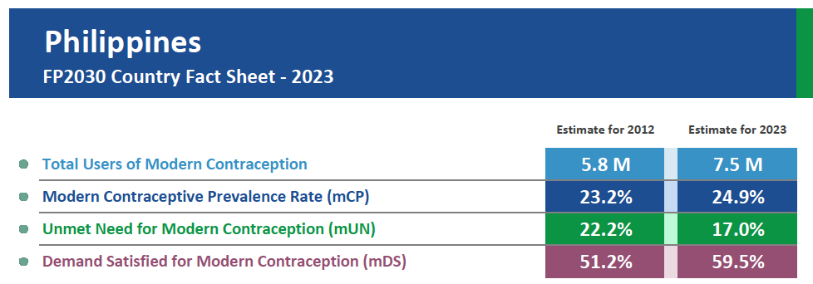

Slide 6
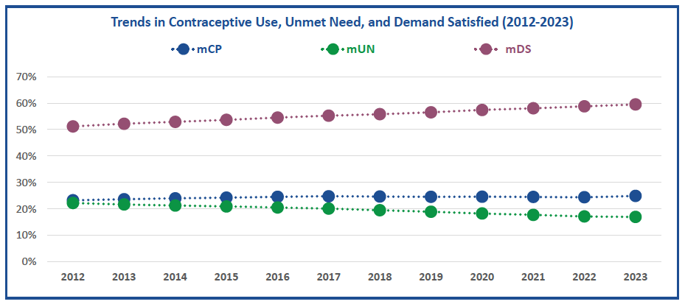
Other FP Indicators

Slide 7
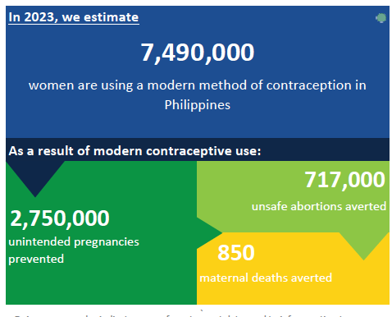
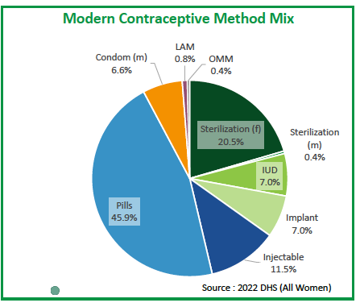
Other FP Indicators

Slide 8
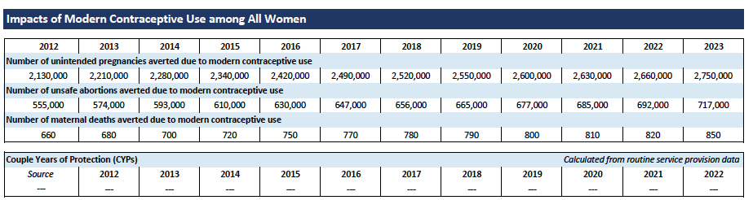
Other FP Indicators

Slide 9
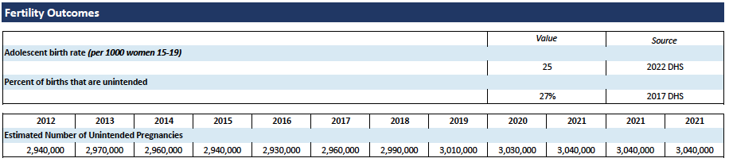
Other FP Indicators

Slide 10
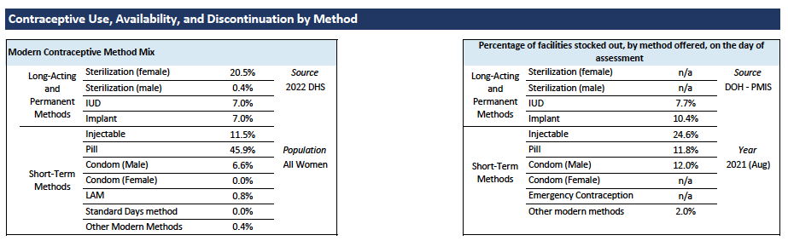
Other FP Indicators

Slide 11
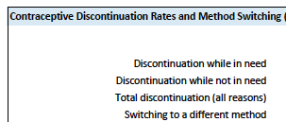
No data in Track 20
Number/ percentage of primary service delivery points with at least THREE methods of modern contraceptives available on day of inspection
Number/ percentage of secondary/ tertiary service delivery points with at least FIVE methods of modern contraceptives available on day of inspection

Slide 12
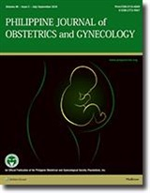
Research Publication Profile on
FP in Philippines
Philippine Journal of Obstetrics and Gynecology
www.pjog.org
3 articles in 3 years
Topics
  Survey on NSV acceptors
  LARC use by adolescents
  Profile on Induced Abortion
YEAR | ON FP | TOTAL PAPERS
2024 | 1 | 28
2023 | 2 | 30
2022 | 0 | 37
YEAR | ON FP | TOTAL PAPERS
2024 | 1 | 216
2023 | 0 | 245
2022 | 2 | 248

Slide 13

Research Publication Profile on
FP in Philippines
Acta Medical Philippina
https://actamedicaphilippina.upm.edu.ph/index.php/acta/index
Pubmed indexed journal
3 articles in 3 years
Topics
  Modern contraceptive use in Indonesia
  Predictors of FP use in teens
  Utilization of SRH services in Teen kiosks in Dasmarinas
YEAR | ON FP | TOTAL PAPERS
2024 | 1 | 216
2023 | 0 | 245
2022 | 2 | 248

Slide 14
Research Publication Profile on
FP in Philippines
Pubmed
Search strategy
((family planning) OR (contraception)) AND (Philippines) = 981 results
2015 to 2024 = 156 results though some sifting needs to be done
Main Topics among 40 searches
Legal changes on unmet need
Male FP thru NSV
Role in Male contraception
Contraceptive Fertility App
Covid 19 and SRH services
Improving quality of FP services
Men’s Involvement in FP
Women’s empowerment in FP
Contraceptive use
Contraceptive dosing strategy

Slide 15
Research Publication Profile on
FP in Philippines
Google Scholar
Search strategy:
Family planning OR
contraception
AND Philippines
Topics
Effect of RH Law on unmet need
KAP on contraception in university
Married couples use of FP
Contraceptive Fertility Tracking APP
KA on contraception and unplanned pregnancies
Promoting SRH in university
Digging deeper on problem of SRH
Transformation of Church Politics Relations
Male RH and use of Non Scalpel Vasectomy
YEAR | TOTAL PAPERS
2024 | 1520
2023 | 1830
2022 | 2000
2021 | 2040
2020 | 2000

Slide 16
Summary of findings in literature review
Not many published papers in local and internation literature on FP
Most topics were on:
  Knowledge attitudes and practices studies
  Operational topics such as strategies or increasing use
  Promotional topics such as increasing involvement and awareness
Many of the papers are free and downloadable
A few authors are non-Filipinos who have papers on the Philippines
What research in Family Planning should be done?

Slide 17


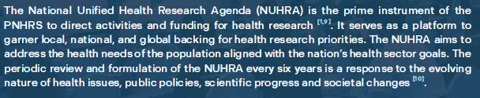
National Unified Health Research Agenda
NUHRA

Slide 18
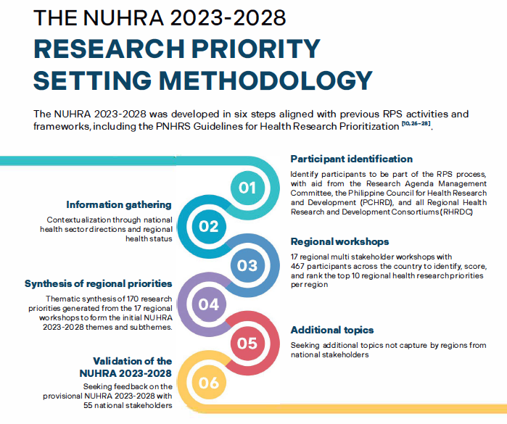
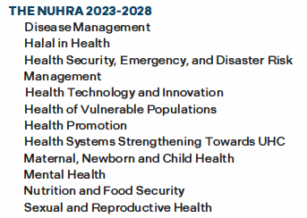

Slide 19
https://doh.gov.ph/sites/default/files/publications/NUHRA.pdf

Slide 20
Coverage of updated NUHRA
2023-2028
Disease management;
Halal in health;
Health security, emergency, and disaster risk management;
Health technology and innovation;
Health of vulnerable populations;
Health promotion;
Health systems strengthening towards UHC;
Maternal, newborn, and child health;
Mental health;
Nutrition and food security; and
Sexual and reproductive health.

Slide 21
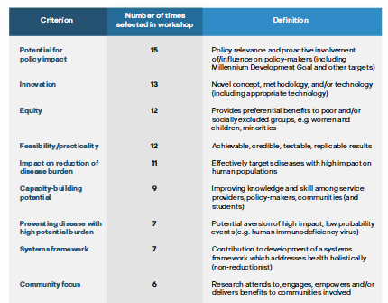

Slide 22
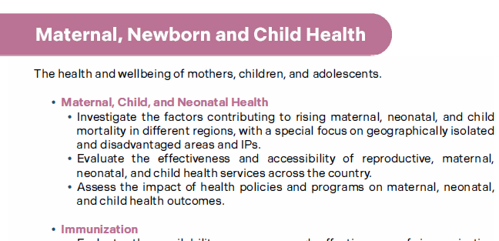
What is in NUHRA?
Prioritized in the top 10 in Regions
1, 2, 3, CAR, 5, 6, 7, 9
CARAGA and BARMM

Slide 23
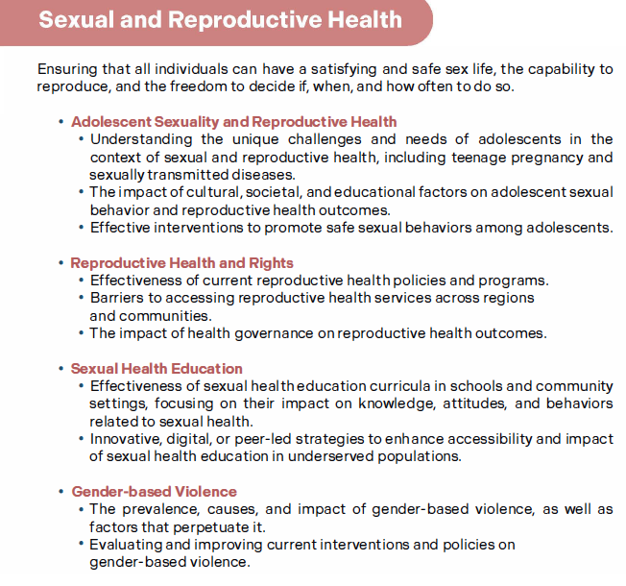
What is in NUHRA?
Prioritized among top 10 in
Regions 3, CAR, 8, 11m BARMM

Slide 24
Issues in the NUHRA regarding FP
NUHRA addresses FP as part of the general SRH agenda, and
  as an intervention in the MNCH agenda, and
  a possible outcome in Health Systems Strengthening or Health Promotion, or
  in targeting specific populations
It would be helpful and useful if more specific issues for research can be identified, especially if some needs are not identified.

Slide 26
Survey on FP Research Scoping
What are specific problems that need to be addressed or services that need to be improved?
What methods can be promoted more?
What populations can be targeted more?
What providers can be enabled more to provide services or promote health?
What policies and resources need to be addressed?
What barriers should be addressed first?

Slide 27

Link to the FP Research Agenda survey
https://docs.google.com/forms/d/e/1FAIpQLSd1si3XWETj-eOY9bXXoO3YxDZS_BvlIdLJNLaQq-7VUL2w2w/viewform?usp=pp_url
Thank you very much for participating.
Thanks to Dr. Mario Espino, Dr. Ryan Lintao for assisting in the preparation of the presentation.

