Slide 1



NATIONAL FAMILYPLANNING CONFERENCE
“Enhancing Family Planning Demand Generation and Services through Technology”

Slide 2







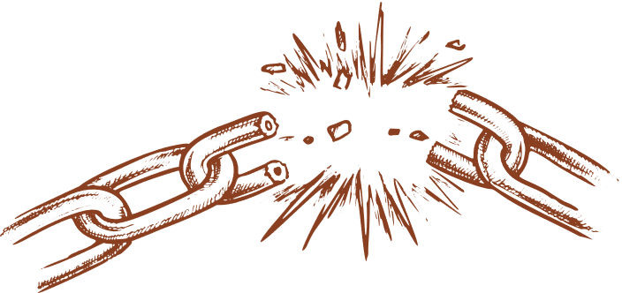



PROBLEM
Financing
Messaging/
Education
Demand
Contraceptive Technology
Health Facility
Social/ Cultural Influences
Family/Partner
Provider:
Training, Skill, Bias
Supply Chain/
Infrastructure
Policy
Adherence & Support

Slide 3

PROBLEM
87% of women not able to discuss family planning with any HSP
Source: NDHS 2022
Messaging/
Education
Demand
Social/ Cultural Influences
Family/Partner
Provider:
Training, Skill, Bias
Supply Chain/
Infrastructure
Adherence & Support

Slide 4
PROBLEM
87% of women not able to discuss family planning with any HSP
Source: NDHS 2022
Messaging/
Education
12% unmet needs
Source: NDHS 2022
Demand
Social/ Cultural Influences
Family/Partner
Provider:
Training, Skill, Bias
Supply Chain/
Infrastructure
Adherence & Support

Slide 5
PROBLEM
87% of women not able to discuss family planning with any HSP
Source: NDHS 2022
Messaging/
Education
12% unmet needs
Source: NDHS 2022
Demand
Social/ Cultural Influences
Family/Partner
Provider:
Training, Skill, Bias
Supply Chain/
Infrastructure
Lack of trained/skilled providers
Adherence & Support

Slide 6
PROBLEM
87% of women not able to discuss family planning with any HSP
Source: NDHS 2022
Messaging/
Education
12% unmet needs
Source: NDHS 2022
Demand
Social/ Cultural Influences
Family/Partner
Stock outs
Provider:
Training, Skill, Bias
Supply Chain/
Infrastructure
Lack of trained/skilled providers
Adherence & Support

Slide 7
PROBLEM
87% of women not able to discuss family planning with any HSP
Source: NDHS 2022
Messaging/
Education
12% unmet needs
Source: NDHS 2022
Demand
Social/ Cultural Influences
Family/Partner
Stock outs
Provider:
Training, Skill, Bias
Weak male involvement
Supply Chain/
Infrastructure
Lack of trained/skilled providers
Adherence & Support

Slide 8
PROBLEM
87% of women not able to discuss family planning with any HSP
Source: NDHS 2022
Messaging/
Education
12% unmet needs
Source: NDHS 2022
Demand
Social/ Cultural Influences
Family/Partner
Stock outs
Provider:
Training, Skill, Bias
Weak male involvement
Supply Chain/
Infrastructure
Lack of trained/skilled providers
Adherence & Support
Changing LGU priorities

Slide 9

Can digitalization or technology strengthen the
FP Value Chain to serve clients BETTER and be our government’s partner in poverty alleviation and social development?

Slide 10
Can digitalization or technology strengthen the
FP Value Chain to serve clients BETTER and be our government’s partner in poverty alleviation and social development?
YES!

Slide 11

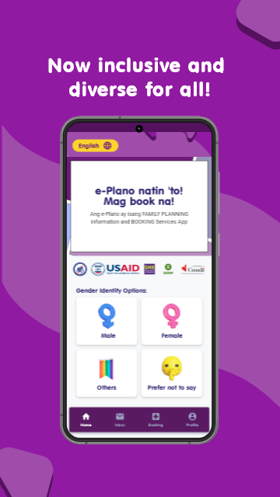
SOLUTION

Slide 12
SOLUTION
  Choose a service

Slide 13
SOLUTION
  Choose a service
  Book an appointment

Slide 14
SOLUTION
  Choose a service
  Book an appointment
  Go to the facility at a set time and date

Slide 15
SOLUTION
  Choose a service
  Book an appointment
  Go to the facility at a set time and date
  Avail the needed service

Slide 16


e-PLANO PILOT SITES
LAGUNA
BAY
BIÑAN
CABUYAO
PAKIL
PANGIL
STA. CRUZ
MANILA
DISTRICT 6

Slide 17
e-PLANO APP METRICS
APP VIEWS
AVAILED FP METHODS
  PILLS
  IMPLANT
  IUD
  BTL
  CONDOM
  INJECTABLES
4 MILLION
REGISTRANTS
14,000
DOWNLOADS
TOTAL SERVICES: 12,250
8,000
SUCCESSFUL BOOKINGS
12,250

Slide 18

Messaging/
Education
Simple and comprehensible information
IMPACT ON THE
FP VALUE CHAIN

Slide 19
Messaging/
Education
Simple and comprehensible information
IMPACT ON THE
FP VALUE CHAIN
Social/ Cultural Influences
Family/Partner
Generate support Family and Community

Slide 20
Messaging/
Education
Simple and comprehensible information
IMPACT ON THE
FP VALUE CHAIN
Social/ Cultural Influences
Family/Partner
Generate support Family and Community
Demand
Awareness

Slide 21
Messaging/
Education
Simple and comprehensible information
IMPACT ON THE
FP VALUE CHAIN
Social/ Cultural Influences
Family/Partner
Generate support Family and Community
Demand
Awareness
Health Facility:
Access & Quality
Access

Slide 22
Messaging/
Education
Simple and comprehensible information
IMPACT ON THE
FP VALUE CHAIN
Social/ Cultural Influences
Family/Partner
Generate support Family and Community
Demand
Awareness
Health Facility:
Access & Quality
Access
Adherence & Support
LGU Backing

Slide 23
Messaging/
Education
Simple and comprehensible information
IMPACT ON THE
FP VALUE CHAIN
Social/ Cultural Influences
Family/Partner
Generate support Family and Community
Demand
Awareness
Health Facility:
Access & Quality
Access
Adherence & Support
LGU Backing
Provider:
Training, Skill, Bias
Competence and Readiness

Slide 24
Messaging/
Education
Simple and comprehensible information
IMPACT ON THE
FP VALUE CHAIN
Social/ Cultural Influences
Family/Partner
Generate support Family and Community
Demand
Awareness
Health Facility:
Access & Quality
Access
Adherence & Support
LGU Backing
Provider:
Training, Skill, Bias
Competence and Readiness
Supply Chain/
Infrastructure
Availability

Slide 25


CHALLENGES
Limited Knowledge
Husband’s
Hesitation
Limited Access to
Health Services
Liza: Undecided Mother
with an Unmet Need for
Family Planning
Fear of Side Effects

Slide 26
CHALLENGES
e-PLANO APP
Accurate and Simple Information
Limited Knowledge
Husband’s
Hesitation
Generate Support from Husband
Limited Access to
Health Services
Convenient Access to Services
Liza: Undecided Mother
with an Unmet Need for
Family Planning
Fear of Side Effects
Assurance Against
Side Effects

Slide 27

CHALLENGES
e-PLANO APP
Stigma
Low Health Literacy
Limited Resources
Ana: Family Planning Demand Generator
Accessibility

Slide 28
CHALLENGES
e-PLANO APP
Stigma
Privacy and Confidentiality
Access to Information
Simplified, Accessible WHO/DOH sourced Information
Visual Aids and Multimedia
Low Health Literacy
Limited Resources
Digital Access to Information
Offline Functionality
Ana: Family Planning Demand Generator
Accessibility
Digital IEC Materials

Slide 29
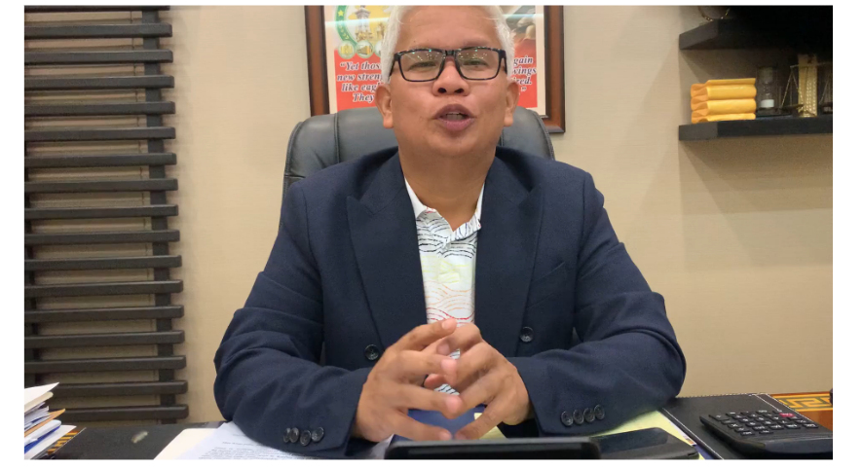
LGU MESSAGE OF SUPPORT
Mayor Armand Dimaguila, Jr.
City of Biñan, Laguna

Slide 30
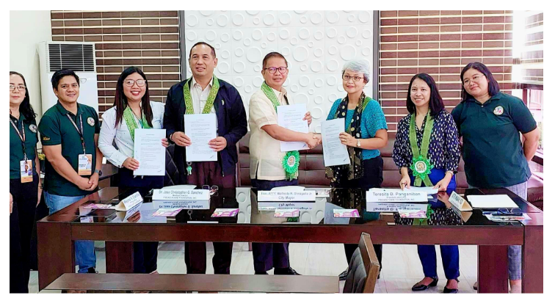
BINAN SUBSCRIBES TO e-PLANO
1ST LGU
“The said mobile application helped the LGU increase its contraceptive prevalence rate, reduce the teenage pregnancy cases, prevent unplanned pregnancies through efficient service delivery of different family planning methods to women of reproductive age (WRA) and couples with identified unmet needs.” - City of Biñan, Laguna

Slide 31
NEXT STEPS
  Expand adoption of the app to more LGUs
  Continuously improve the app features
  Continuously share best practices

Slide 32
THANK YOU!

