Slide 1
REGISTRY OF BARANGAY INHABITANTS AND MIGRANTS
A REGIONAL GAMBIT, A POPDEV CONDUIT
HAROLD ALFRED P. MARSHALL
Regional Director, CPD-Region VI
Presented during the National Conference on Family Planning 2024 | November 20, 2024

Slide 2
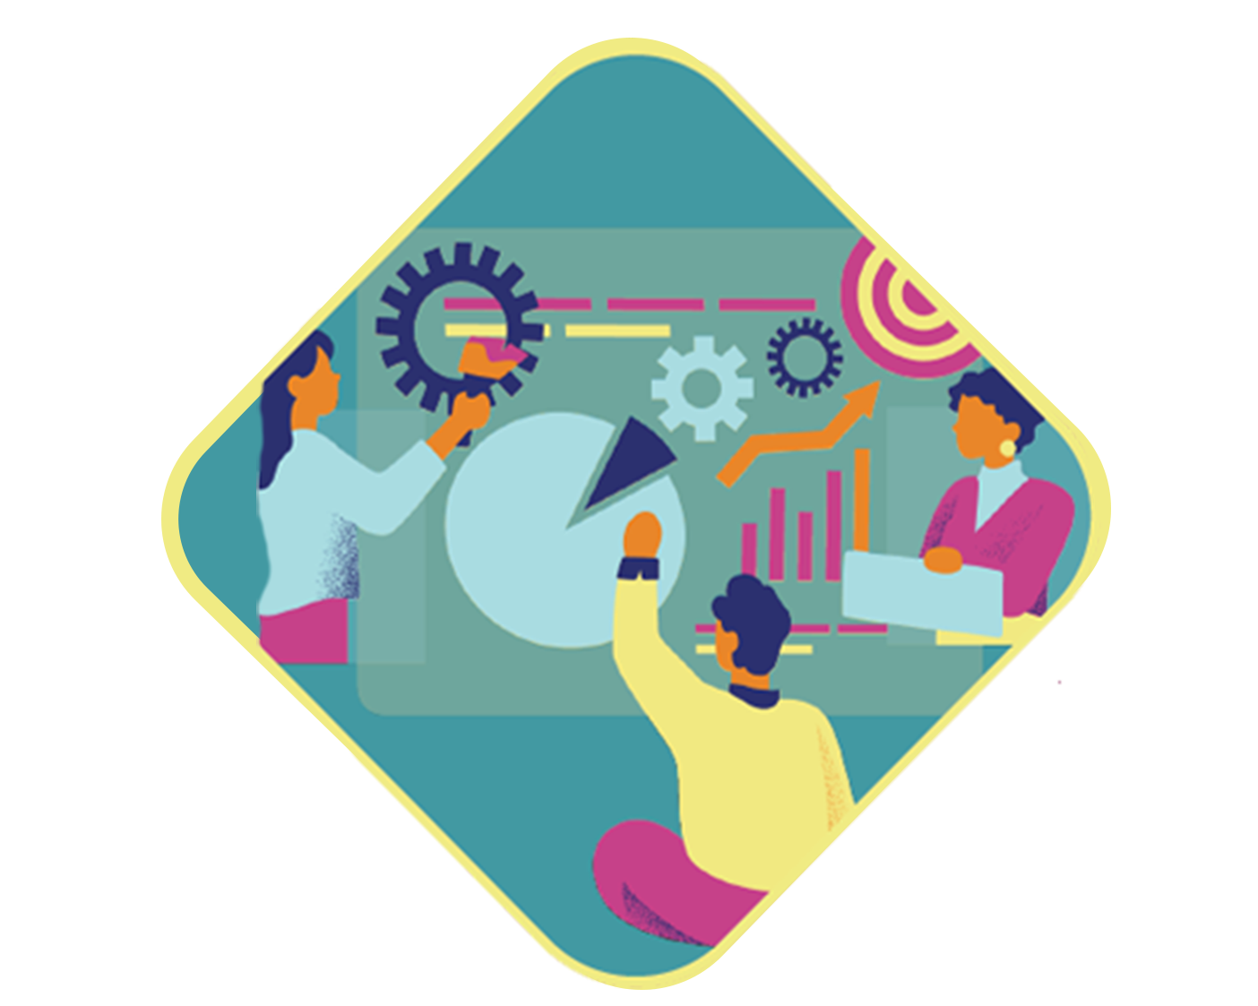
OUTLINE
1
OVERVIEW AND
LEGAL BASES
2
WHAT IS RBIM IN REGION VI?
3
CHALLENGES
4
RECOMMENDATIONS

Slide 3
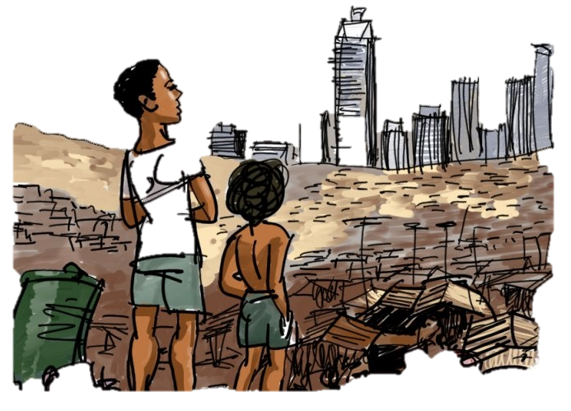
Migration and development are closely related.
Internal migration remains the main driver of rapid urbanization in the country.
Migration has economic, social, and environmental implications - both positive and negative - for the places of origin and destination

Slide 4
LEGAL BASES
RA 7279 Urban Development and Housing Act of 1992
The Local Government Code of 1991
Sections 394 and 488
The Philippine Population and Development-Plan of Action (PPD-POA 2023-2028)
Regional Development Council VI
Resolution No. 90

Slide 5
LEGAL BASES
RA 7279 Urban Development and Housing Act
RA 7279 “Urban Development and Housing Act (UDHA) of 1992: mandates local government units (LGUs) in collaboration with relevant agencies such as CPD, NEDA, PSA, etc. to set up an effective mechanism to monitor movements of the population, from rural to urban, urban to urban and urban to rural areas.

Slide 6
LEGAL BASES
The Local Government Code of 1991
Sections 394 and 488
Section 394: Mandates the Barangay Secretary to keep an updated records of all inhabitants of the barangay containing information such as: name, address, place and date of birth, sex, civil status, citizenship, occupation and such other items of information as may be prescribed by law or ordinance.
Section 488: Appointment of a Local Population Officer tasked to establish and maintain an updated data bank for program operations and development planning.

Slide 7
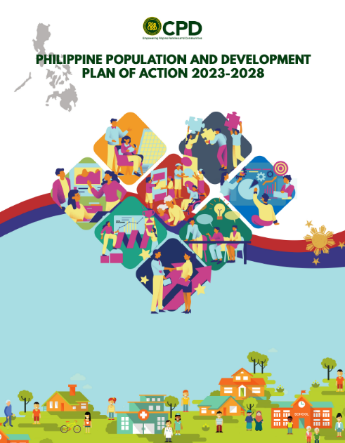
LEGAL BASES
The Philippine Population and Development-Plan of Action (PPD-POA) 2023-2028
The Philippine Population and Development Plan of Action (PPD-POA) 2023-2028 adopts Population and Development (POPDEV) Integration as one of its major thrusts.

Slide 8
LEGAL BASES
The Philippine Population and Development-Plan of Action (PPD-POA) 2023-2028
POPDEV employs the integration of population dynamics in sustainable development initiatives, particularly in planning and policy development, and promotes data banking and management including migration database.

Slide 9
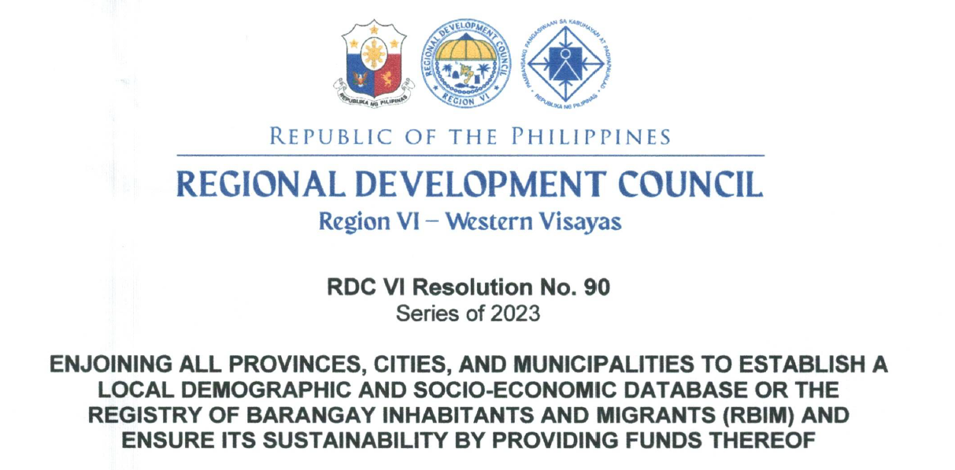
LEGAL BASES
Regional Development Council VI
Resolution No. 90

Slide 10
LEGAL BASES
Regional Development Council VI
Resolution No. 90

Slide 11
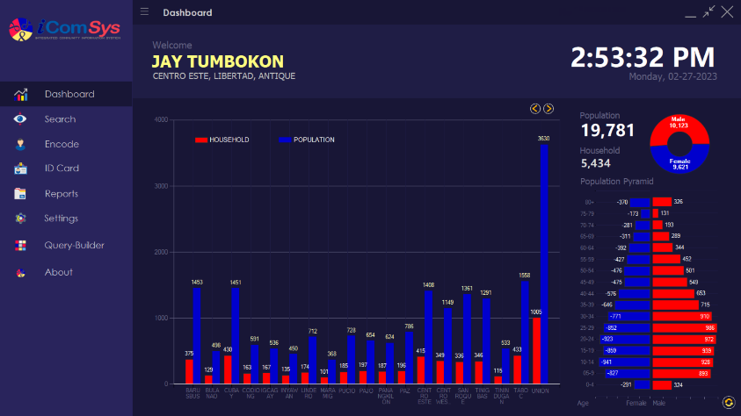
WHAT IS
IN REGION VI?
It is a database of barangay inhabitants and migrants intended to assist the barangays/LGUs in setting up their local baseline data in compliance with the mandates of the law.

Slide 12
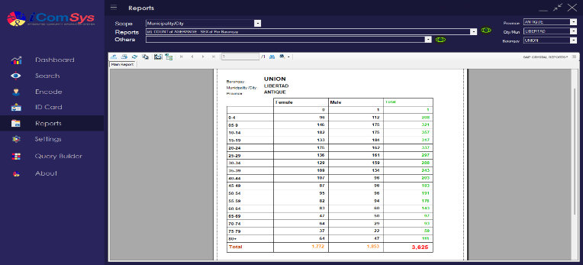
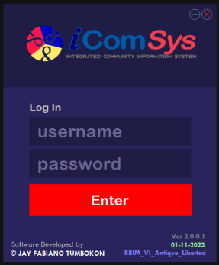
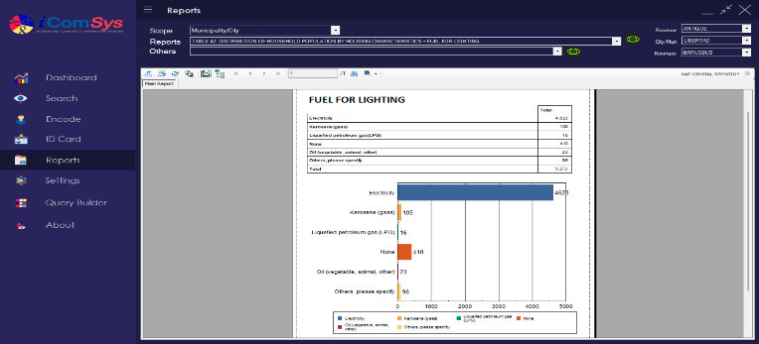
WHAT IS
It is designed to generate demographic and selected socioeconomic data that can be used for local development planning
IN REGION VI?

Slide 13
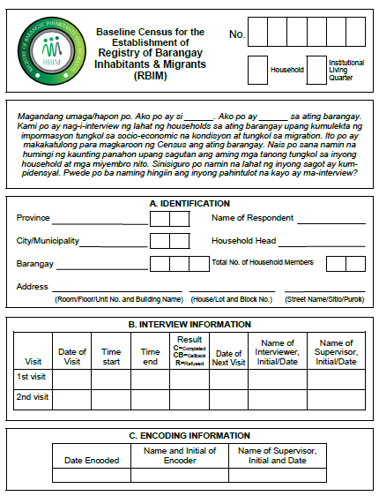
WHAT IS
IN REGION VI?
It has a standard data gathering tool or questionnaires with computer software to ensure the sustainability, accessibility and integrity of database.

Slide 14
Identification (6)
Interview Information (7)
Encoding Information (3)
Demographic Characteristics (10)
Economic (5)
Education (4)
Health (11)
Social (3)
Others (2)
Information on Migrants and Transients (9)
Household dwelling-related characteristics and Residence Five Years from Now (15)
WHAT IS
IN REGION VI?
75
TOTAL
NUMBER OF
INDICATORS

Slide 15
STEPS IN ESTABLISHING AND MAINTAINING RBIM
Identification of key stakeholders’ roles, responsibilities, resources, and capacities.
Development and enactment of local policy for the establishment of RBIM for the sustainability of the project.
Preparation of the data collection and encoding tools, manuals, and protocols, and conduct of training on data gathering.
Collection, encoding, processing and validation of encoded data, and generation of RBIM reports.
Analysis and utilization of results for local program and planning development, policy formulation, and decision-making.

Slide 16
OBJECTIVES OF THE RBIM
To establish and maintain a demographic and socioeconomic baseline data for LGUs in Region VI;
To integrate the data or result in local development plans and for other purposes that are facilitative of demographic and socioeconomic progress;
To serve as basis for the provision of population, health and other services and basis for sectoral and local service requirements.

Slide 17
RBIM
CBMS
REGISTRY OF BARANGAY INHABITANTS AND MIGRANTS
COMMUNITY-BASED MONITORING SYSTEM
RA 7279: UDHA
RA 7160: Local Government Code
RA 11315: Establishing a
Community-Based Monitoring System
POLICY
Php 600,000.00
SAMPLE
BUDGET
Php 3,000,000.00
(for an LGU with 18,000 population)
(for an LGU with 18,000 population)
Every 6 months/Annually
UPDATING
Every 3-5 years
LGU
OWNERSHIP
LGU/PSA

Slide 18
STATUS OF RBIM IN REGION VI
2018 | 2019 | 2021 | 2022 | 2023 | 2024
Malay, Aklan (100% functional) | Libertad, Antique (100% functional) | Maayon, Capiz (100% functional) | San Remigio, Antique (35% encoded) | Brgy. Puey and Brgy 2, Sagay City, Negros Occidental (100% encoded, ready for presentation) | Buenavista, Guimaras (oriented and trained)
 |  | Pontevedra, Capiz (100% functional)
 |  | Iloilo City (75% encoded) | Brgy. Pahanocoy, Bacolod City (100% encoded) |  | Brgy. Tangub, Bacolod City (trained)
 |  | Malinao, Aklan (100% functional)

Slide 19
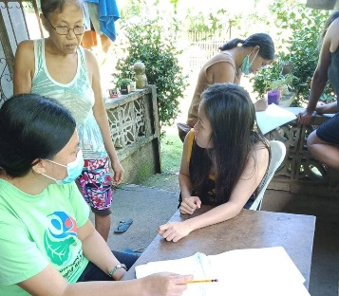
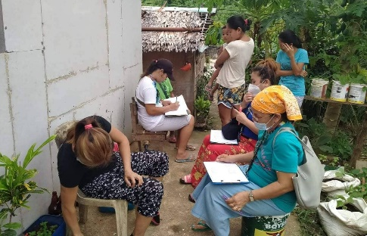
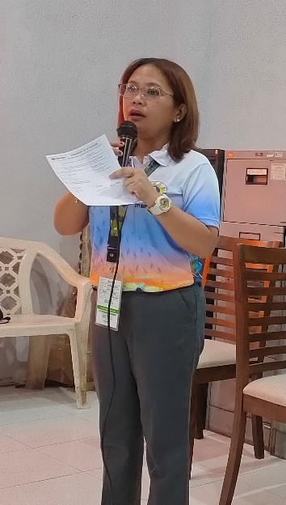
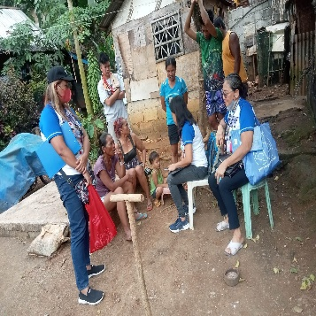
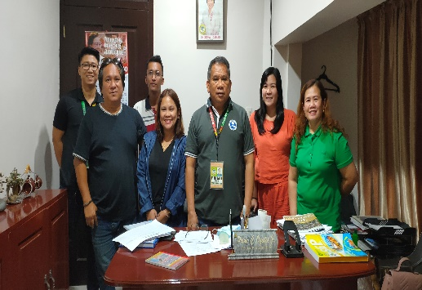
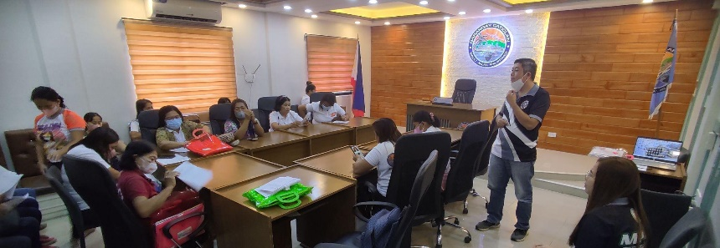
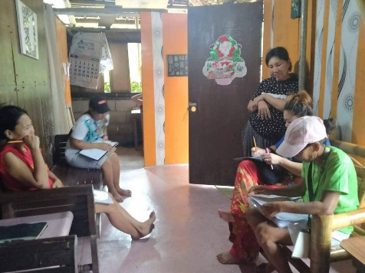
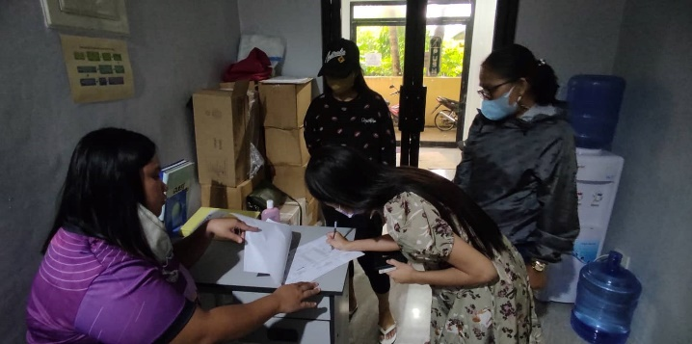
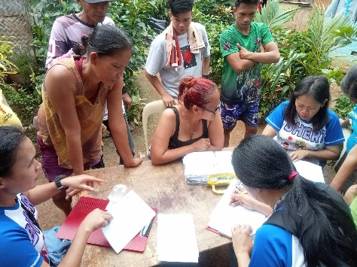
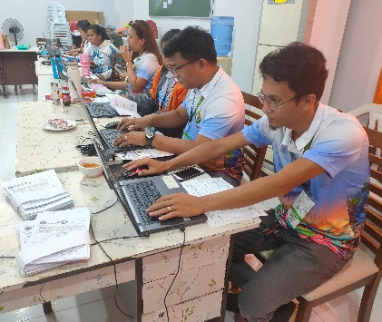
RBIM IN REGION VI
RBIM in Malay, Aklan
RBIM in Sagay City Negros Occidental

Slide 20
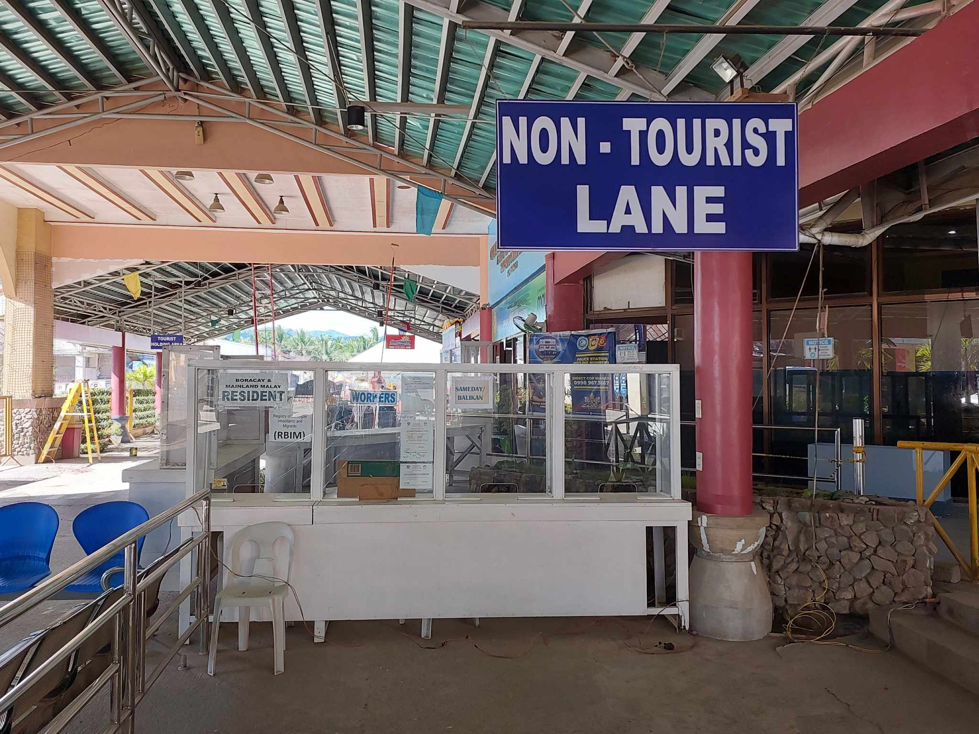
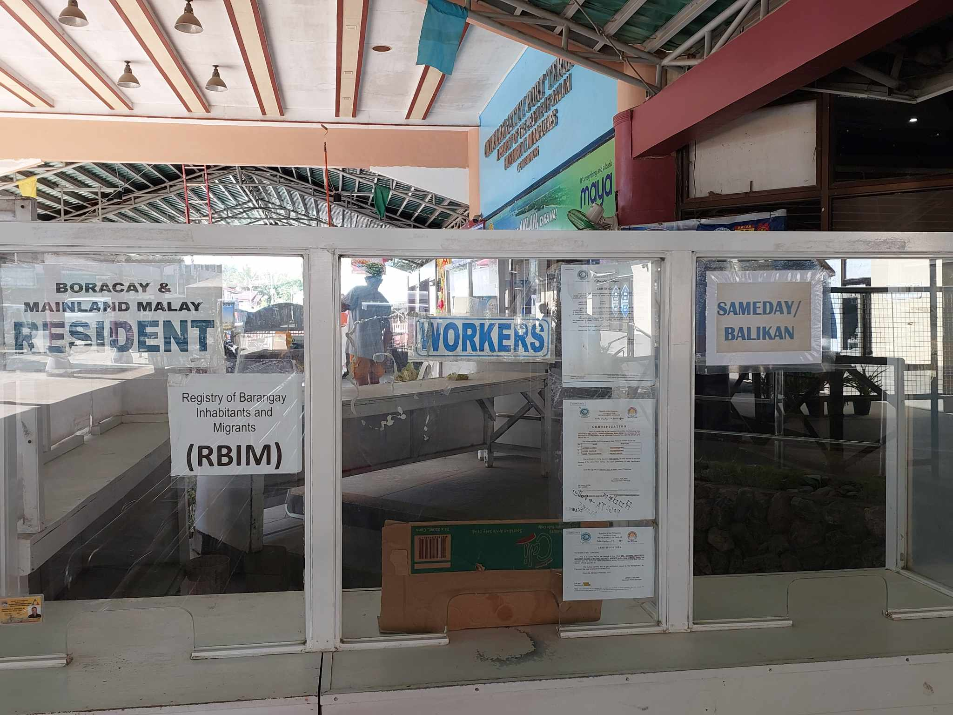
Jetty Port, Caticlan, Malay, Aklan
Notes:
That is why, whenever you will be decided to go to Boracay Island after this Conference, you will have to go through RBIM registration at the port in Caticlan.

Slide 21
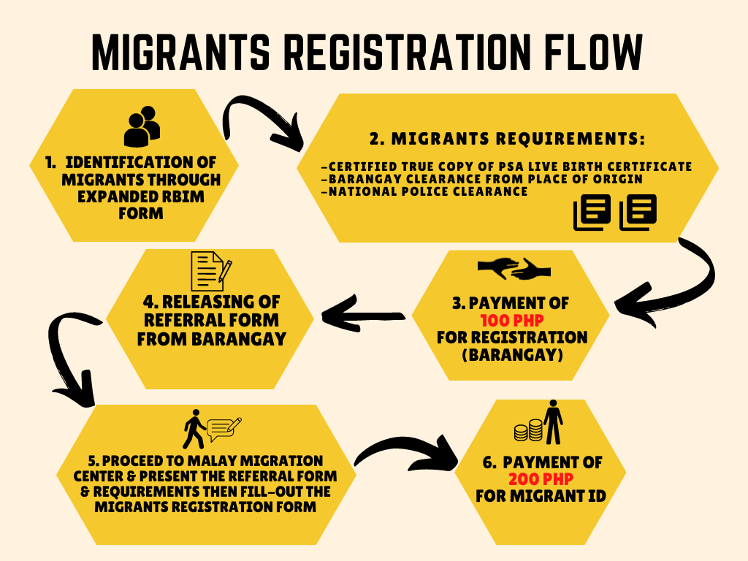
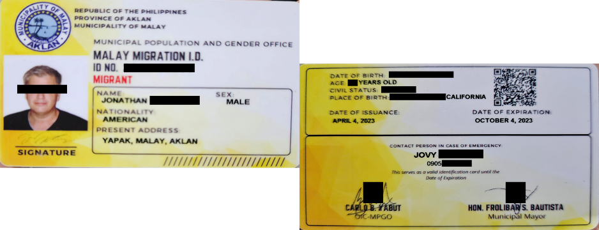
IN MALAY, AKLAN
Notes:
As institutionalized in Malay, Aklan, this is the flow in registering migrants: after identifying who the migrant is and having an ID.

Slide 22
 | MALINAO, AKLAN | MALAY, AKLAN | LIBERTAD, ANTIQUE | MAAYON, CAPIZ | PONTEVEDRA, CAPIZ | ILOILO CITY
Planning
Disaster Response
Identification of Marginalized Sector
Service Requirements
Peace and Order
Food Pack Distribution
Skills Development
Tracking of Migrants
Notes:
Presented here are the LGUs covered during the Focus Group Discussion previously conducted by ETL last October. Other LGUs implementing RBIM but were not reached through the FGD were excluded.
Planning involves tracking and masterlisting of Women of Reproductive Ages for family planning initiatives and strategies

Slide 23
CHALLENGES
Limited LGU Funding for RBIM Sustainability
Insufficient Funds for Monitoring and Updating Activities
Need for Dedicated Human Resources to Manage the Database
Intermittent Power Supply Affecting Server Uptime
Notes:
Limited LGU Funding for RBIM Sustainability: Many Local Government Units (LGUs) face budget constraints that hinder the long-term sustainability of the RBIM. Without consistent funding, it’s challenging to cover essential costs for system maintenance and updates.
Need for Dedicated Human Resources to Manage the Database: Hiring qualified personnel to oversee the RBIM is essential for reliable data management. However, funding limitations often make it difficult for LGUs to employ dedicated staff, impacting the system’s continuity and efficiency.
Insufficient Funds for Monitoring and Updating Activities: Actively maintaining an up-to-date RBIM requires regular meetings, transportation for field visits, and supplies. Limited budgets restrict these activities, making it harder to keep the database current and accurate.
Intermittent Power Supply Affecting Server Uptime: Unstable power supply at server locations causes system downtime, disrupting access to and reliability of the RBIM. This affects timely data input and retrieval, undermining the system’s effectiveness.

Slide 24
RECOMMENDATIONS
LEVEL | POLICY | PROGRAM | RESEARCH
Region |  | Development of Road Map. Continuous provision of CapDev activities and technical assistance. | M&E, and impact assessment of RBIM. Conduct of Longitudinal Study on Migration Patterns. Integration of RBIM in calamity/disaster preparedness in relation to climate change.
LGU | Enactment of policy on the institutionalization of POPDEV program. Multi-sectoral collaboration at the LGU level. | Utilization of RBIM data in development planning and policy formulation.

Slide 25
510-5800 | 510-6800
region6@cpd.gov.ph
Komisyon sa Populayon at Pagpapaunlad- Rehiyon VI

