Slide 1
From potential to actual gain: the demographic dividend in the Philippine context
Josefina N. Natividad, ScD
Notes:
My presentation is a basic introduction – from a demographer’s’ perspective- on the demographic dividend. What is this dividend? And how do we realize it?
First let’s take a little trip down Memory Lane. In the 1960s and 1970s, a major concern of the world was overpopulation.
Those of us who were old enough to be going to movies in those days may remember these scary films about a bleak future with an overpopulated Earth.
You can watch these movies now on youtube.

Slide 2
Z.P.G. ( Zero Population Growth) 1972 Film
The film is about an overpopulated future Earth whose world government
Has totally banned child bearing, on pain of execution.
It was inspired by the best-selling 1968 non-fiction book The Population Bomb, by Paul R. Ehrlich.
Notes:
Read
ZPG was a film inspired by the best selling book The Population Bomb written by Paul Ehrlich and was about a future overpopulated Earth where childbearing was totally forbidden.

Slide 3
Soylent Green, 1973 Film
The story takes place in a dystopian future of dying oceans and year-round humidity caused by the greenhouse effect, with the resulting pollution, depleted resources, poverty, and overpopulation
Notes:
Read … What is Soylent Green? It is food made from dead humans because the future Earth can no longer supply enough food for an overpopulated planet.
Very Mathusian.

Slide 4
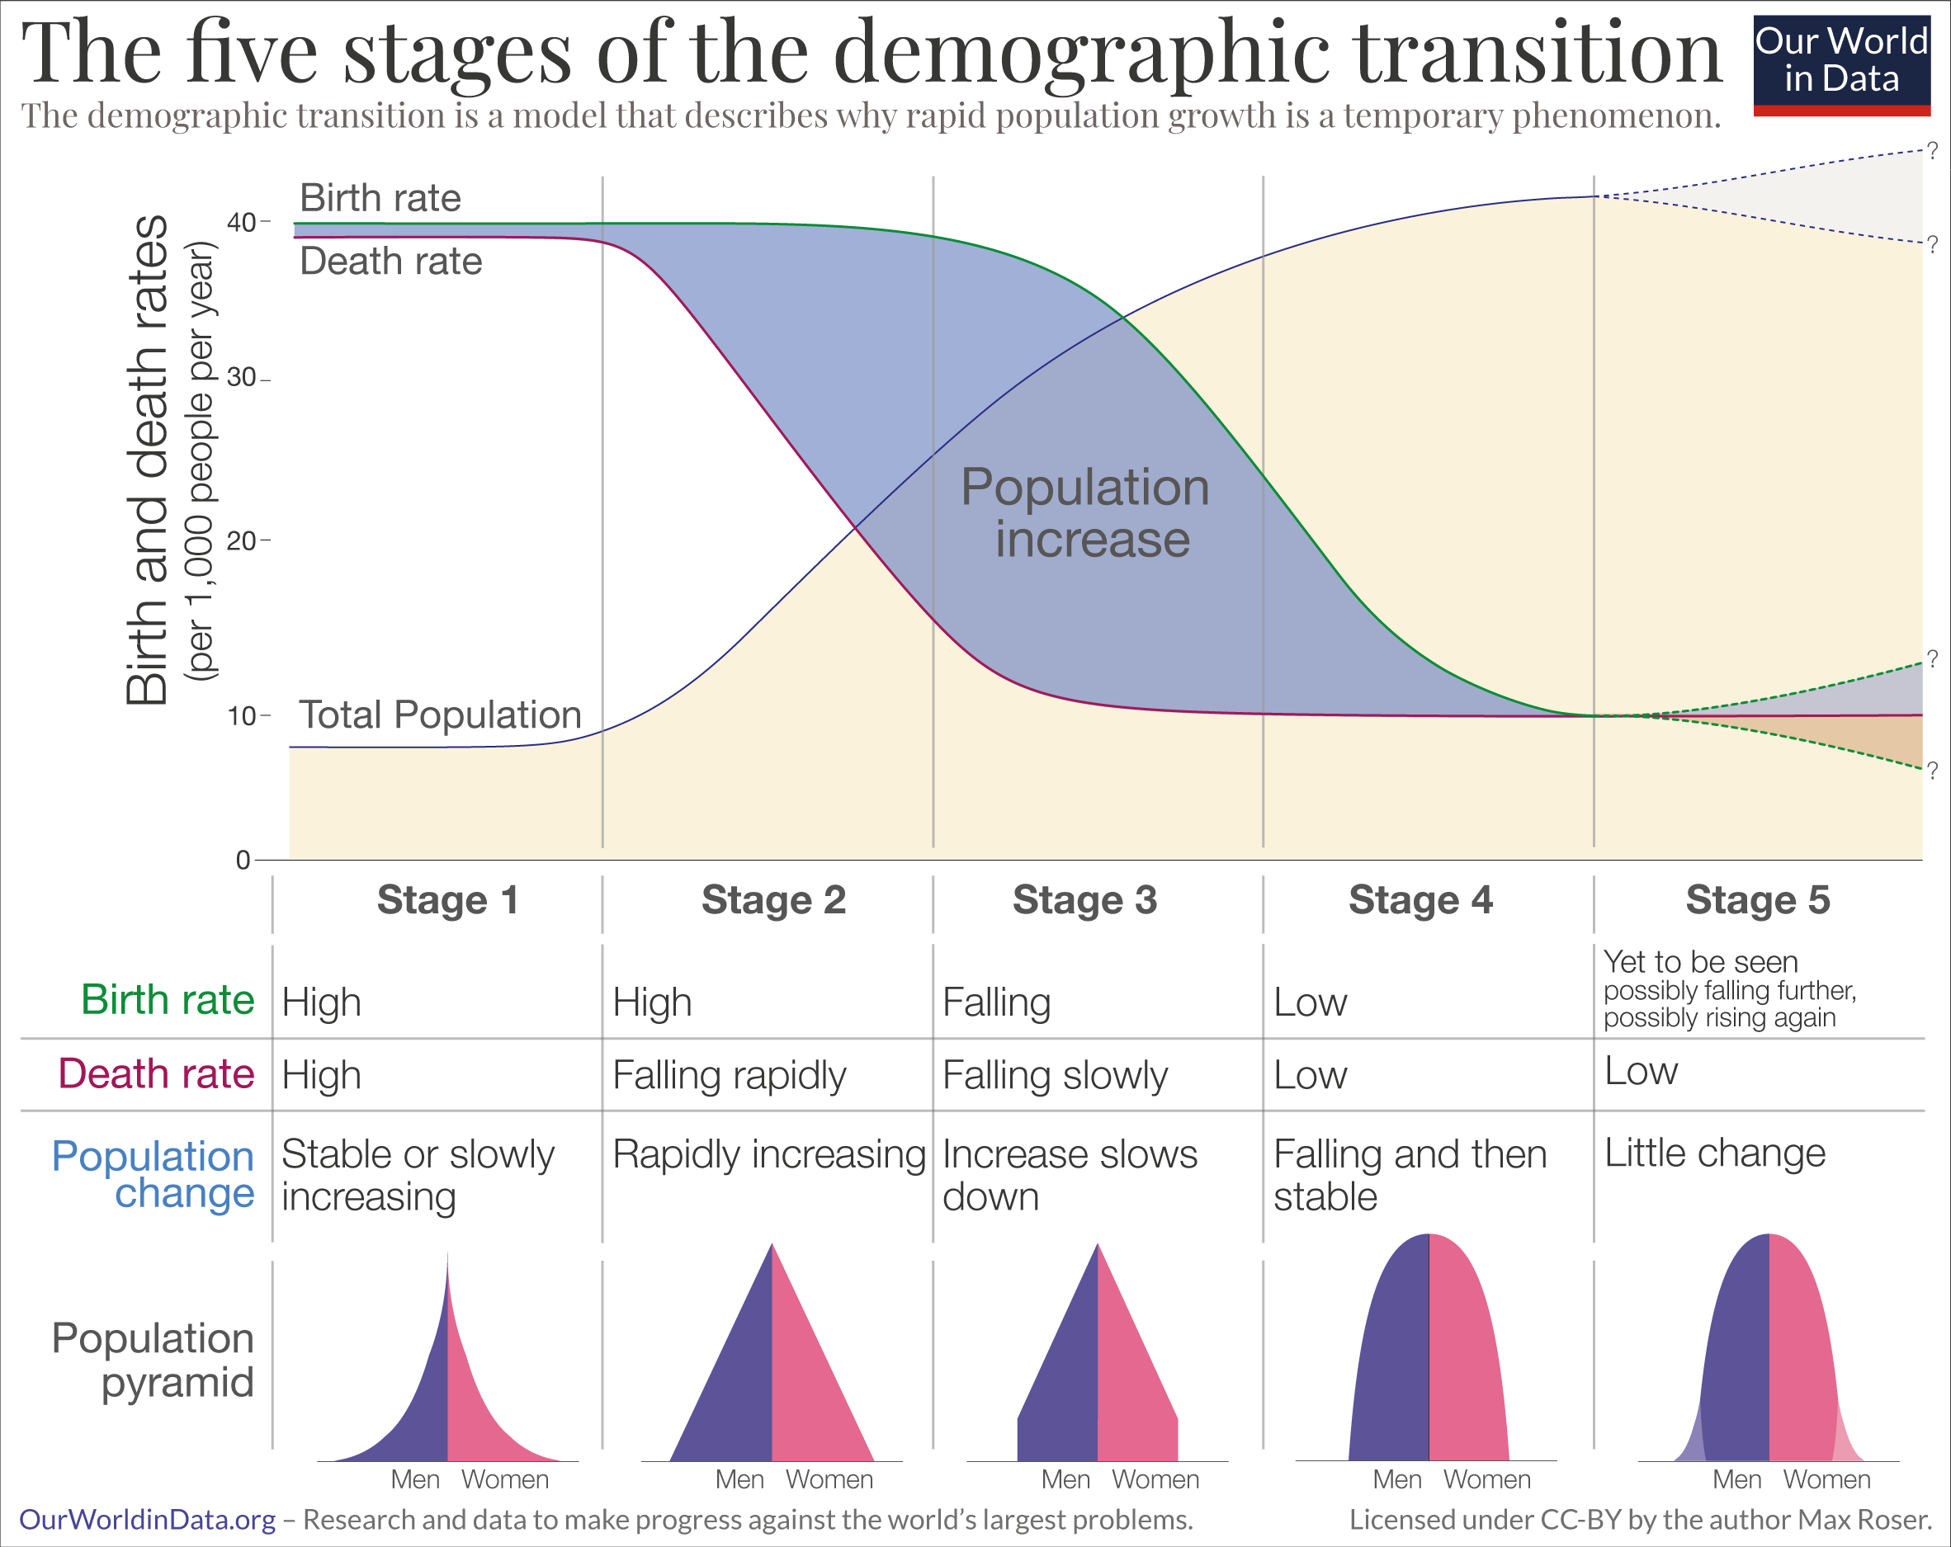
Notes:
This is a representation of the only theory in demography – the theory of the demographic transition
In the early 60s, most developing nations were either at that stage in the demographic transition where the birth rates were high but death rates were falling rapidly (stage 2) or birth rates were falling but death have already fallen to low levels (stage 3). In either case the net effect was rapid population growth.
But as the demographic transition theory predicted stages 2 and 3 are temporary states , there is a next stage where birth rates and death will be equally low and rapid population growth will be a thing of the past (stage 4). This is where most of the world is in now.
Why was there such a panic when the world was at stages 2 and 3? Because while the demographic transition theory correctly modeled the trajectory of population growth from zero growth because of high birth and high deaths to zero growth with low births and low death, the theory did not specify how long the transition process will take. The developed countries at that time (late 50s to early 60s) were observed to have taken about a hundred or two hundred years to get to the tail end of stage 4. The transition needed to be shortened in the less developed countries to prevent the planet from being overrun by too many humans – especially from the poor developing countries.
Thus family planning programs was conceived as a worldwide strategy to combat what was then perceived as runaway population growth.

Slide 5
Source : Philippine Statistics Authority
Notes:
Here is how the Philippine population has actually grown in the last 60 years. It reflects the effect of rapid growth in the past and a slowing down in the near future.
From 27 million in 1960 to 110 million in 2020 was a 300 percent increase.
But from 2020 to 2055, it is projected that the percent change will only be about 81 percent.

Slide 6
Notes:
The main driver to the slowing growth of the Philippine population is fertility decline, an indicator of changing fertility behavior as well as the effect of the enabling factor of contraception and family planning.
In 1973 a woman expected to have 6 children by the time she has gone through the reproductive years also called the Total Fertility Rate. By 2022, TFR has declined to 1.9 children per woman.

Slide 7
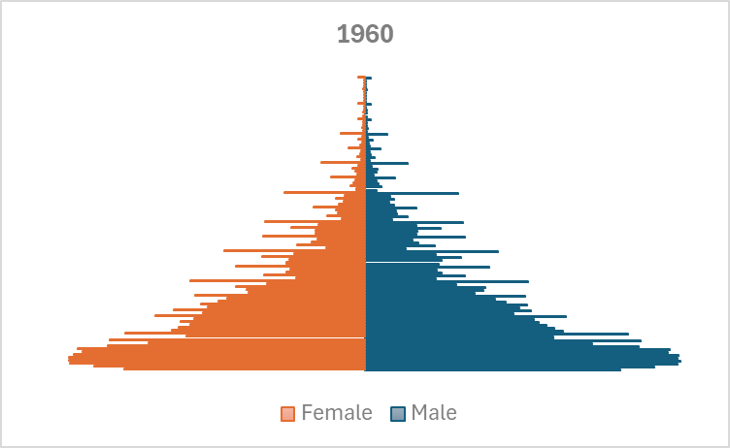
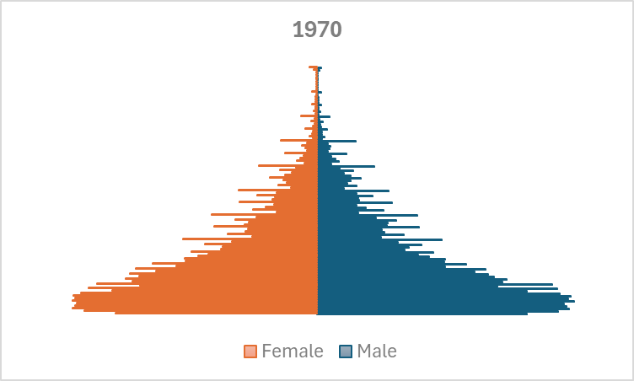
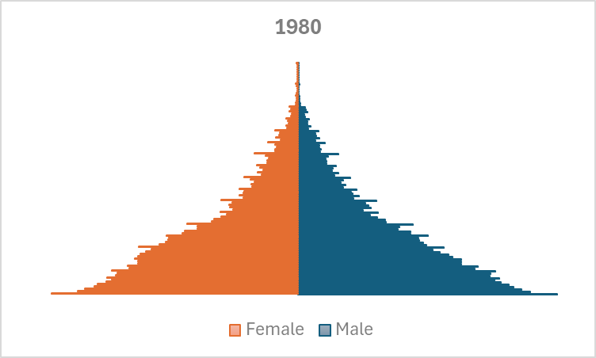
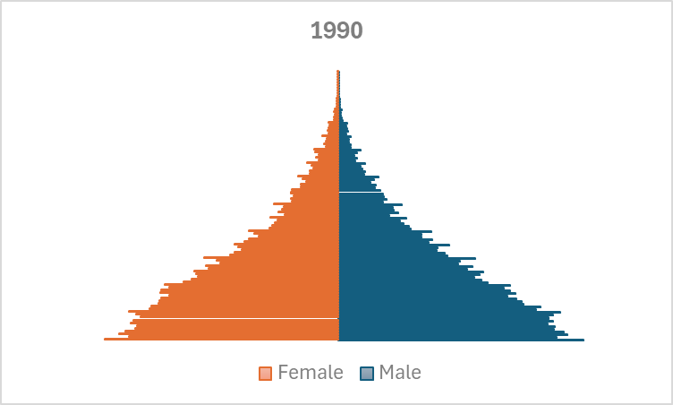
Median age = 16
Median age= 16
Median age=18
Median age= 19
Notes:
The effect of declining fertility can be seen in the gradual change in the shape of the Philippine population pyramid and the rising median age of the population. The base starts to become smaller.

Slide 8
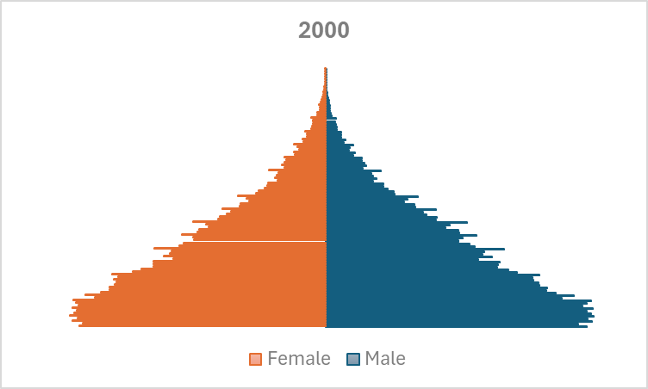
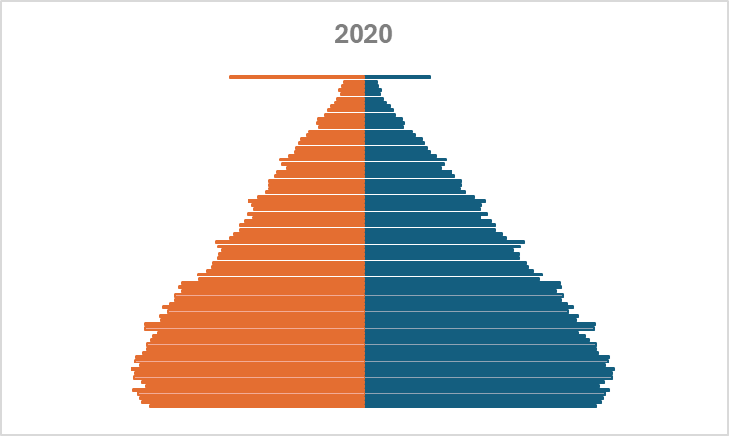
Median age=20.5
Median age=22.5
Median age=24.5
Notes:
By 2020, there is a definite change in the shape of the distribution of the Philippine population or the age structure. Median age has also risen to 24. 5 years.

Slide 9
Change in the age structure means a change in the proportionate share of the three main age groups in the population
The young dependent age group – 0 to 14 years
The working age groups – 15 to 64
The elderly dependent age group --- 65 and over
Notes:
Read

Slide 10
Source: World Population Prospects 2024
Notes:
Here we show a comparison of the age structure of 3 types of countries at different stages in the demographic transition. Uganda and Tanzania have the highest proportion of children, the Philippines and Indonesia are intermediate and Japan and Italy have the lowest share of children in their population.
In contrast in Japan/Italy, the older population is more than twice the size of the population of children. Note that the size of the working age population is about the same for Uganda/Tanzania and Japan/Italy. The major difference is that the dependency burden has shifted to the old.

Slide 11
When is a population considered to be ageing?
- When the proportion of the population aged 65 and over is at least 7 percent
When is a population considered to be aged :
- When the proportion of the population aged 65 and over is at least 14 percent
What is the speed of ageing
- The time in years it will take a population to transition from ageing to aged
Source : Kinsella, K and He W (2009) U.S. Census Bureau, International Population Reports, P95/09-1, An Aging World: 2008, U.S. Government Printing Office, Washington, DC
UN DESA World Population Prospects 2020
Notes:
If the population bogeyman of the 60s and 70s was overpopulation, the bogeyman of the present is population aging.
But population aging is really just the natural consequence of prolonged fertility decline.
Kinsella and He used 2 specific cut offs to designate an aging (tumatanda_) and an aged (matanda) population
Read slide…

Slide 12
Notes:
Here is the changing age structure of the Philippine population from 1960 to 2020.
Consistent with the declining fertility, the proportion of children 0-14 is declining while the older population is gradually increasing. The working age population has also been consistently increasing in the 60-year period, from 1960 to 2020.
The second half of the graph is the projected age structure of the Philippine population up to 2055

Slide 13
Notes:
Based on the projected population to 2055, the Philippines will become an aging population in 2030 and will transition into an aged society in 2055.
So the speed of aging is 25 years.

Slide 14
What is the demographic dividend?
“…If most of a nation’s population falls within the working ages, the added productivity of this group can produce a “demographic dividend” of economic growth, assuming that policies to take advantage of this are in place.”
- Bloom, Canning and Sevilla , 2003
Notes:
The lengthy backgrounder is the back story for this presentation on the demographic context of the demographic dividend in the Philippines.
Read…. In their seminal article…Bloom, Canning and Sevilla contend that …
This conclusion was arrived at from the study of the experience of the East Asian Tiger economies, of Ireland, Japan and other countries where the change in the age structure resulting in the rise of the share of the working ages was found to partly account for their phenomenal economic growth.
All these economies that reaped a demographic dividend of economic growth were able to do so because they invested in improving their human capital, thru health and education as well as provided the right environment for employment and generated savings.

Slide 15
“The combined effect of
A large working-age population
Health
Family
Labor
Financial and human capital policies
can effect virtuous cycles of wealth creation.”
Notes:
In other words,

Slide 16
Critical policy areas
Health
Family planning
Education
Economic policies that promote labor-market flexibility, openness to trade, and savings
Notes:
Read
A large working age population is a necessary but not sufficient condition for reaping a demographic dividend of economic growth.
The working age population must be in good health, must be educated and the appropriate jobs made available – for the potential of this large work force to be harnessed to spur economic growth.
If there is poor human capital formation – i.e. the working age population is unhealthy, with a poor education profile, many may be unemployable or not fit for the jobs that will spur economic growth. Worse there may not be jobs at all.
A large working age population with poor or no job prospects can lead to adverse outcomes like political unrest as has been observed in other countries with a large working age population but with poor human capital formation – like Pakistan.
In other words, a large working age population can be a demographic boon but it can also be a demographic bane.
Moreover, the working age population may be equipped with the right human capital but in the absence of employment prospects appropriate to their skills and training, there is a risk that they will seek employment in other countries with labor shortage but available jobs – the classic brain drain.

Slide 17
Notes:
Here again is the changing age structure of the Philippine population from 1960 to 2020 and projected to 2055.
We are currently in the years where the working age population is highest. Now is the time to ensure that the country can gain from this potential.

Slide 18
HEALTH
Notes:
How ready is the Philippines to turn the potential of a large working age population into a gain for the economy, a driver of economic growth?
As a demographer, I can only offer some snippets of empirical evidence of the current status or profile of the working age population to catch a glimpse of the state of human capital formation in the country.
For health, the proxy measure I use is the average height of Filipino 19-year olds, compared to our ASEAN neighbors.
Adult height shows the combined effect of genetics and nutrition.

Slide 19
Notes:
We are third to last in height.
Even compared to our neighbors of Malay stock – Indonesia and Malaysia we are shorter on average.

Slide 20
EDUCATION
Notes:
Read

Slide 21
Among the population aged 20 and over
25.6 percent of males had elementary level schooling
(10.3 percent completed elementary school, 15.2 percent did not)
21.6 percent of females had elementary level schooling (10.1 percent completed elementary school, 11.5 percent did not
Source: 2020 Philippines Census
Notes:
About a fourth of male and a fifth of females in the working ages have elementary education only.

Slide 22
Expected Years of School.
In the Philippines, a child who starts school at age 4 can expect to complete 12.9 years of school by her 18th birthday.
Learning-adjusted Years of School.
Factoring in what children actually learn, expected years of school is only 7.5 years.
Source: Human Capital Project – World Bank
Notes:
As to the state of the quality of education Filipino youth receive….
Read…

Slide 23
12.8 percent of Filipino youth (15-24) are Not in Education, Employment or Training (NEET)
Notes:
“Tambay”
Idle youth

Slide 24
Source: World Bank Data Portal
Notes:
But, compared to our ASEAN neighbors, we are not that bad.

Slide 25
Labor force participation
Notes:
Read

Slide 26
Source: World Bank Data Portal
Notes:
For the working age population to contribute to economic growth, they have to in the labor force - working or looking for work.
However,
Less than half of women in the Philippines are in the labor force, the second lowest in the ASEAN region. .
These few examples of indicators of the state of our efforts to improve human capital in the Philippines indicate that we have quite a way to go to ensure that we maximize the potential gain from our large working population.

Slide 27
CONCLUSIONS
Notes:
Read

Slide 28
From a purely demographic perspective, the Philippines now has the right age structure to fulfill the first and major pre-requisite for realizing a demographic dividend of economic growth – a declining proportion of children, an older population that is only slowly increasing and a high proportion in the working ages
BUT
It has to work toward boosting the quality of its human capital by improving health, education and employment outcomes for its population – especially at the younger ages (health and education) and the working ages (health, education and employment prospects) – to turn the potential into actual gain
Notes:
Read

Slide 29
Investing in human capital now is also a way to prepare for the inevitable transition to an ageing and later aged society.
The elderly cohort of 2055, when the country becomes an aged society are already born (birth cohort 1990 and earlier) so boosting their human capital now is an investment in that future
Notes:
Read

Slide 30
Finally, improving the nation’s human capital requires an all-nation approach. Government may create the right policies but we all know that the real test is in the implementation of programs to actualize these policies.
We as Filipino citizens should also not leave all the work and the blame on government. Rather we must in our own way and in our own little spheres of influence do our own bit to help improve the human capital of our nation in order to reap a dividend of economic growth from our current age structure.
Notes:
Read

Slide 31
THANK YOU.
Notes:
Read…

