Slide 1
The Longitudinal Cohort Study
on the Filipino Child (LCSFC)
OVERVIEW
Tracking Nutritional Status
of Filipino Adolescents from Ages 10 to 16
and Assessing Significant Implications
Judith B. Borja
Office of Population Studies Foundation, Inc. , University of San Carlos
3rd National Conference on Family Planning
20 November 2024, Crowne Plaza Manila Galleria, Quezon City

Slide 2
Why nutrition in adolescence is important
Key Findings:
Nutritional Status and Linear Growth
Mental Health
Education
Adolescence is an important period of growth: physical, mental, emotional
Nutritional status during adolescence sets the stage for their adult life
Food choices and eating habits formed in adolescence may persist in adulthood
Overweight/obesity in childhood associated with adult obesity, high risk NCD
For girls at risk of early pregnancy: poor nutrition increases risk of low birth weight
Undernutrition linked to poor health outcomes, poor cognitive growth and school performance
Linear growth continues in adolescence and needs to be supported (value of longitudinal growth data during the pubertal transition

Slide 3
The Longitudinal Cohort Study
on the Filipino Child (LCSFC)
OVERVIEW
The Longitudinal Cohort Study
on the Filipino Child (LCSFC)
OVERVIEW

Slide 4
In partnership with the top demographic research institutions in the country
Luzon
domain
Visayas
domain
Mindanao
domain
Consultants:
Dr. Alejandro N. Herrin (Policy Adviser)
Francisco M. Largo and Jan Lorenzo G. Alegado (Policy Analysis)
Dr. Erniel B. Barrios (Statistics)
Dr. Delia E. Belleza, Ms. Priscilla G. Fernando (Psychology)
Dr. Maria Fiscalina A. Nolasco (Qualitative Research
Mr. Leo Angelo L. Ocampo (Database Programming)

Slide 5
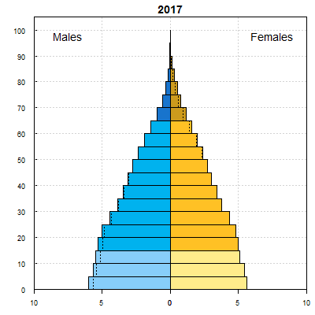
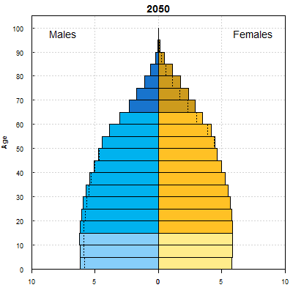
The Sustainable Development Goals (SDG) and the Philippine youth bulge
The SDG (2015-2030) falls within the projected youth bulge period for the Philippines (2015-2050) which potentially increases the critical mass of productive/working age Filipinos (age 15-29).
Main impetus for doing LCSFC:
To examine the human capital formation of the SDG generation – those who transition from childhood through young adulthood within the SDG implementation period.

Slide 6
Longitudinal Cohort Study on the Filipino Child (LCSFC)
Study design:
Prospective study on a cohort of Filipinos who were age 10 in 2016; same sample observed until age 24 in 2030.
Each survey round collects multi-level data (individual, household, barangays)
Nationally representative sample (Luzon, Visayas, Mindanao)
Baseline (2016; age 10): n=4,952
Latest completed wave (2024, ages 17-18): n=4,269 (86% of baseline sample)
Main Objective:
Provide an evidence-based resource that will inform national policy making and development planning on how the SDG agenda can contribute to maximizing the potentials of the Filipino youth.

Slide 7
The LCSFC tracks key milestones in the lives of the cohort (survey and qualitative study) from age 10 to 24
age
24
age
10
age
11
age
12
age
13
age
14
age
15
age
16
age
17
age
18
age
19
age
20
age
21
age
22
age
23
2016
2024
2030
BASELINE
ENDLINE
(start of SDG)
n=5,000
Pubertal transition
Sexual experiences, reproductive behaviors, pregnancy
(end of SDG)
n=2,000
Grade school
Junior HS
Senior HS
College
Post-Grad
Entry into labor force and work trajectories ---------------------------------------------------------------------------------------------------
Cohabitation/Marriage Parenthood--------------------------------

Slide 8
Nutritional Status Measures in the LCSFC
Stunting¹ (being short for age)
Height (in cm) obtained in Waves done through home visits:
Waves 1-4; ages 10-14 and Wave 6, age 16
Wave 5 was done by phone
Under/overweight (based on weight-for-height measure, body mass index² (BMI)
Weight (in kg) obtained in Waves done through home visits (same as height)
Underweight: below normal BMI-for-age
Overweight: above normal BMI-for-age
¹Height-for-age z-score <-2SD below the mean on the 2007 WHO Reference Standards (2007 WHO)
²BMI: weight in kilograms (kg) / height in meters squared (m2); Normal BMI -2SD to +1SD BMI-for-age z-score below the mean on the 2007 WHO

Slide 9
Body Mass Index (BMI-for-age), All Adolescents
ENNS 2021
Underwt (wasting) rates:
10-12 - 10.8%
13-15 - 10.9%
16-19 - 10.9%
Percent
ENNS 2021
Overwt (including obesity) rates:
10-12 - 15.5%
13-15 - 12.0%
16-19 - 11.1%
Males tend to be thinner as well as more overweight than females (double burden of malnutrition)
Note: Presented as weighted proportions across ages

Slide 10
Stunting (By Sex) Higher % stunted among males than females at ages 11-12; reversed at age 16 Decreasing stunting trend from ages 10-13; increased at age 16
NNS 2015 Stunting rates:
10-12 - 32.4%
13-15 - 30.2%
16-19 - 33.5%
Percent
ENNS 2021 Stunting rates:
10-12 - 19.3%
13-15 - 20.3%
16-19 - 28.4%
Note: Weighted proportions; significantly different between females and males at p<0.01 at ages 11, 12 and 16

Slide 11
Key Findings:
Nutritional Status and Linear Growth
Mental Health
Education
Stunting and Catch-up Growth in Adolescence

Slide 12
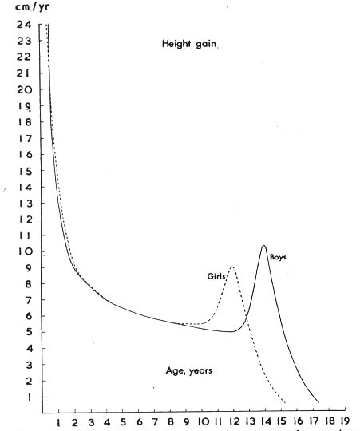
Growth spurt and sex differences in growth
during puberty
Periods of rapid growth:
First 1000 days “window of opportunity for preventing undernutrition”
Puberty “ongoing research on second window of opportunity to reach maximum linear growth potential”
Girls mature earlier than boys (about 2 years earlier). Height velocity declines post-menarche or at later stages of pubertal development

Slide 13
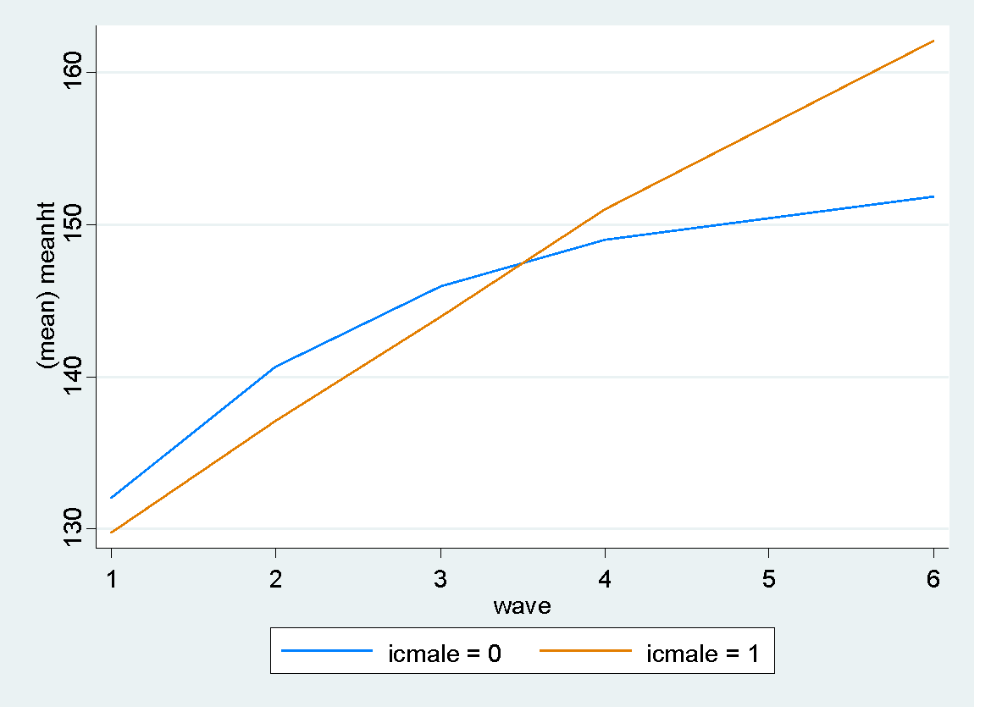
Mean height (cm): Girls vs Boys
Girls mature earlier, are taller than boys at ages 10-12
Boys catch up in height starting at age 13

Slide 14
Predicted HEIGHT VELOCITY* (increase in cm/year) by PUBERTAL STAGE
Girls: Mature faster than boys; decline in HV begins between ages 10-11
Boys: decline begins between ages 12-13
Stages of puberty: 1=pre-pubertal 5=adult stage
* Based on longitudinal models controlling for age, sex, maturational stage

Slide 15
Illustration: shift in stunted (height-for-age zscore: <-2SD) /non-stunted status
 | Age 10 | Age 11 | Age 12 | Age 13 | Age 16
Status | stunted | stunted | not stunted | not stunted | not stunted
Girls (n=44)
Mean ht | 125.8 | 134.8 | 143.1 | 148.0 | 151.8
HFA zscore | -2.40 | -2.19 | -1.7 | -1.6 | -1.61
Ht velocity |  | 6.9 | 8.3 | 5.2 | 1.4
Breast stage 93% menarche<14 |  | 1.9 | 2.5 | 2.9
Boys (n=19)
Mean ht | 125.1 | 132.4 | 140.9 | 150.1 | 160.2
HFA zscore | -2.28 | -2.14 | -1.77 | -1.42 | -1.77
Ht velocity |  | 5.6 | 8.7 | 9.5 | 3.8
Genital stage |  | 2.5 | 3 | 3

Slide 16
Key Findings:
Nutritional Status and Linear Growth
Mental Health
Education
Nutritional Status and School Performance

Slide 17
Stunting and/or low BMI-for age at age 10
associated with poor school performance
¹Predicted rates adjusted for relevant child, household and community characteristics. Height-for age cut-off: Stunted= <-2SD
² IC does not aspire for nor believe he/she can attain college education
³ Mother/caregiver does not aspire for college education for IC nor believes IC can attain such level
Source: Largo, F.M., Bacungan, C.C., Alegado, J.L.G., Borja, J.B., Mayol, N.L., Bechayda, S.A.,Bautista, C.A.P., Herrin, A.N. (2019). Mitigating the effects of undernutrition on schooling performance among 10-year-old children: What can be done? Longitudinal Cohort Study on the Filipino Child. UNFPA-OPS Policy Notes Series_No. 1. USC-Office of Population Studies Foundation, Inc. Retrieved from http://www.opsusc.org.

Slide 18
Boys: Stunting patterns and being on-track with schooling*
(in age-appropriate grade levels; no missed/repeated SY)
Not stunted at ages 10 and 16 (n=1,058)
Stunted at 10, not at 16 (n=116)
Percent
Stunted at 10 and 16 (n=98)
*sample with complete data across waves

Slide 19
STUNTING at age 10 is associated with poor cognitive and total competency scores

Slide 20
LCSFC
Children stunted at age 10 had lower cognitive test scores
(Raven's Standard Progressive Matrices)
Not stunted Stunted

Slide 21
LCSFC
Children stunted at age 10 tend to have lower total competency (school, activity, social) scores
(Child Behavior Checklist)
Not stunted Stunted

Slide 22
How can adequate nutrition help adolescents
reach their maximum growth potentials
First 1000 days: To support growth and development from birth to age 2
Puberty: To support completion of linear growth during puberty
- extend nutrition intervention through adolescent school age
provide nutrition intervention to children/adolescents who are out of school
improve household conditions that affect adolescent nutrition: poverty, food insecurity

Slide 23
How can we help stunted children/adolescents?
Strengthen their human capital formation:
Monitoring their school performance; importance of school- and home-based activities that stimulate learning (encourage reading, provide access to educational materials)
Supplemental learning programs/mechanisms for stunted children/adolescents having difficulty with school performance
Keep stunted children/adolescents in school!
Engage the community: increase awareness re: stunting and cognitive/schooling disadvantage
- are parents aware? are teachers aware?
- do we know who among elementary and high school students are stunted?
- advocate for interventions beyond nutrition for stunting

Slide 24
Longitudinal Cohort Study on the Filipino Child (LCSFC)
For more information on the LCSFC and to access LCSFC publications please visit: https://www.opsusc.org/LCSFC.php For data use requests and other inquiries, please contact: Roland Paul T. Junio
LCSFC Coordinator
Population and Development Unit United Nations Population Fund Email: junio@unfpa.org

