Slide 1
Philippines FP2030 Progress
RON ALLAN C. QUIMADO, MD, MPM-HSD
Medical Officer III
Department of Health - Disease Prevention and Control Bureau
Notes:
FP2030 Commitment Summary
Why does the Philippines have to commit
https://www.canva.com/design/DAGJYv_kWI0/SNZCRhrfczbrx1hO-MJDcg/edit - poster

Slide 2
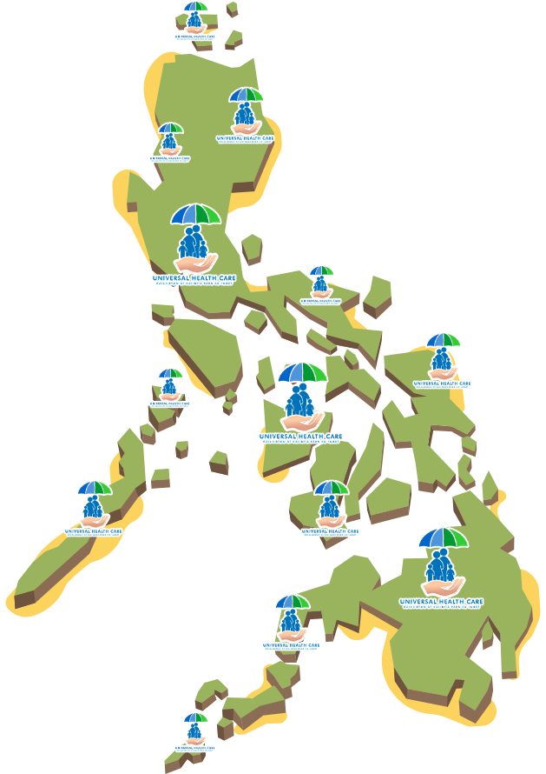
Philippines FP2030
Vision Statement:
By the end of 2030, all Filipinos enjoy a healthy and productive life and are empowered to make informed decisions in family planning and in their reproductive health and rights.
Notes:
The Philippines FP2030 envisions that by the end of 2030, all Filipinos enjoy a healthy and productive life and are empowered to make informed decisions in family planning and in their reproductive health and rights.

Slide 3
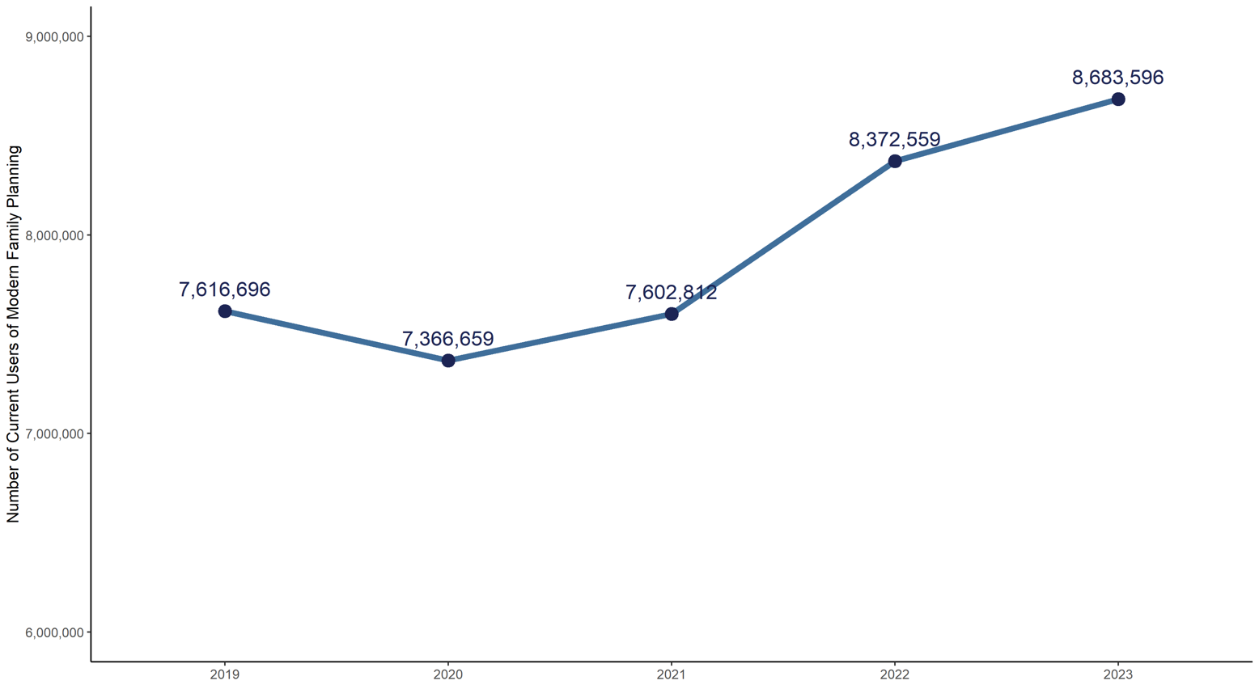
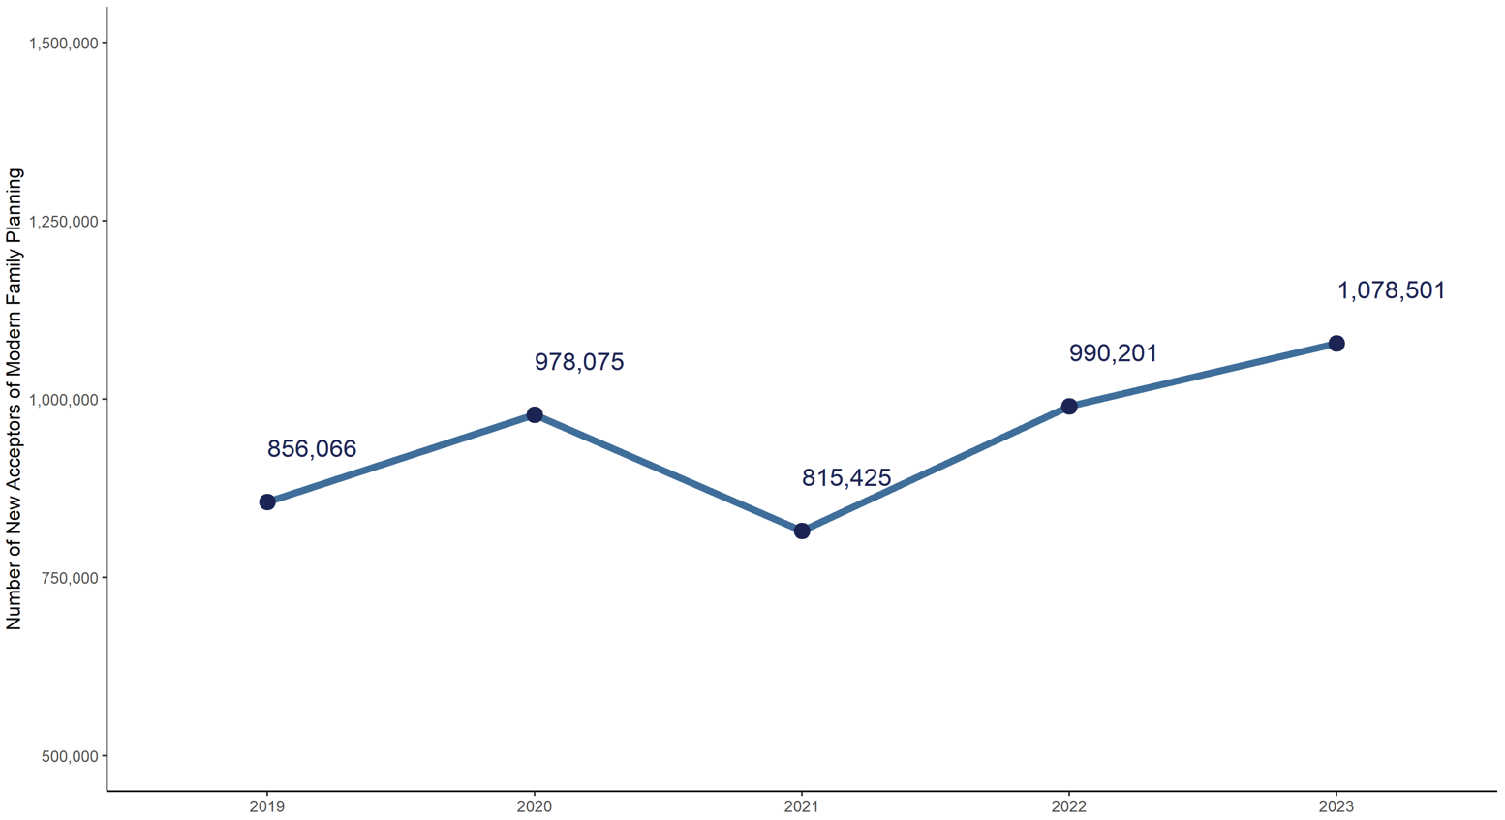
2023 Key Findings
2023 Family Planning Snapshot
Total Demand for FP | 12.9 Million
Modern FP Users (% Demand Satisfied) | 8.7 Million (67%)
New Acceptors | 1 Million
Figure 1.2: New Acceptors of Modern Family Planning, Philippines, 2019 to 2023
Figure 1.1 Current Users of Modern Family Planning, Philippines, 2019 to 2023
Source/s: Department of Health Epidemiology Bureau - Field Health Services Information System (FHSIS)
https://track20.org/download/pdf/Track20%20Technical%20Briefs/english/Technical%20Brief_Impacts%20Averted.pdf
Notes:
The number of women of reproductive age using modern methods of family planning has been increasing in the country.
In the year 2023, there are 12.9 million (44%) women who have a demand or need for family planning.
Out of those women with demand, about 8.7 million (67%) aged 10 to 49 years were using modern methods of FP
which is 4% higher than the number of users of modern FP in 2022
and corresponds to an increase of 311,037 women.
Reference: 2023 Field Health Services Information System
[NEXT SLIDE]

Slide 4
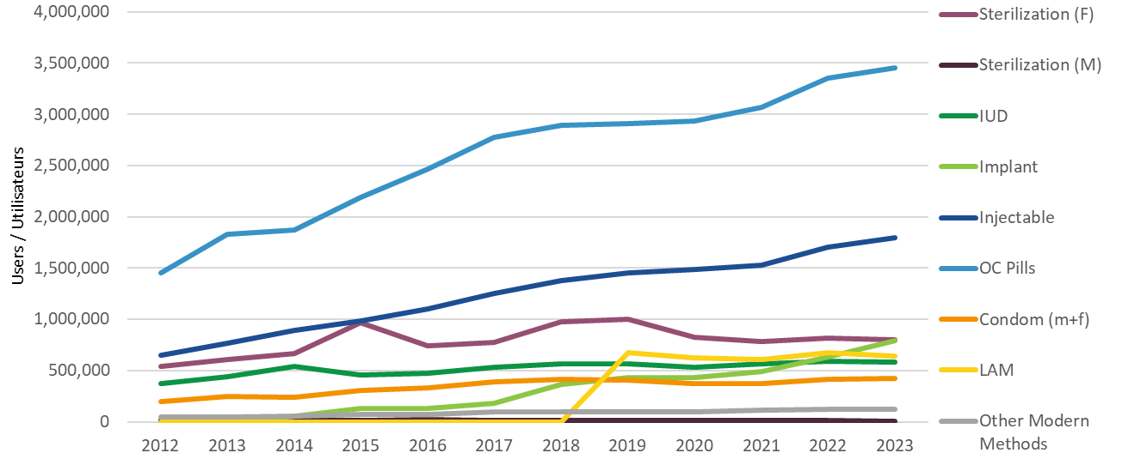
2023 Key Findings
#1 COC
#2 Injectables
#3 BTL
#4 PSI
Source/s: Department of Health Epidemiology Bureau - Field Health Information System (FHSIS)
Notes:
In terms of FP method preference, Oral pills, specifically combined-oral-contraceptives or COCs, remain to be the most commonly used modern family planning method, accounting for 34.48% of the total current users.
This was followed by injectables with 1.8 Million or 20.66% of total current users and female sterilization which accounted for 9.48% of the total modern FP users
With regards to our expansion to Long-Acting Reversible Contraceptives(LARCs), implants had the highest increase in the number of users from 2022 to 2023, which was also the observation in 2022. The users of implants have grown by 24.11% in 2023, making implants the fourth most common modern FP method.
Additionally, an 13.9% increase in the users of postpartum IUD was also observed in 2023.

Slide 5
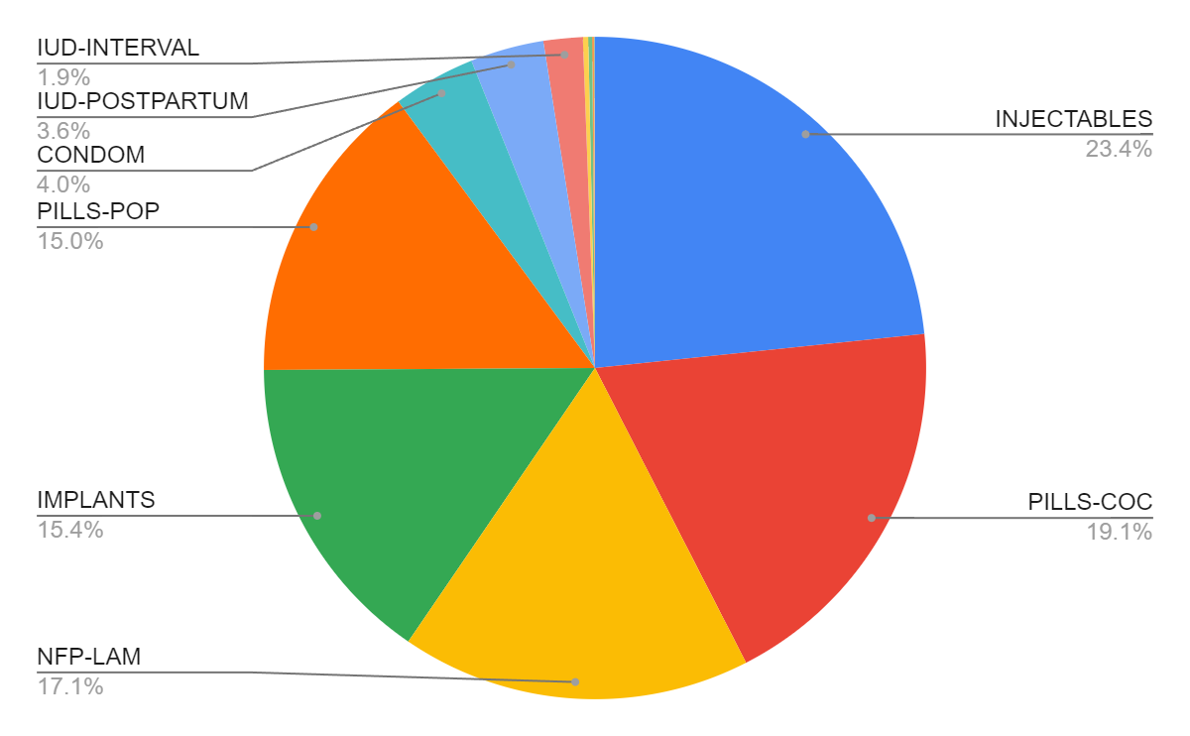
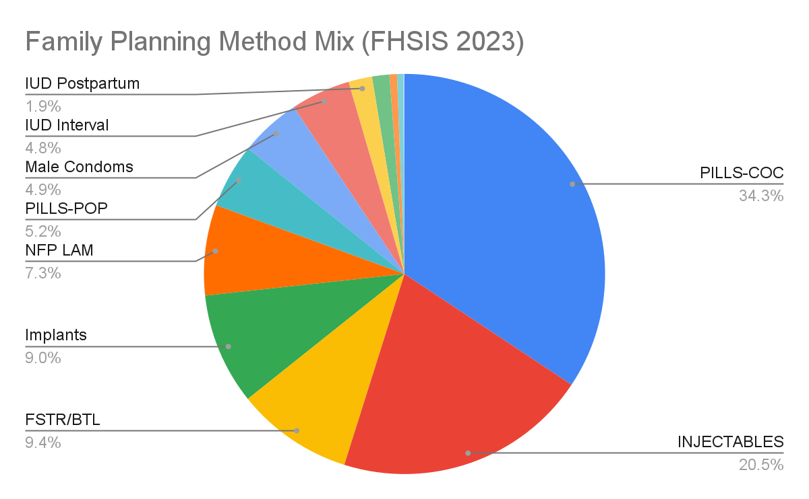
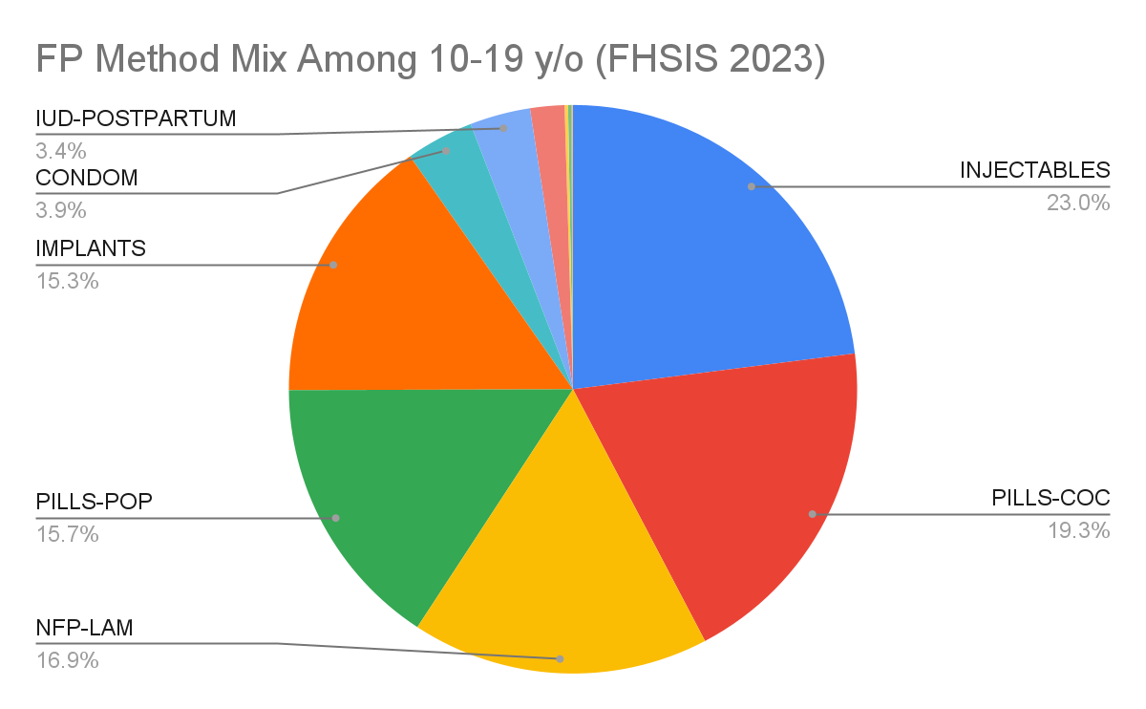
Family Planning Method Mix FHSIS 2023
Among All Women (15-49 years)
Among Adolescents (10-19 years)
COC > Injectables > BTL > Implants
Injectables > COC > LAM > Implants
Source/s: Department of Health Epidemiology Bureau - Field Health Information System (FHSIS)
Notes:
In terms of FP method preference comparing All Women vs Adolescents:
Drivers of FP Use for both are COCs and Injectables;
Top 1 for Adolescents is Injectables while COC is highest for all women.
Implants is the fourth most common modern FP method for both age groups.

Slide 6
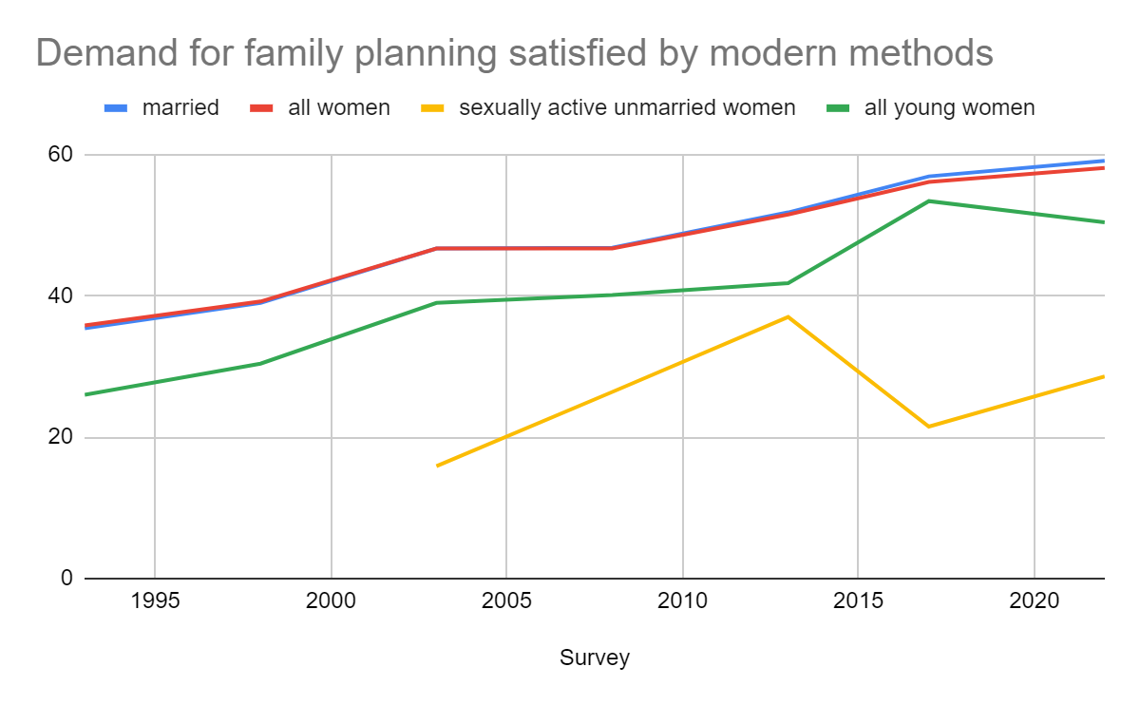
Number of women using a modern method of FP: 8,677,668 | Number of unintended pregnancies averted due to modern FP use | 3,193,623
 | Number of unsafe abortions averted due to modern FP use | 830,249
 | Number of maternal deaths averted due to modern FP use | 973
Number of women using a modern method of FP (15-49yo) 8,000,000 | Number of unintended pregnancies averted due to modern FP use | 3,000,000
 | Number of unsafe abortions averted due to modern FP use | 800,000
 | Number of maternal deaths averted due to modern FP use | 970
2023
Impact of Family Planning
Women using modern method of Family Planning
7,000,000
Unintended Pregnancies Averted * | 2.6 Million
Maternal Deaths averted* | 810
Sources: 2023 FHSIS; WRA computation using 2023 Population estimates; FP Impact using FP2030 Annual Indicator Calculator
Notes:
As a result of our FP coverage, nearly 3 million unintended pregnancies and 800,000 unsafe abortions have been avoided.
This has also prevented almost 970 maternal deaths due to complications during childbirth because of risky pregnancy.
Inshort, modern FP use can help avert maternal deaths that can result from unintended pregnancies and unsafe abortions.
And that declines in FP use may result in additional maternal deaths that could have been averted if women did not face reductions in access to modern family planning.

Slide 7
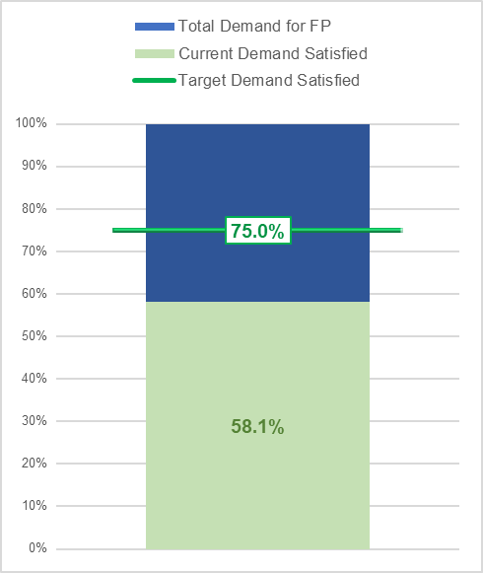
What
is our target
for FP?
Demand Satisfied with Modern Family Planning Methods of
75% by 2030
Source/s: NDHS 2022; FP Dashboard
Notes:
In alignment with the Sustainable Development Goal (SDG) Indicator 3.7.1, the target for the Demand Satisfied with Modern Family Planning Methods is set to 75% by 2030
For the target to be achieved, the program should be able to serve around 10,177, 000 women (assuming that the total demand remains constant) by 2030.

Slide 8
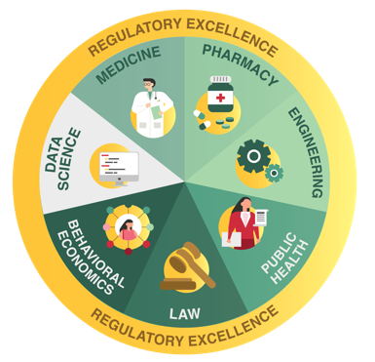
Philippines FP2030 Commitment
Commitment Objective 1: Policy
The Philippines commits to full and effective implementation of the country’s UHC Law, along with the RH Law, that will guarantee all Filipinos equitable access to quality and affordable health care, goods and services, including FP and ARH services whenever and wherever these are needed, and are protected against financial risk especially the poor, vulnerable and underserved populations.
Notes:
Commitment Objective 1: Policy
The Philippines commits to full and effective implementation of the country’s Universal Health Care (UHC) Law,
along with the Reproductive Health (RH) Law, that will guarantee all Filipinos equitable access to quality and affordable health care, goods and services,
including family planning (FP) and adolescent reproductive health (ARH) services
whenever and wherever these are needed, and are protected against financial risk especially the poor, vulnerable and underserved populations.

Slide 9
Commitment Progress: Policy
Inclusion of FP in the Devolution Transition Plan - a roadmap for LGUs
Draft Reproductive Health Multi-Sectoral Work Planning - unified direction for collective efforts
Joint Policies with Health, Economic and, Population and Development for the collaborative mechanism for FP program
Integrating FP with other basic services through the Omnibus Health Guidelines per Lifestage
Notes:
Inclusion of Family Planning in the Devolution Transition Plan - a roadmap for Local Government Units.
Reproductive Health Multi-Sectoral Work Planning- In collaboration with USAID for the initial draft of the framework this will be used as a blueprint or guide for all government actors, technical assistance providers, donors, and other stakeholders in setting the goals, objectives, and performance scorecards. It provides unified direction for collective efforts in advancing reproductive health and socio-economic development in the Philippines. Currently we are being assisted by UNFPA for the final technical and copy editing.
Joint Policies with Health, Economic and, Population and Development for the collaborative mechanism for FP program
Integrating FP with other basic services through the Omnibus Health Guidelines per Lifestage
Commodity security, capacity building on forecasting and supply planning, inventory analysis,
Philippine health insurance (Philhealth) Inclusion of Family Planning - The PhilHealth offers benefit package for modern family planning services in Free-standing Family Planning (FP) Clinics and other health care institutions accredited by PHIC (PhilHealth Circulars 2018-0017, 2018-005, 038-2015, and 16 s. 2008).To date it includes (1) Insertion of IUD, (2) subdermal contraceptive implant, (3) vasectomy (including no-scalpel vasectomy), (4) bilateral tubal ligation
Final Topics in the Health Technology Assessment Priority list released May 2024 includes 2 rod implants (Levonorgestrel 75mg Subdermal implant) and hormonal implants (Levonorgestrel (52mg) Intrauterine Device (IUD). The Self injectable FP or the DMPA-SC will be resubmitted in this year's opening of HTA Topic Nomination

Slide 10
Commitment Progress: Policy
Commodity security, capacity building on forecasting and supply planning, inventory analysis
PhilHealth Inclusion of FP – offers benefit package for modern FP services in free-standing FP Clinics and other health care institutions accredited by PHIC
Final Topics in the Health Technology Assessment Priority list released May 2024
Levonorgestrel 75mg Subdermal implant
Levonorgestrel 52mg Intrauterine Device (IUD)
*DMPA-SC will be resubmitted in this year's opening of HTA Topic Nomination
Notes:
Inclusion of Family Planning in the Devolution Transition Plan - a roadmap for Local Government Units.
Reproductive Health Multi-Sectoral Work Planning- In collaboration with USAID for the initial draft of the framework this will be used as a blueprint or guide for all government actors, technical assistance providers, donors, and other stakeholders in setting the goals, objectives, and performance scorecards. It provides unified direction for collective efforts in advancing reproductive health and socio-economic development in the Philippines. Currently we are being assisted by UNFPA for the final technical and copy editing.
Joint Policies with Health, Economic and, Population and Development for the collaborative mechanism for FP program
Integrating FP with other basic services through the Omnibus Health Guidelines per Lifestage
Commodity security, capacity building on forecasting and supply planning, inventory analysis,
Philippine health insurance (Philhealth) Inclusion of Family Planning - The PhilHealth offers benefit package for modern family planning services in Free-standing Family Planning (FP) Clinics and other health care institutions accredited by PHIC (PhilHealth Circulars 2018-0017, 2018-005, 038-2015, and 16 s. 2008).To date it includes (1) Insertion of IUD, (2) subdermal contraceptive implant, (3) vasectomy (including no-scalpel vasectomy), (4) bilateral tubal ligation
Final Topics in the Health Technology Assessment Priority list released May 2024 includes 2 rod implants (Levonorgestrel 75mg Subdermal implant) and hormonal implants (Levonorgestrel (52mg) Intrauterine Device (IUD). The Self injectable FP or the DMPA-SC will be resubmitted in this year's opening of HTA Topic Nomination

Slide 11
Philippines FP2030 Commitment
Commitment Objective 2: Program
The Philippines commits to providing equitable access to FP information and services to all women, men, boys, and girls regardless of marital, socioeconomic status, religion, ethnicity, and in any situation such as during health emergencies and disasters. The Program aims to achieve a 75 percent demand satisfied with modern FP methods by the year 2030.
Demand Satisfied with Modern Family Planning Methods of
75% by 2030
Notes:
Commitment Objective 2: Program
The Philippines commits to providing equitable access to FP information and services to all women, men, boys, and girls
regardless of marital, socioeconomic status, religion, ethnicity,
and in any situation such as during health emergencies and disasters.
The Philippine Family Planning Program aims to achieve an 75 percent demand satisfied with modern FP methods by the year 2030.

Slide 12
Commitment Progress: Program
FP in Maternal Care Services, and Pre-marriage orientation and counselling
Electronic Logistics Management Information System (eLMIS) and increasing data visibility
Co-management in distribution of commodities w/ CPD
Task-sharing of FP Provision by Community Health Worker
Mobilization of Itinerant teams for FP
Inclusion of FP to Intermediate Health Facilities (BUCAS”Open” Center)
Notes:
FPin Maternal Care Services, and Pre-marriage orientation and counselling
Electronic Logistics Management Information System (eLMIS) and increasing data visibility
Commission on Population and Development co-management in distribution of commodities
Task-sharing of FP Provision by Community Health Worker - BHW assist in information dissemination and referral, resupply of pills and condoms.
Mobilization of Itinerant teams for Family Planning - supported by an issuance for the conduct of mobile outreach and manual is currently being finalized through the assistance of USAID
Inclusion of FP to Intermediate Health Facilities (BUCAS”Open” Center) Health is Life Campaign (Healthy Schools, Communities, Workplace, Hospitals)
Adolescent-Friendly Health Care Providers and Facilities - Currently we have Level 1 = 1457; Level 2 = 364; Level 3 = 34
Implementation of the Comprehensive Sexuality Education and Adolescent Reproductive Health (CSE-ARH) convergence - through DepEd - they are mandated to develop mentally- and age-appropriate RPRH curriculum for the K-12 Basic Education Curriculum.
Conduct of training of Adolescent Job Aid Skills Enhancement Training through CHDs
Readiness Assessment in Providing the Minimum Initial Service Package for Sexual and Reproductive Health in Emergencies (MISP-SRH) in the Philippines (Done last May 8-9, 2024, partnered with UNFPA, FPOP) and BARMM (Done last August 12-13, 2024, partnered with FPOP); Ongoing development of MISP-SRH Basic Training Manual partnered with UNFPA, ACCORD
Possible Training of Facilitators on November 2024 (tentative)
Capacity Building and Development of e-learning Modules

Slide 13
Commitment Progress: Program
Adolescent-Friendly Health Facilities and Care Providers (AJA-trained)
I Choose for Social and Behavior Change Communication among adolescents
Collaboration in the Comprehensive Sexuality Education and Adolescent Reproductive Health (CSE-ARH) convergence
Minimum Initial Service Package (MISP) for SRH
Capacity Building and Development of e-learning Modules for FPCBT-1
FP Basic Course = 1626 ( general audience)
FPCBT-1 = 447 (FP providers)
Notes:
FPin Maternal Care Services, and Pre-marriage orientation and counselling
Electronic Logistics Management Information System (eLMIS) and increasing data visibility
Commission on Population and Development co-management in distribution of commodities
Task-sharing of FP Provision by Community Health Worker - BHW assist in information dissemination and referral, resupply of pills and condoms.
Mobilization of Itinerant teams for Family Planning - supported by an issuance for the conduct of mobile outreach and manual is currently being finalized through the assistance of USAID
Inclusion of FP to Intermediate Health Facilities (BUCAS”Open” Center) Health is Life Campaign (Healthy Schools, Communities, Workplace, Hospitals)
Adolescent-Friendly Health Care Providers and Facilities - Currently we have Level 1 = 1457; Level 2 = 364; Level 3 = 34
Implementation of the Comprehensive Sexuality Education and Adolescent Reproductive Health (CSE-ARH) convergence - through DepEd - they are mandated to develop mentally- and age-appropriate RPRH curriculum for the K-12 Basic Education Curriculum.
Conduct of training of Adolescent Job Aid Skills Enhancement Training through CHDs
Readiness Assessment in Providing the Minimum Initial Service Package for Sexual and Reproductive Health in Emergencies (MISP-SRH) in the Philippines (Done last May 8-9, 2024, partnered with UNFPA, FPOP) and BARMM (Done last August 12-13, 2024, partnered with FPOP); Ongoing development of MISP-SRH Basic Training Manual partnered with UNFPA, ACCORD
Possible Training of Facilitators on November 2024 (tentative)
Capacity Building and Development of e-learning Modules

Slide 14
Philippines FP2030 Commitment
Commitment Objective 3: Financial
The Philippines commits to ensuring and increasing domestic funding for the family planning program. Throughout this partnership, at least US$ 20 Million will be allocated and spent annually by the national government for the family planning program for commodity security, systems strengthening, service provision, social and behavior change communication activities, financial protection especially among the poor and underserved populations, and building the capacity of the city- and province-wide healthcare systems.
Notes:
The Philippines commits to ensuring and increasing domestic funding for the family planning program.
Throughout this partnership, at least US$ 20 Million will be allocated and spent annually by the national government for the family planning program for commodity security, systems strengthening, service provision, social and behavior change communication activities, financial protection especially among the poor and underserved populations, and building the capacity of the city- and province-wide healthcare systems.

Slide 15
Commitment Progress: Financing
Financing Support to Centers for Health and Development
Exploring strategic procurement reforms
Expansion of benefit packages for FP
FP commodities procured by the National Government are given for free to clients and/or are subsidized by PhilHealth.
Notes:
Financing Support to Centers for Health and Development
Exploring strategic procurement reforms
Expansion of benefit packages for FP
FP commodities are procured by the National Government are given for free to clients and/or are subsidized by PhilHealth.

Slide 16
As of the FY 2024, there is a P749,919,000 allotted for the line time of Family Planning and Reproductive Health (FPRH) dedicated for commodities from the Central Office (CO).
In addition to national budget allocation, the regions through the Centers for Health Development have P7,588,296,000 for Family Health, Immunization, Nutrition and Responsible Parenting (FHINRP) budget that can be allotted to FP commodities if there is a need for augmentation.
Additionally, P14,847,320 suballotment to CHD for CO budget augmentation for FP trainings
Budget Item | Reproductive Health
FPRH | 749,919,000
PHM | 14,847,320
TOTAL in Peso: | 764,766,320
Notes:
FPRH- hard component
PHM- soft component,

Slide 17
Philippines FP2030
Action Plan
PRIORITY AREA: Policy
ACTIONS: Advocacy on Adolescent Pregnancy Prevention Bill Rescission of Policy requiring FDA Analysis for procuring FP commodities Strengthen accountability - Quarterly meeting (FP2030 focals, DOH, CPD, UNFPA, USAID, WHO, Likhaan/PSRP)
PRIORITY AREA: Programming
ACTIONS: Expand FP Choices Strengthen Immediate Postpartum FP, with emphasis of ICV (include adolescent mothers) Expansion of training of community health workers Revival of National Implementation Team for Reproductive Health Data visibility
PRIORITY AREA: Financing
ACTIONS: Expansion of PhilHealth COPB (includes removal of PSI- single / double rods) Closing the gap of Philhealth reimbursements Incentivize the establishment and maintenance of AFHF
Notes:
Among the priority

Slide 18
Maraming Salamat
Notes:
Para sa isang Healthy Pilipinas kung saan bawat buhay mahalaga. Maraming salamat po!
[END OF PRESENTATION]

Slide 19
Optional Slides

Slide 20
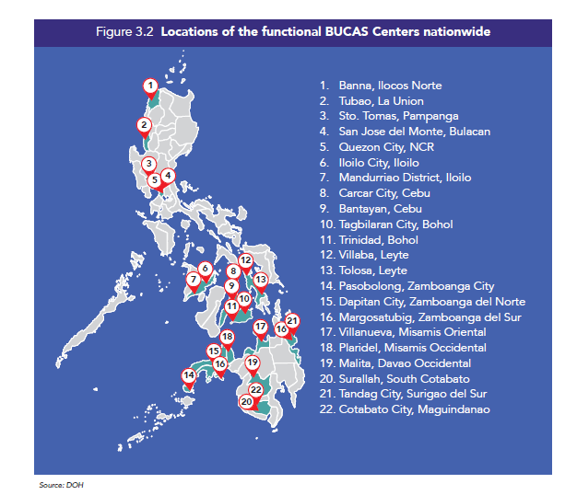
BUCAS - BAGONG URGENT CARE AND AMBULATORY SERVICE CENTER
The BUCAS centers are envisioned to provide ambulatory and urgent services
The BUCAS center shall be integrated with the existing Healthcare Provider Network (HCPN).
As of June 3, 2024, the Office of the Secretary has received 79 proposals for new BUCAS Centers, with 16 already operational and 5 more set to be inaugurated soon.
XXXXX
Notes:
The BUCAS centers are envisioned to provide ambulatory and urgent services. To
define further, these services are any kind of individual-based services provided on
an outpatient basis; and any population-based or community-based
programs/services that may benefit the community members / constituents. These
services may range from health promotion to rehabilitation with a focus on primary
and secondary interface; may involve simple or complex/specialized procedures
depending on the capacity of the BUCAS center [e.g. elective surgeries (cataract
surgery), dermatologic procedures, dialysis, etc)]; and may or may not give
continuous care

Slide 21
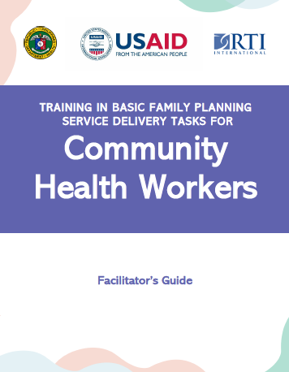
Training in Basic Family Planning Service Delivery Tasks for CHW
Designed for continuous coaching of CHWs who perform or will perform FP tasks to provide correct messages
Promotes proper shifting of tasks in FP service delivery and programming.
Support needed: Transportation allowance and supplies
Trained 99 Health Service Providers as trainers and 504 CHWs as Basic FP Service Delivery Providers
CHWs address geographic access barriers caused by health worker shortages
CHWs may reduce financial barriers for clients
CHWs can address the social barriers that inhibit family planning use
CHWs reach women whose mobility is constrained by social norms
Training Manual In Basic Family Planning
Service Delivery Tasks For Community Health Workers
HIP
Notes:
Link: Community health workers: bringing family planning services to where people live and work
Complements the Barangay Health Worker Reference Manual developed by the DOH in 2022.

Slide 22
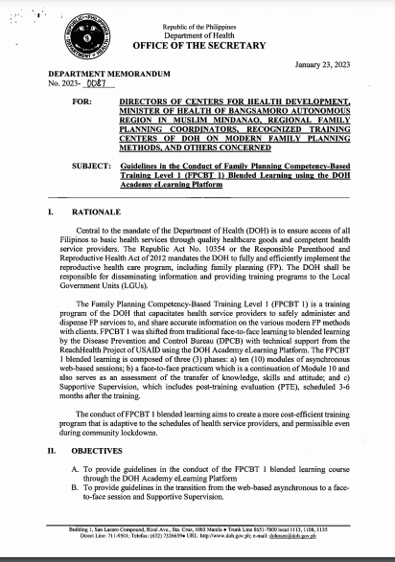
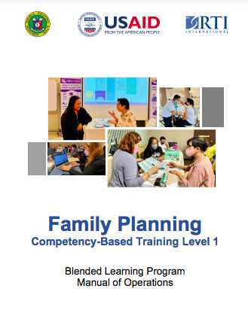
E-Learning for Family Planning Competency Based Training
Basic Course in Family Planning
Department Memorandum Guideline
Blended Learning Program Manual
Expand Access to Methods by strengthening FP training
Mix of online, in-person, and post-training evaluation activities
Designed for health professionals – doctors, nurses, and midwives.
The online course can be taken by both FP providers and non service providers
https://learn.doh.gov.ph/
Notes:
https://tinyurl.com/FPTrainersGuide

Slide 23
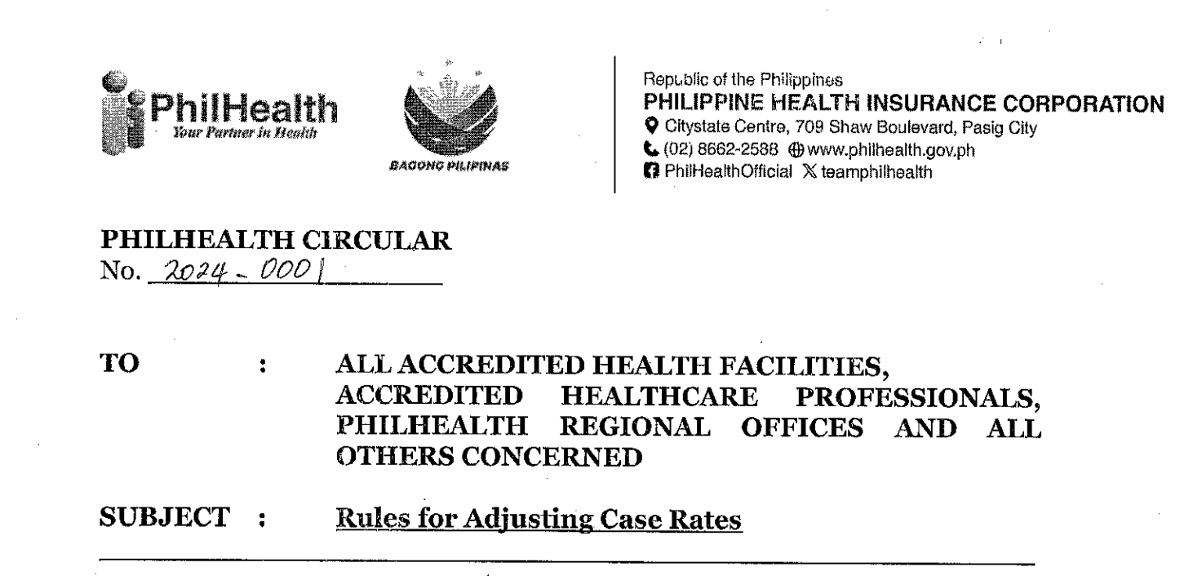
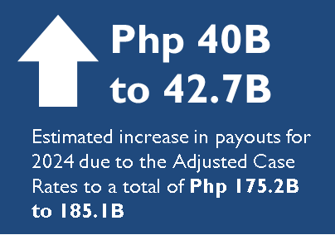
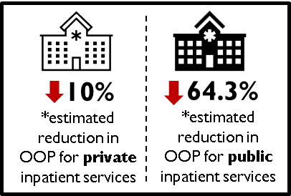
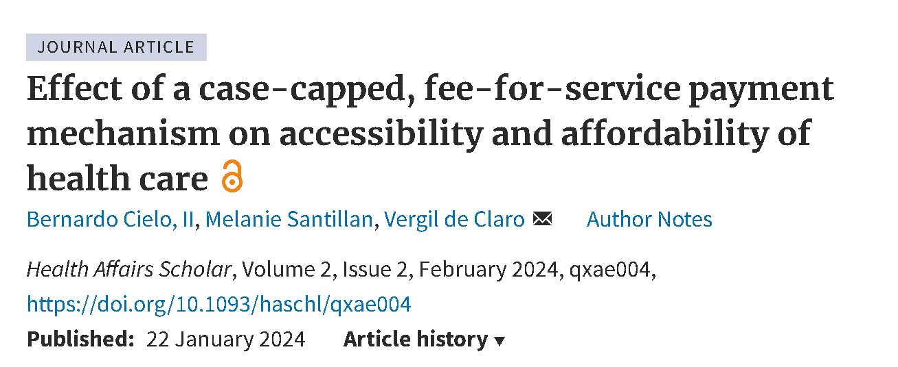
Improving Insurance Payments for Family Planning Services
Social Health Insurance Policy support provided to the Philippines is expected to drive up payments for family planning services by USD 8.9M and total SHI payment by up to USD 776.3M in 2024.
PhilHealth Policy
https://www.philhealth.gov.ph/circulars/2024/PC2024-0001.pdf
Commentary Article (Health Affairs Scholar)
https://academic.oup.com/healthaffairsscholar/article/2/2/qxae004/7585307

Slide 24
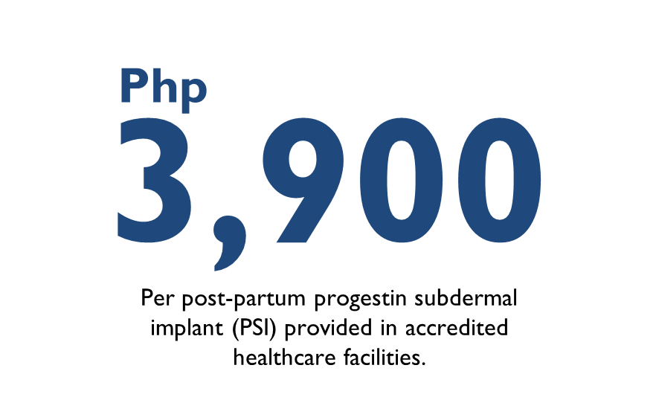
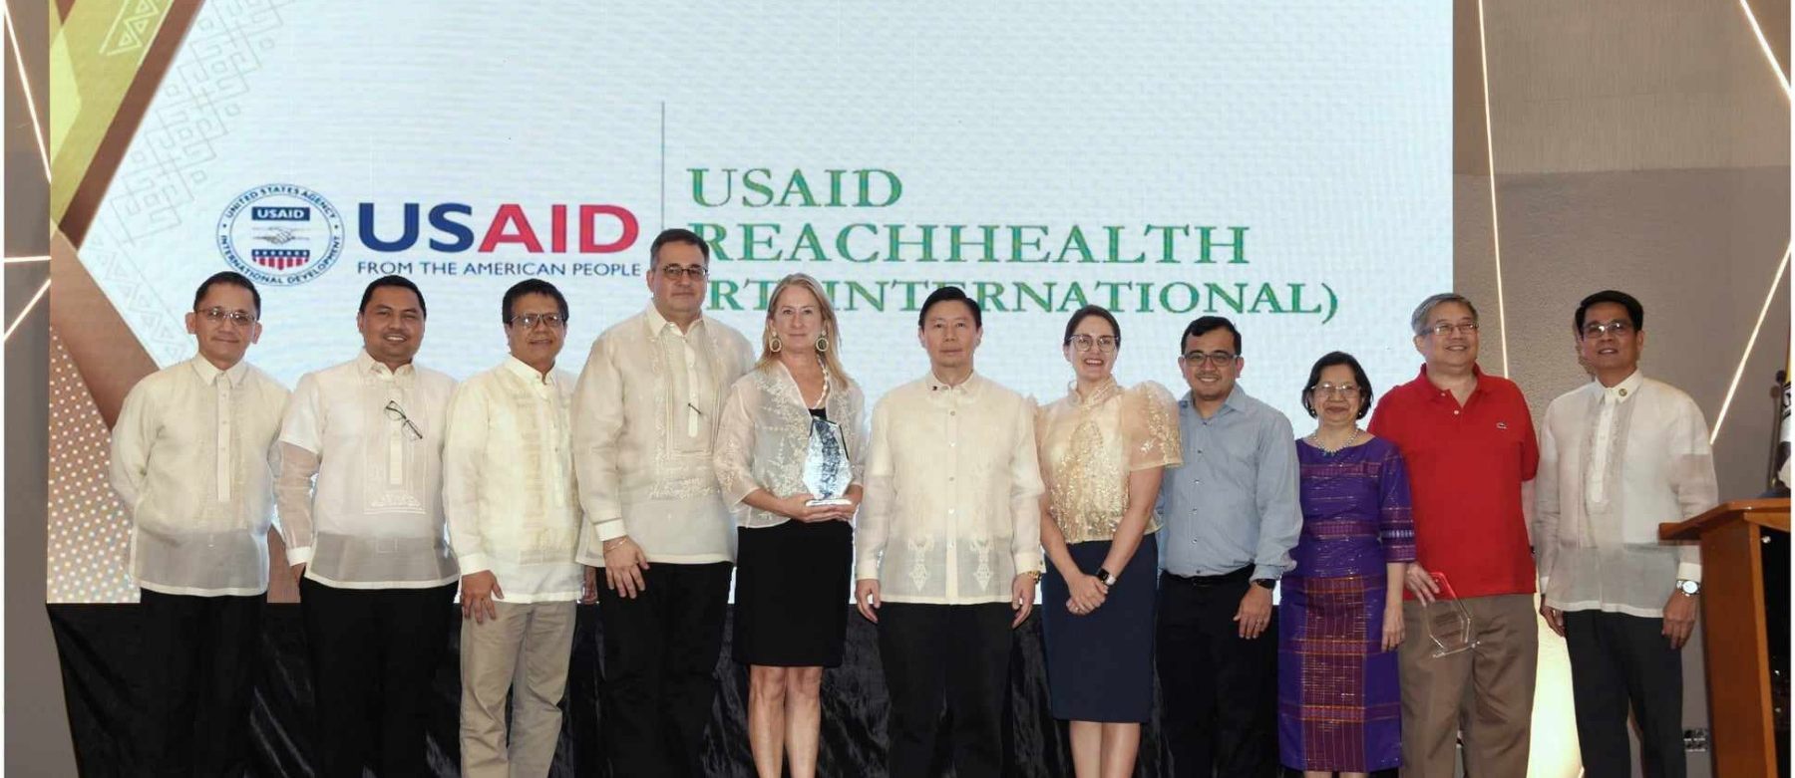
Inclusion of Postpartum PSI coverage
Postpartum Progestin Subdermal Implant (PSI) was included in social health insurance coverage. Prior 2024, Postpartum PSI was not covered under the National Health Insurance Scheme.
PhilHealth Stakeholders Awarding for USAID for technical assistance provided from 2019-2024
in developing social insurance policies on Primary Care, SDG benefits (FP), and COVID-19.
PhilHealth Policy Rules of Adjusting Case Rates

Slide 25
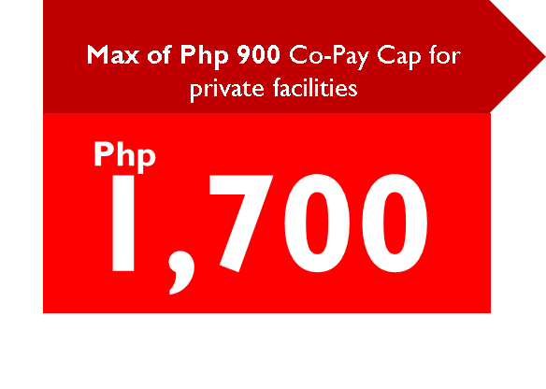
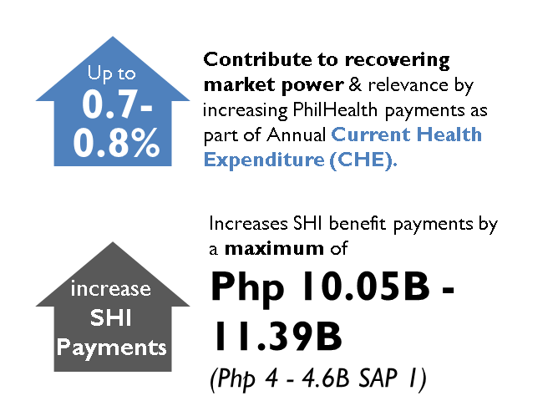
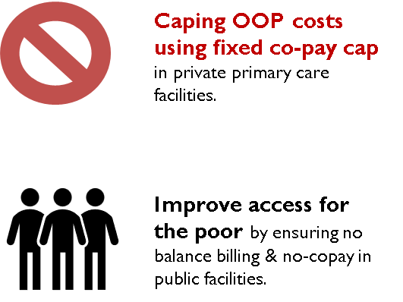
Strengthening Primary Care Financing & FP & ARH in Primary Care Settings
Capitation for primary care services was increased. Primary care (Konsulta) serves as an important gatekeeper and navigator in accessing Family Planning services.
Primary care seeks to cover primary care consultations including FP counselling & adolescent reproductive health (ARH) consultations, select primary care medicines & diagnostics.
Approx. 300% increase (from Php 500 & Php 750 per capita)

Slide 26
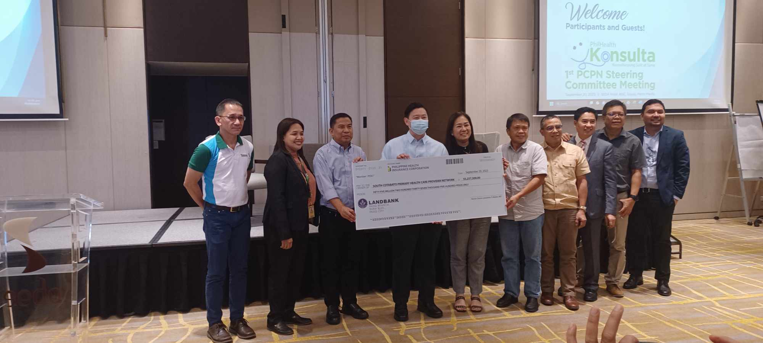
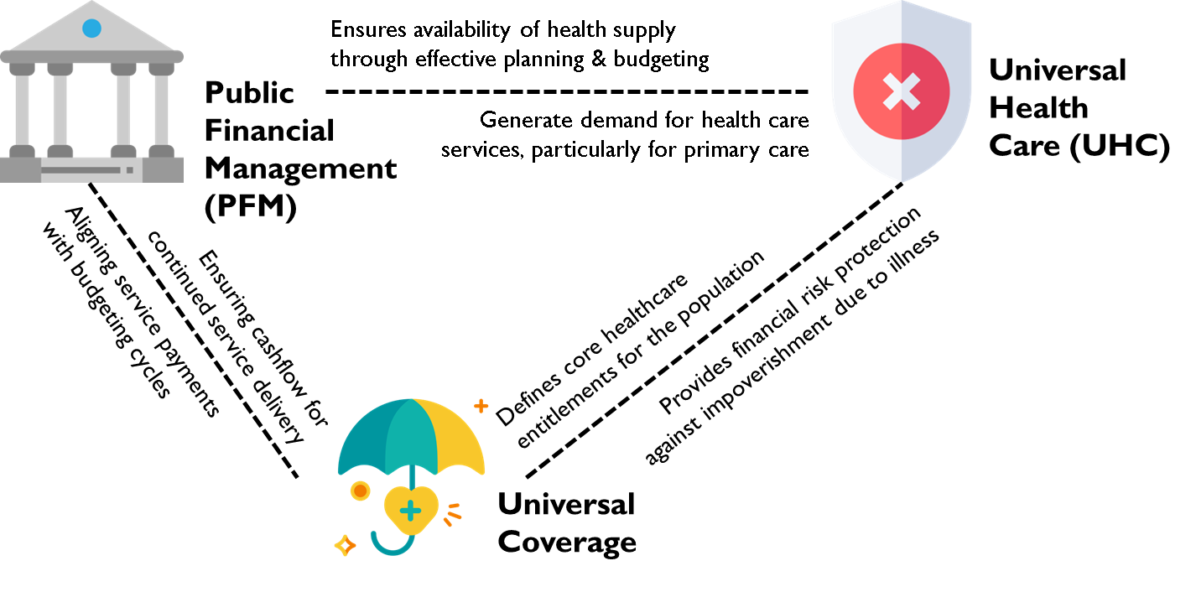
Supporting the formation of Primary Care Networks
Primary Care capitation was frontloaded to select provinces including South Cotabato under a sandbox implementation as part of an effort to align Health Financing (HF) with Public Financial Management (PFM) in the Philippines.
Ceremonial awarding of the first tranche payments to South Cotabato Primary Care Provider Network during the First PCPN Steering committee.
First PCPN Steering committee conducted on September 2023.
Php 55M
was frontloaded to South Cotabato in 2023 that they can immediately use to expand health supply (including FP).
323%
Increase in primary care consultations since frontloading (including FP consults) from 2022-2023.
Php 28.9M
money value of service delivered in South Cotabato within the first 4 months of implementation.
100%
Provision of essential primary care medicines for NCD & infectious disease management in South Cotabato.

Slide 27
CSE-ARH CONVERGENCE
Implementation of the Comprehensive Sexuality Education and Adolescent Reproductive Health (CSE-ARH) convergence in 9 regions and 16 LGUs, including 109 schools (68 pilot, 41 expansion schools) and 124 partner health facilities.
Conduct of psychosocial screening (Rapid and Comprehensive HEEADSSS in schools and health facilities)
Peer Health Navigators installed as agents to normalize accessing health and non-health services among adolescents
USAID ReachHealth: CSE-ARH Convergence Framework

Slide 28
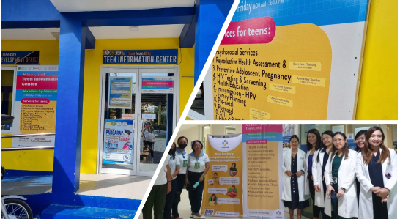
FUNCTIONAL ADOLESCENT FRIENDLY HEALTH FACILITIES
553 health facilities supported by USAID ReachHealth, WHO Philippines (Subnational Initiative Phase 2) and UN Joint Programme on Adolescent Pregnancy as functional AFHF, each having 8 functional elements:
Facility is known to the community through signages
Utilizes up-to-date and age-appropriate SBC materials
Holds demand generation activities through different modalities
Staff trained on appropriate approach to adolescents through Foundational Course on Adolescent Health, AJA, ADEPT, conduct of Rapid HEEADSSS
Offers audio-visual privacy and practice of confidentiality of information
Provides age-appropriate information and services, ensuring confidentiality
Clear and easy to access referral linkages and follow-up
System of recording and reporting
Notes:
281 USAID + 272 WHO Subnational Initiative Phase 2 (Davao, Caraga and Western Visayas Regions) and UN Joint Programme on Accelerating the Reduction of Adolescent Pregnancy (JPARAP) in Eastern Visayas;
Photo below with consent

Slide 29
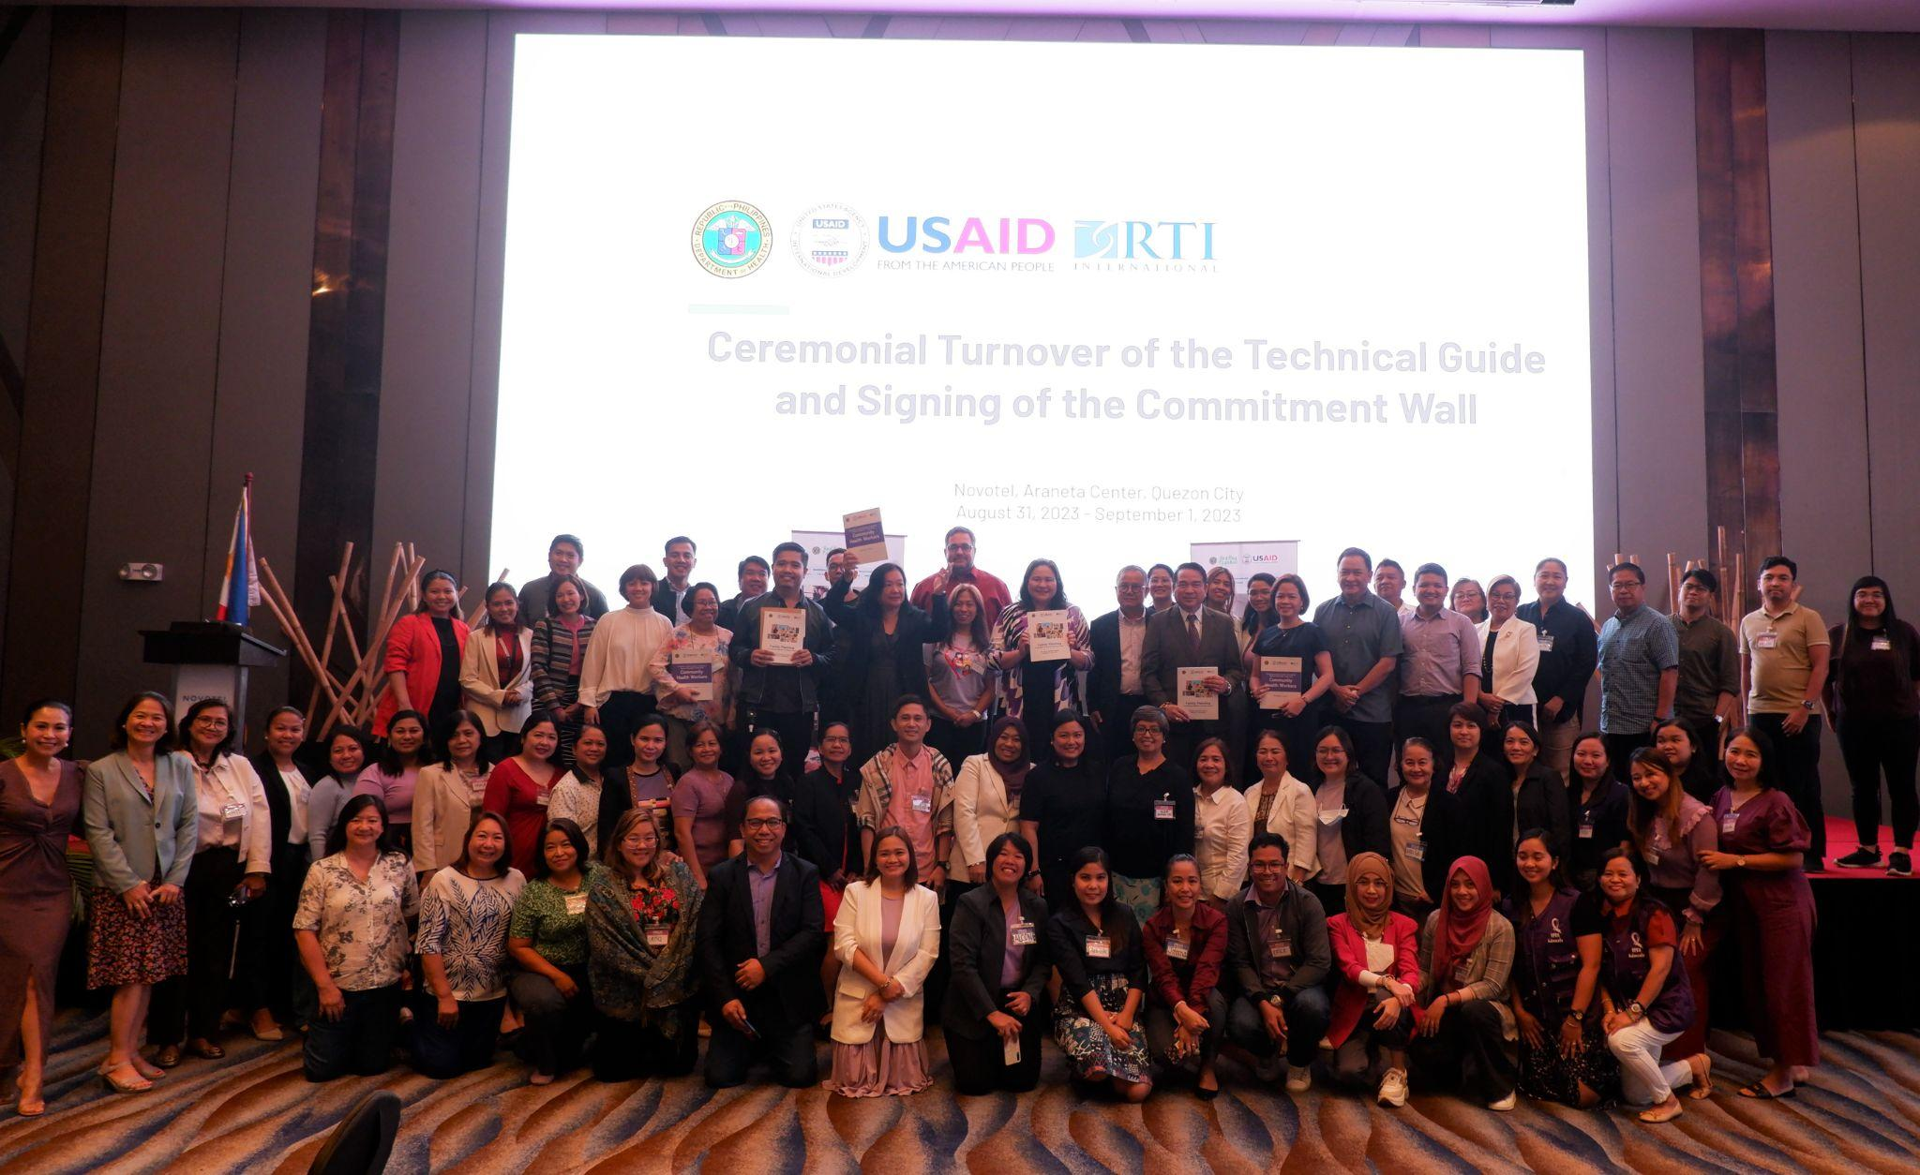
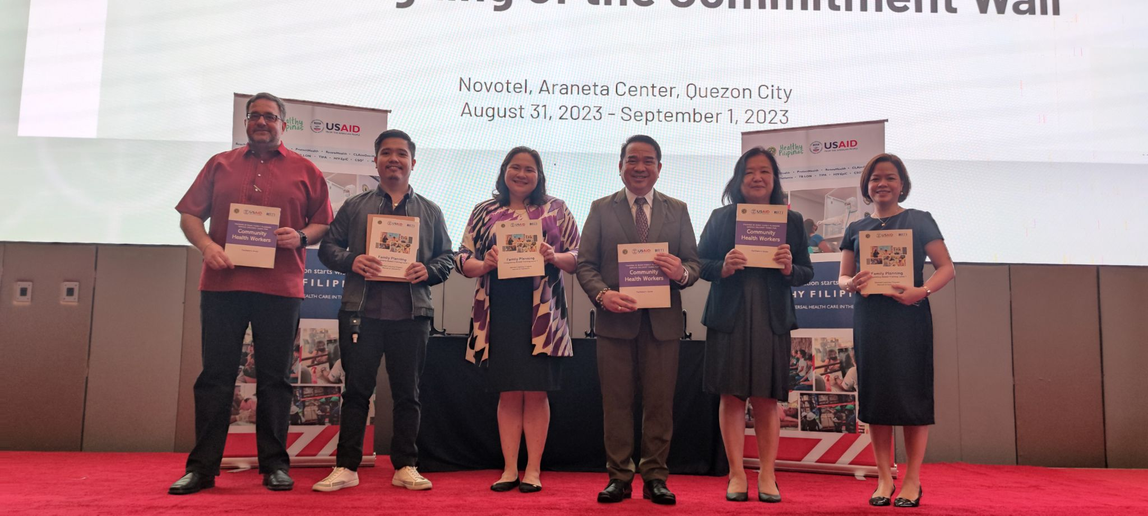
Launching of Basic Course in Family Planning/ Didactics of FPCBT-1
The DPCB together with USAID’s ReachHealth launched the Blended Learning Program (BLP) for the Family Planning Competency-Based Training level 1 (FPCBT-1) as well as the Training Course in Basic Family Planning Service Delivery for Community Health Workers on August 31, 2023. The event was attended by FP program regional coordinators and by representatives of selected LGUs, CSOs, FP training providers, and DOH-retained hospitals.
The event continued with a planning workshop with CHD representatives until September 1, 2023, where discussion was made for the operationalization of the FPCBT training and strengthening community-based FP service delivery and lastly consultations was done for the national and regional targets for FP and Adolescent Health.
No. Completers (as of 2023) | Type of Training
403 | Basic Course in Family Planning (DOH Academy Platform)
129 | FPCBT-1 Blended Training Program (including in-person training)

Slide 30
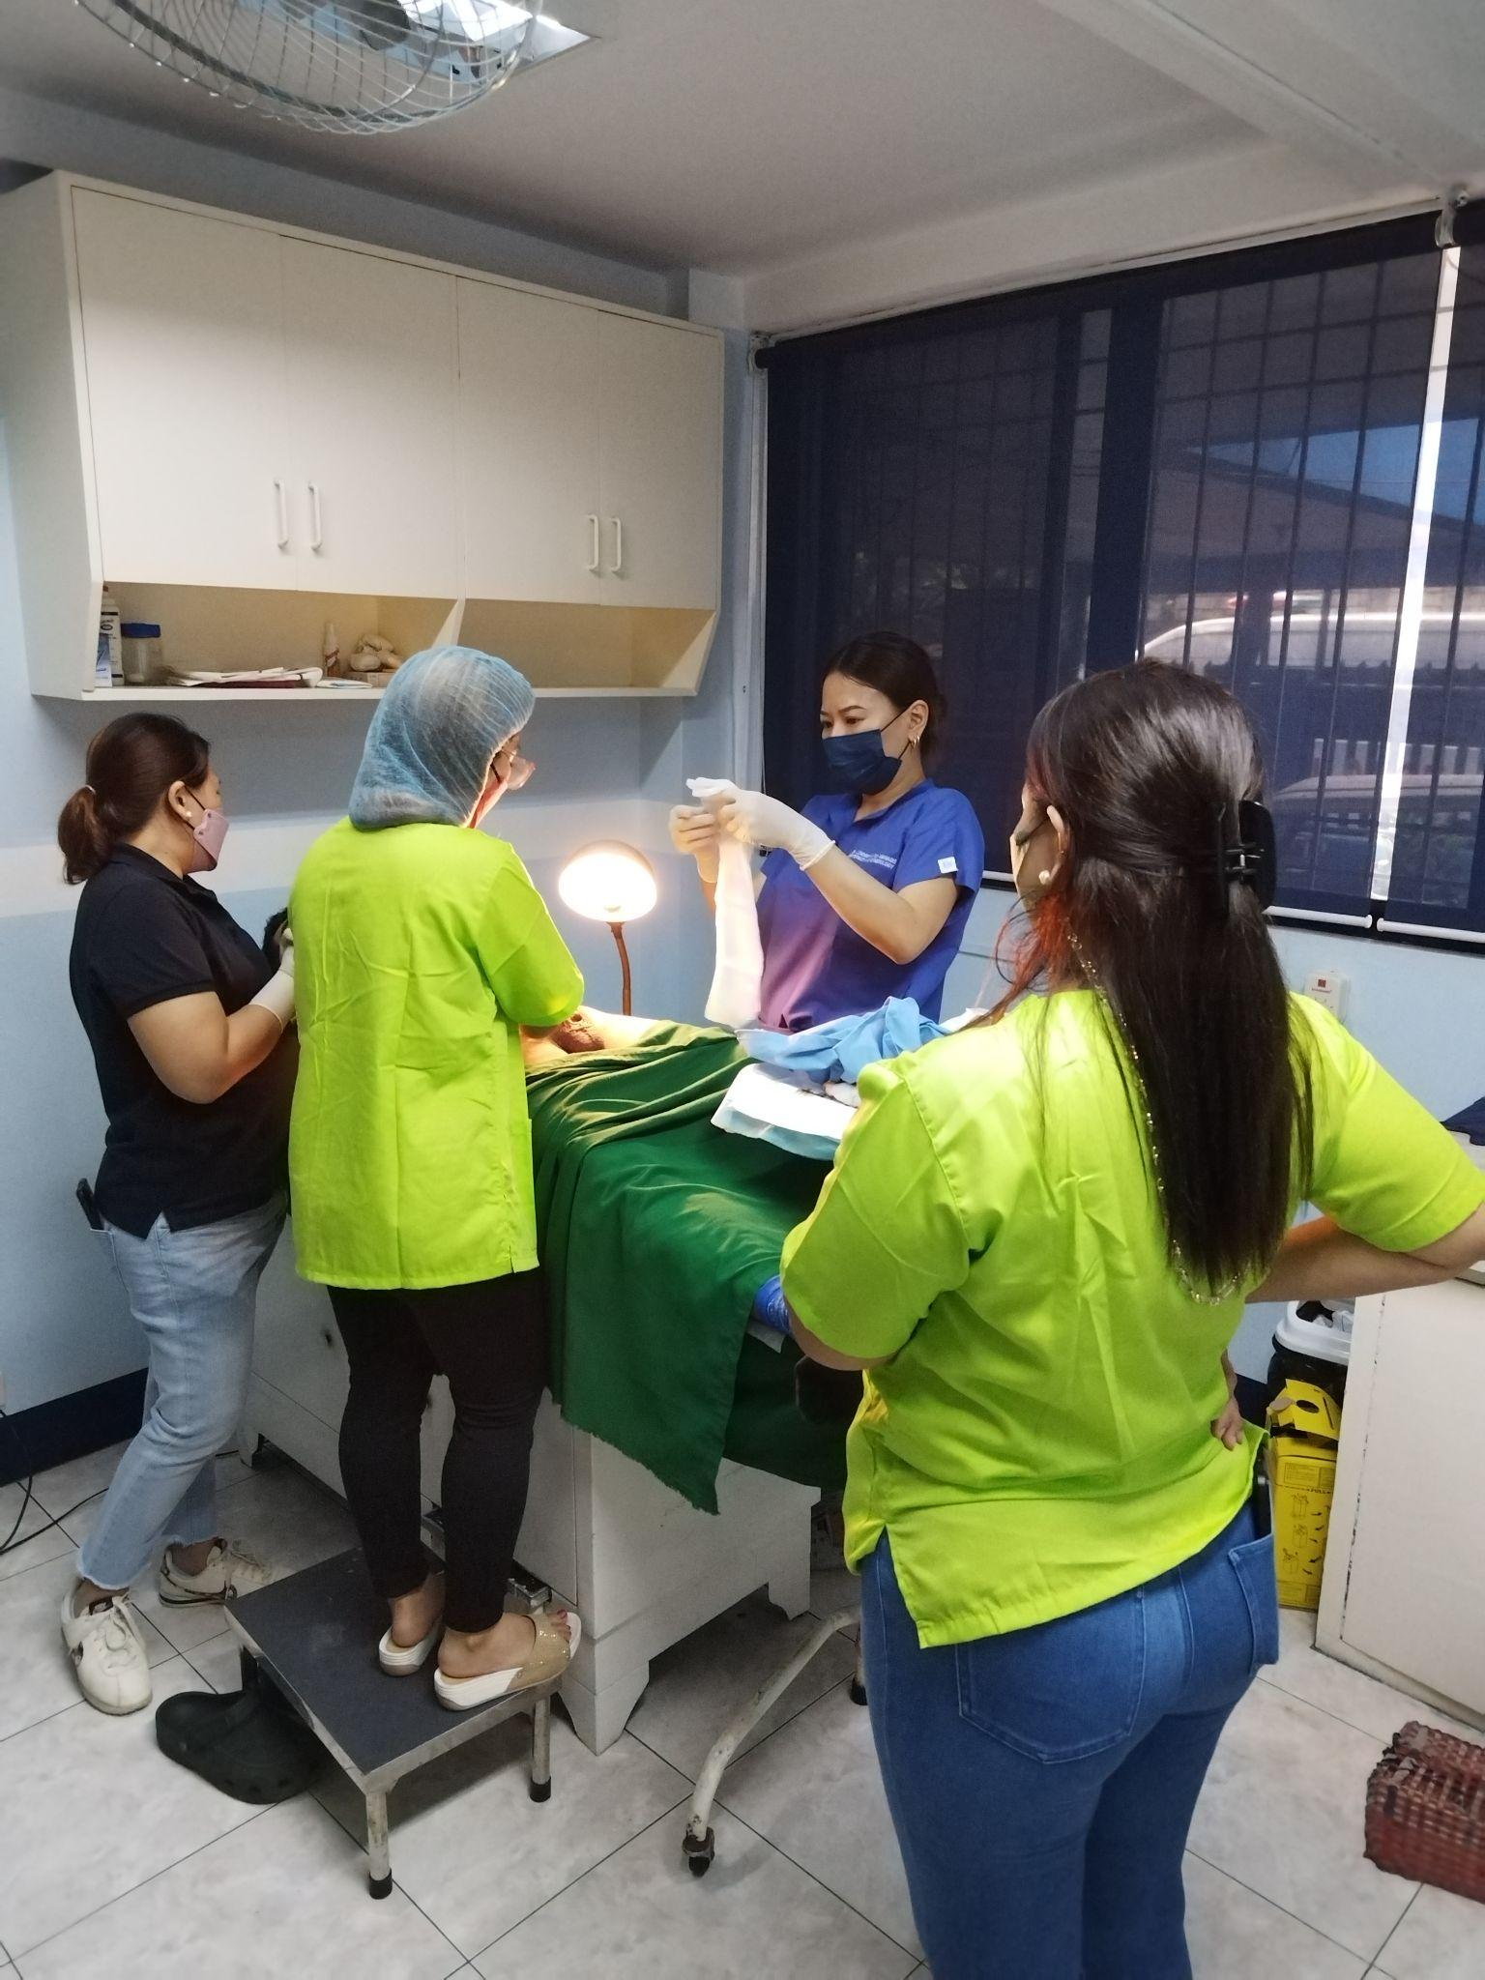
Increasing Access to Broad Range of FP Services
Supported the mobilisation and/or capacity strengthening for 30 FP itinerant teams, in collaboration with CSOs, to increase access to FP services in hard-to-reach areas.
In collaboration with DOH, CHDs, CPD, IMAP, PSRP, and other stakeholders, trained 428 HSPs in various FP services: 172 in FP counselling through FPCBT 1; 206 in progestin-subdermal implant (PSI); 40 in interval intra-uterine device (IUD); 6 in postpartum IUD, and 4 in non-scalpel vasectomy (NSV). In addition, the project has supported 27 FP trainers: 9 in FPCBT level 1 and 18 in PSI.
Installed NSV services in 16 health facilities in Pampanga, Manila, Iloilo, and Negros Occidental, Agusan Del Norte, General Santos and Zamboanga Del Sur in collaboration with the Cooperative Movement for Encouraging NSV (CMEN) serving as training provider for Luzon and Visayas, and the City Health Office of Davao in Mindanao.
Capacitated and collaborated with the Philippine Obstetrical and Gynecological Society – Cebu to build the capacity of HSPs in FP/ARH services and support the establishment of adolescent-friendly health facilities.
USAID ReachHealth - Installation of NSV Services Tondo Foreshore Super Health Center and Lying- In Clinic in collaboration with CMEN

Slide 31
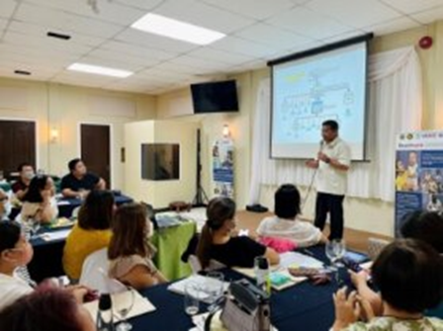
Continuous Quality Improvement of FP Services
Supported DOH in developing an online introductory course on CQI that is now available on DOH Academy
Technical assistance provided to almost 300 health facilities in implementing continuous quality improvement (CQI) and client satisfaction survey (CSS) mechanisms, with 6 health facilities supplied with touchscreen CSS kiosk.
Capacitated 3 LGUs (Mandaue City, San Remegio, and Cebu City) in standardizing service delivery process for family planning.
Capacitated 7 health care provider networks (Batangas, Manila, Bohol, Zamboanga Del Sur, Zamboanga Del Norte, General Santos City, and South Cotabato) in implementing quality management practices through policy development, formation, and capacitation of CQI teams, and strengthening of quality improvement learning sessions.
USAID ReachHealth - CQI Coaches Workshop in Bohol- September 2023

Slide 32
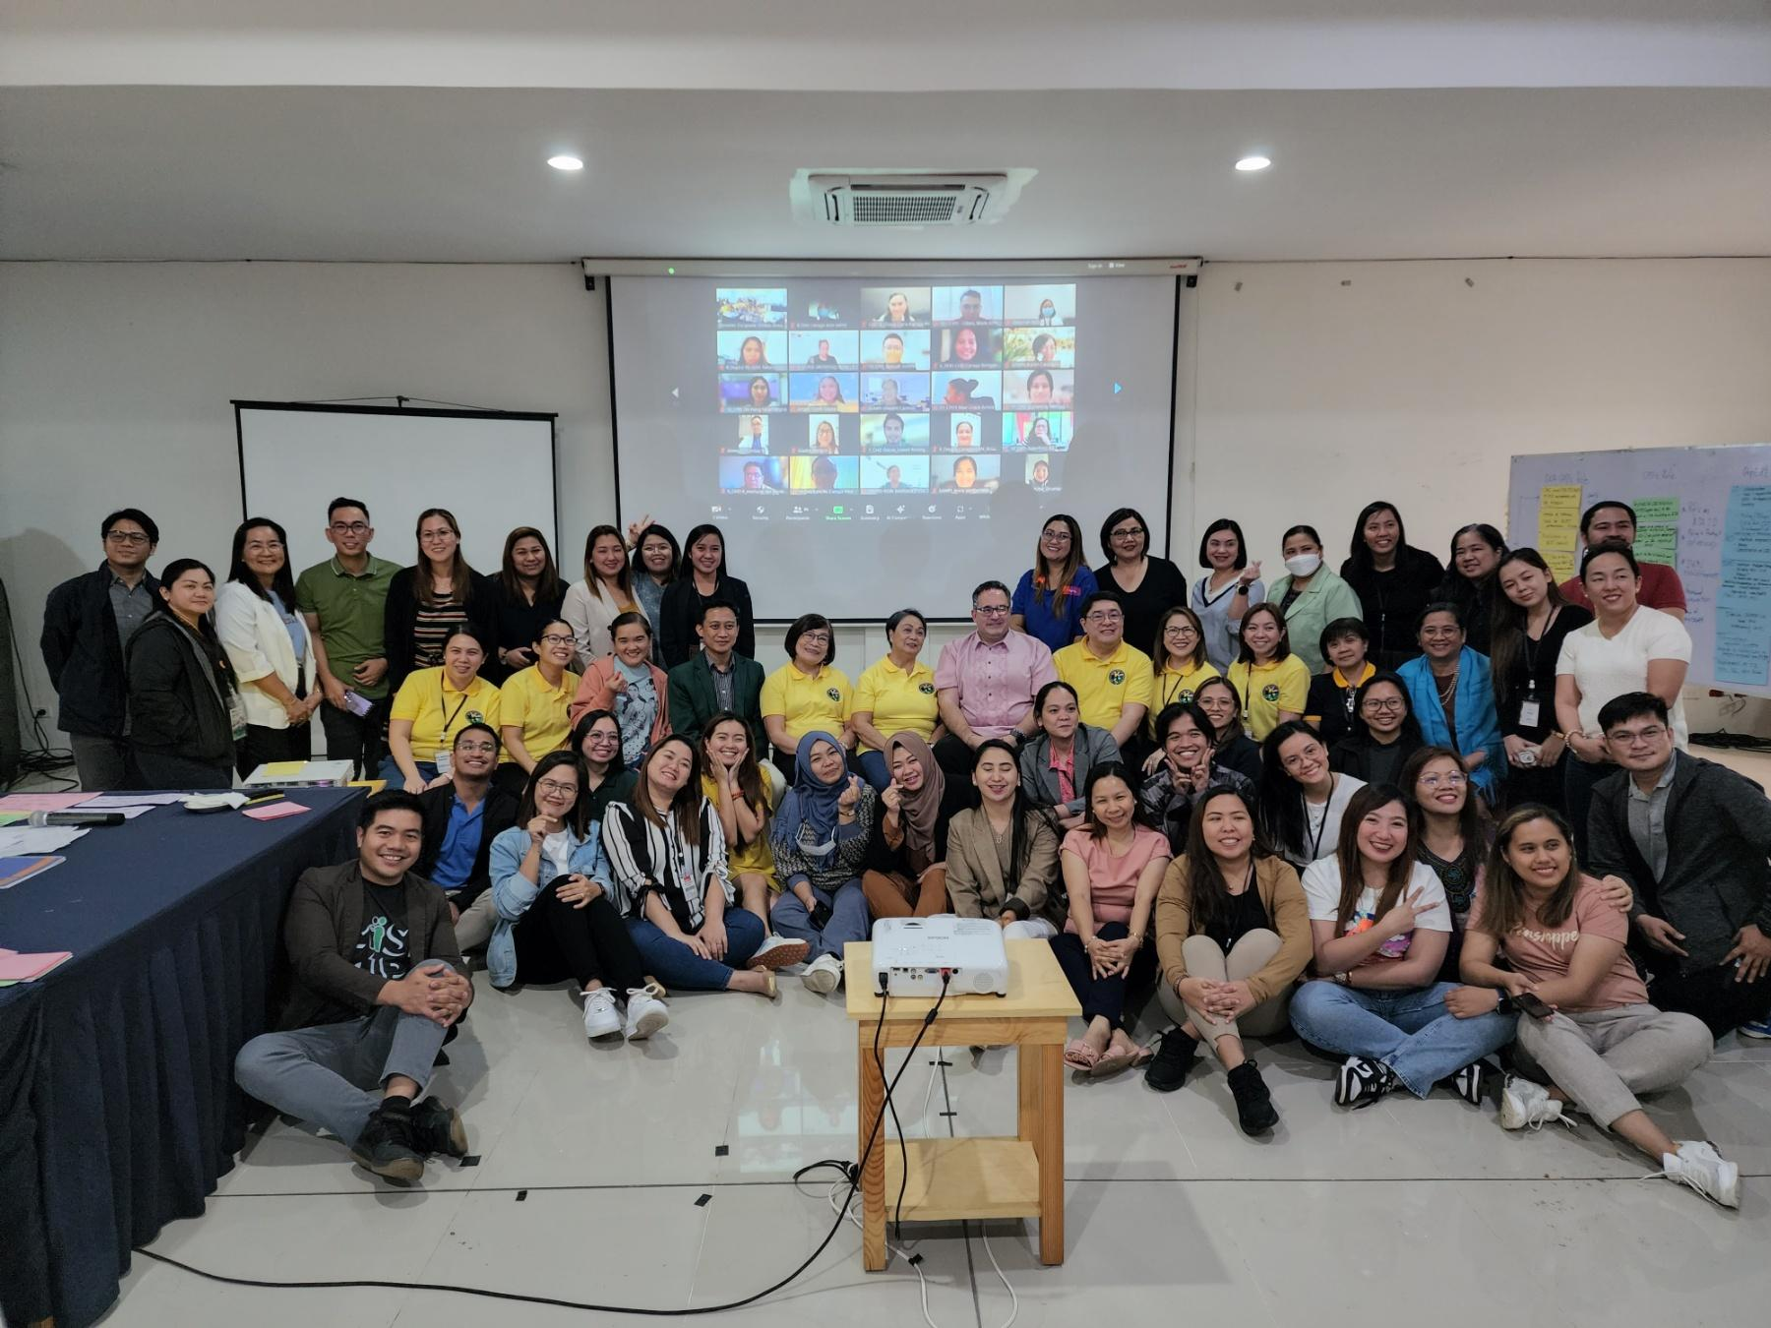
AJA 2.0 SKILLS ENHANCEMENT TRAINING (ASET)
Co-development of the updated Adolescent Job Aid 2.0 (AJA 2.0) Manual through the Society of Adolescent Medicine of the Philippines (SAMPI) Grant
ASET Pilot run for 79 facilitators and planning for roll-out in Luzon, Visayas and Mindanao for adolescent health service providers and champions representing DOH, DepEd, and CPD from Luzon, Visayas, and Mindanao
First roll-out with supportive supervision held through CHD IVA for 19 adolescent health champions

Slide 33
Biyaheng Kalusugan for Family Planning
Health is Life is a health literacy campaign dedicated to enabling Filipinos to adopt a healthier lifestyle that will empower them to live life to the fullest. Based on the seven priority areas identified in the Department of Health’s Health Promotion Framework Strategy, the campaign promotes the “7 Healthy Habits para sa Healthy Pilipinas”, in this context is on Family Planning, through a mix of mass media and community-based interventions primarily focusing on improving the knowledge of individuals on how to practice the habits, raising awareness on services available to them, and advocating for health-supporting policies and infrastructure.
Priority Area Behavioral Outcomes

Slide 34
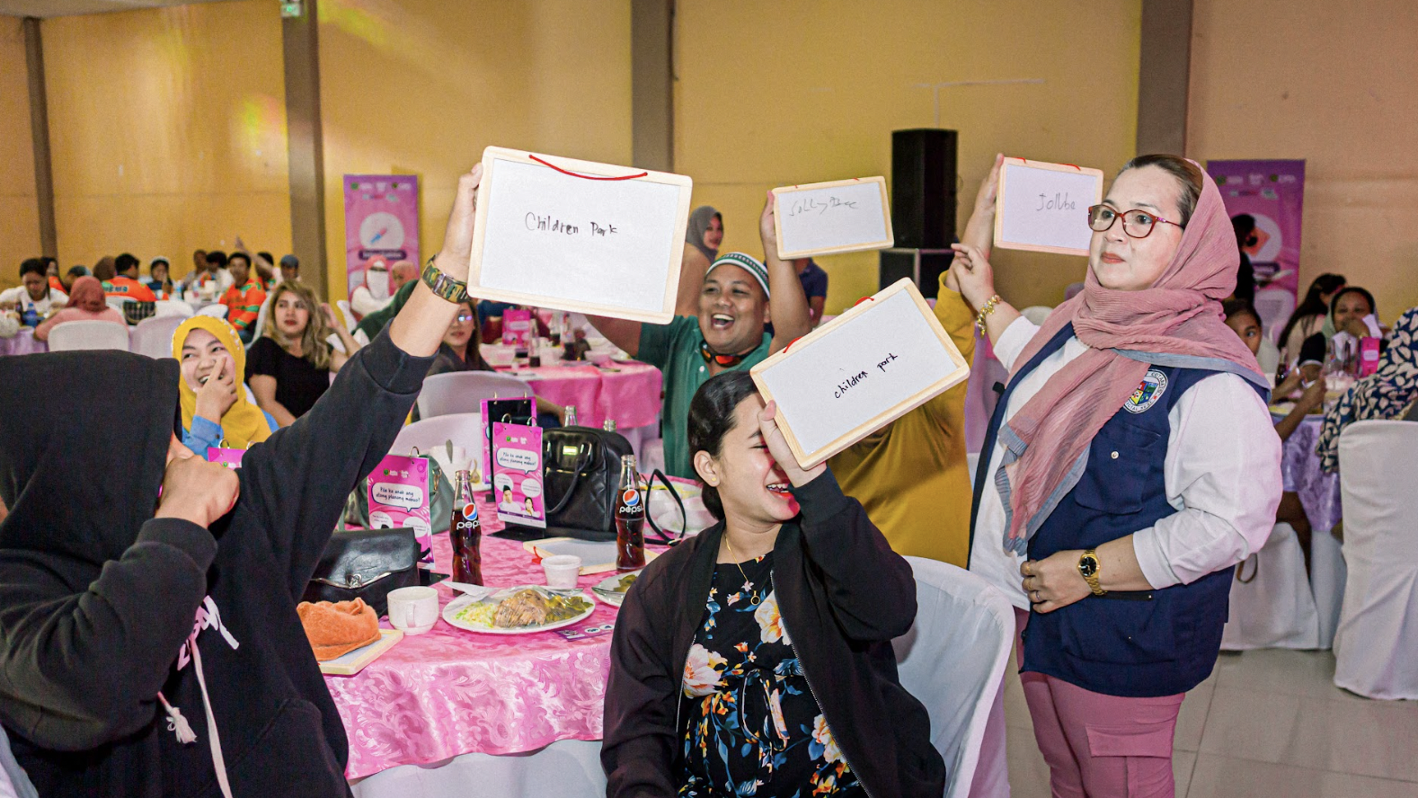
Biyaheng Kalusugan for Family Planning
Last year’s Biyaheng Kalusugan events, with the theme “Usap Tayo sa Family Planning para protektado ang Pamilyang Pilipino!”, aimed to engage communities in generating well-informed discourse about the different family planning methods and the vital role of communication between couples and families. The event was held in BARMM with activities that highlighted:
importance of discussion as a couple on their plans and the economics of planning for their own families with the help of prompt cards
awareness on the possible family planning methods that singles and couples could avail of through interactive materials and live demonstrations

Slide 35
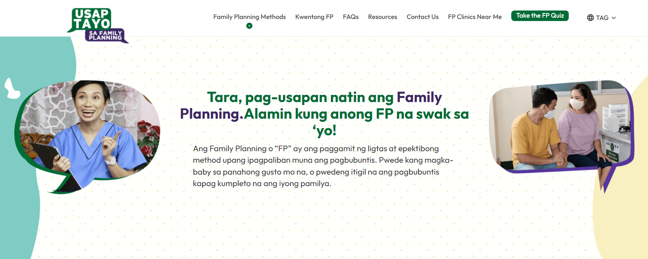
Development and Implementation of the Adult FP Campaigns
Family Planning campaigns It’s OK to Delay and Usap Tayo sa FP were developed in partnership with USAID ReachHealth.
It’s OK to Delay encourages young adults to use FP to use FP to delay starting a family until they are ready.
Usap Tayo sa FP provides FP options to couples with at least 1 child, whether they are spacers or limiters.
The campaigns are currently being implemented both online and offline, with the website and social media pages complemented by print materials for HCWs and clients.
Usap Tayo sa FP has reached over 24 million and It’s OK to Delay has reached over 21 million through their online platforms.

Slide 36
Implementation of online ARH campaigns
Campaigns for teens and parents of teens were developed in partnership with USAID ReachHealth.
The I CHOOSE #MalayaAkongMaging campaign provides useful and relevant information to teens on topics such as puberty, mental health, sexual health, and more
The Konektado Tayo campaign encourages parents and guardians to talk to their teens about topics related to their teenage lives, providing resources and tips on how to understand and connect with them better.
I CHOOSE #MalayaAkongMaging has reached over 74 million and Konektado Tayo has reached over 35 million through its online platforms.

Slide 37
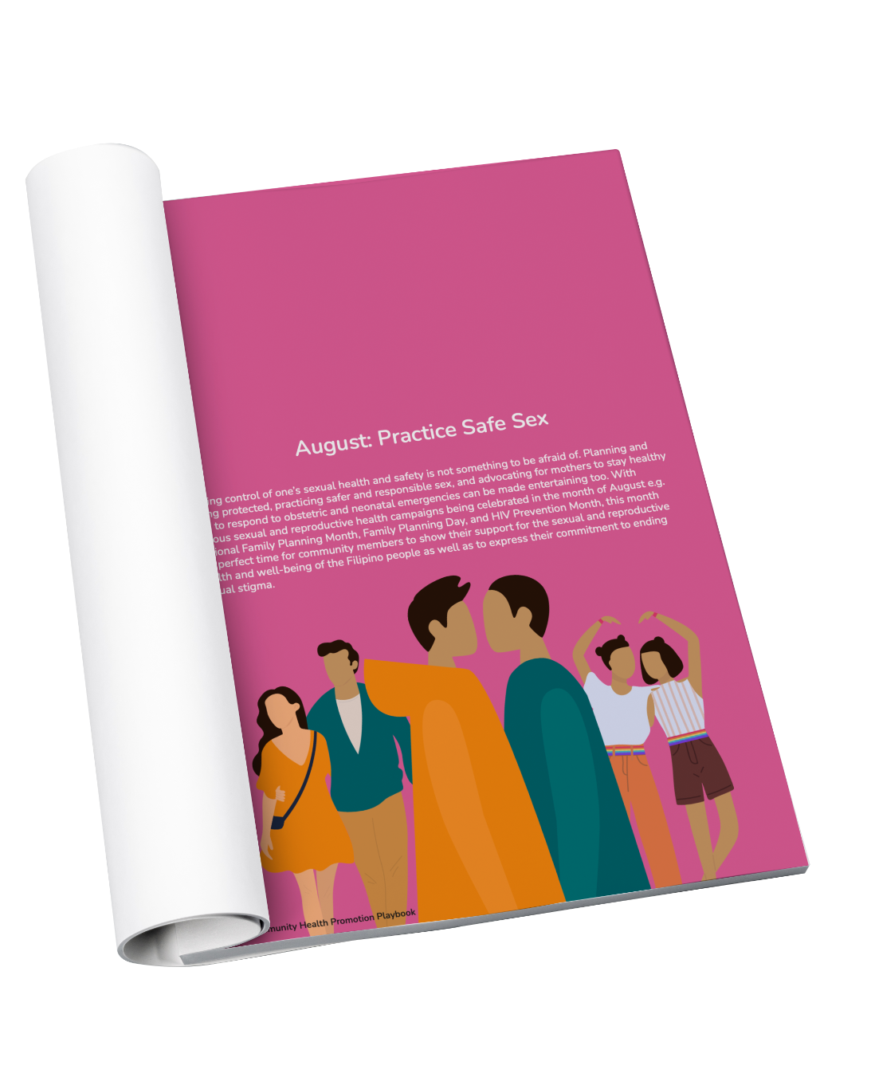
Below-The-Line
Community Health Promotion Playbooks
The Community Health Promotion Playbook is a compendium of health event activities that the local chief executive is encouraged to implement in their respective LGU. Each month includes three different activities for the LGU to ideally be able to use this playbook for the next three years, until 2024.
Notes:
To complement our strong online presence, we formulated the Community Health Promotion Playbook to enable local governments to run different social mobilization activities in their own communities. This people based approach in health promotion takes into consideration the innovativeness, visibility, engagement, and most of all desirability of the activities in making health information fun and educational! These are simple activities that can be utilized by the LGU in jumpstarting their own Health Promotion Campaigns in their respective areas

Slide 38
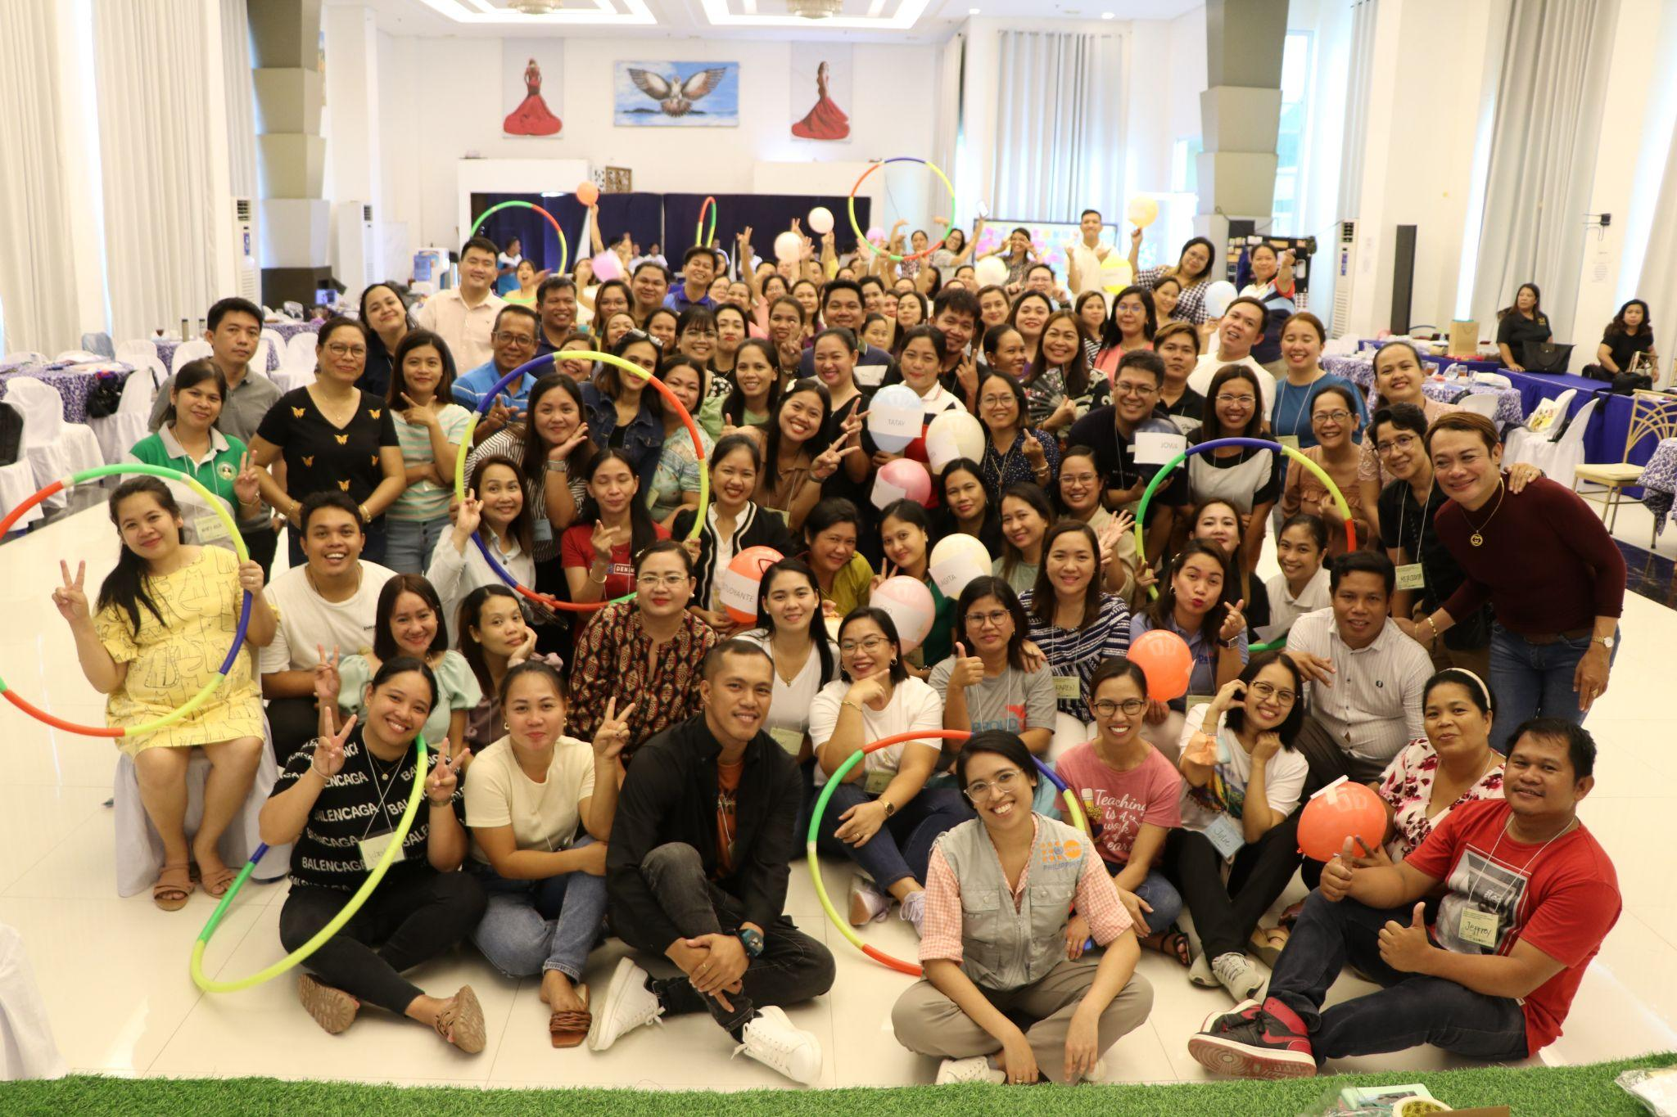
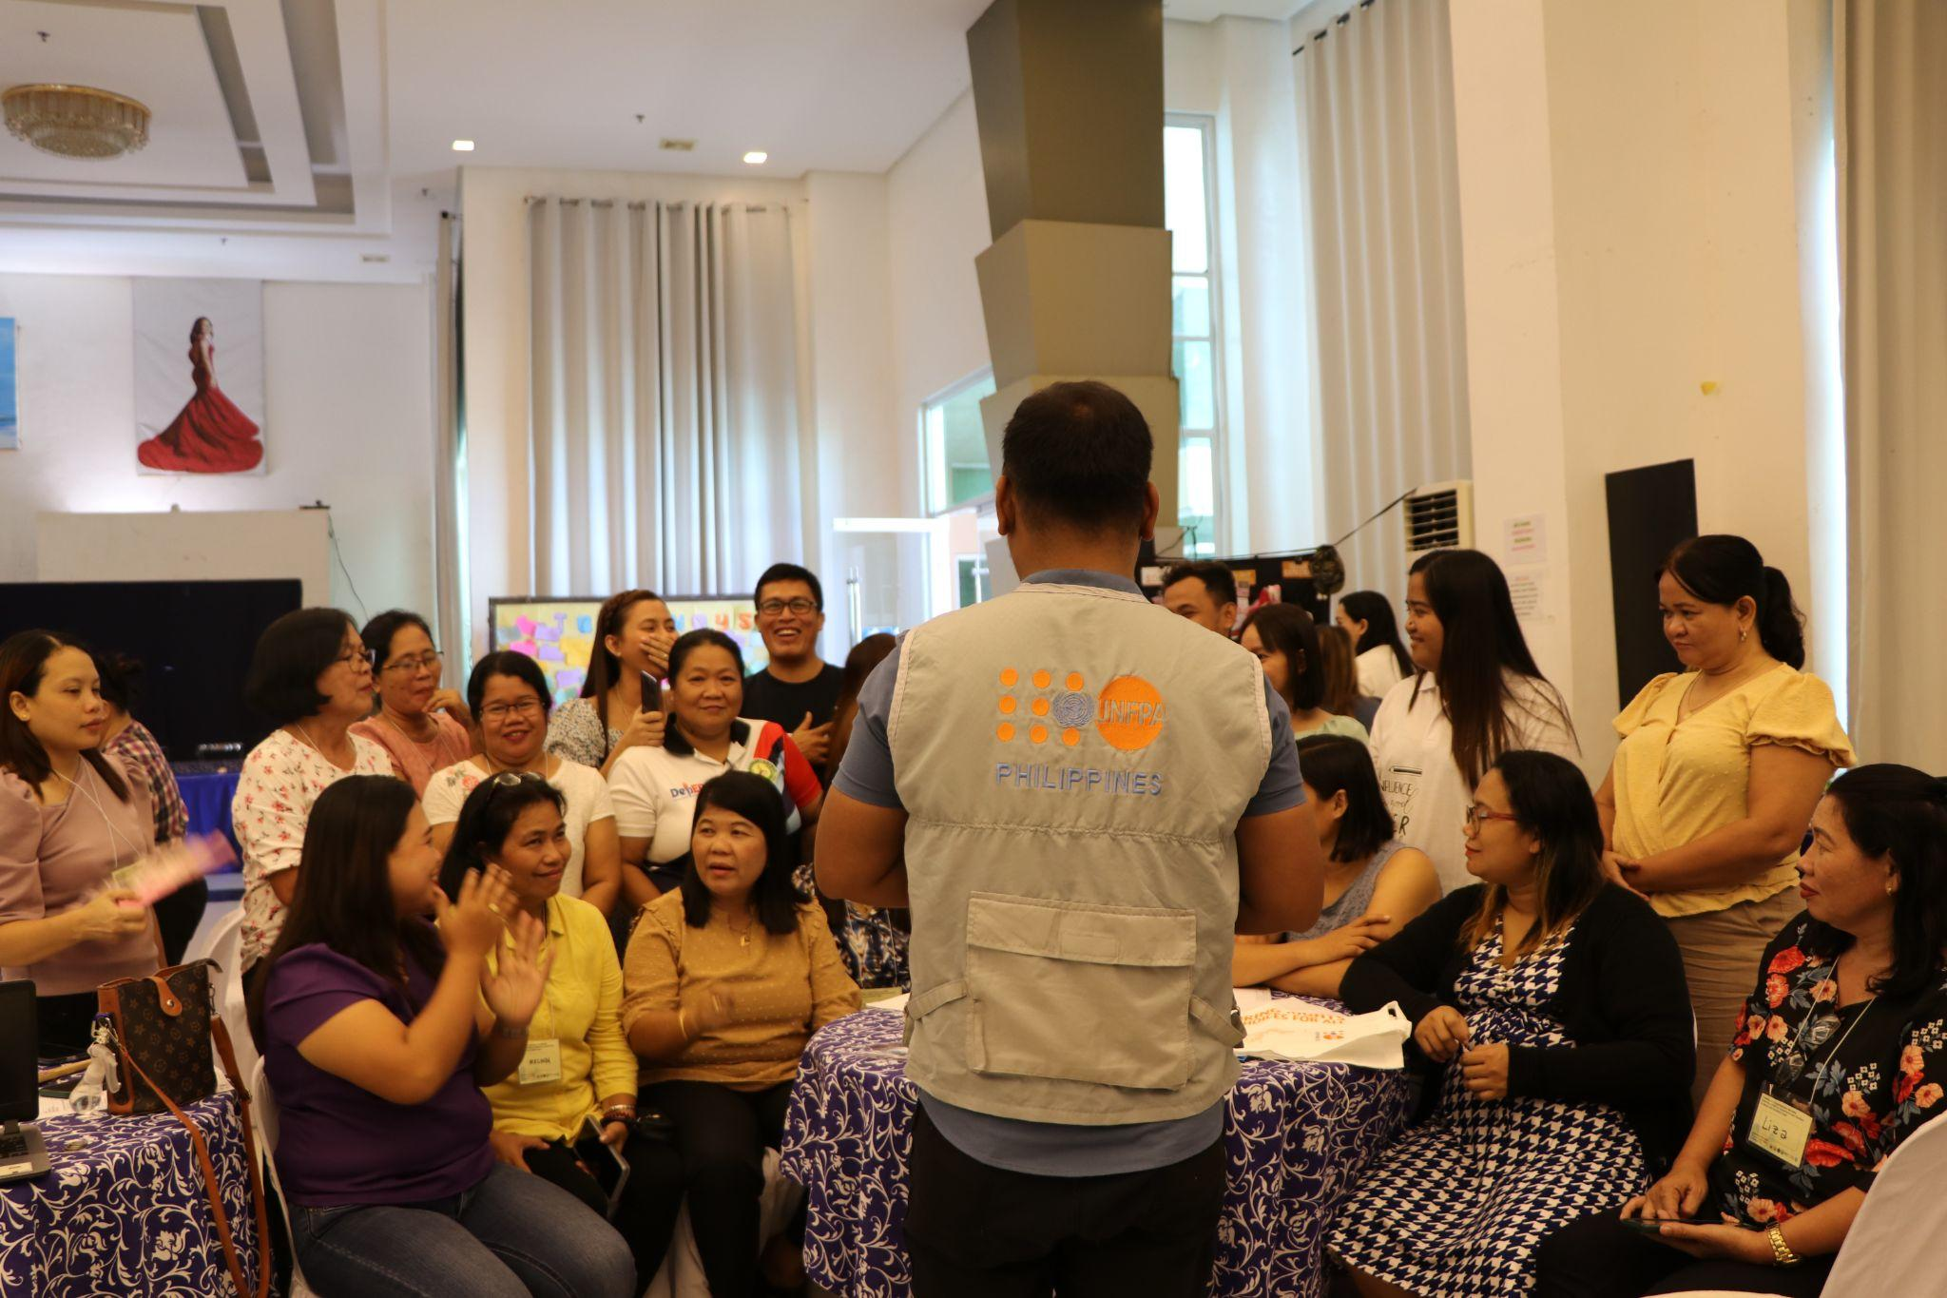
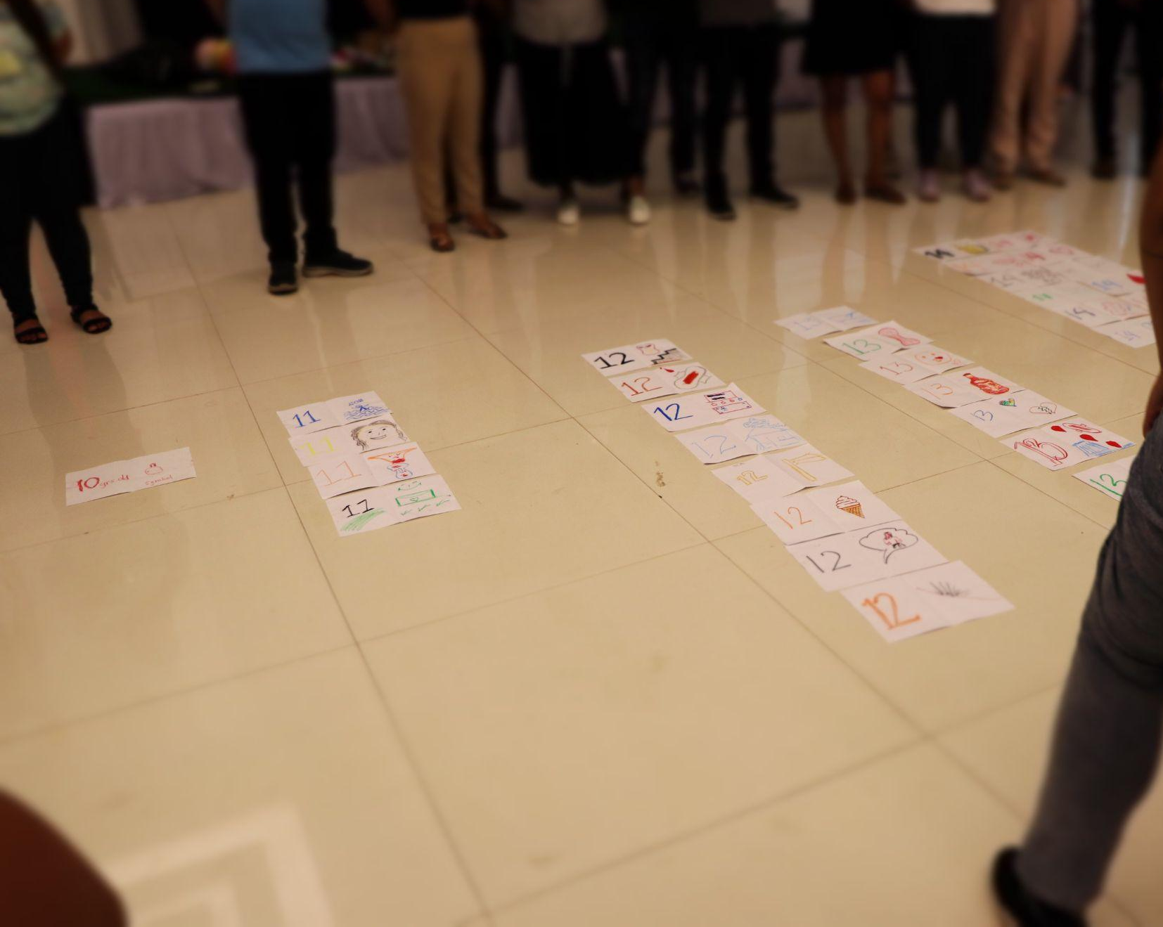
Implementation of In-School Comprehensive Sexuality Education
Comprehensive Sexuality Education as stipulated in RPRH Law has been rolled out since 2020 in selected public schools in 16 regions nationwide
As of 2023, DepEd with assistance from UNFPA and CHSI has reached 1, 144,821 million learners through 209,541 teachers trained on CSE
2023 CSE Assessment Findings::
Since the roll out of CSE in-school in 2020, positive outcomes such as teachers knowing what CSE is about, lesson planning, and learners’ positive feelings on CSE lessons and attitudes on CSE outcomes have been observed.
However, there is a need to improve teachers’ self-efficacy through external support from parents, colleagues, and community members

Slide 39
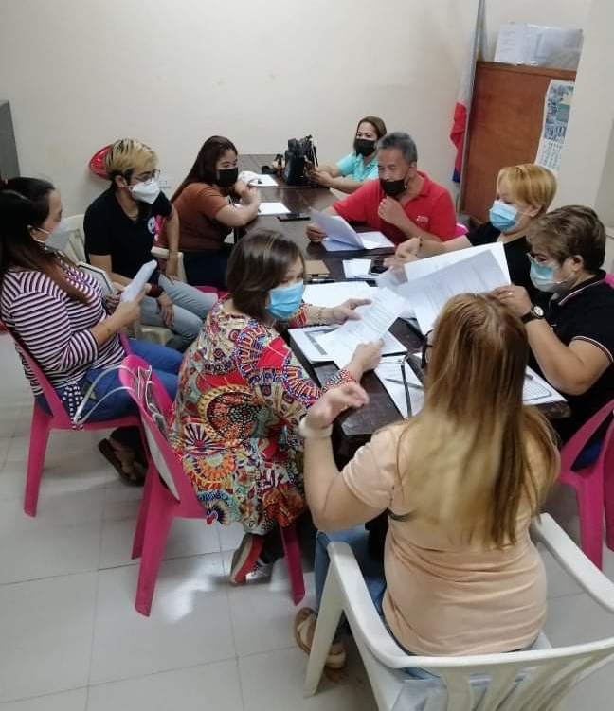
Implementation of Out-of-School Comprehensive Sexuality Education
The learning modules on Adolescent Sexual and Reproductive Health (including family planning, STIs and HIV, gender and GBV prevention and human rights) for left-behind adolescents were reviewed and further refined to better align with international guidance on out-of-school CSE.
Using these modules, 50 vulnerable adolescents (30 girls engaged in transactional sex and 20 transgender girls) from urban poor communities in Navotas and Malabon were provided with out-of-school CSE learning sessions. Positive changes in knowledge on various aspects of ASRH were documented through pre- and post-test scores of the participants.

Slide 40
Intersection of GBV and FP
FamiLigtas is an online GBV campaign linked to a feminist, survivor-centered hotline run by Lunas Collective; reached 12.4M people online and on radio, generated USD600K in media value, and brought onboard 86 journalists, 117 celebrities and social media influencers.
Strengthened gender-responsive care and preventive screening through trainings in Gender Sensitivity and 4Rs of 2,918 service providers in 17 LGUs; provided GBV services to 20,518 survivors; Established and enhanced WCPUs and referral networks in 16 health facilities across 14 LGUs.

Slide 41
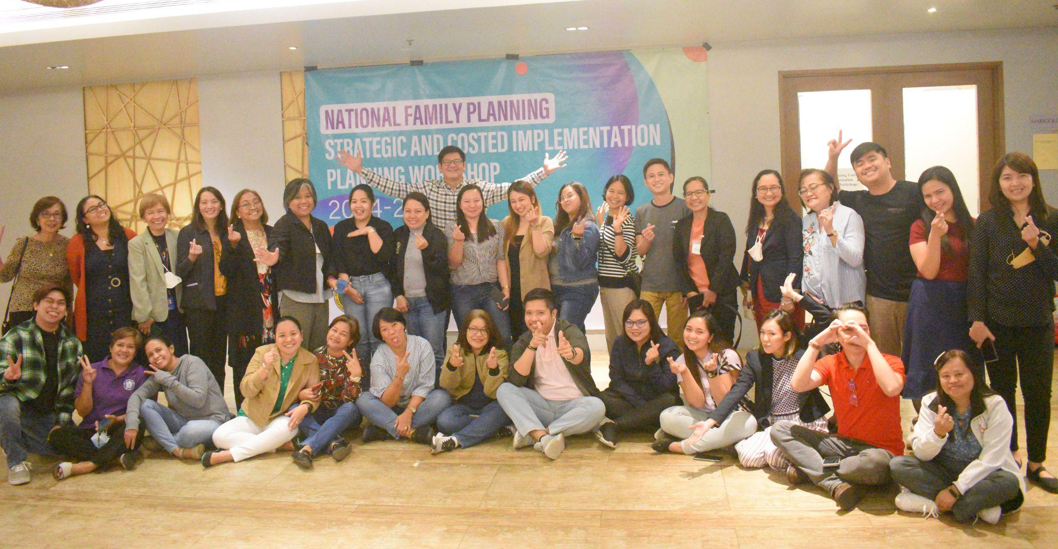
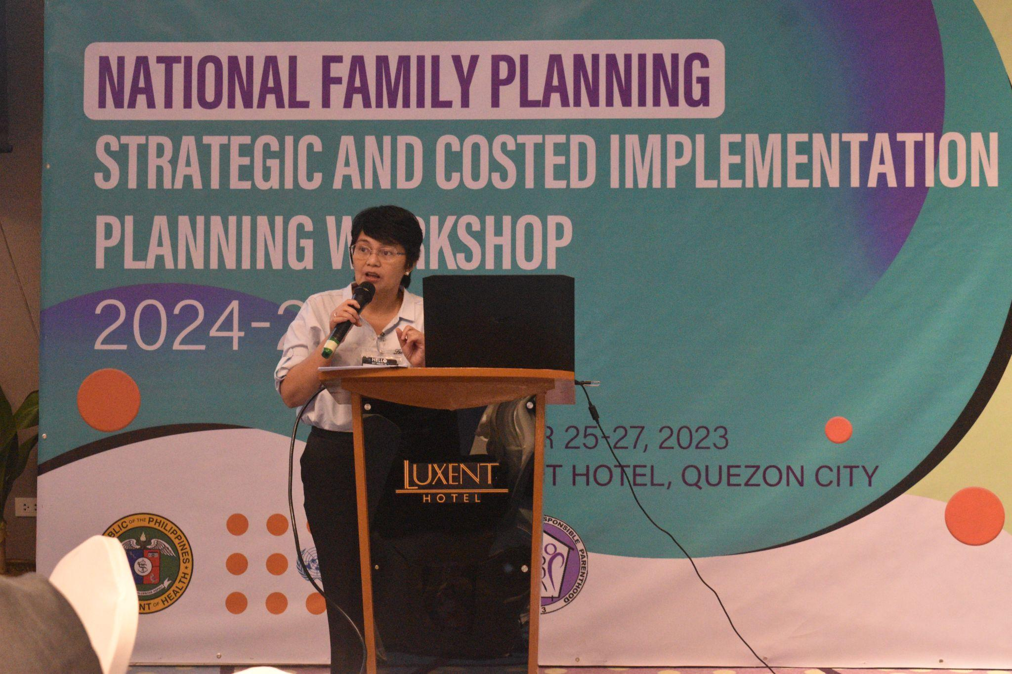
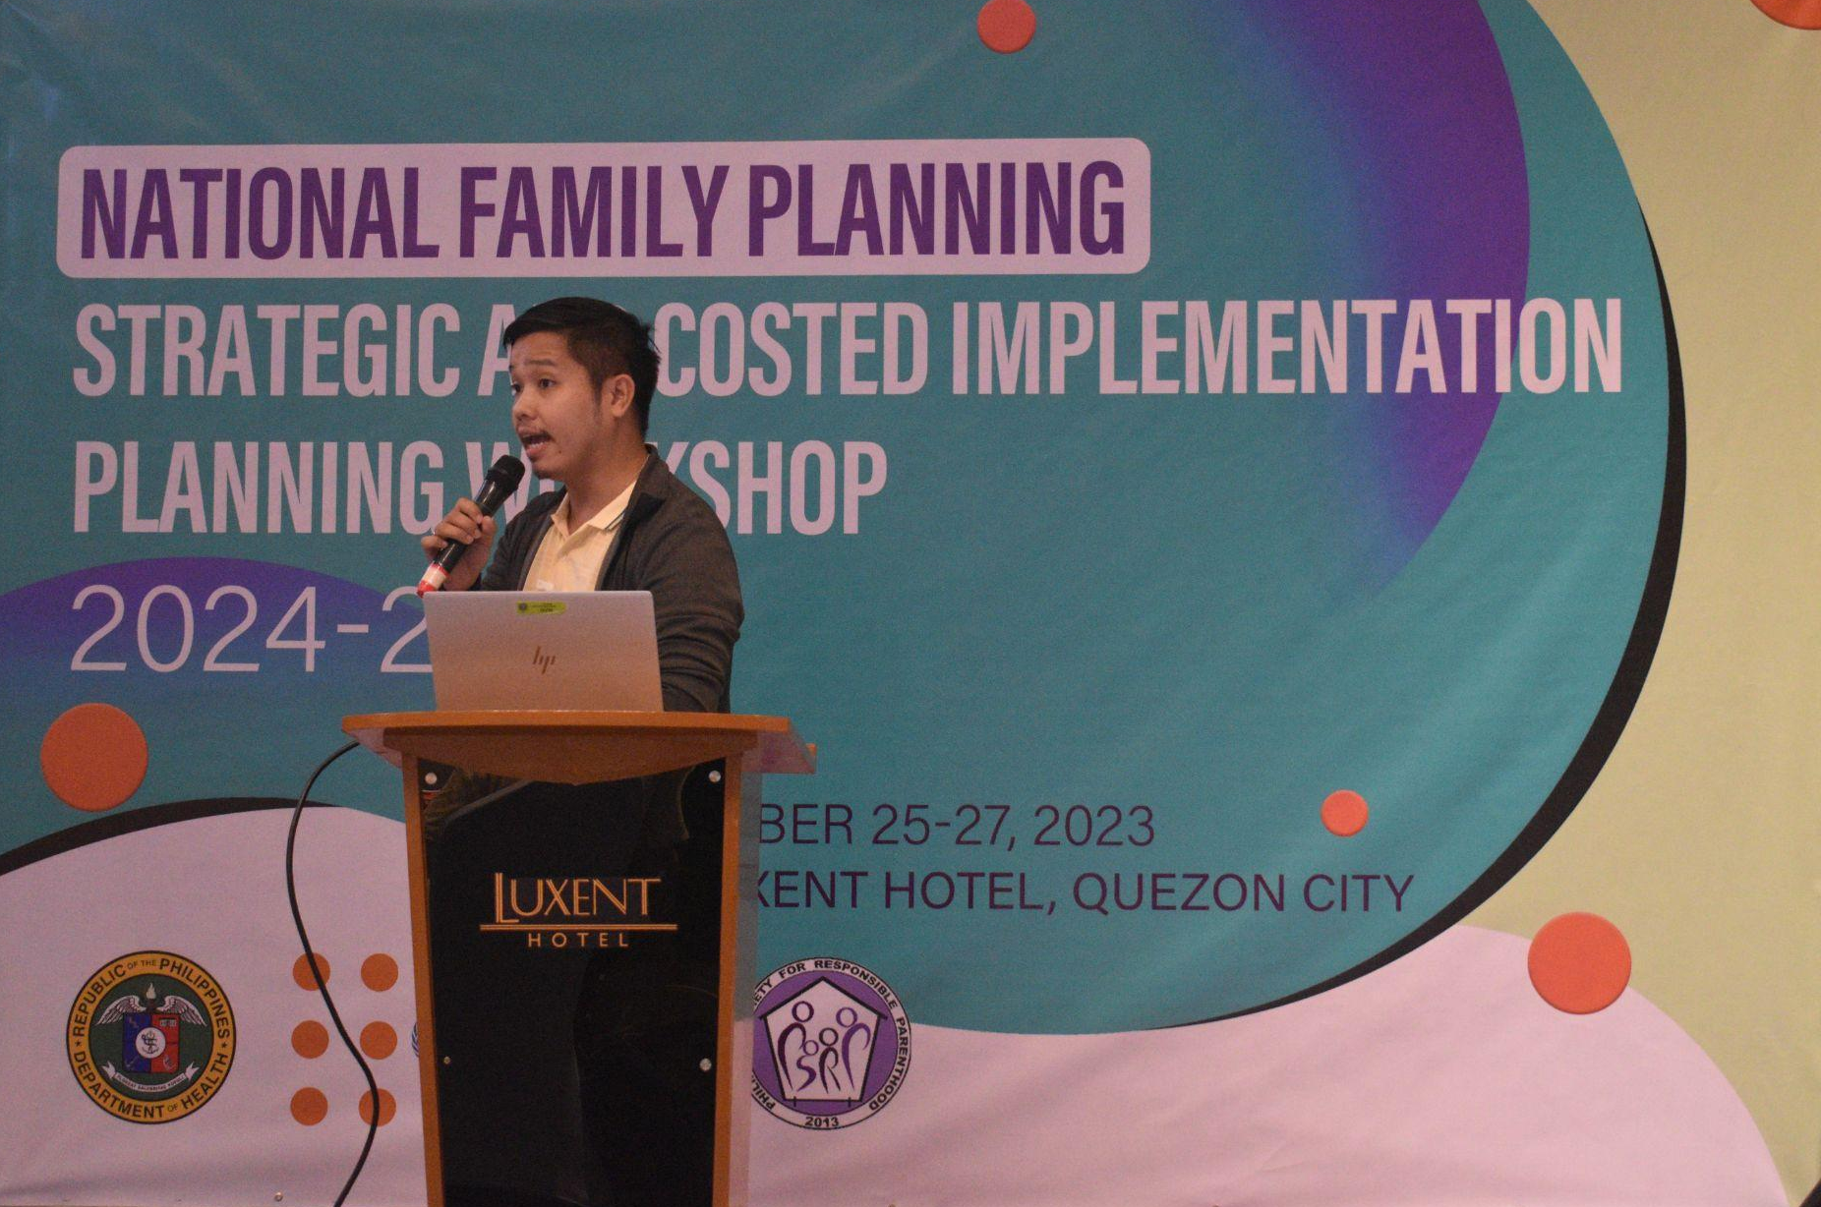
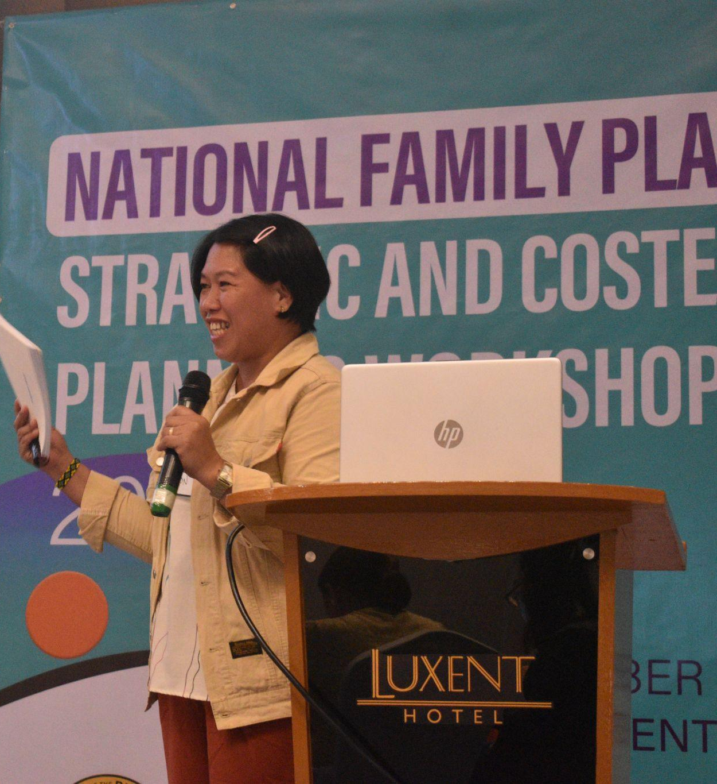
Family Planning Costed Implementation Plan Workshop
The Department of Health through the DPCB has endeavored on preparing the Family Planning Costed Implementation Plan as a reference in a multi-year planning and budgeting of critical activities.
It serves as a guide in the development of an Annual Work and financial plan that includes detailed activities to reduce Unmet Needs for Modern Family Planning. The FP-CIP has guided the costing of FP commodities to be procured as well as enabling activities to support High Impact Practices on FP (i.e. training, social media campaigns, support for FP in hospitals, technical assistance activities, etc.)

