Slide 1










ICPD IN THE PHILIPPINES
30 Years of Putting People’s Rights at the Heart of Development
Undersecretary LISA GRACE S. BERSALES, Ph.D.
Executive Director V, Commission on Population and Development

Slide 2




OUTLINE OF THE PRESENTATION
1
2
3
ICPD Programme of Action
Updates on Areas of Action
Moving Forward`

Slide 3
Adopted by 179 governments in 1994, this Programme of Action to address the critical challenges and interrelationships between population and sustained economic growth in the context of sustainable development development.

Slide 4
Focus on people
The PoA shifted the focus from demographic targets to meeting the needs of individuals, and recognized that population is about people, not numbers.
Fosters human rights
The PoA emphasized the importance of human rights, including reproductive rights, and the empowerment of women and girls.
Addresses a range of POPDEV interrelated issues
The PoA went beyond traditional population issues to address a variety of development problems, including poverty, environmental sustainability, and family support.
Guides national population policies
The PoA advanced a new definition of population policy that gave prominence to reproductive health and women's empowerment.

Slide 5
Population and Sustainable Development
Poverty Eradication and Employment
Health
Sexual and Reproductive Health, Services and Rights
Education
Gender Equality and Women’s Empowerment
Adolescents and Young People
Ageing
International Migration
Urbanization and Internal Migration
Data and Statistics
Areas of Action

Slide 6
Population and Sustainable Development
Policy and Program Accomplishments:
PD 79 (National Population Policy)
Philippine Development Plans
Philippine Population and Development Plan of Action for 2023-2028
Integration of population agenda in sectoral development policies, strategies and programs
SDG initiatives
Interventions

Slide 7

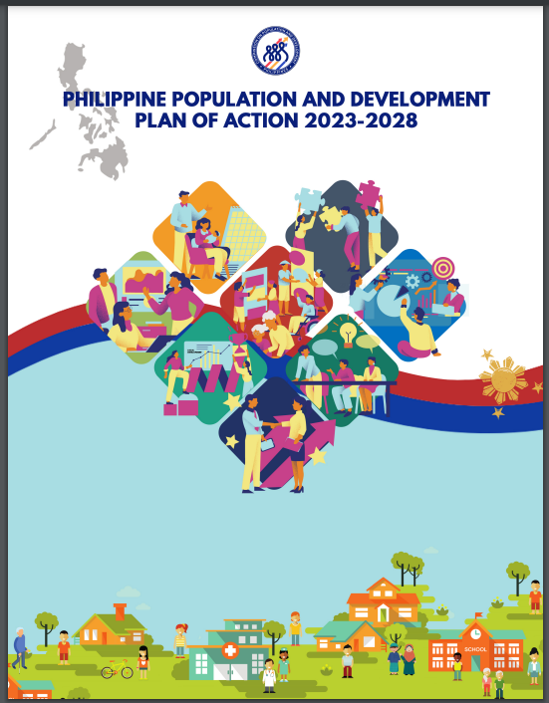
The Philippine Population and Development Plan of Action (PPD-POA) 2023- 2028 serves as the government’s overall blueprint in managing the country’s demographic situations and addressing interrelated population and development issues in support of the Philippine Development Plan (PDP) 2023-2028.

Slide 8
GOAL
Optimize demographic opportunities and address persistent population issues and challenges to reap demographic dividend and accelerate sustainable and inclusive development at all levels.

Slide 9



STRATEGIC FRAMEWORK
Optimize demographic opportunities and address persistent population issues and challenges to reap demographic dividend and accelerate sustainable and inclusive development at all levels
GOAL
Facilitate demographic transition
Promote inclusive and sustainable wellbeing and development of all age groups through their life course
Promote inclusive development of all sectors especially the marginalized population
Facilitate enabling socioeconomic preconditions for demographic dividend
Facilitate more rational distribution of population
OBJECTIVES

Slide 10
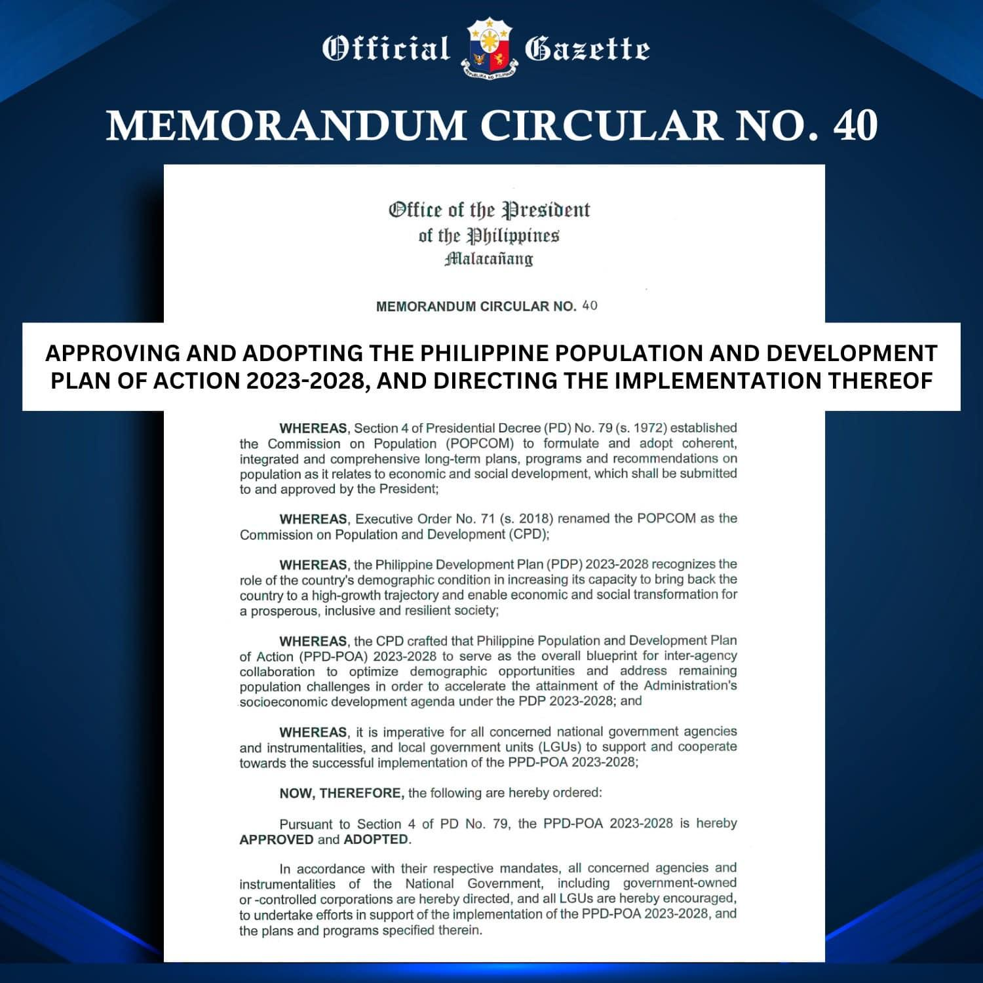
The President has approved the Philippine Development Plan of Action (PPD-POA) 2023-2028 by virtue of Memorandum Circular No. 40 “Approving and Adopting the Population and Development Plan of Action 2023-2028, and Directing the Implementation Thereof”.
This Memorandum Circular provides for the implementation of the PPD-POA 2023-2028 through the whole-of-government and whole-of-society approach, encouraging the participation of local government units (LGUs), civil society organizations (CSOs) and the private sector.

Slide 11
Population is growing at a slower pace but still increasing in numbers.
Population size and growth rate: 1948-2020
Source: PSA, various population censuses

Slide 12
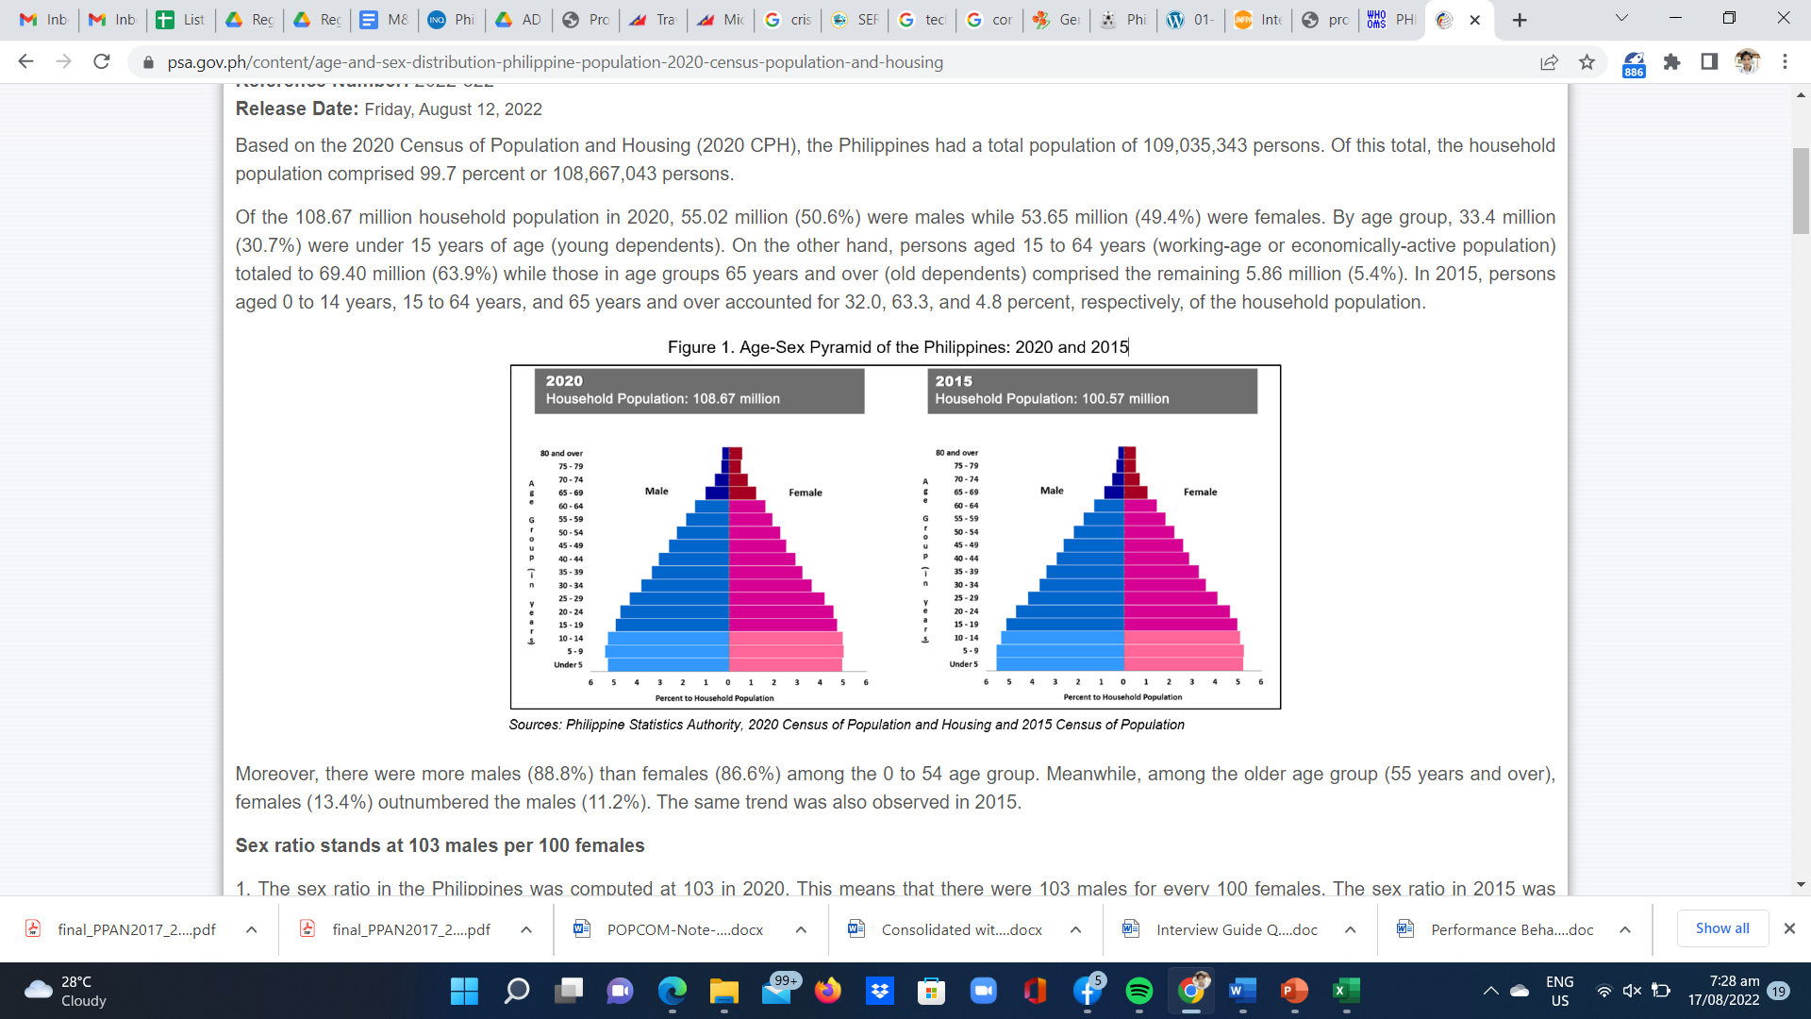



The proportions of the working age and older persons are increasing while proportion of young population is decreasing.
Population distribution by age group and sex: 2015 and 2020
65 and above - 5.86 million (5.4%)
15-64 yo - 69.40 million (63.9%)
0-14 yo - 33.4 million (30.7%)
2015
2020
Source: PSA, various population censuses

Slide 13
Fertility declined below the replacement fertility level.
Source: PSA, various NDHS

Slide 14
Fertility level and trends vary across regions.
Total fertility rate by region: 2017 and 2022
Source: PSA, 2017 and 2022 NDHS
Notes:
Sexual and Reproductive Health Services and Rights
Challenges:
Need to strengthen implementation of RPRH law and other relevant laws particularly within the context of devolution
Need to ensure availability of FP commodities
Need to strengthen initiatives on comprehensive sexuality education at all levels
Need to improve men’s involvement in RPRH

Slide 15
Background Characteristics | Total Fertility Rate (TFR)
 | 2017 | 2022
Education
No education | 4.6 | 2.5
Elementary | 4.1 | 3.0
JHS (G7-10) | 3.0 | 2.4
SHS (G11-12) |  | 2.7
Post-secondary |  | 1.6
College | 2.0 | 1.5
Wealth Quintile
Lowest | 4.3 | 3.1
Second | 3.2 | 2.2
Middle | 2.6 | 2.0
Fourth | 2.1 | 1.5
Highest | 1.7 | 1.4
Total | 2.7 | 1.9
Women with lower levels of education and income have higher fertility.
Total fertility rate by education and wealth quintile:
2017 and 2022
Source: PSA, 2017 and 2022 NDHS
Notes:
Gender Equality and Women’s Empowerment
Challenges:
Need to strengthen functionality of VAWC Desks particularly case reporting mechanisms
Need to strengthen enforcement of existing laws
Need to improve institutional capacities in GAD planning and budgeting
Need to increase labor force participation of women
Need to create a more enabling environment for women’s political participation and representation

Slide 16
Which population groups declined the most?
% reduction in the TFR (15-49) from 2017 NDHS results 2022 NDHS results :
National: -27%.
Urban -28%, Rural -23%.
All regions declined except BARMM. Highest:NCR ( -39% from 1.92 to 1.17), Eastern Visayas (-37%), Bicol (-32%) Cagayan Valley (-31%) Davao (-31%), Northern Mindanao (-31%).
Apart from BARMM, which was flat, the minimum decline was -16% in MIMAROPA.
Taking population size into account, about 1/6 of the national decline was due to the National Capital Region and about 1/6 was due to Calabarzon.
The probability that a woman with 4+ children will have another child (in a calendar year) declined from 19% in 2010 to 4% in 2021. This is the sharpest decline with respect to order-specific rates.
Source: Tom Pullum (2023), Recent Fertility in the 2022 NDHS, USAID

Slide 17
Decline in wealth quintiles
Richest: -18% (1.7 to 1.4)
Richer: -30% (2.1 to 1.5)
Middle: -24% (2.6 to 2.0)
Poorer: -32% (3.2 to 2.2)
Poorest: -26% (4.3 to 3.1)
Over half of the national decline was due to the poorest two quintiles. About 1/10 was due to the highest quintile.
Source: Tom Pullum(2023), Recent Fertility in the 2022 NDHS, USAID

Slide 18
Conclusion of the USAID study
No evidence of data quality problems.
All age intervals declined, especially the youngest (15-19 and 20-24).
Across-the-board declines by place of residence and region (except for BARMM).
The two poorest wealth quintiles fell the most. Because they had the highest initial TFRs, variation across quintiles was reduced.
The percentage of women age 15-49 never in a union increased from 36% to 42%. The compositional change caused a decline in the national TFR but was a relatively minor effect.
Source: Tom Pullum(2023), Recent Fertility in the 2022 NDHS, USAID

Slide 19
Conclusion of the USAID study
The annual decline from 2010 to 2021 was close to linear, with no evidence of levelling off.
No significant evidence of a COVID effect, which would only have started with conceptions in March or April of 2020, and births 9 months later.
Finally: further analysis on this topic (and others) is needed.
Source: Tom Pullum(2023), Recent Fertility in the 2022 NDHS, USAID

Slide 20
The percentage of married women using modern contraceptives has increased since 1993.
Percentage of married women aged 15-49 who used traditional and modern contraceptives: 1993-2022
Source: PSA, various NDHS
Notes:
Sexual and Reproductive Health Services and Rights
Challenges:
Need to strengthen implementation of RPRH law and other relevant laws particularly within the context of devolution
Need to ensure availability of FP commodities
Need to strengthen initiatives on comprehensive sexuality education at all levels
Need to improve men’s involvement in RPRH

Slide 21
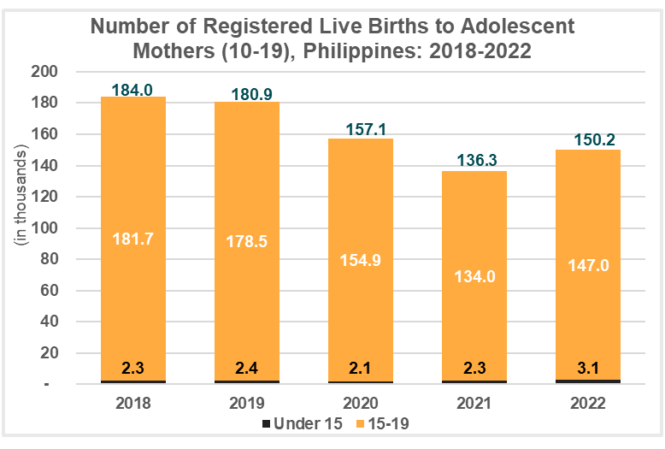
An upward trend in adolescent pregnancies, particularly those under the age of 15, was recorded from 2021 to 2022.
Adolescent pregnancies are considered “high-risk”, as they are more likely to encounter complications during childbearing and labor, leading to increased morbidity and mortality for both mother and child
Source: PSA, various CRVS
Notes:
Adolescents and Young People
Challenges:
Need to address legal barriers to access of minors to reproductive health services including legal and safe contraceptives
Need to intensify promotion and implementation of CSE including adults
Need to strengthen reporting and management mechanisms for incidence of sexual abuse among children and young people
Need to improve institutional capacities in planning, budgeting, implementing and assessing adolescent and youth strategic interventions

Slide 22
Sexual and Reproductive Health, Services and Rights
Policy and Program Accomplishments:
Responsible Parenthood and Reproductive Health Act of 2012 ( RA 10354)
EO 12 s. of 2017 on Attaining and Sustaining Zero Unmet Need for Family Planning
Universal Health Care Act of 2019 ( RA 11223)
EO 141 s. of 2021 Addressing the Root Causes of Adolescent Pregnancy
2021 Act Prohibiting the Practice of Child Marriage(RA 11596)
Interventions
Notes:
Assessment based on the results of the consultative workshop by the CPD for the 7th APPC: assessing the implementation of the ICPD PoA and the APMD PD
Thematic concerns are based on APMDPD indicators

Slide 23
Gender Equality and Women’s Empowerment
Policy and Program Accomplishments:
Magna Carta of Women of 2009 ( RA 9710)
2022 Act Raising the Age of Sexual Consent
( RA116481)
Philippine Plan for Gender Responsive Development 1995-2025
General Appropriations Act (1993-Present) providing for 5% Gender and Development (GAD) Budget mandatory allocation
Interventions
Philippines’ high ranking in the Gender GAP Index of the World Economic Forum (16th for 2020, 17th for 2021, and 19th for 2022)

Slide 24
Gender Equality and Women’s Empowerment
Policy and Program Accomplishments:
Philippine Plan for Gender Responsive Development 1995-2025
General Appropriations Act (1993-Present) providing for 5% Gender and Development (GAD) Budget mandatory allocation
Anti-Mail Order Spouse of 2017
Philippines’ high ranking in the Gender GAP Index of the World Economic Forum (16th for 2020, 17th for 2021, and 19th for 2022)
Interventions

Slide 25
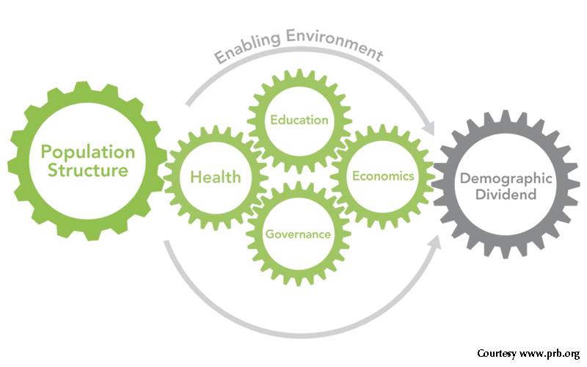
What is the Demographic Dividend (DD)?
“.. accelerated economic growth that can happen as the population age structure changes.”
But harnessing the demographic dividend is not automatic, and requires strategic investments in health, education, economic policy, and governance.
Source: Edillon ( 2024), presentation on Maximizing the Demographic Dividend by Accomplishing the Sustainable Development Goals

Slide 26






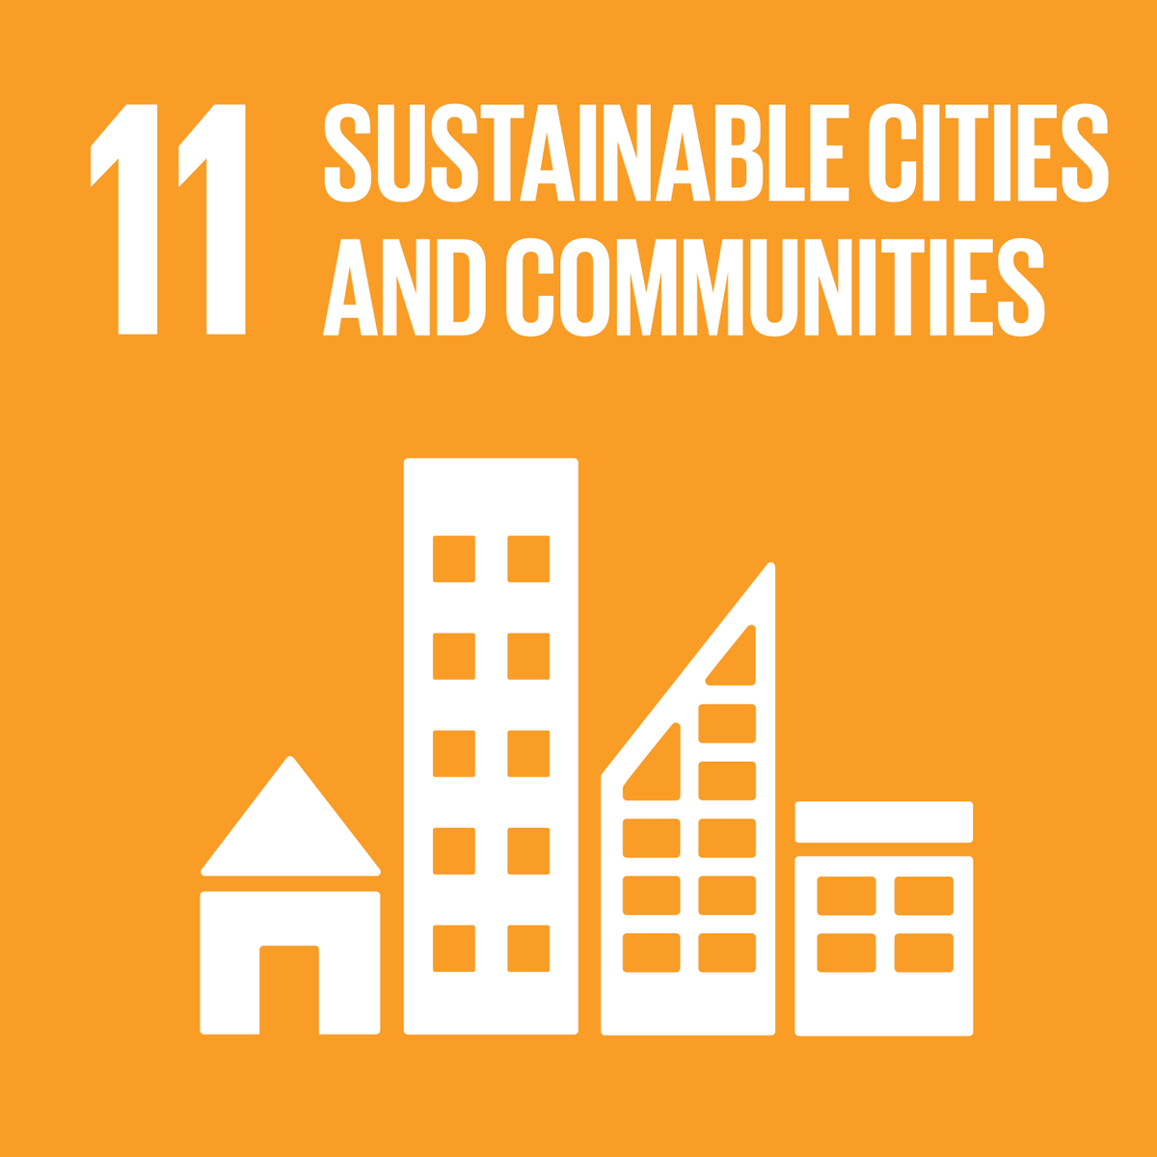

Sustainable Development Goals & Demographic Dividend
Source: Edillon ( 2024), presentation on Maximizing the Demographic Dividend by Accomplishing the Sustainable Development Goals

Slide 27
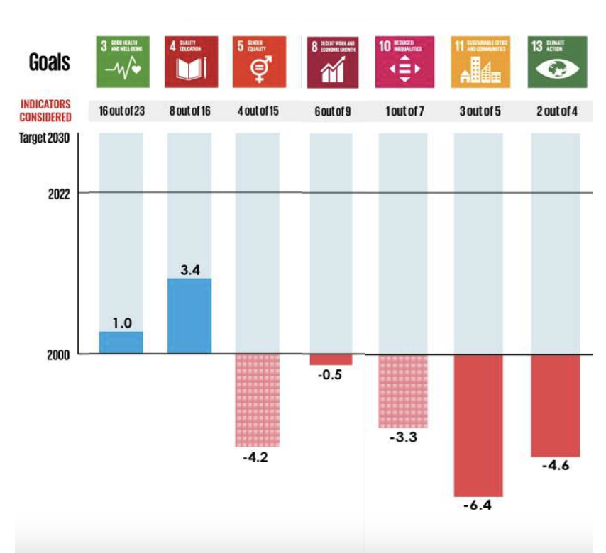

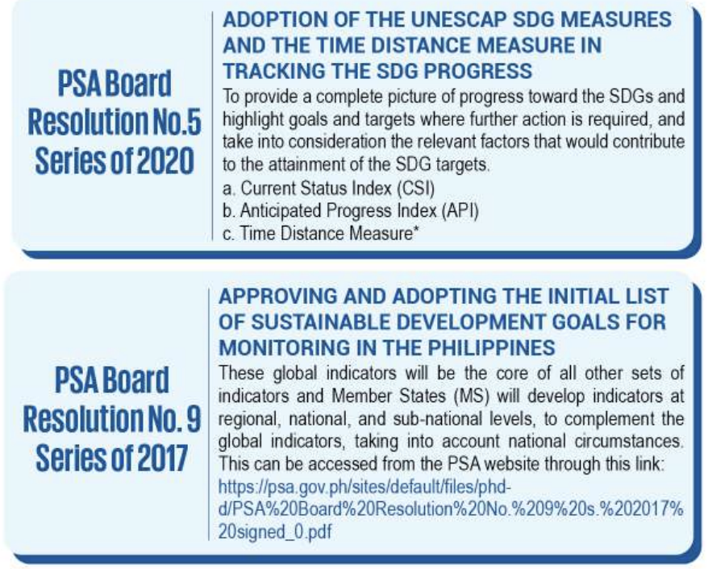
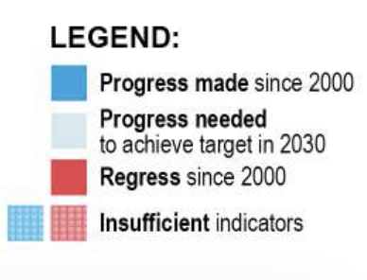
Source: Edillon ( 2024), presentation on Maximizing the Demographic Dividend by Accomplishing the Sustainable Development Goals

Slide 28
Philippines stands out in Southeast Asia as one of the last few countries, together with Lao PDR and Timor-Leste, to benefit from First Demographic Dividend
Source: Edillon ( 2024), presentation on Maximizing the Demographic Dividend by Accomplishing the Sustainable Development Goals

Slide 29
During similar demographic stage, aspirational and neighboring peers benefited from larger First Demographic Dividends
Source: Edillon ( 2024), presentation on Maximizing the Demographic Dividend by Accomplishing the Sustainable Development Goals

Slide 30
Moving Forward: Strategies to Achieve the Demographic Dividend
Investing in health and quality education and achieving
health and education-related SDG indicators and targets
2. Increase income earning ability, especially among the youth
3. Enhance Population Development research, advocacy, and
knowledge management system
4. Encourage savings build-up
Source: Edillon ( 2024), presentation on Maximizing the Demographic Dividend by Accomplishing the Sustainable Development Goals
Notes:
1. Investing in health and quality education and achieving health and education-related SDG indicators and targets
To accelerate the demographic dividend, prioritize health, education, and income-earning opportunities, especially for youth. Invest in quality healthcare, reproductive health, and early childhood programs. Improve education infrastructure, teacher training, and data-driven approaches. Ensure universal secondary education and expand vocational training, fostering continuous learning and access to skill development.
2. Increase income earning ability, especially among the youth
To increase youth income-earning ability, focus on employment and entrepreneurship. Create job programs with private sector partnerships, provide vocational training, and support youth entrepreneurship with access to capital and training. Promote gender equality in work, financial literacy, and rural job initiatives to foster productivity and economic growth among the youth.
3. Enhance PopDev research, advocacy, and knowledge management system
- The foundation of any demographic analysis lies in the quality and timeliness of existing data systems. Currently, the Census on Population and Housing, Population Projections, Civil Registry and Vital Statistics Systems, and Administrative Data for Education and Health provide us with valuable insights. However, for these systems to remain relevant and useful, we must work continuously to enhance their quality, coverage, and timeliness. This improvement will allow us to track demographic trends more accurately, facilitating a better understanding of population changes.
4. Encourage savings build-up
- The labor force faces challenges such as low income, regional wage disparities, a wide income gap, and high inflation, making it difficult to save or invest. Job creation relies on economic growth, which can be stimulated by improving the business environment to attract investors. Expanding the labor market will help the country capitalize on its working-age population, increase labor participation, boost income and savings, and encourage investment.

Slide 31
Thank you very much!

Slide 32


