Slide 1
TEEN CENTERS
SK FEDERATION OF THE CITY OF SAN FERNANDO
#WalangKabataangMaiiwan

Slide 2
ISSUES/CONCERNS:
INCREASING NUMBER OF TEENAGE PREGNANCIES
D
SIGNIFICANT NO. OF CHILD AND SEXUAL ABUSE
D
PERCENTAGE INCREASE IN HIV / STI / AIDS CASES
RELEVANT NO. OF YOUTH RECORDED AS CAR’s
AND CICL’s
NEW CASES OF MENTAL HEALTH PROBLEMS
LEADING TO SELF-HARM

Slide 3
CITY OF SAN FERNANDO:
Safest Space for the youth in Ilocandia Region by 2025
V I S I O N

Slide 4
MISSION
To establish the San Fernando Teen Center and SK TEEN CENTERS in every barangay that will provide quality comprehensive youth care and services in a safe and peaceful environment

Slide 5
CORE VALUES
ACCOUNTABILITY
SAFETY
QUALITY
SERVICE
DIVERSITY & INCLUSION
LOVE OF GOD AND PEOPLE
Aligned with City’s core values

Slide 6
STRATEGIES
A
Leverage Partnerships
B
Quality Services for at – Scale Result
C
Evidence-based Policies
D
Advocacy and Social Mobilization

Slide 7
Youth Care Priority Services
MENTAL HEALTH, SUBSTANCE USE & SELF-HARM
VIOLENCE & INJURY
POSITIVE HEALTH & DEVELOPMENT
SEXUAL & REPRODUCTIVE HEALTH

Slide 8
Investment of SERVICES
POSITIVE HEALTH & DEVELOPMENT
Investment in enhanced access to quality of information, care and services; opportunities for participation
VIOLENCE & INJURY
Investment for enhanced safety, protection and access to justice
SEXUAL AND REPRODUCTIVE HEALTH
Frequent and quality of sexual reproductive information and care
MENTAL HEALTH, SUBSTANCE USE & SELF-HARM
Routine and support for prevention, early intervention and timely care for mental health, substance use and self-harm

Slide 9
TEEN CENTERS
one-stop-shop facility where adolescents and youth can easily access a wide range of information and services to ensure their health and well-being.

Slide 10
TEEN CENTERS
YOUTH DESK
E-LIBRARY &
WORKSTATION
AUDIO-VISUAL
INFORMATION SPACE
CHAT HUB

Slide 11
SERVICES AVAILABLE

Slide 12
YOUTH DESK
COMMUNITY BASED HIV SCREENING PROGRAM
EDUCATIONAL SERVICES
EMPLOYMENT AND LIVELIHOOD ASSISTANCE AND SERVICES
D
D
PERSONALITY ENHANCEMENT AND POSITIVE LIFESTYLE EDUCATION
MANAGEMENT OF PHYSICAL AND SEXUAL ABUSE-REFERRAL SYSTEM

Slide 13
E-LIBRARY & WORKSTATION
FREE INTERNET ACCESS AND WIFI ZONE
TRADITIONAL LEARNING MATERIALS FOR REFERENCES
STUDY SPACE FOR STUDENT
PRINTING SERVICES

Slide 14
CHAT HUB
RECREATION SPACE FOR INDOOR GAMES
PEER TALK

Slide 15
AUDIO-VISUAL INFORMATION SPACE
COMPREHENSIVE SEXUALITY EDUCATION
FAMILY PLANNING AND INFORMATION AND SERVICE INCULDING CONTRACEPTIVES
D
D
LEADERSHIP SKILLS DEVELOPMENT
CITIZENSHIP AND SOCIAL RESPONSIBILITY SKILLS DEVELOPMENT
VOLUNTEERISM AND INVOLVEMENT IN SOCIAL AND COMMUNITY DEVELOPMENT

Slide 16
ESTABLISHMENT OF ISDN

Slide 17
The ISDN consists of different agencies and facilities that are providing information and services that address various issues affecting the youth and adolescents in the city such as teenage pregnancy, STI and HIV/AIDS, psycho-social issues, substance abuse, violence against women and children, among others.

Slide 18
Setting-Up and Mobilizing ISDN
Identify the needs and issues of the stakeholders.
Map available information and services for youth and adolescents in the city.
Identify agencies that provide services for the identified needs of youth and adolescents.
Set-up a referral system or collaborative mechanism among participating agencies.
Formally organize the ISDN through a Partnership Agreement
Develop ISDN Network and Financial Plan.
Implement ISDN Work and Financial Plan (WFP) and
Referral System.
Monitor and evaluate ISDN activities.

Slide 19
COORDINATIVE MECHANISM
AND REFFERAL FACILITY
Initiating Facility
(Teen Center)
Receiving Facility
(ISDN PARTNER)
Provide outward referral form
Communicate with the receiving facility
Assess the clients and their needs
Observe service protocols
Provide needed information or services
Decide to refer (if needed service not available)
Receive client with referral form
Provide needed services
Provide feedback referral form
The ISDN coordinating or management structure shall monitor the referrals, ensure back referrals, enhances referral flow or systems and capacitate members of the ISDN and information providers.
Feedback to initiating facility

Slide 20
TEEN CENTER COORDINATORS

Slide 21
SAN FERNANDO TEEN CENTER
City Head Coordinator (CHC) – Local Youth Development Officer
The City Head Coordinator (CHC):
Shall man the San Fernando Teen Center.
Shall take the lead in monitoring the operation of the 59 SK Teen
Centers.
Shall serve as the secretariat of the ISDN.
Shall prepare and conduct appropriate trainings to the BHC’s and
BPF’s.

Slide 22
SAN FERNANDO TEEN CENTER
City Assistant Head Coordinator (CAHC) – City Population Officer
The City Assistant Head Coordinator (CAHC):
Shall Assist the manning of the San Fernando Teen Center.
Shall assist the CHC in monitoring the operation of the 59 SK Teen Centers.
Shall represent in any form the absence of the CHC.

Slide 23
SK TEEN CENTERS
(barangay-based)
Barangay Head Coordinator (BHC) – SK Chairperson
The Barangay Head Coordinator (BHC):
Shall man the SK Teen Center.
Shall take the lead in convening the BPF’s in formulating and
implementing the Projects, Programs and Activities covered by the
AIP of the SK Teen Center.

Slide 24
SK TEEN CENTERS
(barangay-based)
Barangay Peer Facilitators (BPF) – SK Members
The Barangay Peer Facilitators (BPF):
Shall assist the BHC in manning the SK Teen Center.
Shall assist the BHC in formulating and implementing the Projects, Programs and Activities covered by the AIP of the SK Teen Center.

Slide 25
In the absence of the Sangguniang Kabataan Officials, the Task Force on Youth Development or the Committee Head on Youth and Sports Development shall undertake the responsibility of integrating the projects, programs and activities of the Teen Center. The council shall issue guidelines to ensure the implementation of this provision.
.

Slide 26
TimeLine GOAL
Engage all SK Officials in Mandatory Trainings necessary for their Skills Development in Youth Governance
Institutionalizing the Establishment of the San Fernando Teen Center and 59 SK Teen Centers with Selected Pilot Barangays to implement
2018
2019
2020
2021
Compliance to the Financial Independence Policy, Crafting the City Youth Development Plan, Creation of the Youth Code Ordinance and Convening the CYDC
55% of the barangay has established their SK Teen Center

Slide 27
TimeLine GOAL
4 SK Teen center were launched with a total of 47/59 barangay in the city
A total of 33 SK Teen Center were established
2022
2023
2024
2025
10 SK Teen Center were launched with a total or 73% of the total barangay in the city
100% establishment of Sangguniang Kabataan Teen Center in the City

Slide 28
SK FEDERATION STRATEGY ROAD MAP

Slide 29
SUCCESS INDICATORS
DECLINING CASES OF TEENAGE PREGNANCY AND MATERNAL MORTALITY
LESSER NUMBER OF OSY’S AND INCREASING NUMBER OF SCHOLARSHIP PROGRAMS
ZERO CASE OF HIV/ STI/ AIDS
INCREASING NUMBER OF JOB EMPLOYMENT AND LIVELIHOOD OPPORTUNITIES
NO RECORDED CAR’S & CICL’S
MORE ACTIVE YOUTH ARE PARTICIPATING IN SK ACTIVITIES AND YOUTH RELATED ENGAGEMENT
WELL-IMPROVED SAFE SHELTER FOR ABUSED WOMEN AND CHILDREN
ADDITIONAL EARLY INTERVENTIONS TO MENTAL HEALTH ISSUES

Slide 30
TEEN CENTER ORDINANCE

Slide 31
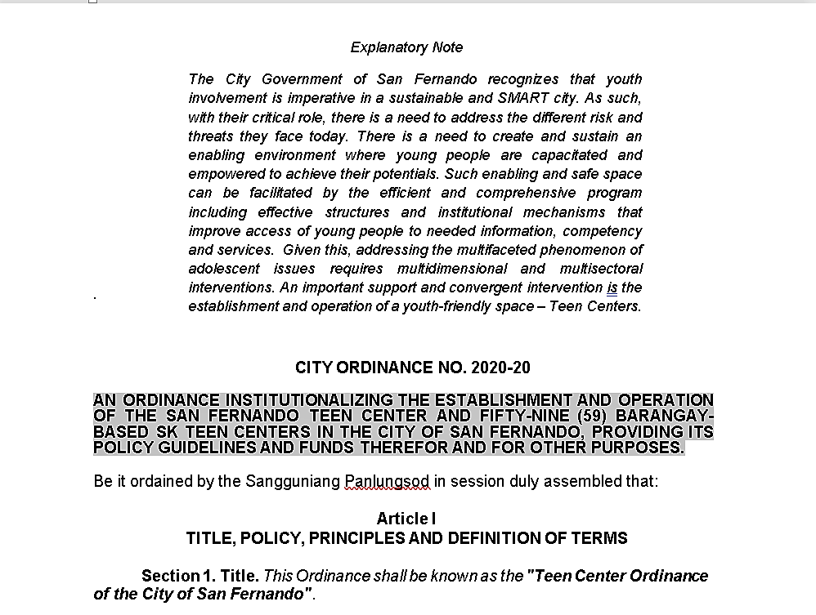

Slide 32
ACTUAL SK TEEN CENTERS

Slide 33
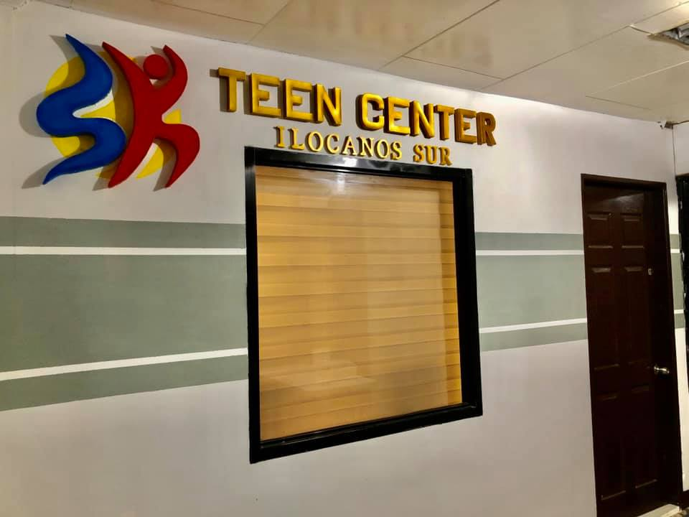
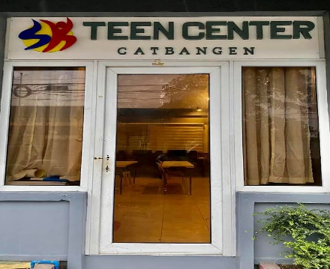
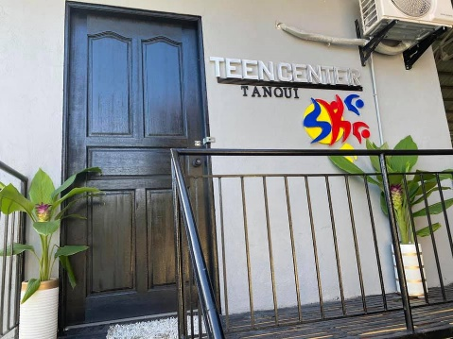
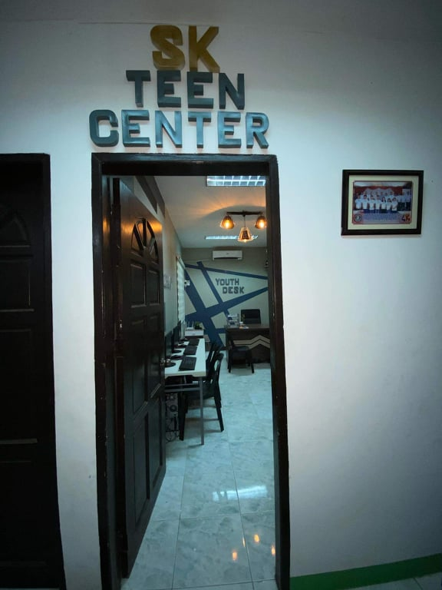
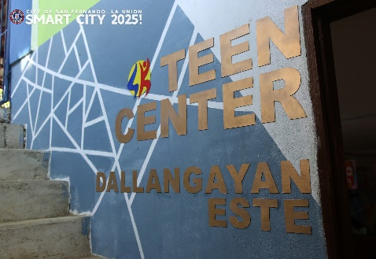
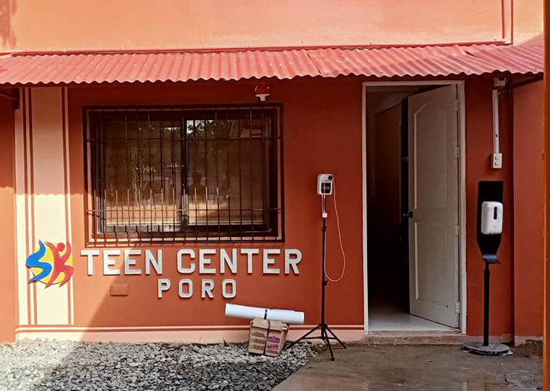
EXTERIOR
DESIGN

Slide 34
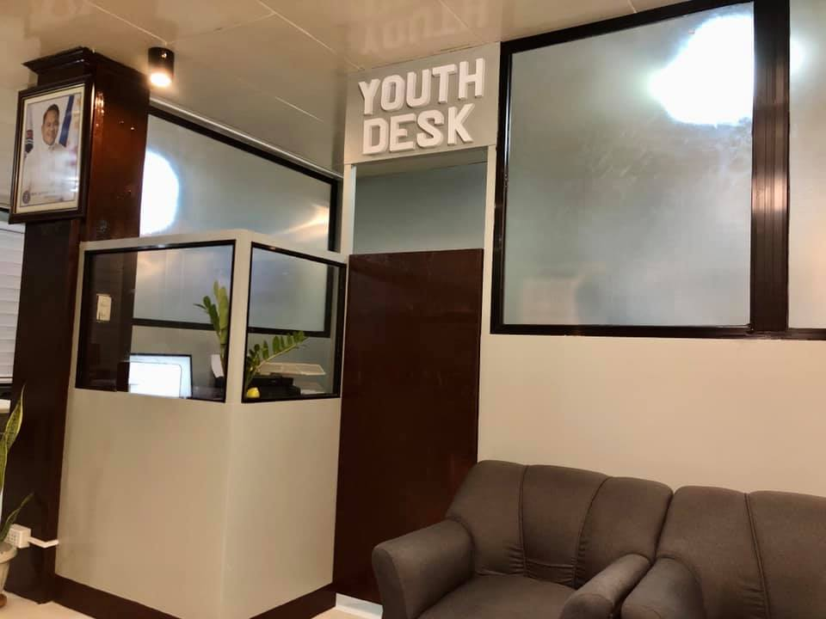
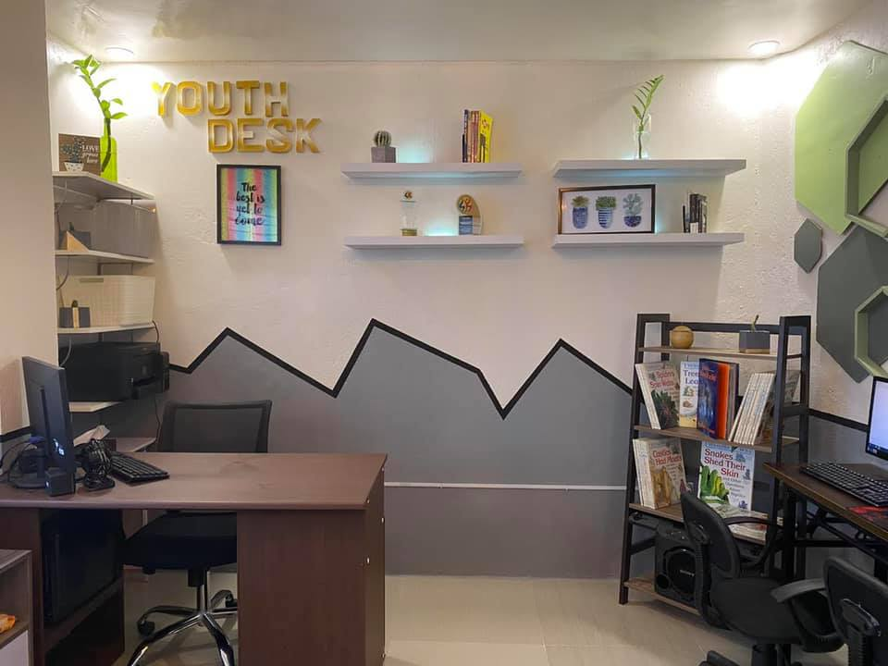
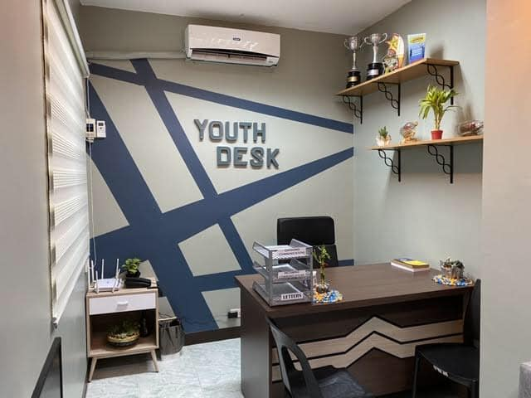
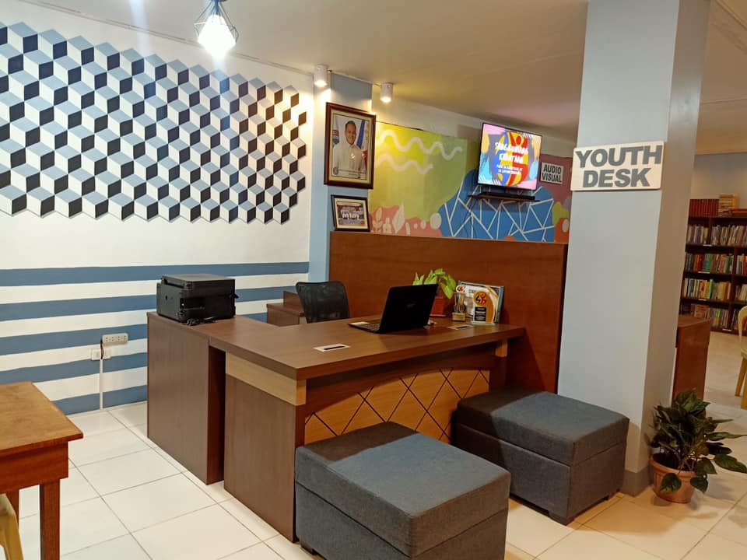
YOUTH DESK

Slide 35
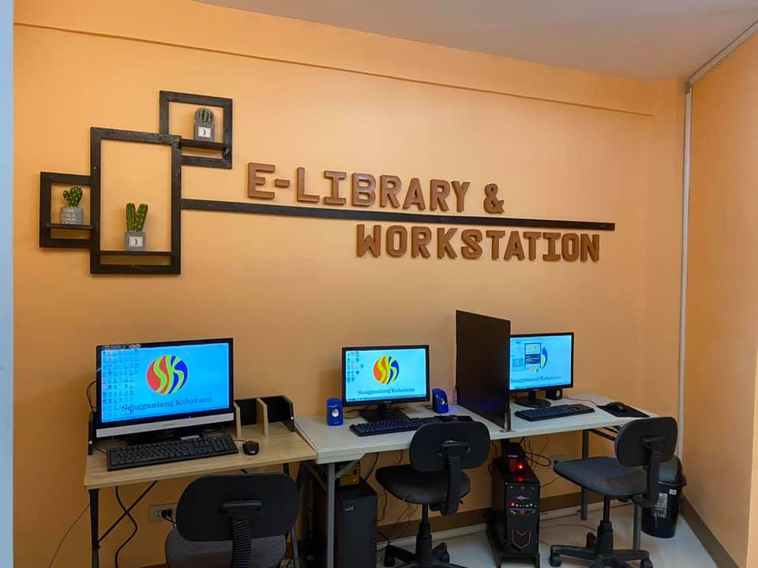
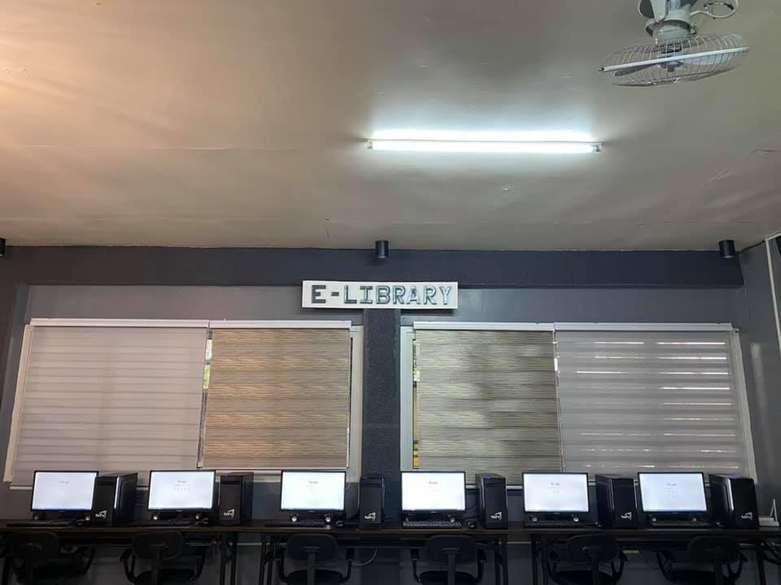
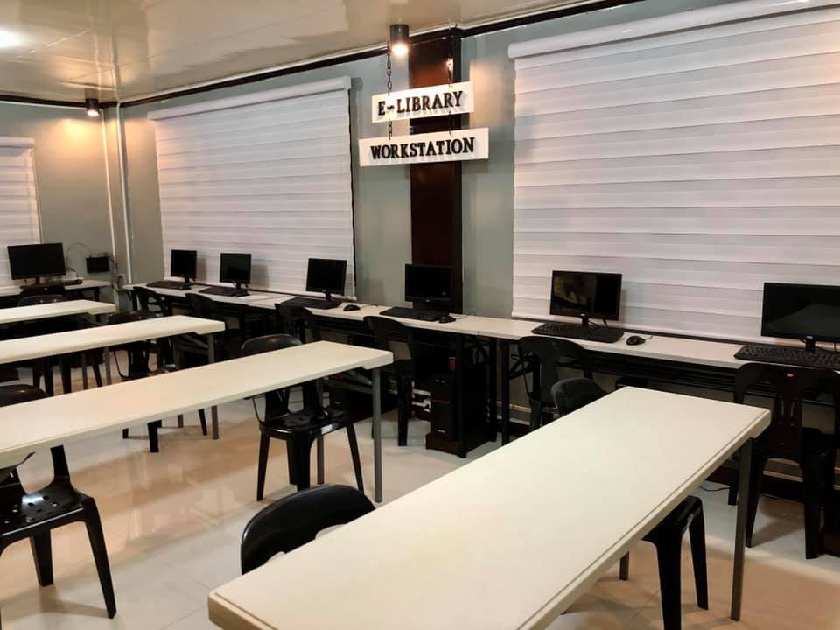
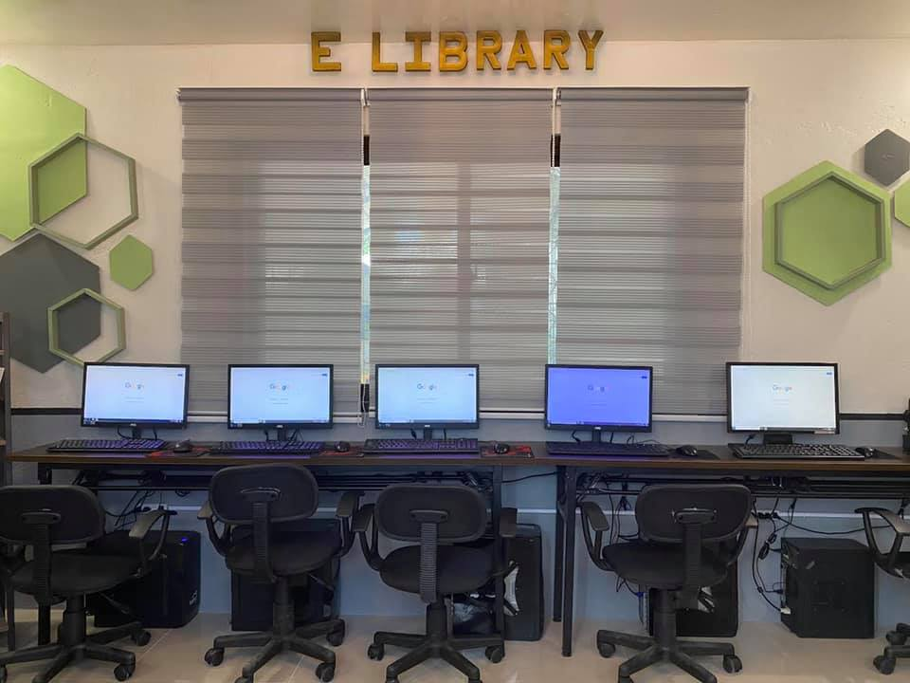
E-LIBRARY
AND
WORK
STATION

Slide 36
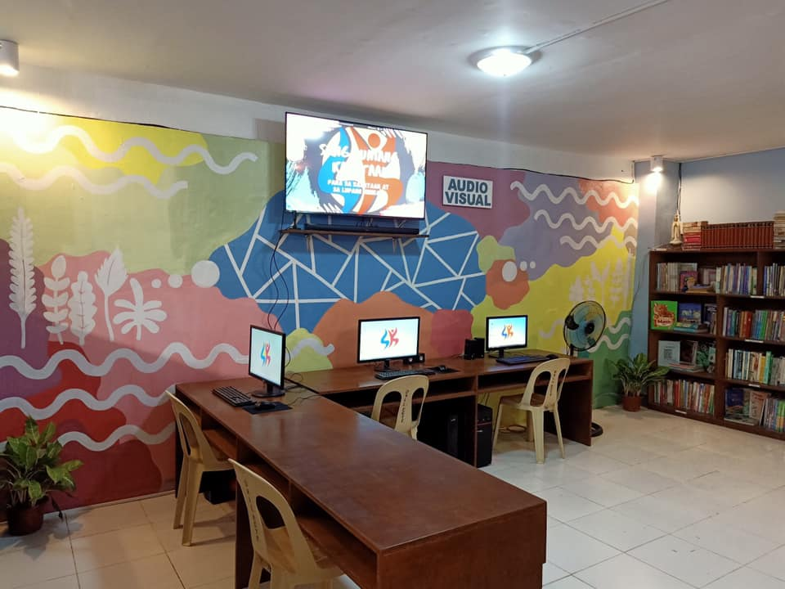
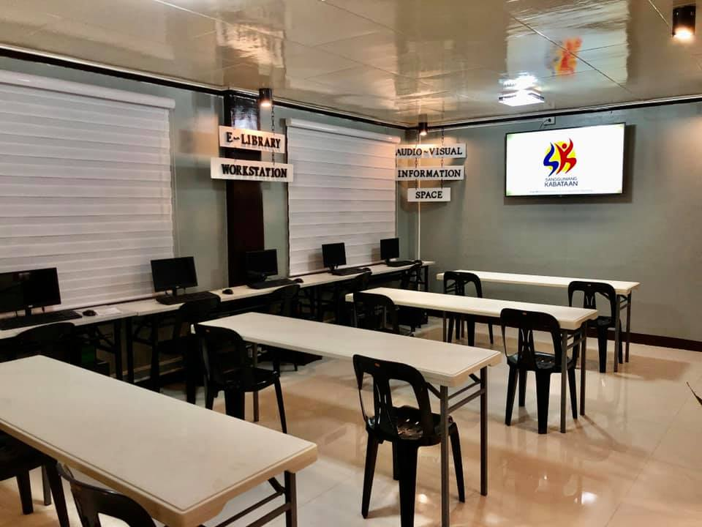
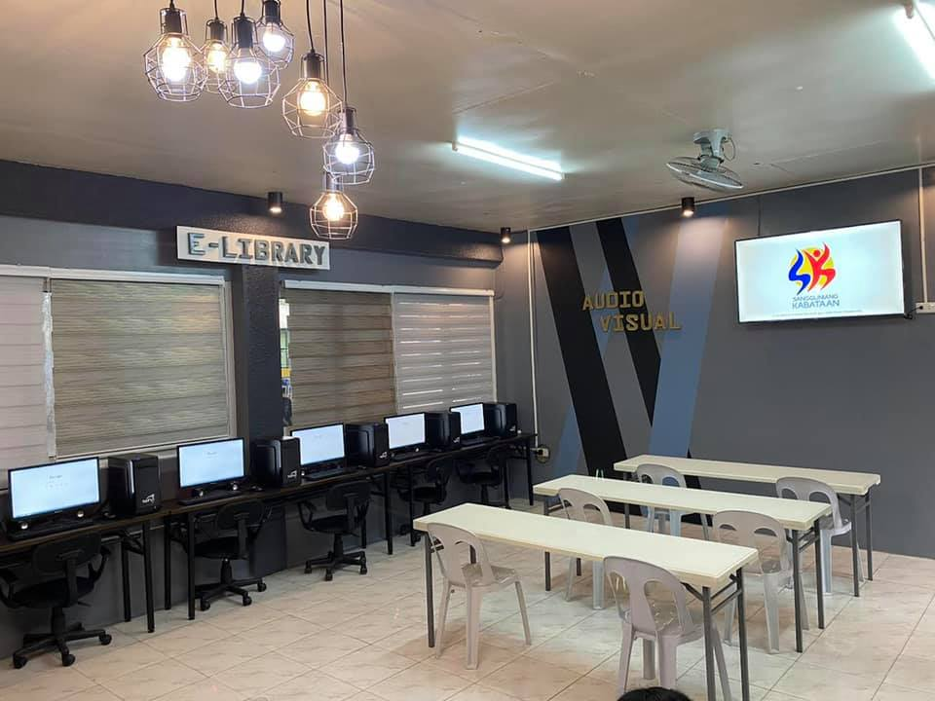
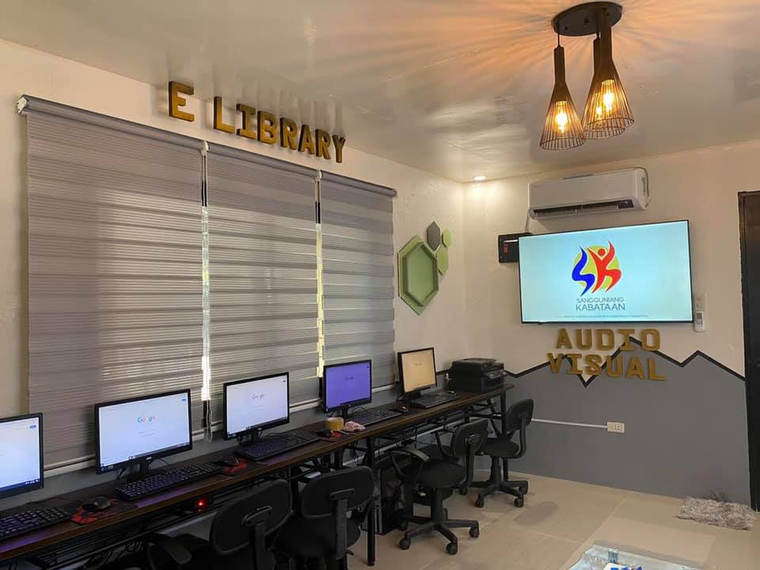
AUDIO-
VISUAL
INFORMATION
SPACE

Slide 37
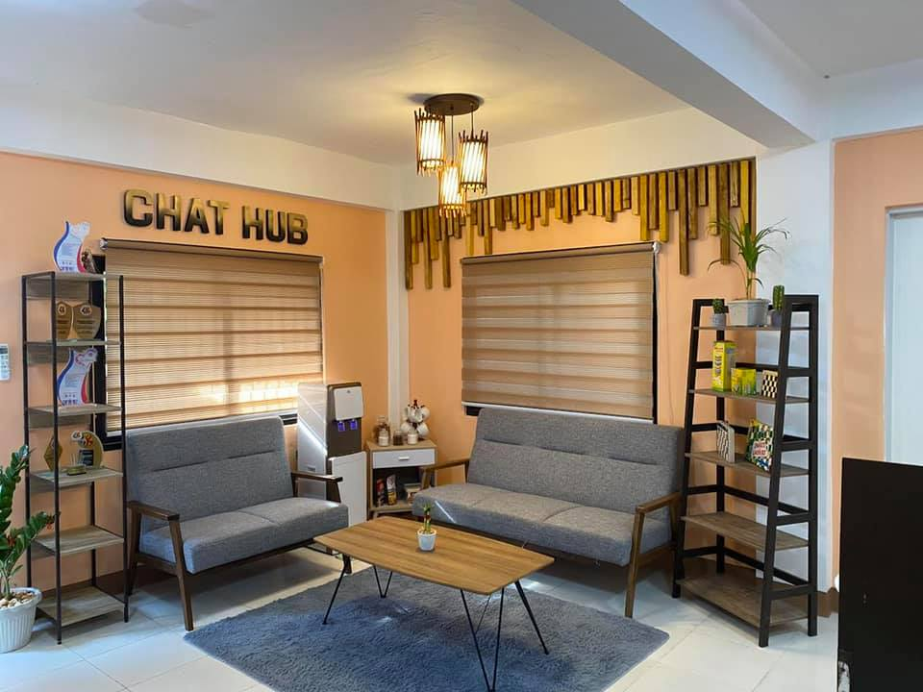
CHAT
HUB

Slide 38
SAN FERNANDO TEEN CENTER

Slide 39
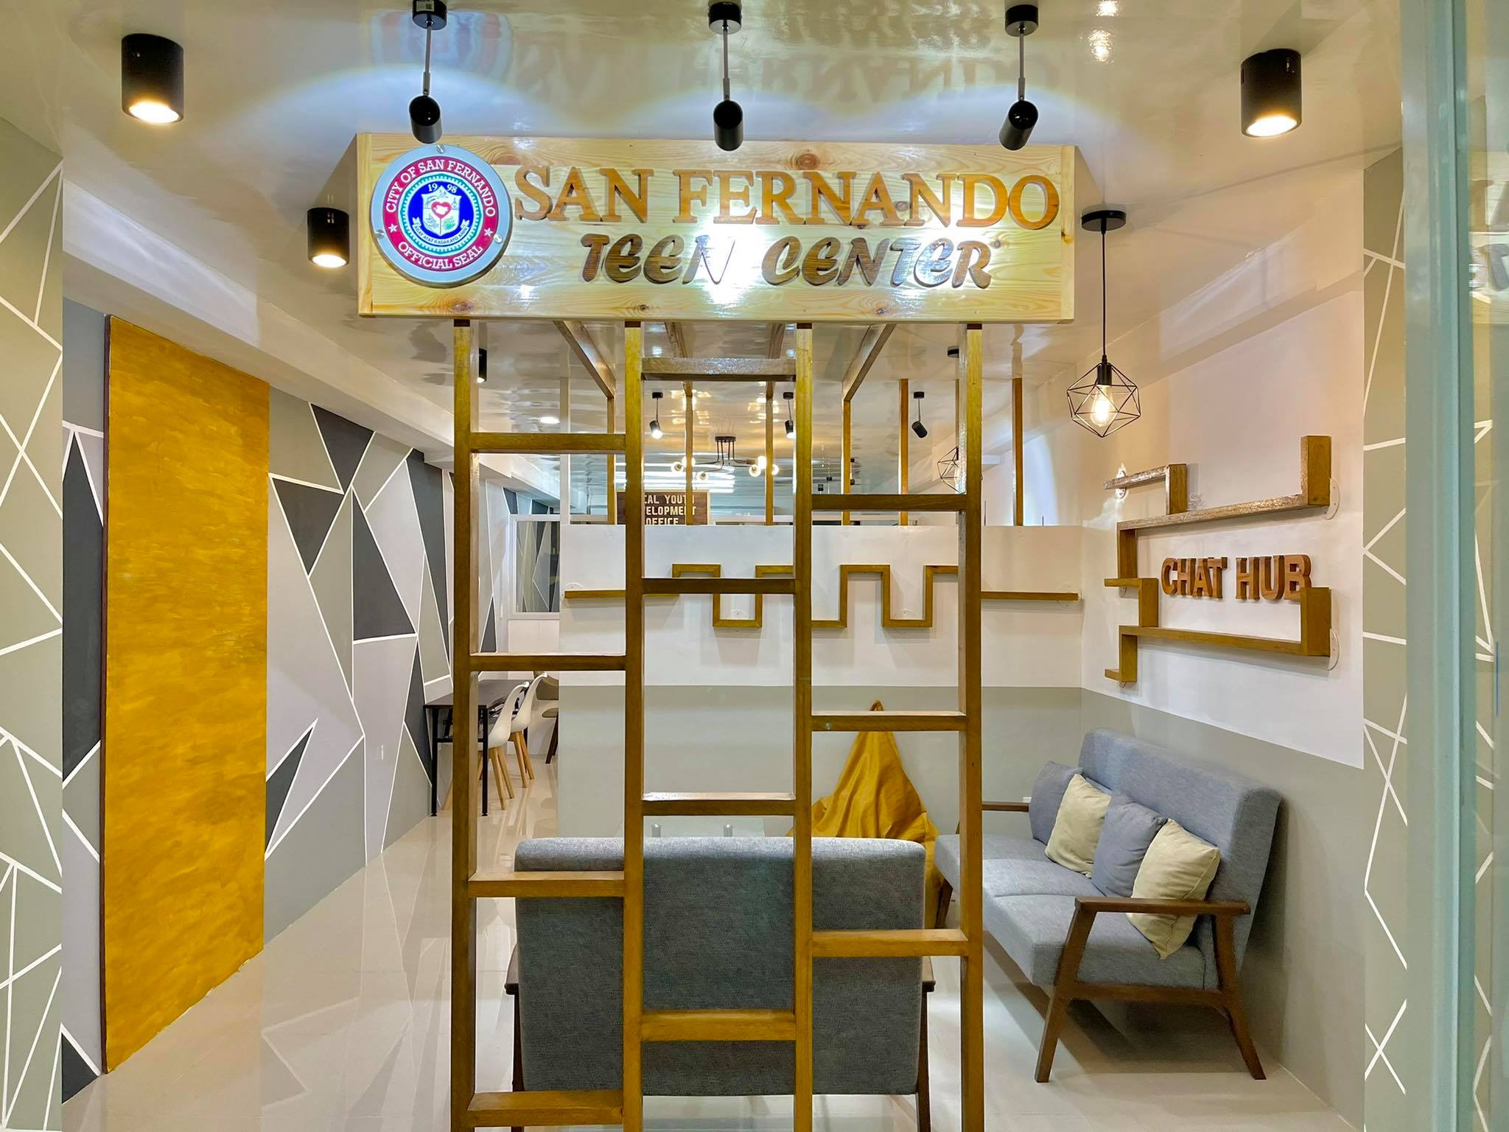

Slide 40
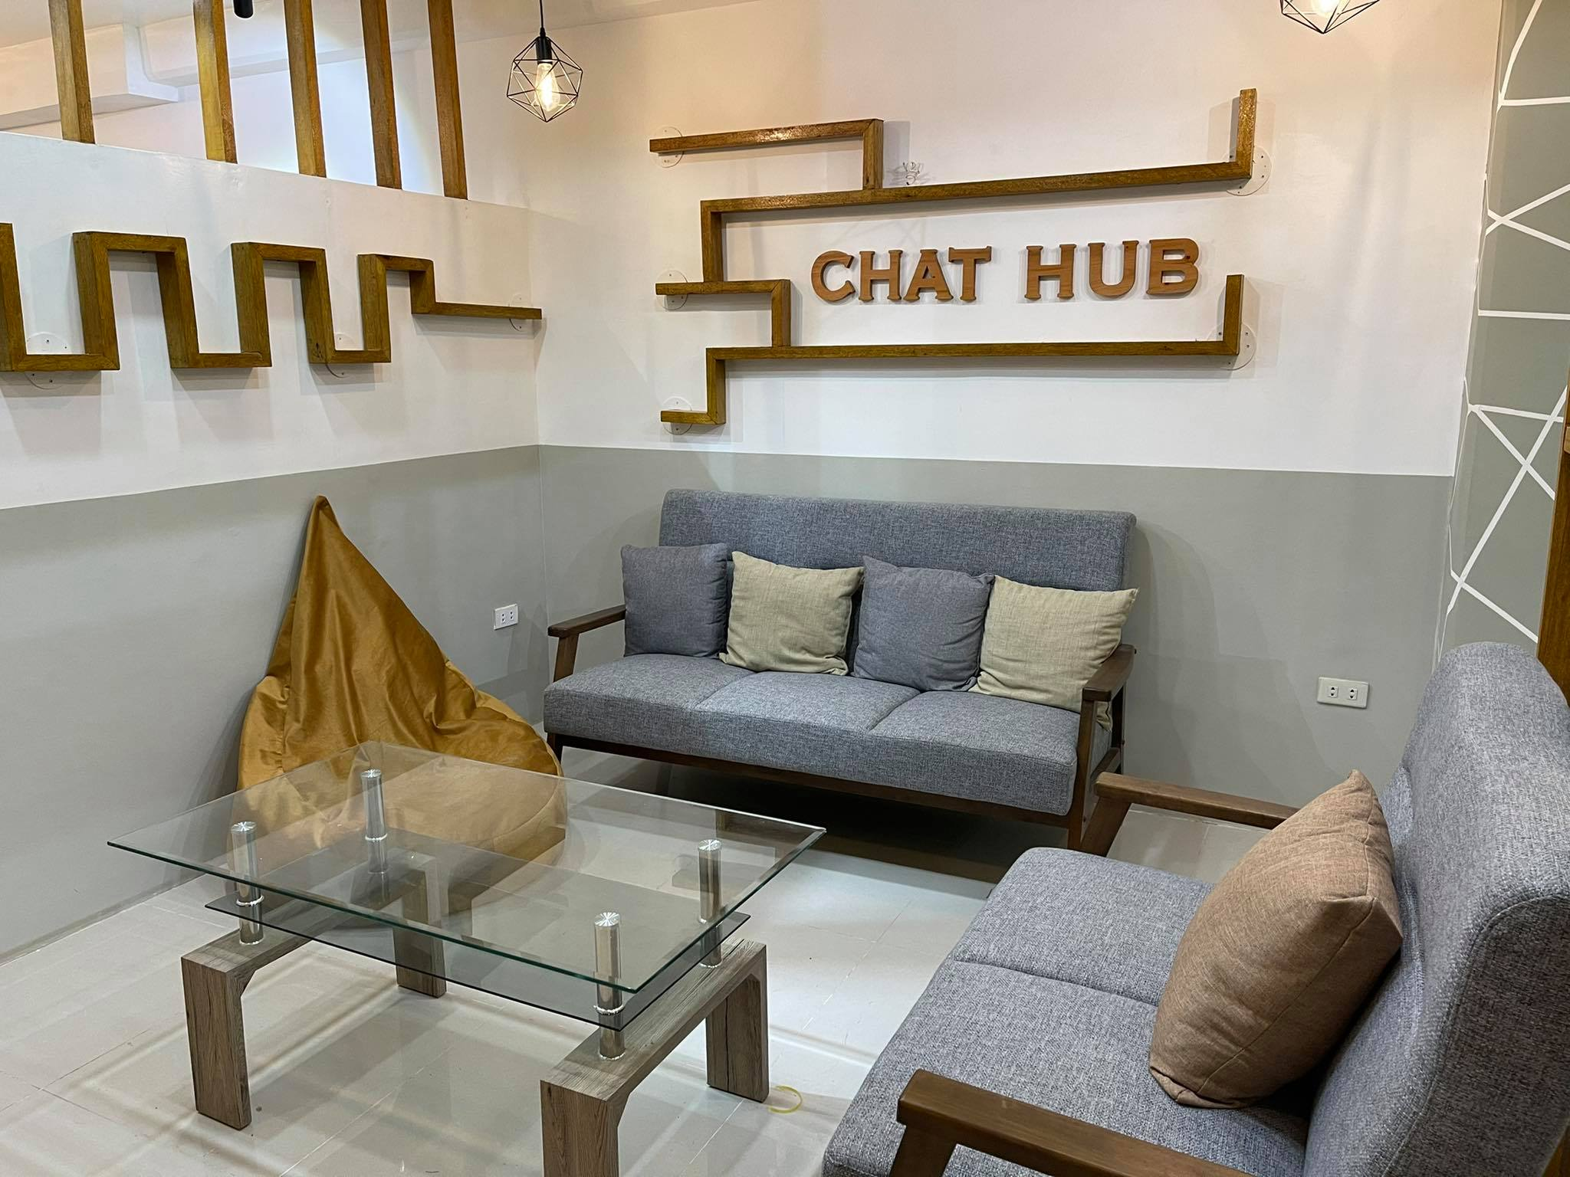

Slide 41
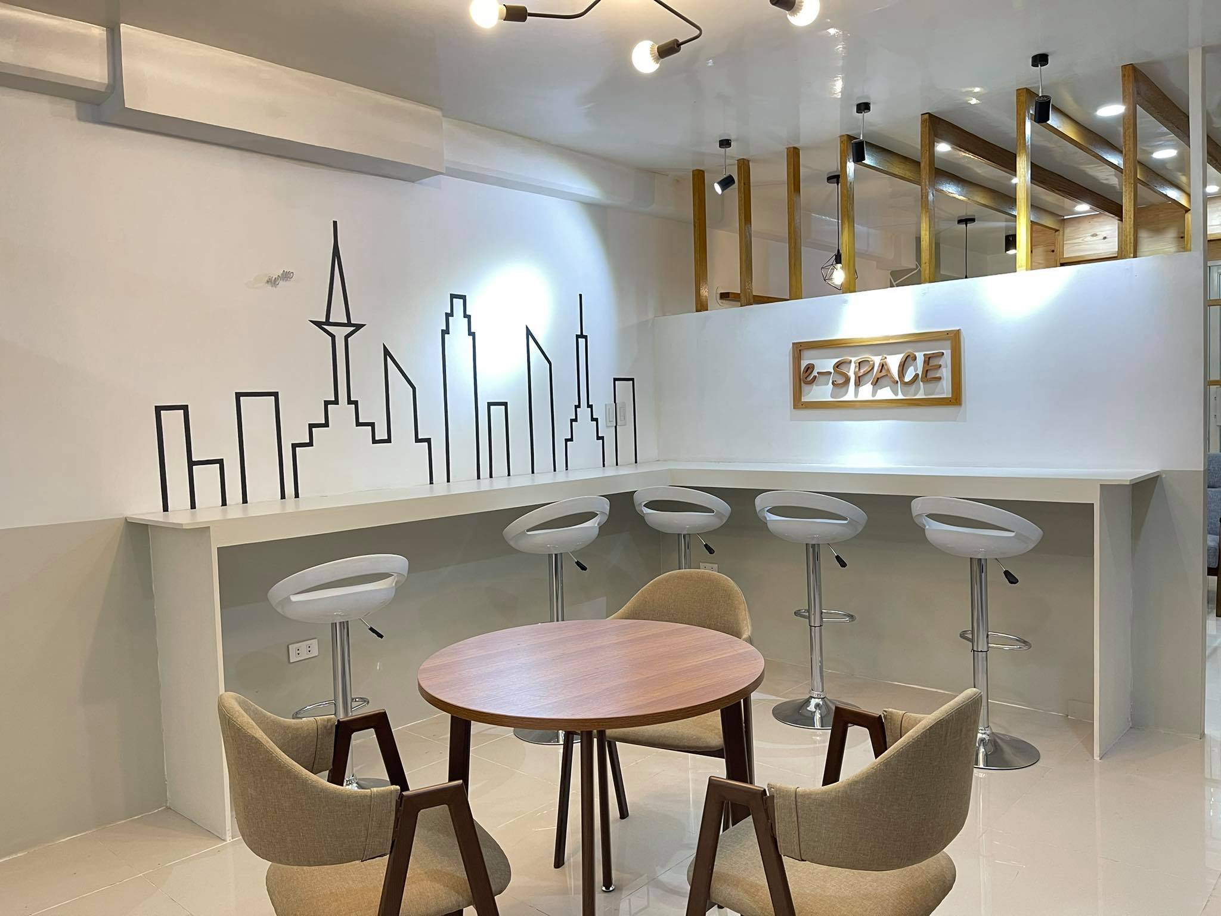

Slide 42
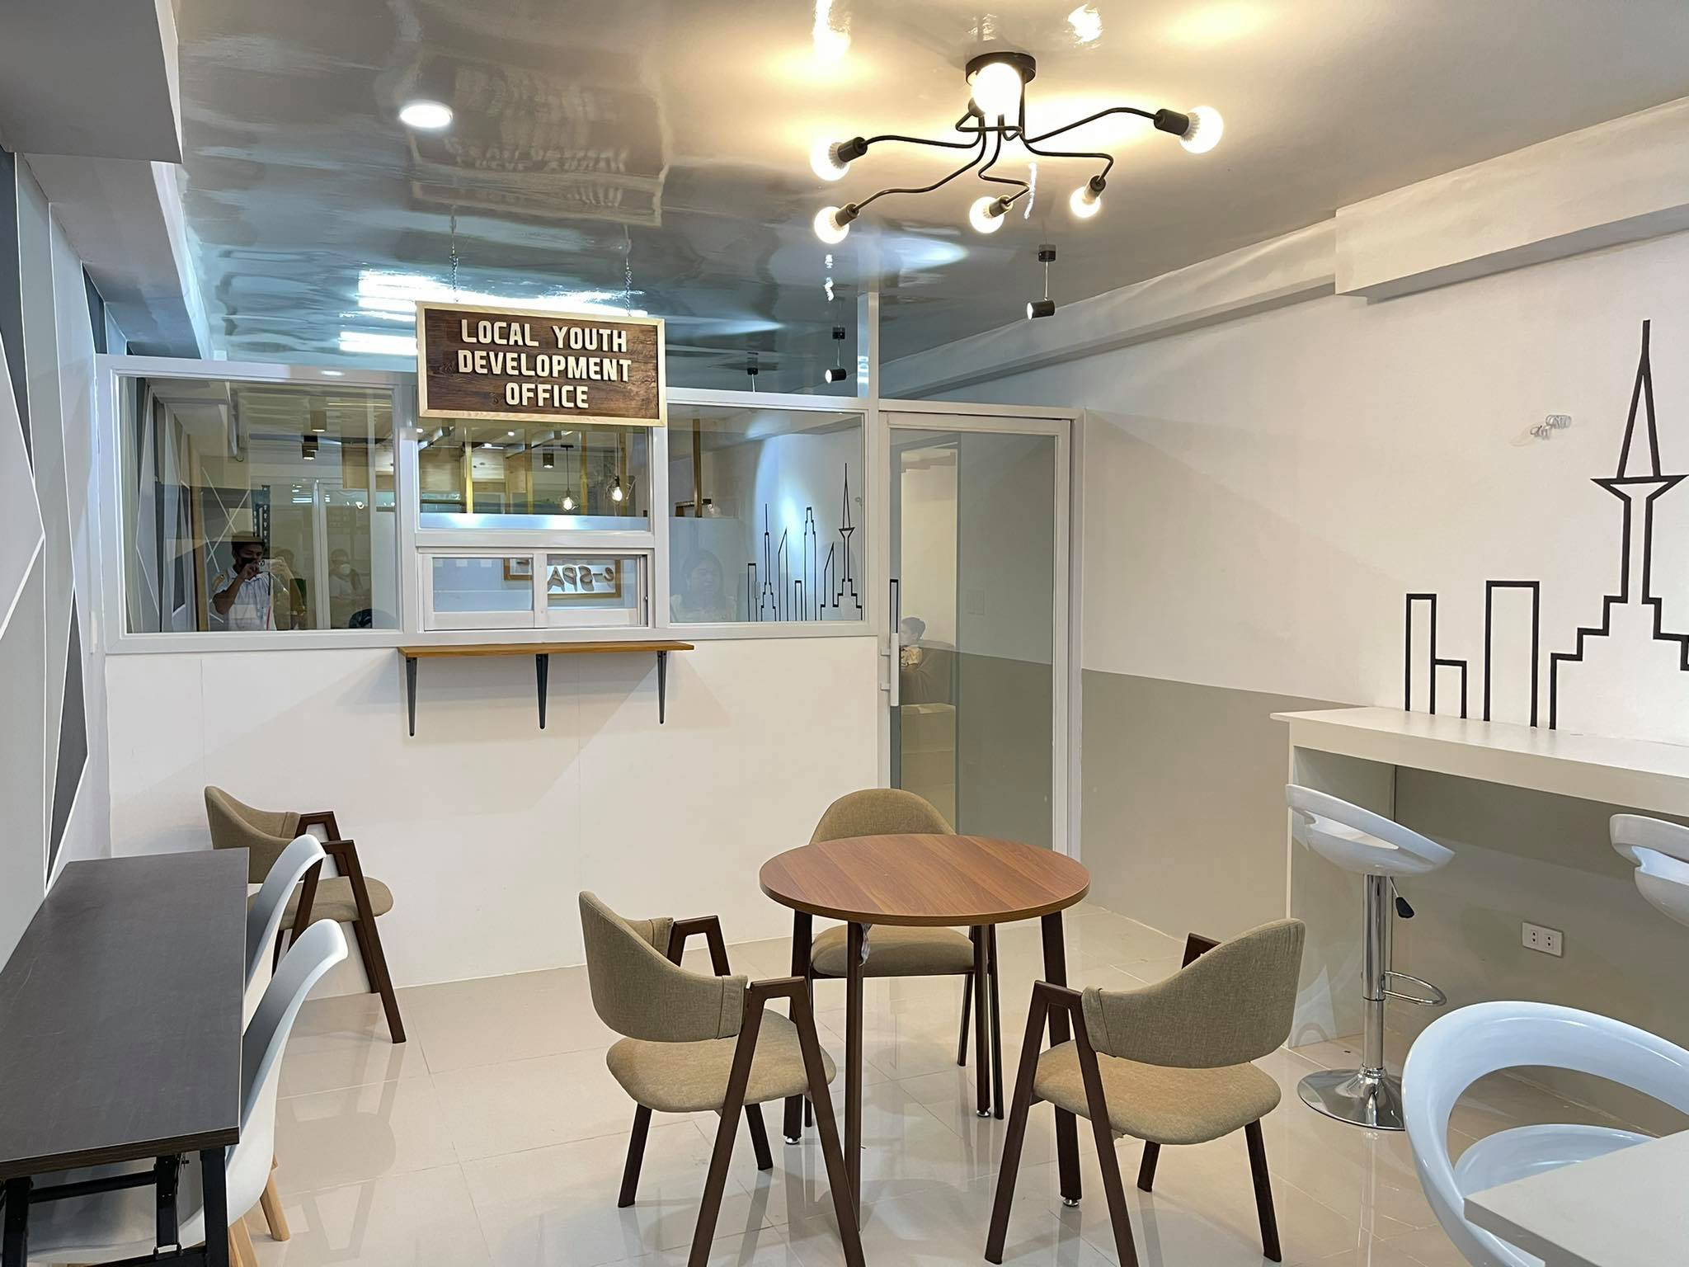

Slide 43
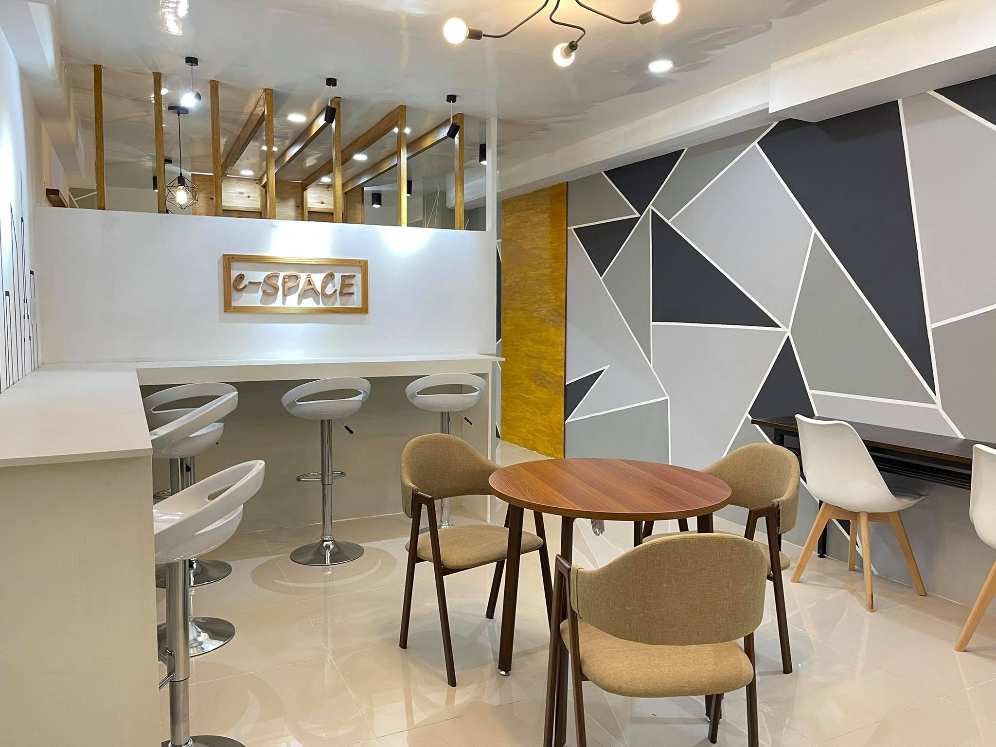

Slide 44
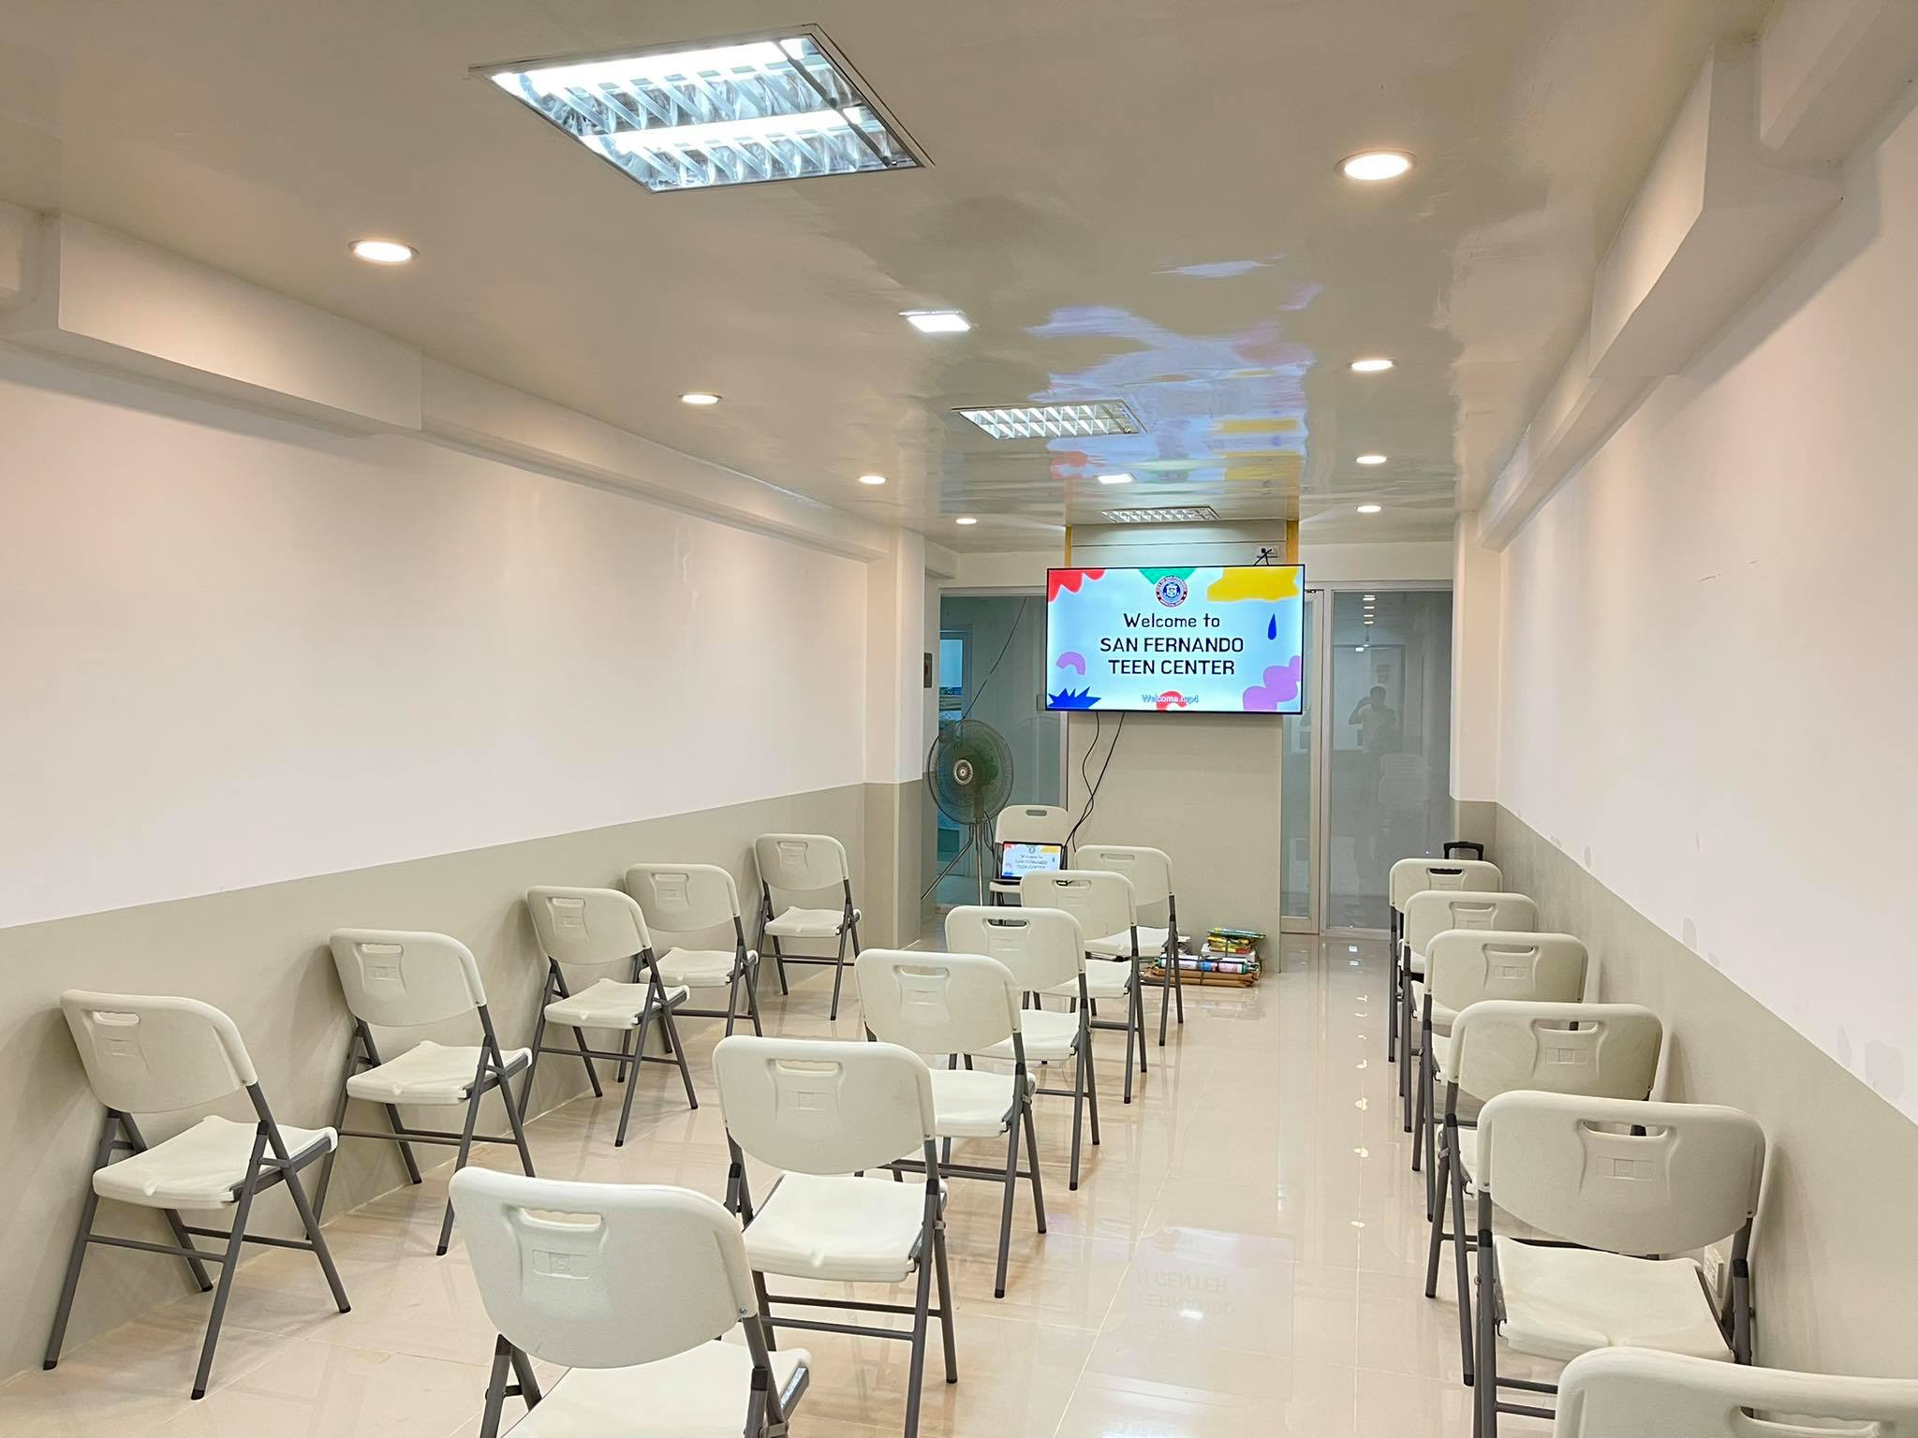

Slide 45
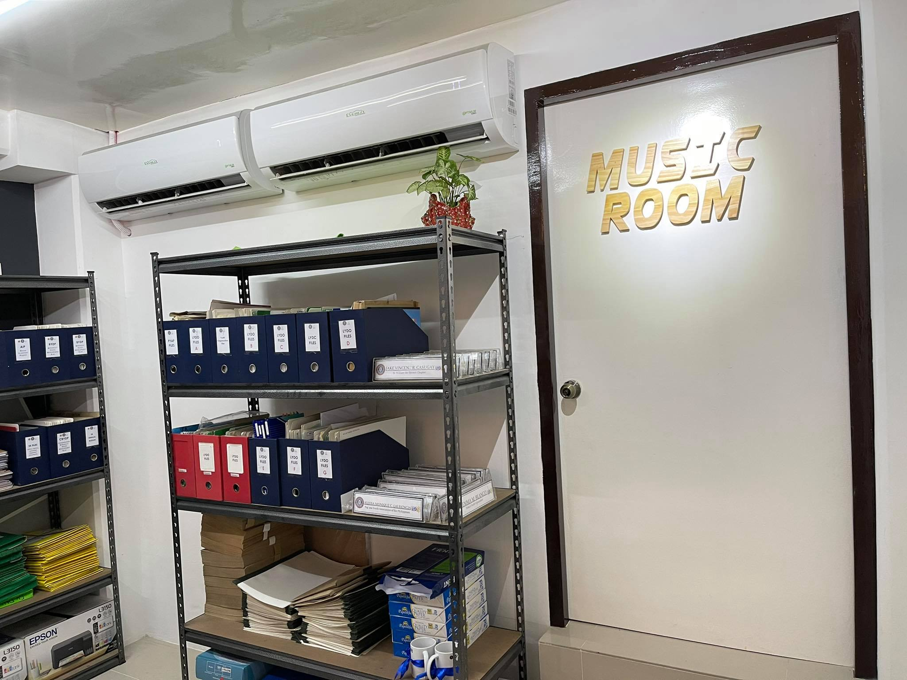

Slide 46
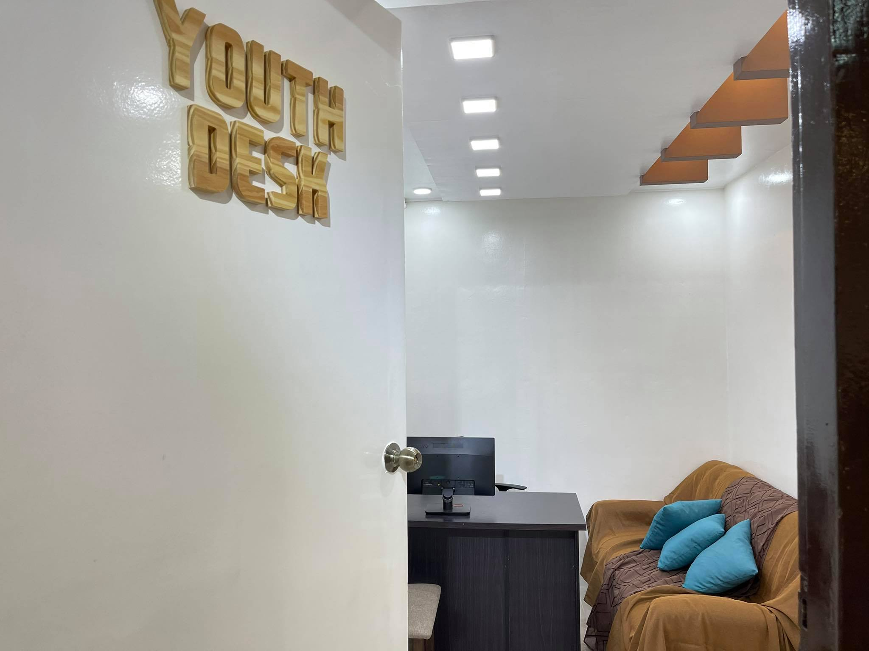

Slide 47
CITY OF SAN FERNANDO:
Safest Space for the youth in Ilocandia Region by 2025
ACHIEVED VISION

Slide 48
AGYAMAN KAMI!
#WalangKabataangMaiiwan

