Slide 1
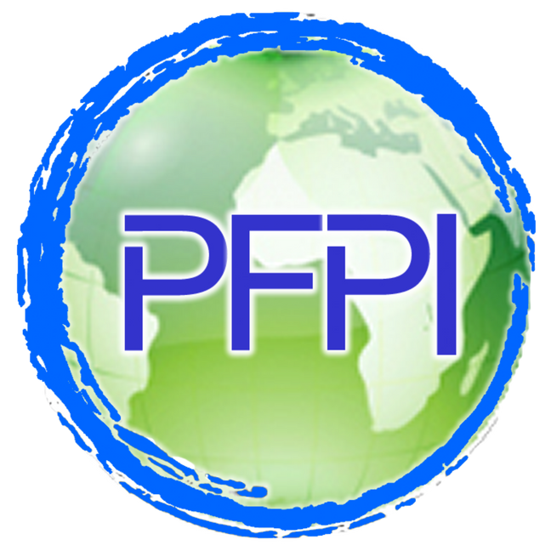
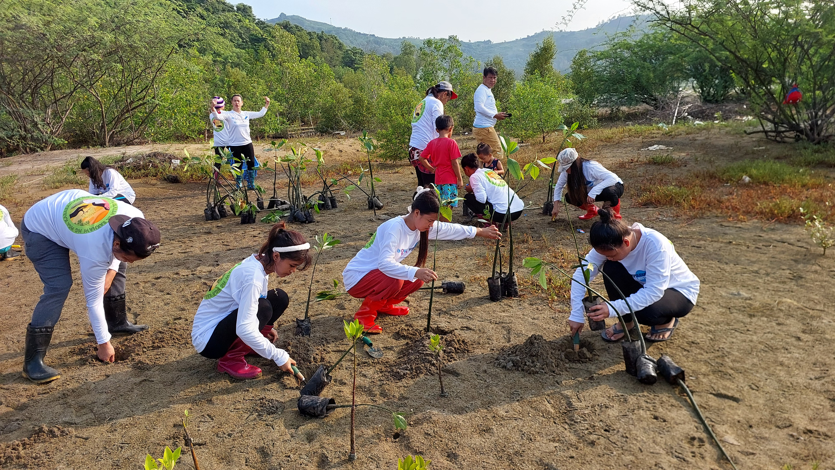
PATH Foundation Philippines, Inc. (PFPI)
Integration of FP and SRHR into Climate Change Policies and Frameworks in the Philippines
3rd National Conference on Family Planning
November 20–21, 2024 | Crowne Plaza Manila Galleria
FAITH I. BACON
Population, Environment and Development (PED) Advisor
Notes:
Photo shows a mangrove tree planting activity in a women-managed area in Zambales. The project aims to integrate FP/RH into marine conservation and climate change adaptation. Mangrove trees help coastal communities mitigate the effects of extreme weather events, specifically storm surge.

Slide 2
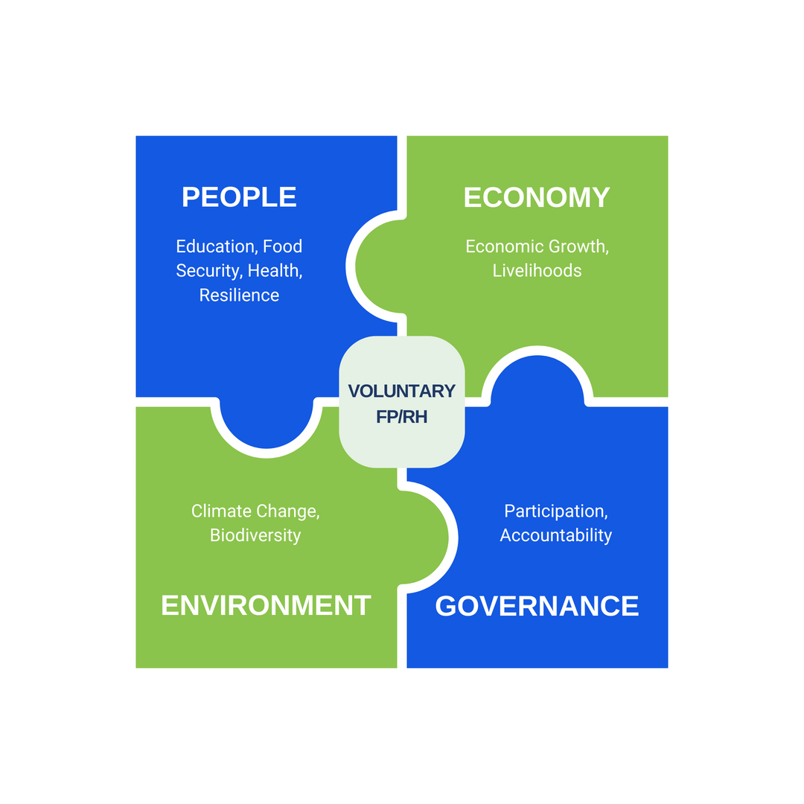


Rationale
Notes:
The World Health Organization study shows that 3.6 billion people globally live in areas highly susceptible to climate change and approximately 250,000 additional deaths per year are expected between 2030 and 2050 from undernutrition, malaria, diarrhea and heat stress. Records from the National Aeronautics and Space Administration (NASA) Goddard Institute for Space Studies on temperature also indicate continued global warming, with September 2023 being the highest recorded temperature since 1880. These data project an extremely vulnerable population and ecosystems with potentially irreversible effects and will continue to worsen if short- and long-term actions are not instituted.
Development challenges the Philippines face are interconnected—poverty, environmental degradation and unmet need for family planning.
Adverse effects of climate change compound all these challenges.
Population dynamics plays a pivotal role in determining human vulnerabilities and the ability to adapt to the impacts of climate change.
Development interventions that fully tap into the synergies between sectors are crucial to addressing the root causes of poverty, conserving the environment and combating climate change—holistically from a systems thinking perspective.
The infographic shows the interconnectedness of sectors from a systems thinking perspective. At the center is FP/RH (population considerations), which is oftentimes overlooked.

Slide 3
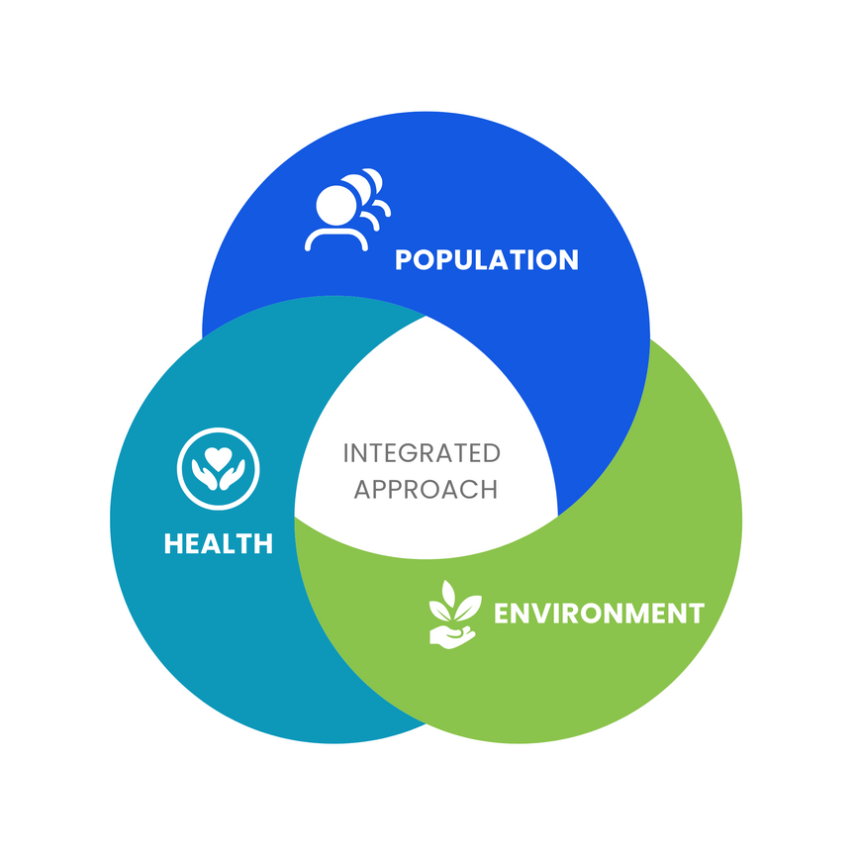
Study Objective
  Identify existing gaps, challenges and opportunities for FP/RH and SRHR integration through a rapid scan of the national climate change plans, policies, strategies and financing in the Philippines
  Use the results of the study to inform advocacy on PHE integration, specifically in climate action
Notes:
In recognition of the role that population dynamics play in determining human vulnerabilities and the ability to adapt to the effects of climate change, PFPI undertook a rapid desk review of the national climate action policies, plans, strategies, and financing mechanisms of the Philippines to examine the extent to which FP/RH and gender issues are integrated into these instruments.

Slide 4

Integration of population dynamics, FP/RH, SRHR and gender equity in climate plans, policies and frameworks
Document | Population Dynamics | FP/RH | SRHR | Gender Equity
AmBisyon Natin 2040 | ✅ | ❌ | ❌ | ✅
Philippine Development Plan (PDP) | ✅ | ✅ | ✅ | ✅
Nationally Determined Contribution (NDC) | ❌ | ❌ | ❌ | ✅
National Climate Change Action Plan (NCCAP) | ✅ | ✅ | ❌ | ✅
National Disaster Risk Reduction and Management Plan (NDRRMP) | ✅ | ✅ | ✅ | ✅
Philippine Master Plan for Climate Resilient Forestry Development (PMPCRFD) | ✅ | ❌ | ❌ | ✅
✅
PDP; NDRRMP
Notes:
Since the PDP is the "mother" of all development plans, it can be used as a basis to advocate for the integration in other plans or the localized plans (RDPs and LGU development plans). The previous PDP actually prescribed integration through the PHE Approach but there was no documentation of how it was operationalized.
The NDRRMP includes a part on MISP. This highlights the importance of sustaining SRHR services amidst natural disasters (relevant to recent typhoon events)

Slide 5

Integration of population dynamics, FP/RH, SRHR and gender equity in climate finance mechanisms
Document | Population Dynamics | FP/RH | SRHR | Gender Equity
Climate Change Expenditure Tagging (CCET) | ❌ | ❌ | ❌ | ✅
People’s Survival Fund (PSF) | ❌ | ❌ | ❌ | ✅
Global Environment Facility (GEF) | ❌ | ❌ | ❌ | ✅
Green Climate Fund (GCF) | ✅ | ✅ | ✅ | ✅
✅
GCF
Notes:
While the GCF mentions and/or highlights the importance of these elements, it is common knowledge that accessing this fund is highly challenging because of its technical requirements.
*CCET-Mainstreams climate change in the national and sub-national budgeting processes; provides an avenue to assess the alignment and scale of mobilization of public funds based on the NCCAP

Slide 6


Limited Explicit Integration
01
The NDC, NCCAP, NDRRMP and PDP lack explicit and comprehensive integration of population dynamics, FP/RH, and gender within their core frameworks.
Fragmented Approaches
02
Fragmented approaches predominate over a comprehensive integration of population dynamics, FP/RH, and gender in climate change policies, strategies and frameworks.
Key
Findings
03
Resource Allocation and Implementation
Despite recognizing the importance of these elements, the allocation of resources and the implementation of specific programs at the ground level remain limited.
04
Policy-Program Coordination and Collaboration
Coordination among sectors and agencies including LGUs responsible for climate change, population and health is crucial; however, there is often a lack of effective collaboration and coordination between these sectors.
Notes:
1. Limited Explicit Integration: While some parts of the documents recognize these challenges, such as climate change-induced migration, there is a dearth of clear strategies or concrete actions to address these issues.
2. Fragmented Approaches: This results in missing the opportunity to fully address the interconnectedness of population, FP/RH, gender, and climate change. For example, while the NDRRMP acknowledges the disproportionate impact of disasters on vulnerable groups, including women, there is a lack of specific guidelines and proposed interventions that integrate FP/RH into disaster preparedness, response, and recovery.
3. Resource Allocation and Implementation: There is a need for more concrete budgeting and resource allocation for initiatives focusing explicitly on integrating population dynamics, FP/RH, and gender into climate change policies.
4. Policy-Program Coordination and Collaboration: Sectors often craft their own policies and implement programs in siloes (not coordinating with other sectors), e.g., LCCAP not coordinated well with MHO.

Slide 7

The current national climate change policies and plans in the Philippines show promising aspects related to gender but lack explicit and comprehensive integration of population dynamics, FP/RH and SRHR across the board.
01
02
While some of plans, policies, and frameworks mention population dynamics and gender equity, FP/RH often remains implicit or absent.
Conclusions
03
The fragmented approach across policies limits comprehensive integration, hindering the recognition of the interconnectedness between population issues and climate change.
04
Inadequate resource allocation, limited technical capacities of government institutions and a lack of effective coordination and collaboration among sectors further impede the integration efforts.
Opportunities to operationalize the integration of population dynamics, FP/RH, SRHR into climate action (i.e., with actual activities and funding) can be through the PDP, NDRRMP and GCF, which mention and/or highlight the importance of these aspects.
Notes:
The PDP, NDRRMP and GCF can be leveraged as "test platforms" to demonstrate the integration of population dynamics, FP/RH, SRHR into climate action (i.e., low-hanging fruits).

Slide 8

Promote Explicit and Systemic Integration
Develop detailed strategies and specific actions within the climate change policies and plans addressing FP/RH, SRHR and population dynamics explicitly and systematically, (i.e., policy updating, developing supplementary guidelines, conducting interlinkage assessments)
01
Ensure Resource Allocation and Implementation
02
Secure concrete budget allocation for initiatives directly integrating population dynamics, FP, SRHR and gender into climate change policies. (i.e., dedicated funding, capacity building on integration)
Recommendations
03
Facilitate Intersectoral Policy-Program Coordination
Encourage partnerships and collaborative efforts to bridge sectoral divides and promote comprehensive integration ( i.e., identification of convergence points, establishing interagency working groups)
04
Sustain Advocacy, Champions Building and Awareness Raising
Develop messages and campaigns to raise awareness about the benefits of integrating FP/RH in climate change action and identify and develop PHE champions to advocate for integrated approaches.
Notes:
EXPLICIT INTEGRATION
*Policy Updating: Participate in the review process for existing climate change policies like the NDC and NCCAP to explicitly integrate and articulate FP/RH, SRHR and population dynamics. Amend or supplement these policies with dedicated sections focusing on these elements.
Supplementary Guidelines: *Develop supplementary guidelines or frameworks specifically addressing the integration of population dynamics, FP/RH, SRHR and gender within climate change initiatives, providing detailed strategies and actions.
*Interlinkage Assessment: Conduct assessments to identify and highlight the interconnectedness between population dynamics and climate change impacts, ensuring a holistic approach in policy formulation.
RESOURCE ALLOCATION AND IMPLEMENTATION
*Dedicated Funding: Create dedicated budget allocations within the national budget for programs integrating population dynamics, FP/RH, SRHR and gender into climate change policies, plans and programs. Strengthen the CCET monitoring framework with the integration of gender lens (hence, FP/RH and SRHR as subcomponents).
*Capacity Building: Invest in capacity-building programs at the national and local levels to ensure effective implementation of integrated initiatives, providing training and resources to relevant agencies and LGUs.
POLICY-PROGRAM COORDINATION
*Convergence Points: Review coordination and collaboration mechanisms to address any gaps, challenges, and to identify potential areas for policy-program sectoral convergence.
*Interagency Working Groups: Establish interagency task forces or working groups that bring together representatives from climate change, health, gender and population management sectors to ensure collaborative efforts in policy formulation and implementation. Build on existing inter-agency bodies or working groups expanding their mandate if necessary. Also, ensure that there is representation of private sector and civil society groups.
*Knowledge Sharing Platforms: Develop platforms or forums for knowledge sharing and best practice dissemination among agencies, fostering collaboration and learning across sectors.

Slide 9

Study other instruments
Expand the study to cover the National Adaptation Plan (NAP), NDC Implementation Plan (NDCIP), NDC Gender Action Plan (NDCGAP) and other relevant instruments.
01
Conduct case studies on climate financing
Way
Forward
Expand the study to further understand the climate action financing landscape with case studies to identify best practices, lessons learned, and opportunities for scaling up, replication, and increasing financial commitments for FP/RH and SRHR in the context of climate action, e.g., experience from other countries with similar climate change vulnerability as the Philippines.
02
03
Document experience at the local level
Document case studies of LGUs that have effectively incorporated FP/RH and SRHR into their Local Climate Change Action Plans (LCCAPs), as well as climate change adaptation and mitigation programs, projects, activities and budgets, which can serve as models for replication.
Notes:
The NAP, NDCIP and NDCGAP were not yet publicly available during the conduct of the study. However, PFPI was able to push for PHE to be included in the NAP, even though the final language is not explicit—it only says "integrated/cross-sectoral and multidisiplinary approaches" (1.2 Guiding Principles).
Mapping GEF- or GCF-funded projects in other countries that have successfully integrated population dynamics, FP/RH and SRHR and climate action will also be beneficial to provide models for replication in the Philippines.

Slide 10
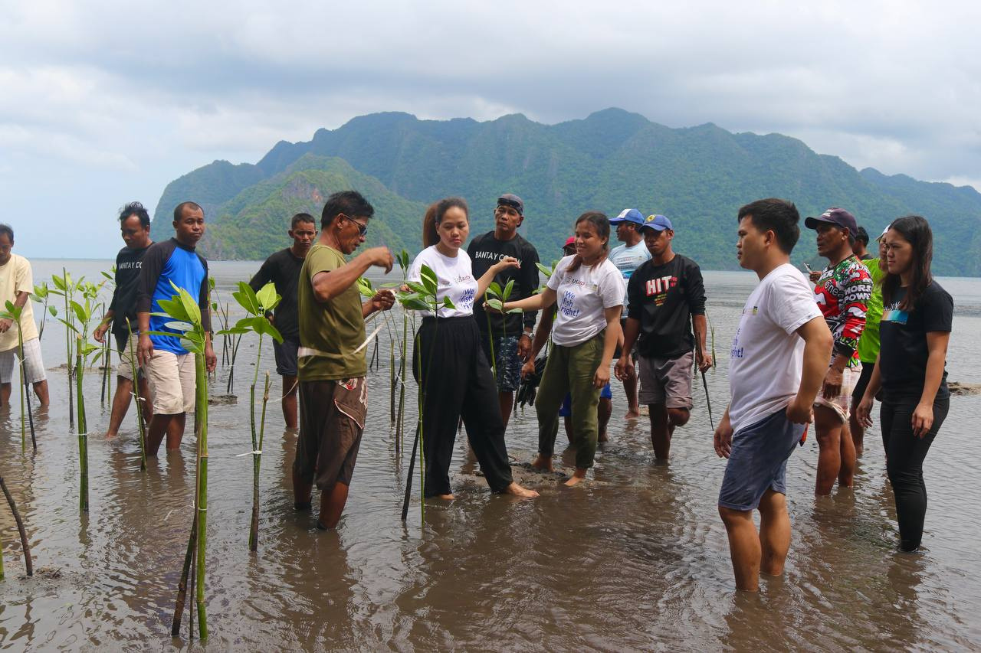
GET IN TOUCH
Message Us
info@pfpi.org
Mailing Address
22/F Unit 2205 Cityland Condominium 10, Tower II 154 H. V. Dela Costa St., Makati City
Website
www.pfpi.org

