Slide 1
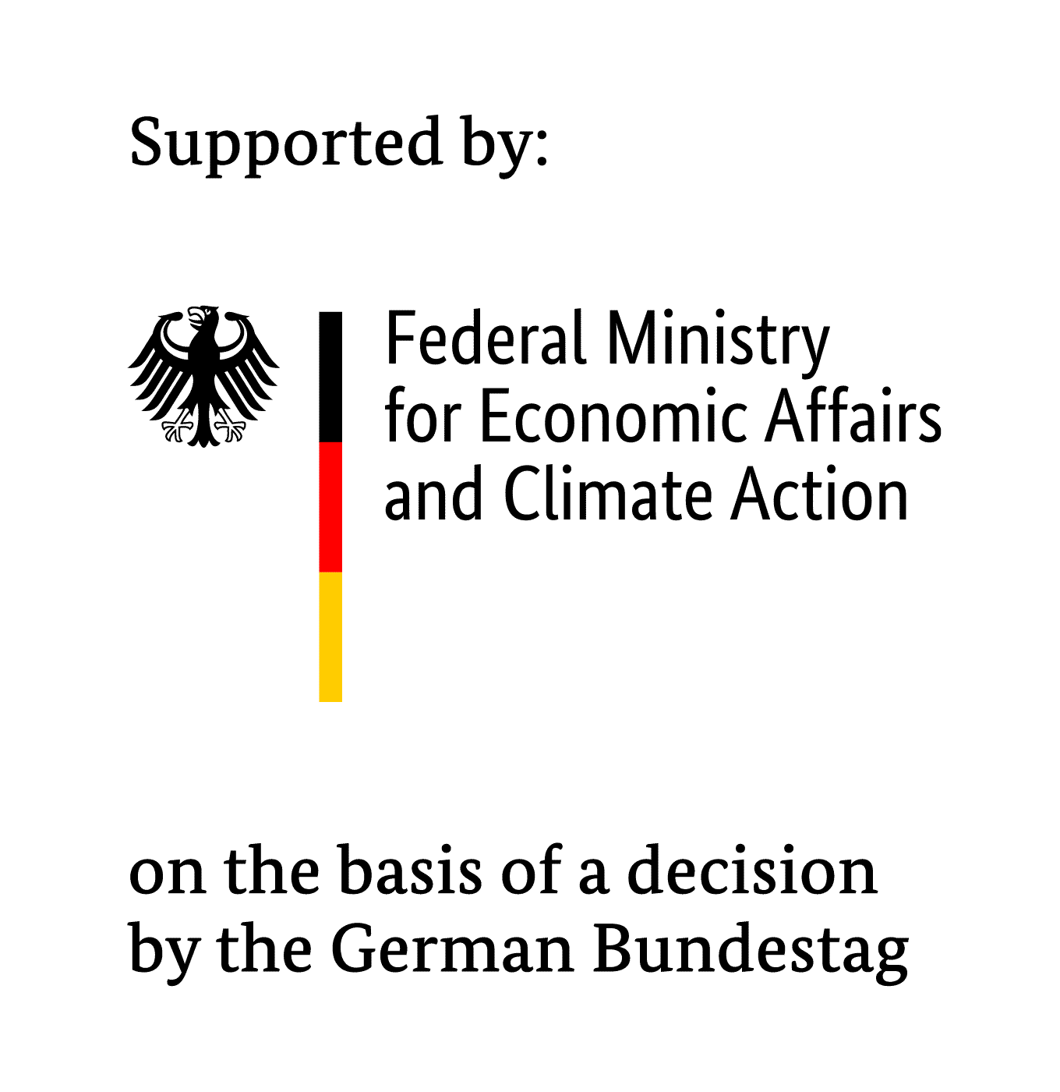
Human Mobility in the Context of Climate Change II (HMCCC II)
In partnership with
Implemented by

Slide 2
GIZ Philippines and the Pacific Island Countries
On behalf of the Federal Republic of Germany and its commissioning parties, GIZ works with development partners in around 120 countries, providing support such as technical assistance and capacity building for change-makers to achieve sustainable and inclusive development.
This year, the Philippines and Germany are celebrating 70 years of diplomatic cooperation. GIZ has been supporting the government, communities, and civil society to achieve the country’s goals of:
Climate change mitigation and adaptation Peace and human development
Disaster risk reduction
Biodiversity conservation
Urban and rural development

Slide 3
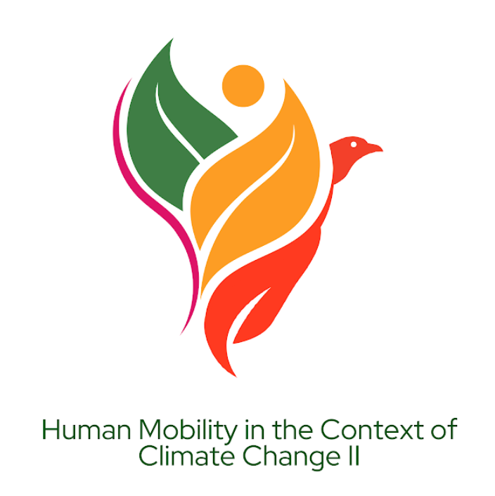
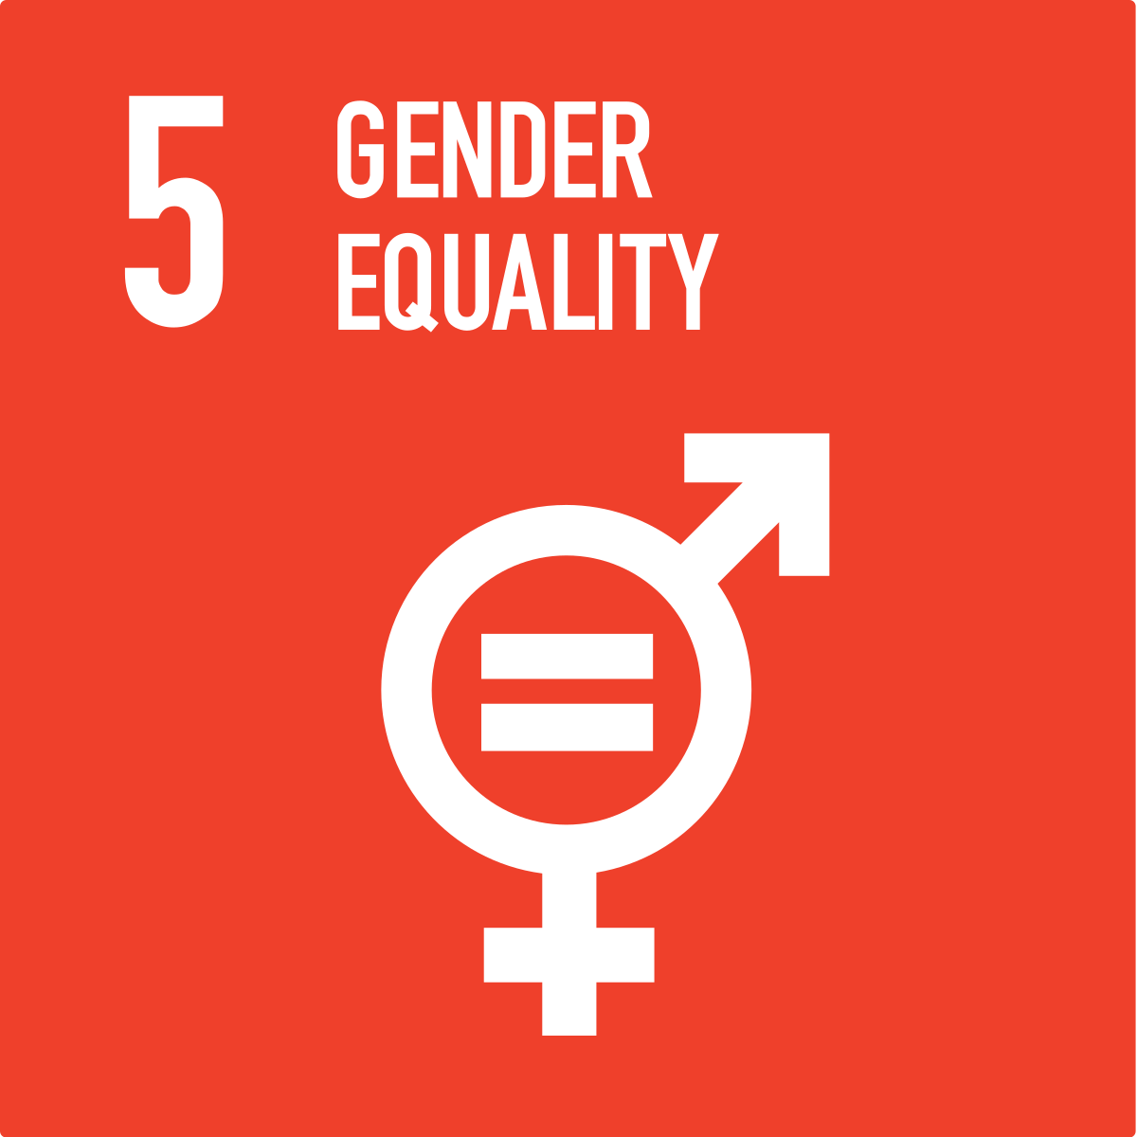
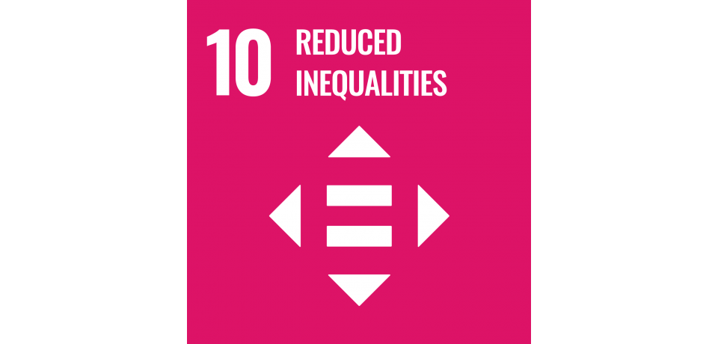
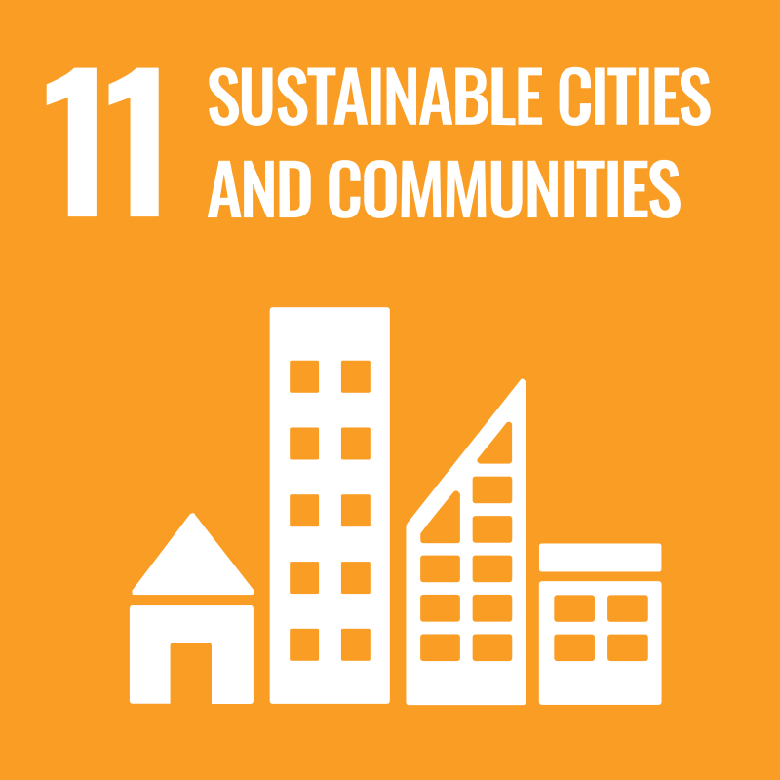
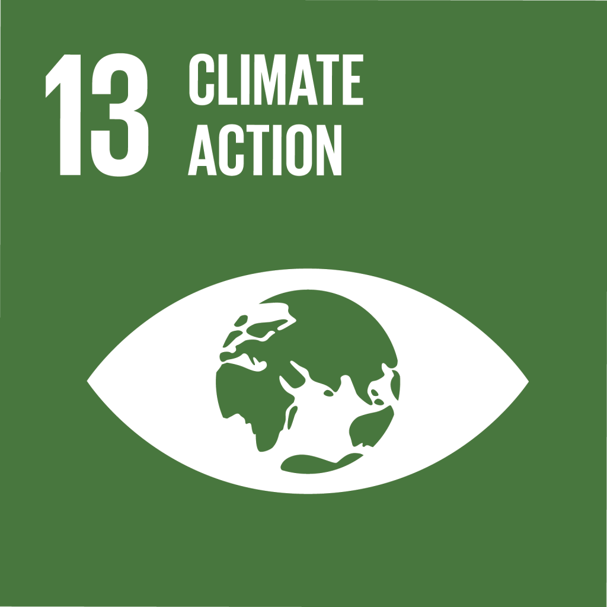
HMCCC II Project
Objective: The implementation of climate-resilient and gender-responsive approaches for climate-induced human mobility at national, regional, and international levels is improved
Timeframe: 2024 – Q1/2027
Countries: Fiji | Philippines | West Africa
Main PH Partner: Commission on Population and Development
PH Project Areas: Tanay, Rizal and Buenavista, Agusan del Norte
Type of Partnership: Technical Assistance
In partnership with
Implemented by

Slide 4
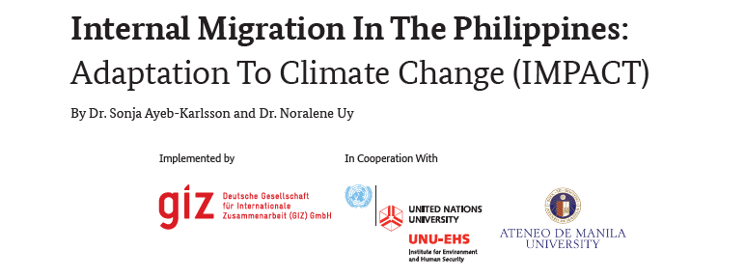
Photo from Vecteezy.com

Slide 5
Research Questions
01
03
02
How do climatic and environmental stress impact people and their mobility decisions in the Philippines?
How does human (im)mobility impact origin areas in the Philippines
(on an individual, family, and societal level)?
How does human (im)mobility impact destination areas in the Philippines (including people arriving and those hosting, on an individual, family, and societal level)?

Slide 6
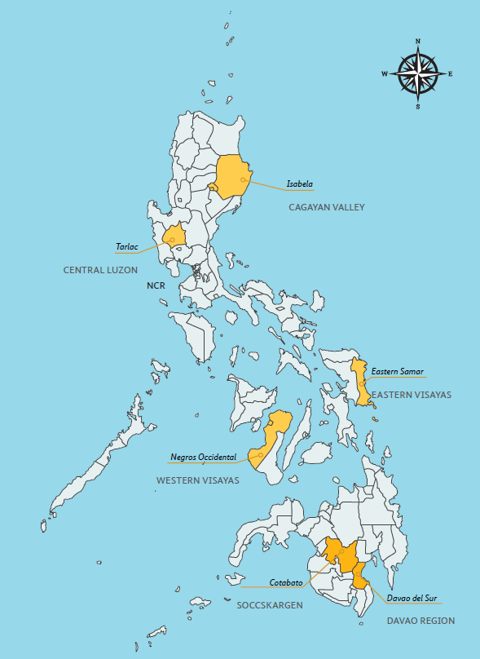
IMPACT Research Areas
Study sites in Origin and Destination areas:
Isabela, Tarlac, and the NCR in Luzon
Eastern Samar and Negros Occidental in the Visayas
North Cotabato and Davao del Sur in Mindanao

Slide 7
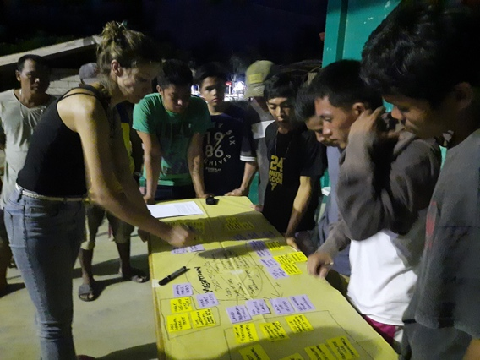
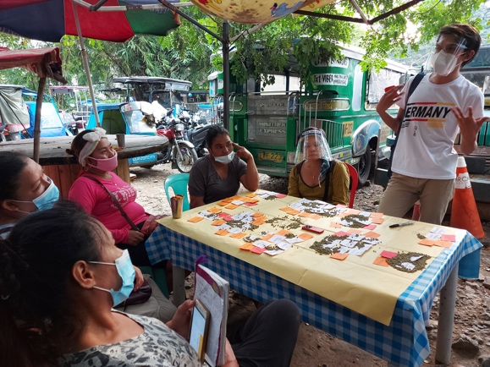
IMPACT Research Methods
355 Female respondents
322 Male respondents
Participatory Rural Appraisal Collective Storytelling Sessions Livelihood History Interviews Key Experience Sessions

Slide 8
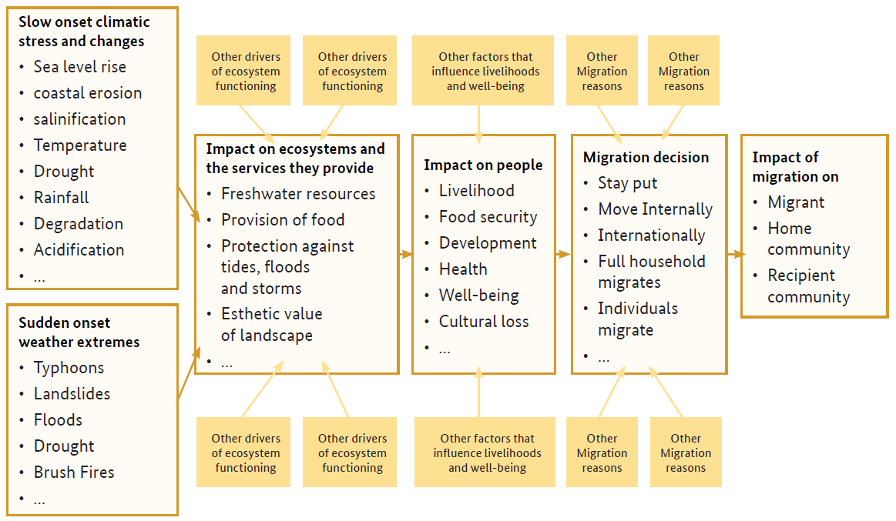
IMPACT Conceptual Framework
Central to the “Climate-migration Impact Chain” conceptual framework is the prevailing notion that people do not migrate because of climate change as such, but because of the way climate change impacts their livelihoods, food security, and wellbeing.

Slide 9
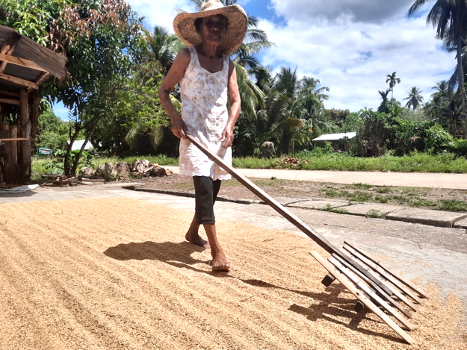
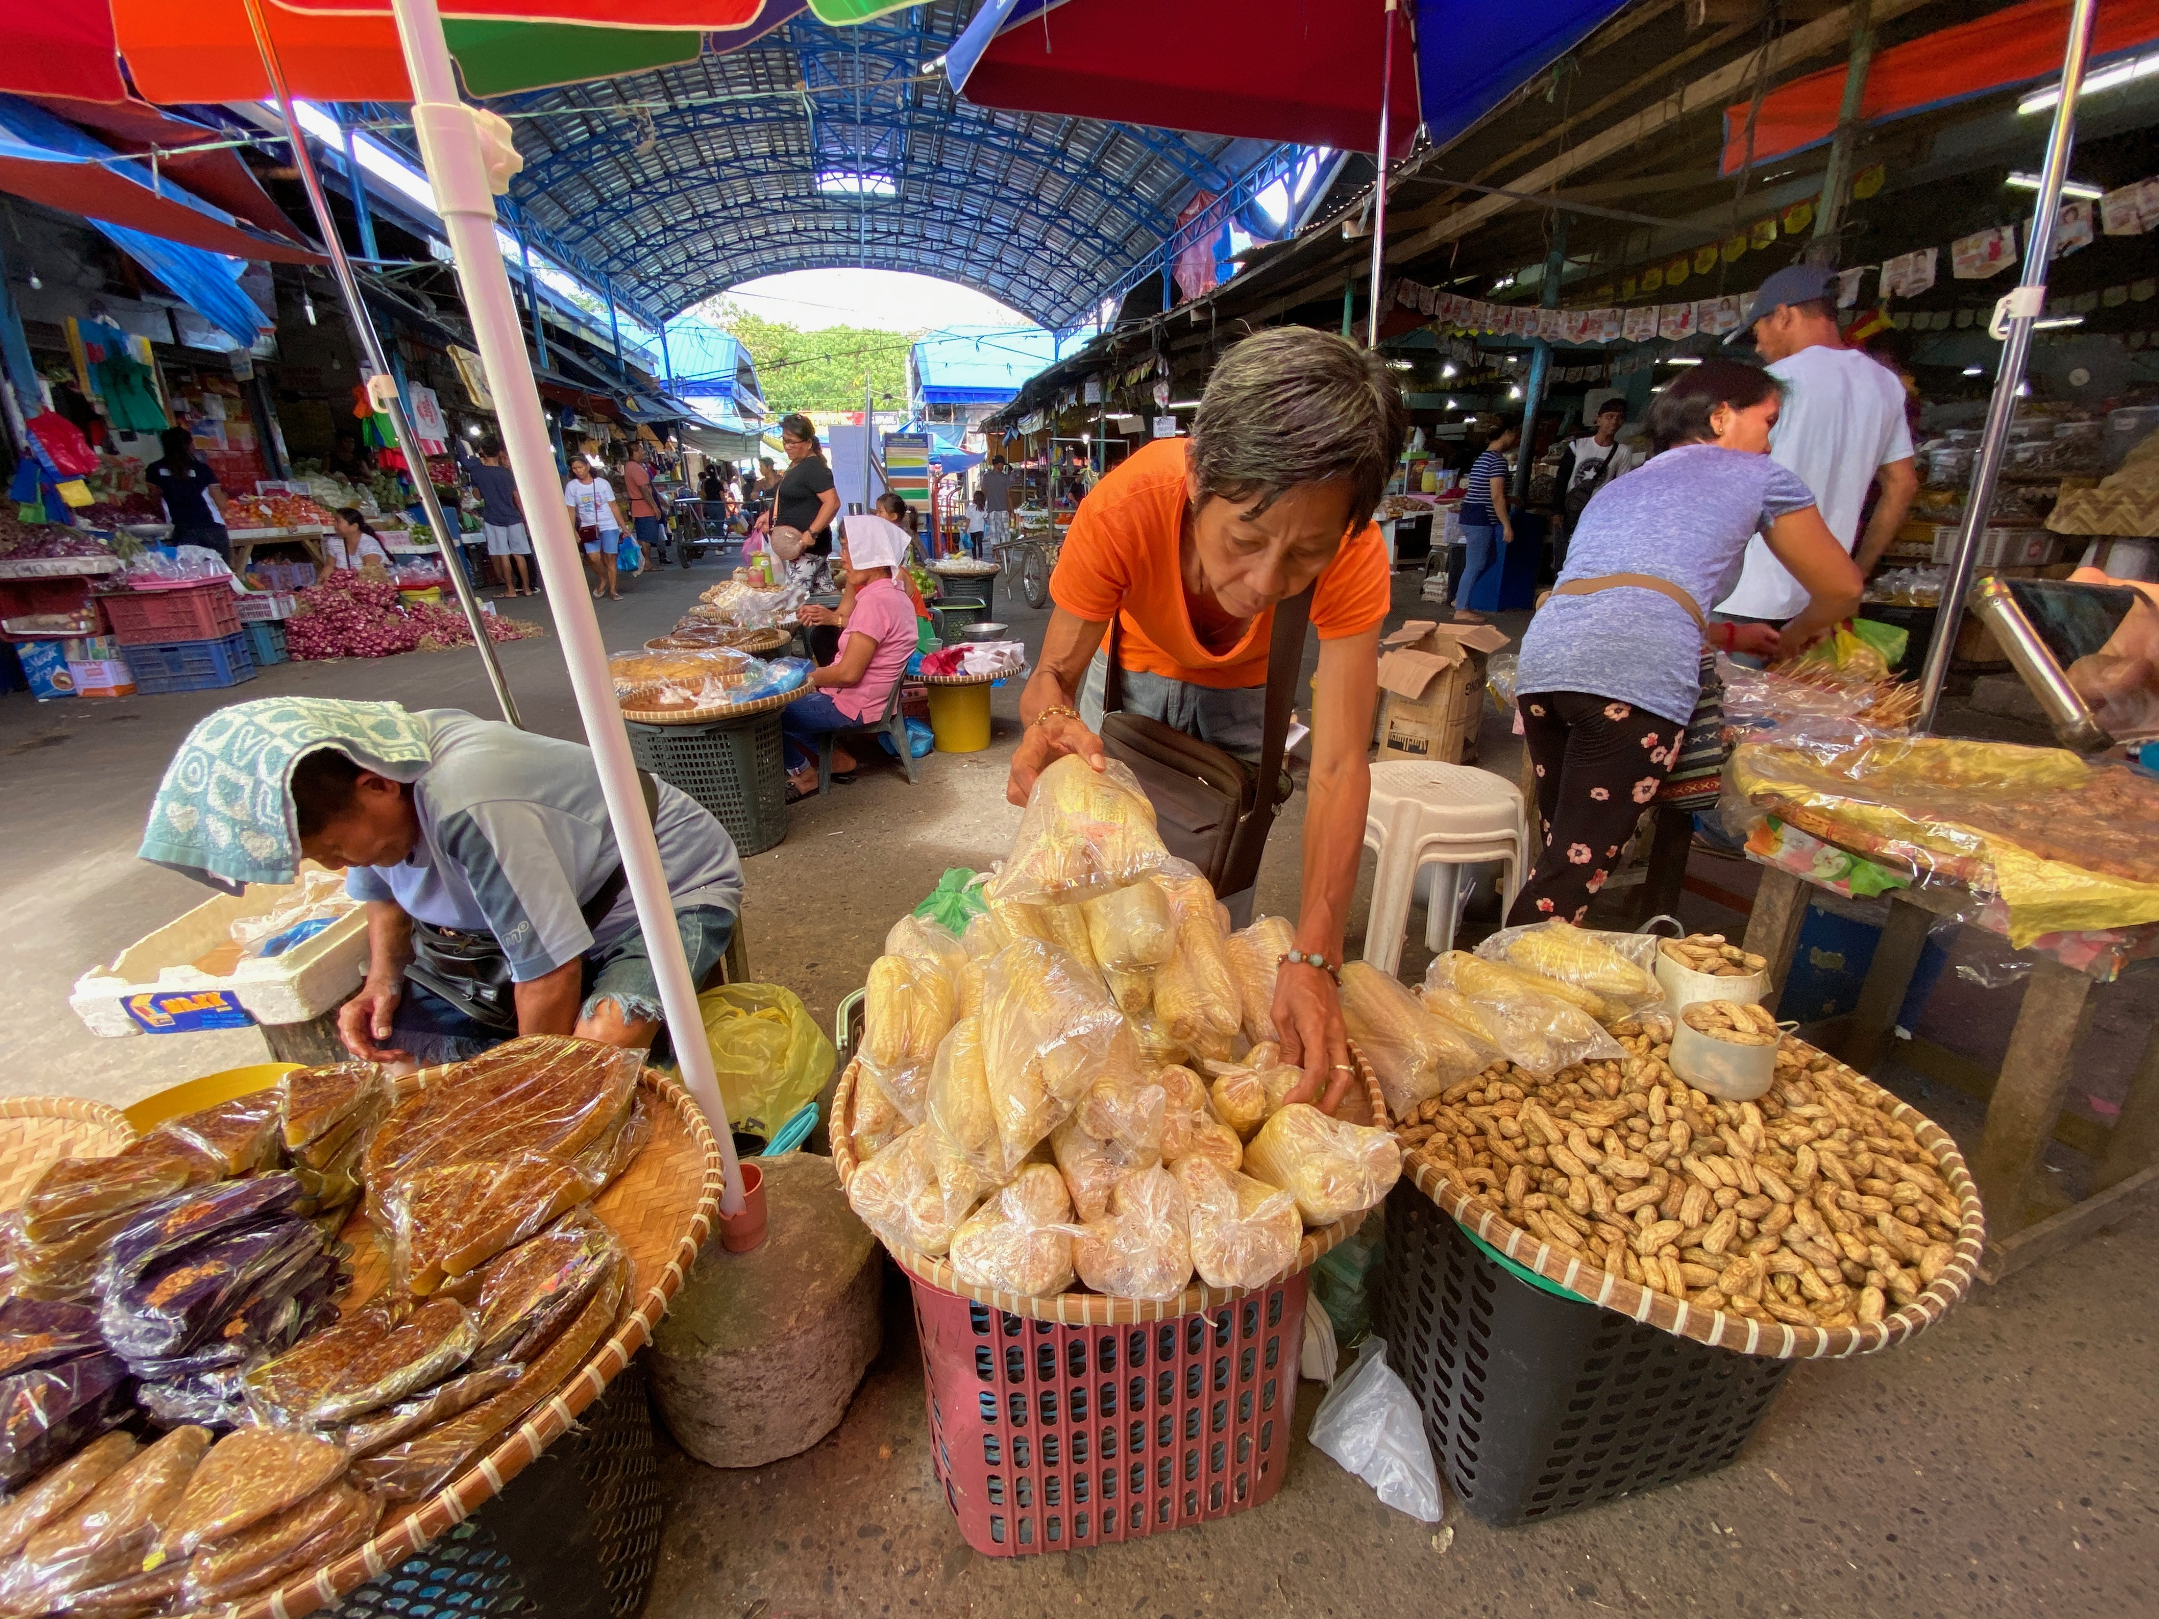
The impact of climatic and environmental stress on people and their mobility (migration) decisions in the Philippines
“The changing weather pattern is a factor for migration. People used to harvest four times a year. Now, they can only harvest once a year. The high temperature leads to crop failure... Livelihood is also seasonal. People move to find other jobs since there are no alternative jobs here. These challenges push people to migrate to urban centres for a stable source of income.” — Male FGD, Labon, Sulop, Davao del Sur
“It makes it harder for our farmers to know when to start harvest, especially those that do not have access to irrigation systems. Some would plant their seeds expecting rains in December but only to witness sunny days. That is definitely climate change. Events like these make sustaining livelihoods very difficult. This is the reason why our debts keep piling up. It is hard when you only get to harvest once a year and all expenses are covered by loans.” — Female (51), LHI, Maypangdan
Most of the farmers and fisherfolks take on construction work and alternative jobs in surrounding areas or nearby cities. Aside from impact on their incomes, they also share how the intense temperature is causing negative effects on their health.

Slide 10
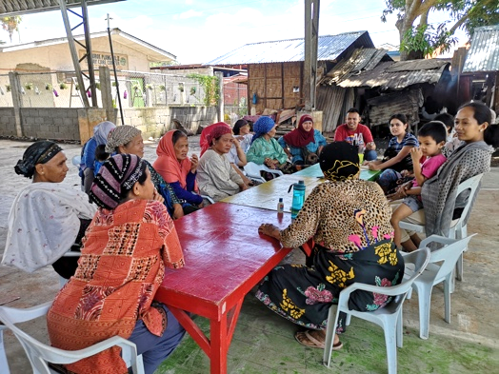
The impact of (im)mobility on origin areas in the Philippines – on an individual, family, and societal level
“I myself have experienced destructive typhoons. As a typhoon Haiyan survivor, we experienced trauma and need support from the government.” – Male FGD, Maypangdan
“We own land in Negros Oriental, where my parents planted with wheat and coffee beans. We had to leave our home due to rising armed conflict in the area.” – Female, LHI, Dos Hermanas
In Visayas, especially in Eastern Samar, the impact of disasters upon the wellbeing of families was a strong narrative. In Mindanao, migration is an adaptation strategy for many, not only to explore better livelihood opportunities, but also to avoid armed conflict.
Origin areas often face reduced development and decline of agriculture due to the loss of labour force.
Internal migration can however also lead to economic improvement and better quality of life for families in origin areas (e.g. through remittances)

Slide 11
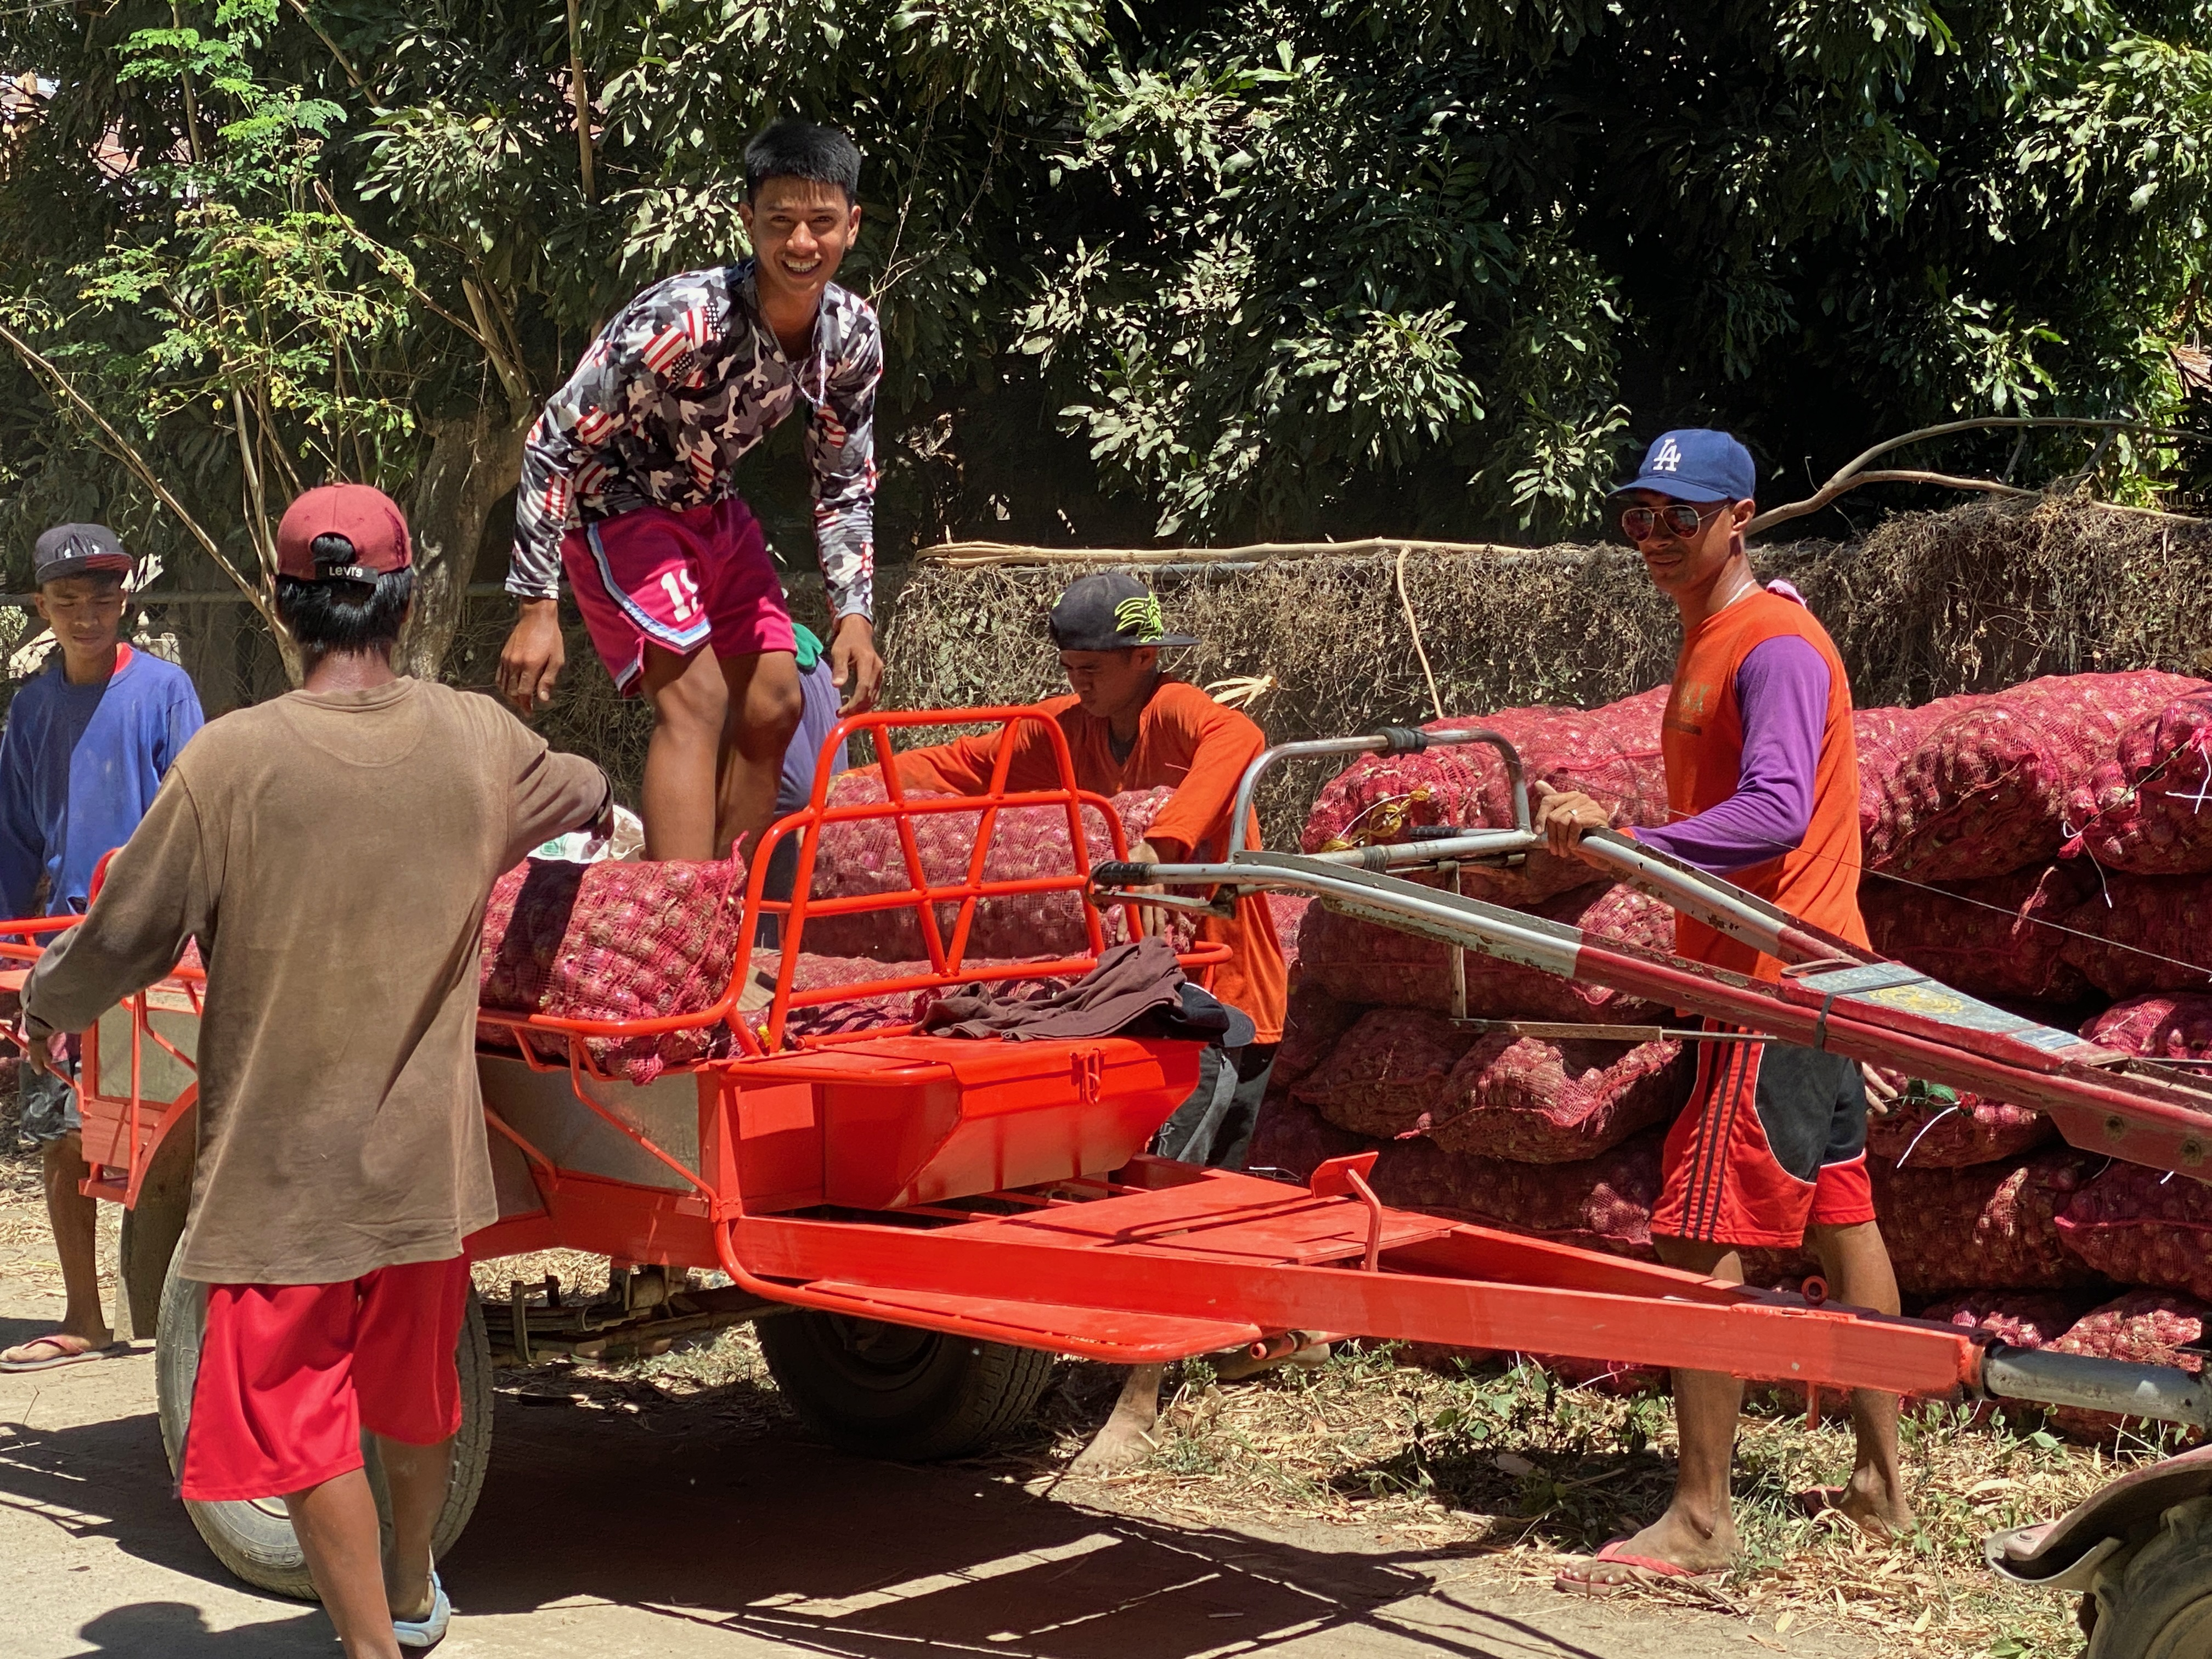
The impact of (im)mobility on origin areas in the Philippines – on an individual, family, and societal level
Key Research Findings
“The fisherfolks here do not want to leave fishing. The Bureau of Fisheries and Aquatic Resources has chosen us as a community partner and we get assistance for our fishing needs. We chose not to permanently switch from fishing to another livelihood since the government is assisting us.” – Male (51), LHI, Maypangdan
For many, however, it is not easy to shift livelihood or employment, or to even migrate to urban areas. This is due to the lack of training, skills, and network for the available jobs in destination areas. When given the necessary support, they are also able to make a choice to stay and nurture their livelihood.
Land was also described as the most precious asset that everything emanates from — people’s identity, lifestyle, and source of income in origin areas. Keeping the family together was also among the important factors for many.
Despite challenges in environmental conditions, many remain in their origin areas for reasons such as place attachment, social network, and reluctance to start over in a new place or due to lacking assistance from the government.

Slide 12
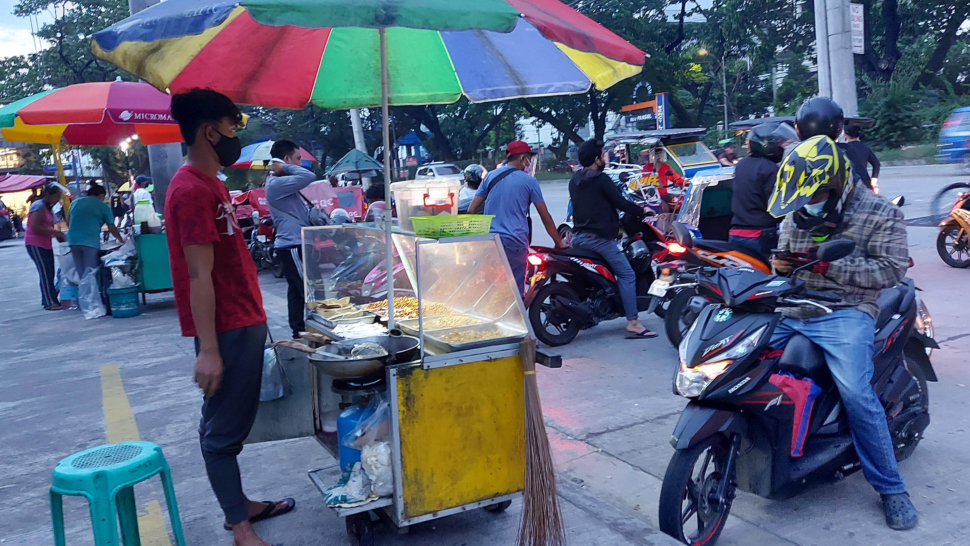
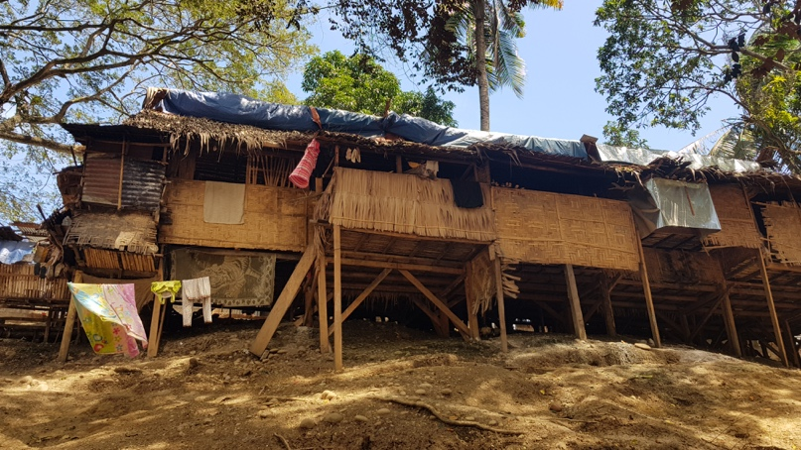
The impact of (im)mobility on destination areas in the Philippines – on an individual, family, and societal level
Are migrants better off after they make it to Metro Manila, or other urban areas?
In the destination sites, migrants who are happy with their movement explained that this is founded on the availability of education and livelihood opportunities to improve the family situation or even give back to others left behind
However, not all migration stories to urban centres are success stories
Migrants often need additional training and experience to work in urban areas
Arriving populations tend to take up livelihoods in the informal sector
When poor households move to cities, they tend to reside in informal settlements and peripheral areas that are often prone to climate-related hazards
Socioeconomic power relations exist between original inhabitants and migrants, where migrants can be socially excluded or discriminated
As a result, they tend to have limited access to social services, and it is difficult for them to enter the formal sector
The more people arriving, the more facilities and services will be required for housing, health, education, transportation and employment. This presents challenges in the provision of social services by local governments.

Slide 13
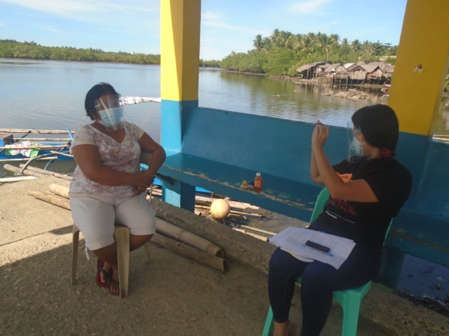
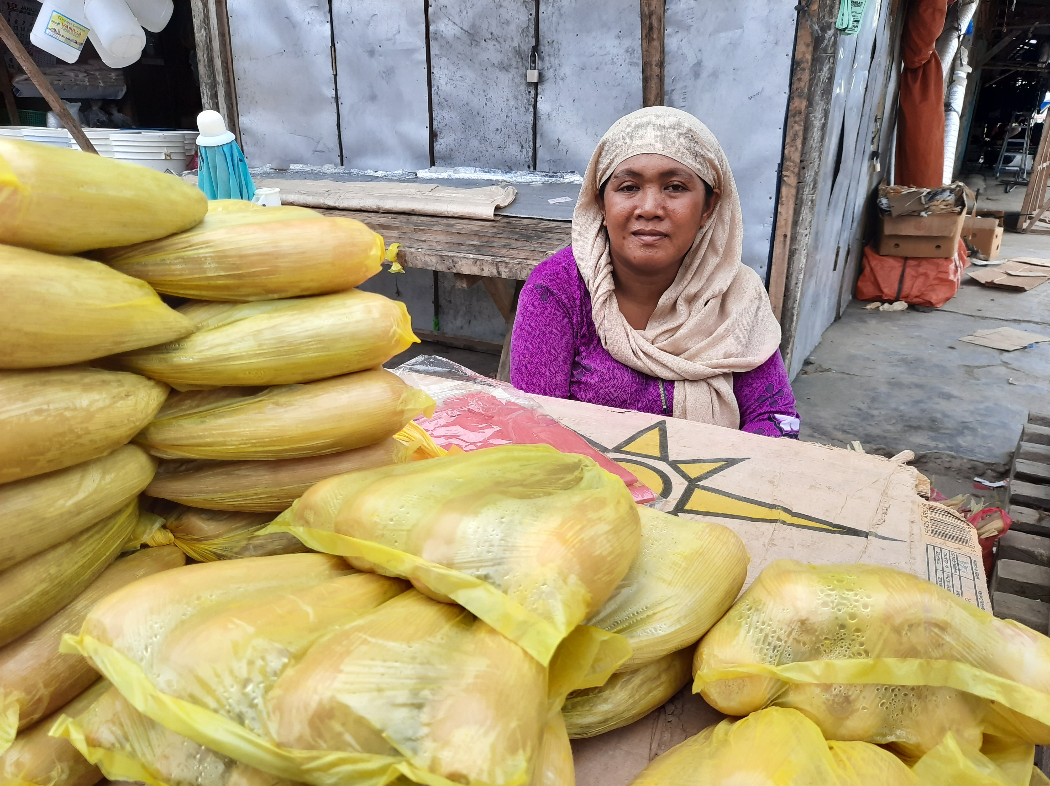
The impact of climate-induced internal migration on Filipino families
Migrants express that they look forward to going back to their origin areas because ‘home’ is different, and they feel a deep desire to be reunited with their families.
The links between migration, gender, and family further touches upon topics such as early marriage, gender roles in the household, and the capacity of women
“It used to be very common here for girls to either get married at a very young age or move to Manila. Almost all women who left to work do so to help their family. If they stayed, they would be totally dependent on the income of their husbands, if there is any. If they go abroad or to cities, they know that people will look at them differently since they will be able to buy a house and land, and have an additional source of income apart from their husband’s.” – Female (34), KES, Salvacion
“My brother’s wife always has something to say to my sister, judging her for leaving her child with us to work in Manila. It is difficult to see my niece without a mother.” – Female (19), KES, Poblacion
The group sessions revealed gender roles where women tend to have the double burden of child rearing, household chores, and earning an income to supplement
Fathers reported often relaying on their daughters to take up the female gender roles of the household early on in the absence of their mother. Similar gender roles were left behind on the sons such as by supporting and managing with stretched resources
Many informants shared challenges such as by raising children with disabilities alone, and looking after children who were prone to sickness especially in times of flood

Slide 14
Moving forward
Filipino families and vulnerable populations should be provided with platforms to increase their climate change awareness, meaningful participation in planning, and their resilience
Regular collection and analysis of disaggregated data would shape gender-responsive and inclusive local planning to better support the integration of incoming population movements.
Comprehensive policy frameworks on the climate-migration nexus must be prioritized, including monitoring data and impacts of rapid and slow onset events, and their relationship to human mobility through displacement, immobility and migration
"If people want to move, I hope they have the support and options to do so,
such as through financial assistance in relocation and capacity building in migration.
If people want to stay, I hope we can have support in improving what we have in the farm.”
The IMPACT study on HMCCC emphasizes the hope that adaptation and migration
will be more of a choice – one that they are supported to make.

Slide 16
References
Climate Change Commission (2014). Second National Communication to the UNFCCC. Philippines. CCC, Manila.
Cruz, R. V., Harasawa, H., Lal, M., Wu, S., Anokhin, Y., Punsalmaa, B., & Huu Ninh, N. (2007). Asia. In M. L. Parry, O. F. Canziani, J. P. Palutikof, P. J. van der Linden, & C. E. Hanson (Eds.). Climate change 2007: Impacts, adaptation and vulnerability. Contribution of Working Group II to the Fourth Assessment Report of the Intergovernmental Panel on Climate Change (pp. 469-506). Cambridge University Press, Cambridge.
Cruz et al. 2013 Cruz, F. T., Narisma, G. T., Villafuerte II, M. Q., Cheng Chua, K. U. & Olaguera, L. M. (2013). A climatological analysis of the southwest monsoon rainfall in the Philippines. Atmospheric Research, 122, 609–616.
Germanwatch (2018). Global climate risk index 2018. Germanwatch, Bonn.
Jose, A. M. and Cruz, N. A. (1999). Climate change impacts and responses in the Philippines: Water resources. Climate Research, 12, 77–84.
Philippines Statistics Authority (PSA) and University of the Philippines Population Institute (UPPI) (2019). 2018 National Migration Survey. PSA and UPPI, Quezon City.
Quisumbing, A. and McNiven, S. (2010). Moving forward, looking back: The impact of migration and remittances on assets, consumption, and credit constraints in the rural Philippines. The Journal of Development Studies 46 (1), 91-113.

Slide 17
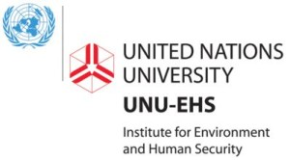
Acknowledgments
Ms. Sabrina Zwick, Dr. Robert Oakes, and Dr. Kees van der Geest, United Nations University’s Institute for Environment and Human Security.
Dr. Nimfa Ogena (University of the Philippines Population Institute), Jorge Ebay (University of the Philippines-Visayas), and Dr. Emma Porio (Ateneo de Manila University).
Arjay Dineros, Julie Anne Dela Cruz, Francis Sy, Dr. Richelle Verdeprado, Seth Barce, Leonarda Murillo, Hannah Hipe, Leanna Catamora, Gloria Amor Paredes, and Mary Jill Banta.
Coastal Cities at Risk in the Philippines Project, Ateneo de Manila University (Dr. Emma Porio), Visayas State University (Prof. Maria Aurora Teresita Tabada), and University of Southern Mindanao (Amme Rose Blonto).
Thea Kersti Tandog (University of the Philippines Mindanao) and Florenz Dean Cojuangco (National Resilience Council).

Slide 18
Thank you! Let’s work together!
Mia Simpao
Head of HMCCC II Philippine Component
mia.simpao@giz.de
Christina Rentzmann
Peace and Development Cluster Coordinator
christina.rentzmann@giz.de

