Slide 1
Enhancing Disaster Preparedness and Humanitarian Response Data through the Common Operational Dataset on Population Statistics
Romesh Silva, PhD; Mallika Synder, PhD;
Marianne Amparo Guzman, MPopS; Charl Andrew Bautista, MD, MBA

Slide 3
Background
The Philippines is 1st in the World Risk Index (WRI) for 3 consecutive years
Frequent natural disasters and conflict-induced displacements increase the demand for timely and accurate demographic data to guide life-saving interventions.
Annual typhoons affect millions of lives, and billions in livelihood and infrastructure, necessitating for well-informed, data-driven and effective planning frameworks.
Notes:
World Risk Report by Institute for International Law of Peace and Armed Conflict of the Ruhr-University Bochum in Denmark

Slide 4
What is COD-PS
UNFPA Mandate
Ensuring the availability, quality and usability of the COD-PS is an institutional responsibility of the United Nations Population Fund (UNFPA) within the United Nations humanitarian system.
Definition: The Common Operational Dataset on Population Statistics (COD-PS) is a set of up-to-date subnational population projection disaggregated by sex and age to the lowest geographic administrative level possible.
Base Population: 2020 Census of Population and Housing
Reference: May 15, 2024
Levels: National to municipal, sex-age disaggregated at all levels
Based on the best available humanitarian and national statistics data and standards

Slide 5
Objectives
To provide up-to-date, best available, and accurate population data disaggregated by sex, age, and location to the lowest possible level to support disaster preparedness and humanitarian response in the Philippines
To enhance population projection by integrating crisis-related mobility and displacement for more effective planning and resource allocation
To serve as unified, reliable dataset for interagency coordination in both development and humanitarian context

Slide 6
Data & Methodology
Primary Data Sources:
Baseline Population: 2020 Census of Population and Housing
Mortality and Fertility Data: Civil Registration and Vital Statistics (CRVS), National Demographic and Health Survey (NDHS), and Field Health Services Information Systems (FHSIS).
Migration and Mobility: Data from the Department of Social Welfare and Development (DSWD), Commission on Filipinos Overseas (CFO), and Bureau of Immigration (BI), and the Census of Population and Housing (CPH)

Slide 7
Data & Methodology
Method: Deterministic Cohort-Component Framework
Method for subnational projection down to ADM - 3: Iterative Proportional Fitting

Slide 8
Data & Methodology
Baseline | Mortality | Fertility | Migration
Baseline (2020 Census of Population & Housing) | ADM-1 life expectancy at birth (IAWGPP estimates) | ADM-1 total fertility rate (IAWGPP estimates) | International net migration balance (UN World Population Prospects, 2022)
Excluded 2M OFWs/people in consulates and missions to account only for those within the national borders | Predicted trends in life expectancy (UN World Population Prospects, 2022) | Predicted trends on fertility (UN World Population Prospects, 2022) | Emigration estimates (Commission on Filipino Overseas, 2019)
 | Age-specific mortality rates (Coale-Demeny-Vaughan West Model life tables) | Age-specific fertility rates (IAWGPP estimates) | Immigration estimates (2020 CPH) – residence in the last 5 years
 |  |  | Displacement data (DSWD DROMIC) used for validation

Slide 9
2024 COD-PS vs
2020 Census-Based Population Projection
The projection window for the 2024 COD-PS update is a short-term projection window
The COD-PS has component of crisis-related mobility and used DROMIC data on top of the other national statistics and government data used for the official projection
Due to purpose for humanitarian response planning, the base population used in this projection excludes 1.97 million individuals identified as OFWs in the 2020 census, and 2,000 individuals enumerated at embassies, consulates, and missions abroad

Slide 10
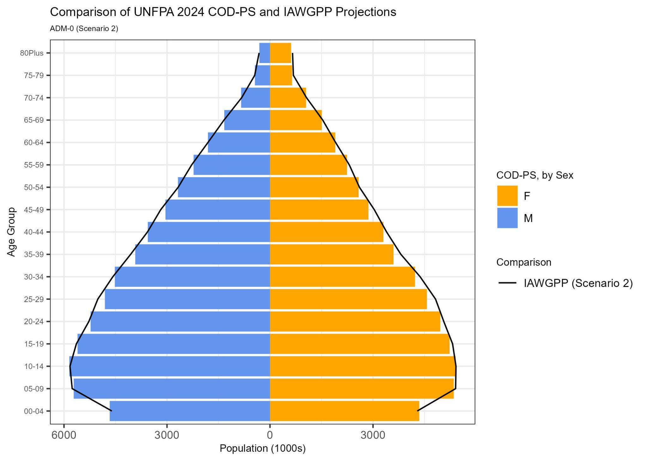
Results
The 2024 COD-PS update projects population to May 2024 and estimates a total resident population of 111.1 million -consisting of 54.5 million females and 56.7 million males, with the age-sex distribution across the country shown for the national population.

Slide 11
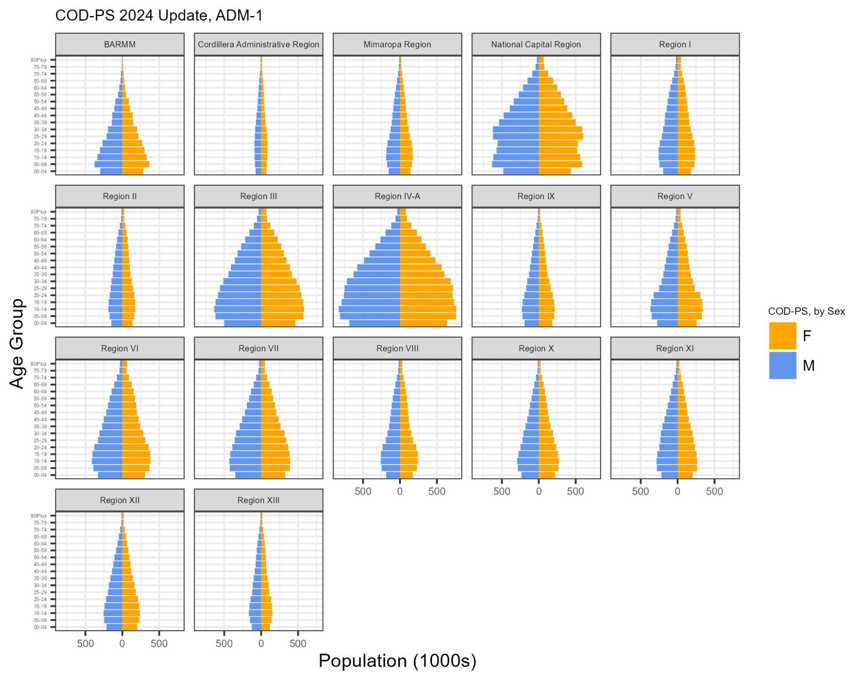

Slide 12
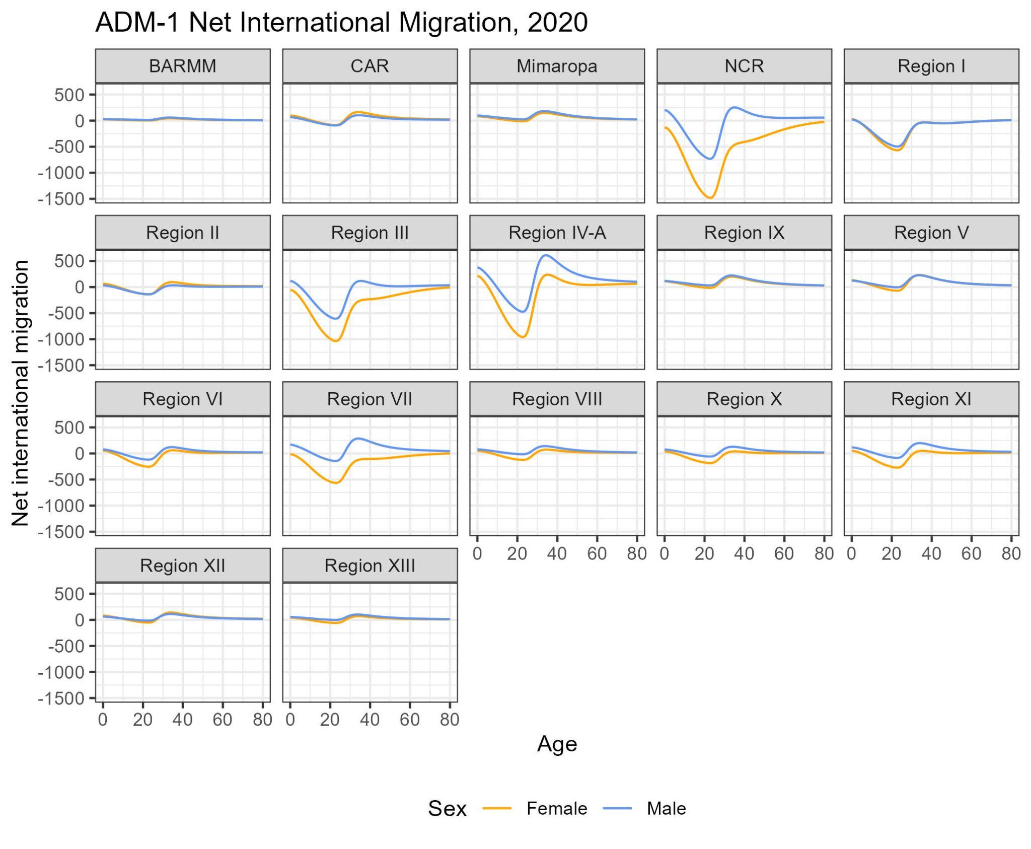
International migration: NCR, Calabarzon, Central Luzon, and Central Visayas are the top senders of migrants overseas, with greater share of women among registered emigrants.

Slide 13
Results
Internal migration:
Significant out-migration from NCR reflect the large in-migration to other regions; but in-migration from other regions continue at working ages
DSWD DROMIC displacement data validated the ADM-2 and ADM-3 level of migration patterns based on the areas prone to natural disaster or conflict-related displacement
Significant out-migration from high-risk areas; in-migration to safer urban areas

Slide 14
COD-PS Use Case
COD-PS Use Case:
During Typhoons Kristine and Pepito, COD-PS was used to estimate affected populations quickly, disaggregated by municipality, age, and sex.
Process of Targeting:
Get the percentage of sub populations: women in reproductive age, young people, adolescent girls, persons with disability, etc
Apply this percentages to the number of affected population published by DSWD in DROMIC Report

Slide 15
COD-PS Use Case

Slide 16
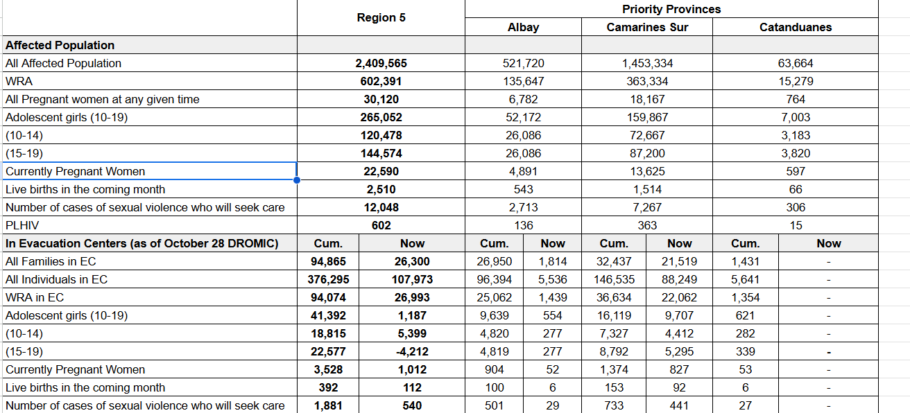

Slide 17
Crisis-Related Displacement
DSWD DROMIC displacement data validated the observed patterns of provincial and municipal migration patterns based on the areas prone to natural disaster or conflict-related displacement
Significant out-migration from high-risk areas; in-migration to safer urban areas
DSWD’s DROMIC Data: age- and sex-specific data for displaced populations remains limited, it does not indicate where the displaced population come from before they were received in the evacuation centers or where they go after leaving the evacuation centers or receiving sites outside
Local Government Units who collect the DROMIC data lack the capacity to collect, analyze, and use DROMIC data in their own planning and response

Slide 18
Lessons Learned & Recommendation
COD-PS data led to faster, more targeted response efforts by humanitarian teams, reducing gaps in aid and prioritizing the most vulnerable populations in high-impact areas.
Incorporate COD-PS into DRR frameworks for disaster preparedness and resource allocation based on reliable demographic projections.
Prioritize support to high-risk and vulnerable populations by leveraging COD-PS projections

Slide 19
Ways Forward
Refine COD-PS to integrate more granular, real-time data sources and update it yearly with the reference date
Provide support to the government in enhancing local government unit capacities in collecting, analyzing, and using humanitarian data in local DRR planning;
as well as in establishing or strengthening systems to track or monitor mobility especially mobility during disasters
Notes:
From the case of Typhoon Kristine and Pepito, we used the COD-PS as test case. Although the numbers are being validated as our implementing partners work on the ground in our response sites. Nonetheless in terms of our preparing our response and immediately implementing we were able to move faster and accurately in terms of targeting and preparing our dignity kits, and other lifesaving sexual and reproductive health interventions.
In terms of direction, we have initial discussions with DSWD and the CPD on how we can work together in strengthening the systems and capabilities of the LGU to capture internal movements or mobility especially down to the barangay level to further enhance the accuracy of the COD-PS and we intend to update the COD-PS yearly as mentioned. We are also working UN Global Pulse they also have project tracking internal mobility using telecoms data during disasters.
We continue to encourage all stakeholders to adopt COD-PS for both disaster preparedness and response. This is of course a supplement to the official projections released by the PSA with the work of IAWGPP. It can be downloaded from the Humanitarian Data Exchange

