Slide 1
PROJECT AKKAP:
Determining the Effectivity of a Youth-led Adolescent Health Program in Increasing Adolescent Reproductive Health Service Utilization in Iloilo and Negros Occidental
Jasper Ruby V. Vijar, RMT, MD
Co-Founder and Programs Director
Team Dugong Bughaw, Inc.
Presented during the National Conference on Family Planning 2024 / May 28-29, 2024
Notes:
1

Slide 2
Outline of Presentation
National Conference on Family Planning 2024
INTRODUCTION
.
METHODS
CONCLUSIONS/ IMPLICATIONS
I
III
V
II
IV
VI
OBJECTIVES
RESULTS
RECOMMENDATIONS/
NEXT STEPS

Slide 3
Introduction
National Conference on Family Planning 2024
The goal of AHDP is to improve the health status of adolescents and to enable them to fully enjoy their right to health.
Main health issues among adolescents include injuries, violence, mental health, alcohol and drug abuse, tobacco use, HIV/AIDS, other infectious diseases, early pregnancies and childbirth, nutrition and micronutrient deficiencies and obesity.
With this, attention and proper education must be provided as support to the adolescent population in the Philippines.

Slide 4
Challenges under the AHDP
There are several challenges faced by this program, including lack of awareness on health services provided by the adolescent-friendly health facilities (AFHFs), standardized reporting of services provided, referral, and most notably, the lack of youth participation in conducting youth related interventions.
Department of Health, 2024. Gaps and Issues on Adolescent Health and Development Program. Retrieved from: https://caro.doh.gov.ph/adolescent-health-program.
Salam et.al, 2016. Adolescent Health Interventions: Conclusions, Evidence Gaps, and Research Priorities. Retrieved from: https://www.ncbi.nlm.nih.gov/pmc/articles/PMC5026678/

Slide 5
Objectives
National Conference on Family Planning 2024
This project aims to increase the utilization of ARH services in rural health units (RHUs) of the province and HUCs of Iloilo and Negros Occidental through a youth-led adolescent health program entitled Project AKKAP.
Specifically, the project aims to:
Increase the utilization of ARH services in the Adolescent-Friendly Health Facilities
Measure the youth participation in program outputs to scale the impact through a developed tool
Document lessons learned and present recommendations from the engagements
Notes:
This project aims increase the u=liza=on of ARH services in the rural health units (RHUs) of the province and HUCs of Iloilo and Negros Occidental.

Slide 6
Methods
National Conference on Family Planning 2024
Conceptual Framework of Project AKKAP:
Problems/Gaps
Lack of Awareness on health services provided by Adolescent Friendly health Facility (AFHF)
Standardized Reporting of Services Provided
Referrals
Lack of youth participation in conducting youth related interventions
Intervention
Project AKKAP
(Alagaan ang Kalusugan ng Kabataang Pilipino)
Effect
Increase utilization of Adolescent Reproductive Health Services
Engagement of a pool of trained peer navigators for referral
Youth-led demand generating events
Monitoring through a mobile application (reach52)
USAID ReachHealth Project. Annual Workplan

Slide 7
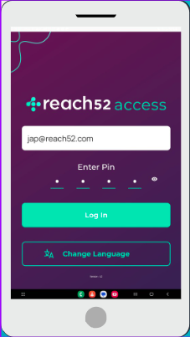
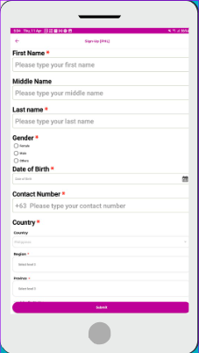
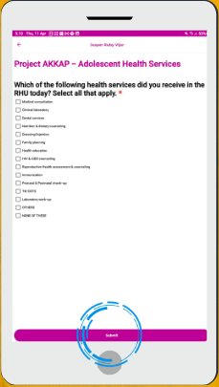
Methods
National Conference on Family Planning 2024
reach52 access application
Profiling
Referral

Slide 8
Methods
National Conference on Family Planning 2024
This is a mixed study which utilizes the baseline data and effect of the intervention through comparing secondary data from the RHU and gathering qualitative data from community respondents during focused group discussions.
Phases of the Intervention:
Phase 1. Planning and Coordination
Phase 2. Training
Phase 3. Launching and Execution
Phase 4. Monitoring and Evaluation
Phase 5. Reporting

Slide 9
Results
National Conference on Family Planning 2024
Quantitative
Improvement of KAP
Improvement on KAP (70%) of 36 Trained Peer Navigators
Program Reach
Additional 241 Peer Navigators through re-echo sessions
Total reach of demand-generating events of 1,492 adolescents
Total digital platform reach of 87,773
Utilization of ARH Services
There was a significant increase in the utilization of ARH services comparing the last quarter of 2023 as baseline (88.00 土 28.48) and the first quarter of 2024 (152.56 土 40.86) (p=0.022)
Notes:
there was a significant increase in the utilization of ARH services comparing the last quarter of 2023 as baseline (88.00 土 28.48) and the first quarter of 2024 (152.56 土 40.86) (p=0.022)

Slide 10
Results
National Conference on Family Planning 2024
Observations and Insights of the Team During Field Activities
The RHU recognizes the importance of involving youth organizations such as Sangguniang Kabataan in forwarding the agenda of AHDP.
Through the intervention adolescents were made aware of the services offered, location and existence of Adolescent Friendly Health Facilities (AFHF)
Demand generating events led by youth groups yielded age-appropriate discussion and interaction.
Existing gaps such as referral and reporting in the AHDP implementation have been magnified.
Dialogues on sustaining the initiative to support AHDP such as Barangay Ordinances and Executive Orders are underway.
Notes:
Barriers: Adolescents not included in discussions What does th

Slide 11
Conclusions/Implications
Regional Conference on Family Planning 2024
Improvement of KAP
Youth-led interventions on Adolescent Reproductive Health is effective in increasing the awareness on pressing adolescent and sexual health concerns among municipalities and HUCs in Iloilo Province and Negros Occidental.
Program Reach
Digital application such as the reach52 access app is a good alternative to data gathering among our adolescents and can assist the reporting among RHU.
Utilization of ARH Services
Peer Navigator referrals and the demand generating events they organized, paved way to the increase in ARH services offered by their RHU.

Slide 12
Recommendations/Next Steps
National Conference on Family Planning 2024
Improvement of KAP
The inclusion of a member of the youth in the technical working group will be instrumental in creating age-appropriate ARH initiatives.
Program Reach
There is a need for the standardization of reporting forms on adolescent health data in Rural Health Units.
Utilization of ARH Services
A tripartite MOA among Youth Organizations, LGU and RHU, translated to a Barangay Ordinance or Executive Order must be in place to sustain grassroots initiatives on Adolescent and Reproductive Health.
Establishment of a service-delivery network should be made a priority by the Department of Health, Department of Education and Local Government Units.

Slide 13
National Conference on Family Planning 2024
Jasper Ruby V. Vijar, RMT, MD
Co-Founder and Programs Director
09275360666
docjasper@tdb.community
hello@tdb.community

